Slide 1
Snowflake - Continuous Data Loading using Snow Pipe

Slide 2
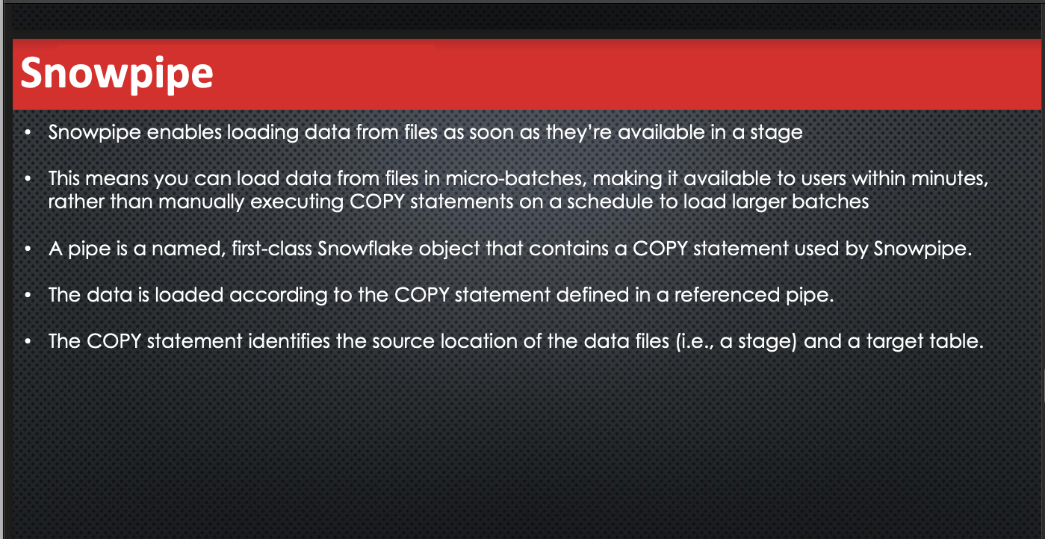

Slide 3
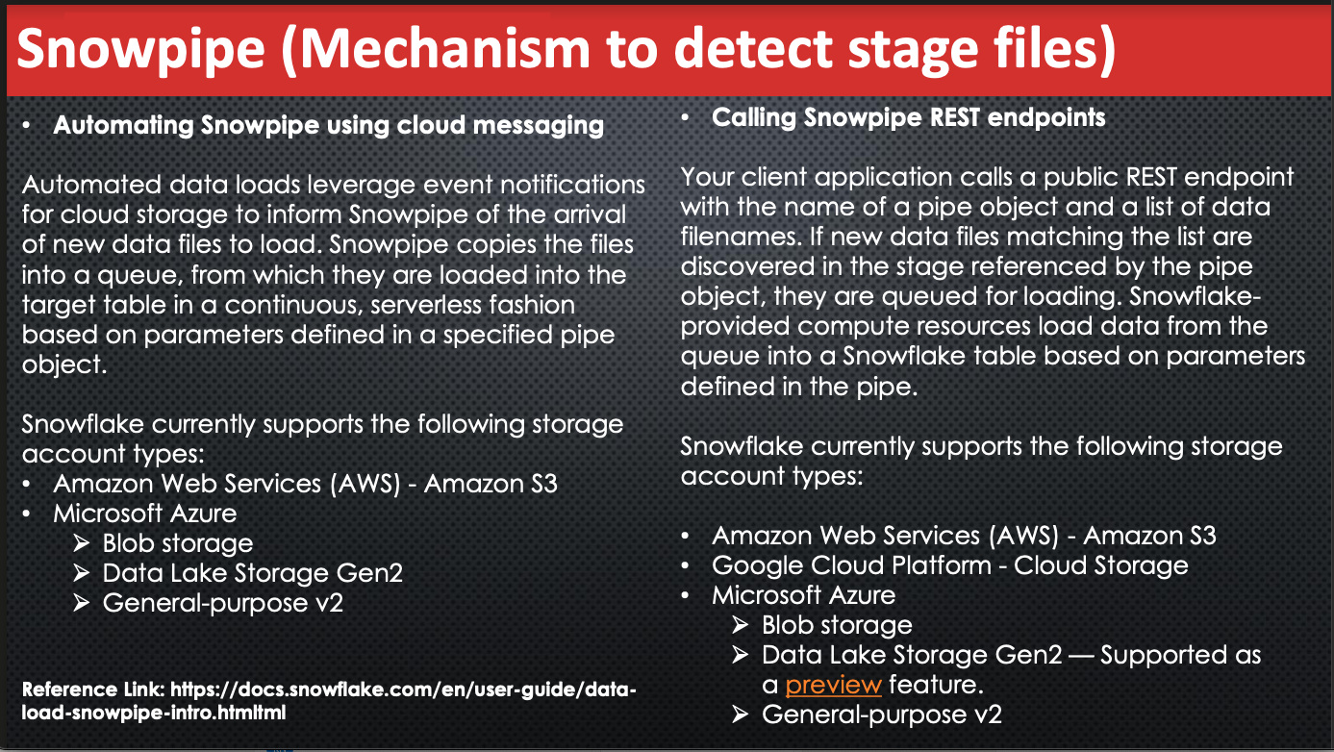

Slide 4
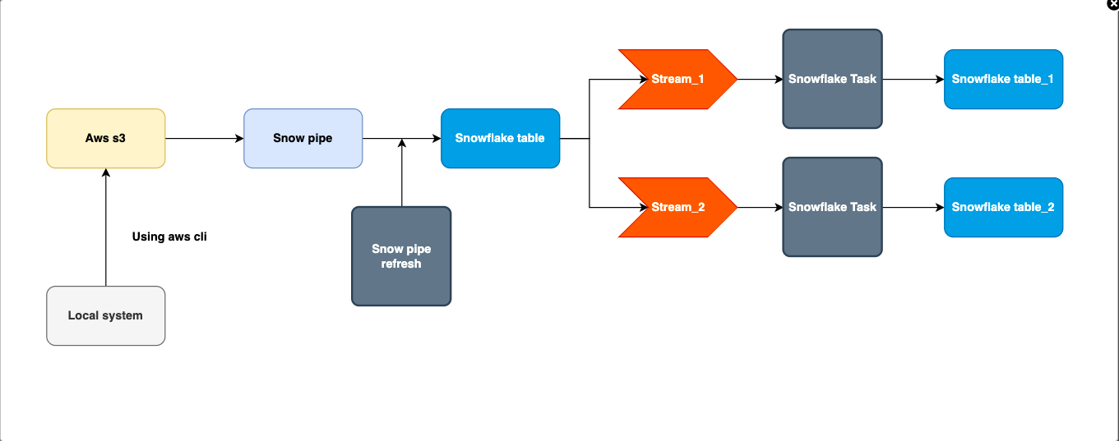

Slide 5
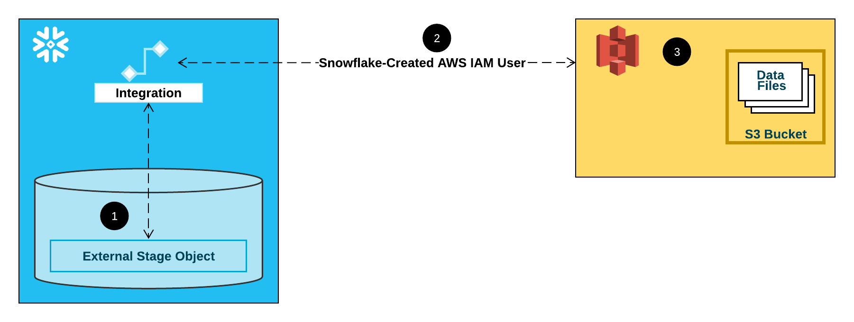

Slide 6
Automating Snowpipe for Amazon S3
Create a New S3 Event Notification to Automate Snowpipe
Step 1: Create a Stage (If Needed)
Step 2: Create a Pipe with Auto-Ingest Enabled
Step 3: Configure Security
Step 4: Configure Event Notifications
Step 5: Load Historical Files
Step 6: Delete Staged Files

Slide 7
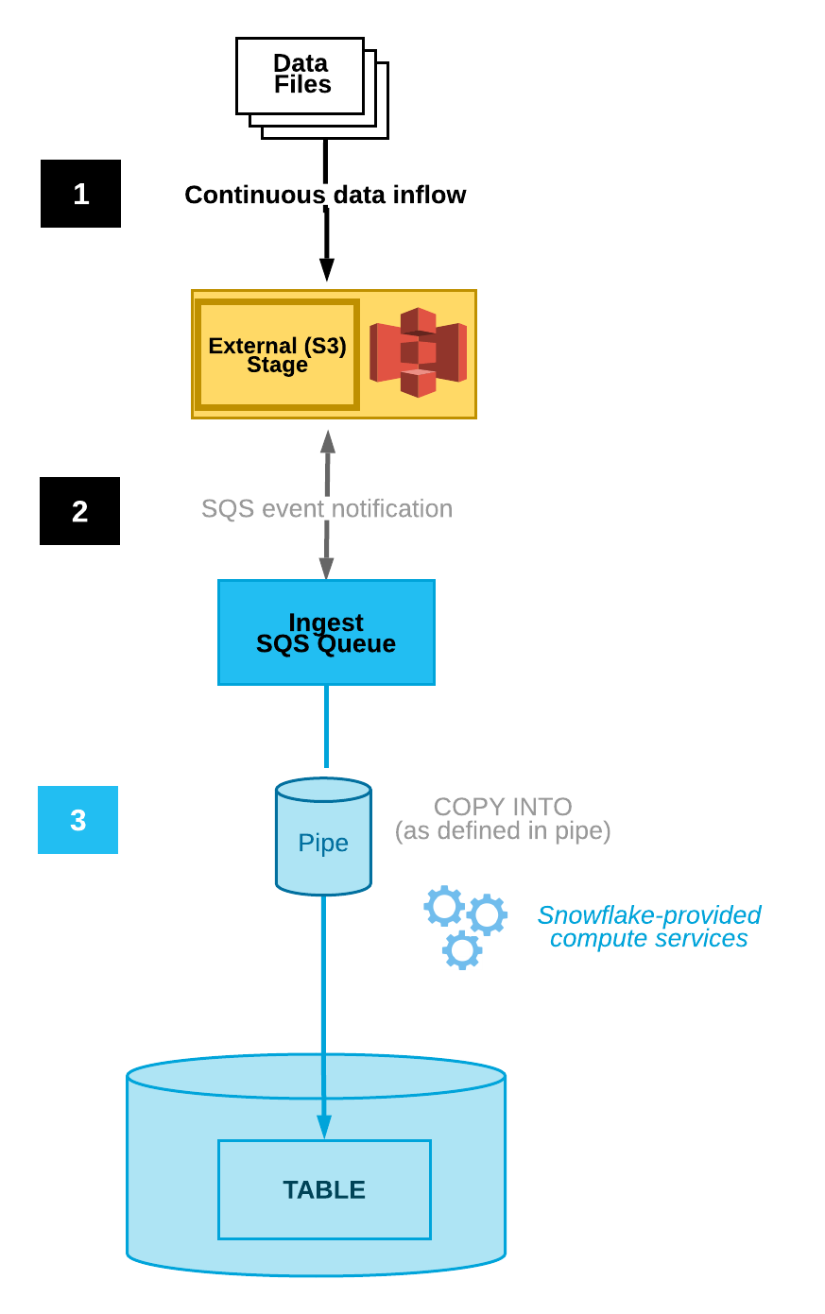
Snowpipe Auto-Ingest Process
Data files are loaded in a stage.
An S3 event notification informs Snowpipe via an SQS queue that files are ready to load. Snowpipe copies the files into a queue.
A Snowflake-provided virtual warehouse loads data from the queued files into the target table based on parameters defined in the specified pipe

Slide 8
Create a Stage
Create an external stage that references your S3 bucket using the CREATE STAGE command.
Snowpipe fetches your data files from the stage and temporarily queues them before loading them into your target table. Alternatively, you can use an existing external stage.
a) Create an Integration Object
create or replace storage integration Snowflake_Obj
type = external_stage
storage_provider = s3
enabled = true
storage_aws_role_arn = 'arn:aws:iam::456067747731:role/snowflake-role2'
storage_allowed_locations = ('s3://snowflakedemo1/snowflake/csv/');

Slide 9
Create a Stage
b) Create the File Format
create or replace file format Emp_file_format
type = csv field_delimiter = ',' skip_header = 0
null_if = ('NULL', 'null') empty_field_as_null = true;
c) Create the Stage
create or replace stage snow_stage
storage_integration = Snowflake_Obj
url = 's3://snowflakedemo1/snowflake/csv/'
file_format = Emp_file_format;

Slide 10
Create a Pipe with Auto-ingest enabled
d) Create a pipe to ingest CSV data with auto-Igest enabled
create or replace pipe snowpipe.public.snowpipe
auto_ingest=true
as copy into snowpipe.public.emp_snowpipe
from @snowpipe.public.snow_stage
file_format = (type = 'csv');

Slide 11
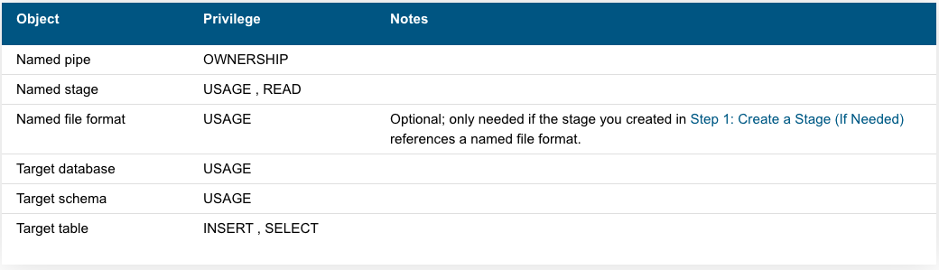
Configure Security
For each user who will execute continuous data loads using Snowpipe, grant sufficient access control privileges on the objects for the data load (i.e. the target database, schema, and table; the stage object, and the pipe).
Using Snowpipe requires a role with the following privileges:

Slide 12
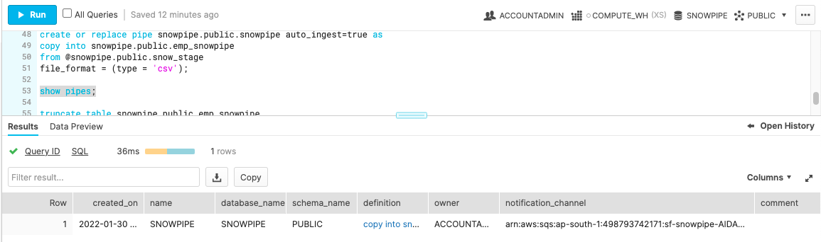
Configure Event Notifications
Configure event notifications for your S3 bucket to notify Snowpipe when new data is available to load.
The auto-ingest feature relies on SQS queues to deliver event notifications from S3 to Snowpipe.
For ease of use, Snowpipe SQS queues are created and managed by Snowflake. The SHOW PIPES command output displays the Amazon Resource Name (ARN) of your SQS queue.
Execute the SHOW PIPES command:
show pipes;
Note the ARN of the SQS queue for the stage in the notification_channel column. Copy the ARN to a convenient location.

Slide 13
Configure Event Notification
Log into the Amazon S3 console.
Configure an event notification for your S3 bucket using the instructions provided in the Amazon S3 documentation. Complete the fields as follows:
Name: Name of the event notification (e.g. Auto-ingest Snowflake).
Events: Select the ObjectCreate (All) option.
Send to: Select SQS Queue from the dropdown list.
SQS: Select Add SQS queue ARN from the dropdown list.
SQS queue ARN: Paste the SQS Queue name from the SHOW PIPES output.
3. Snowpipe with auto-ingest is now configured!

Slide 14
Load Historical Files & Delete the Staged Files
When new data files are added to the S3 bucket, the event notification informs Snowpipe to load them into the target table defined in the pipe.
To load any backlog of data files that existed in the external stage before SQS notifications were configured.
Delete the staged files from the S3 Bucket after you successfully load the data and no longer require the files.

