Slide 1
Exploratory Data Analysis On Facebook Users Data
By Abhishek Thakur
Email ID:- abhishekrcks1995@gmail.com

Slide 2
Introduction
Facebook is a social networking service. which allows users to connect with friends or people they don't know, online.
Facebook It allows users to share pictures, music, videos, and articles, as well as their own thoughts and opinions with however many people they like.
Today Facebook is the world largest social networking site with 2.934 billion users world wide.

Slide 3
Problem Statement
To identify, study and analyze the differences and identify the pattern out of it.
Which gender have more friend
How users are using depending on age group.
Which version is more accessible for usage.

Slide 4
Installing & Importing Libraries
Numpay
Pandas
Seaborn
matplotlib.pyplot

Slide 5
Data Acquisition & Description
Data Pre-Profiling
Importing Facebook user data
Data has 15 columns and 99003 rows
15 continuous variable only Gender is categorical
user id being considered as identifier

Slide 6
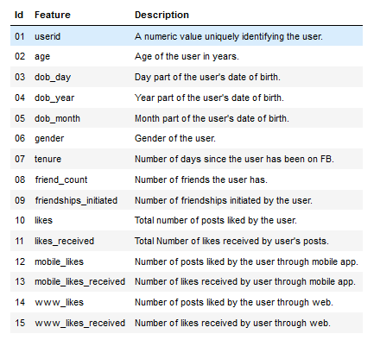
Data Information

Slide 7
Data Pre-Processing
15 Columns and 99003 Rows
Gender has missing value
Tenure missing value
Age has outlier
User Id is identifier rest all are continuous variable.

Slide 8
Data Post-Profiling
& EDA
Post-Profiling
Filling missing value in gender with Mode
Filling missing value in Tenure with Mean
Considering age between 12 -95
User Id is identifier rest all are continuous variable.

Slide 9
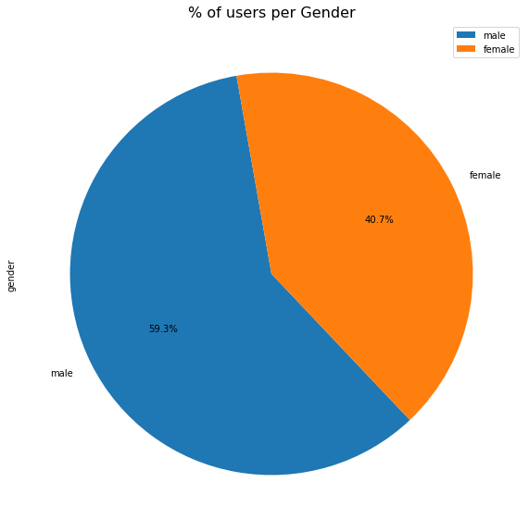
Pie Plot On Users vs Gender

Slide 10
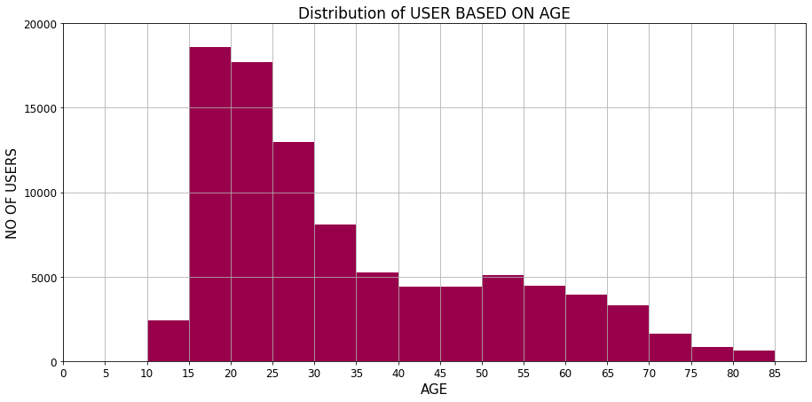
Distribution of USER BASED ON AGE

Slide 11
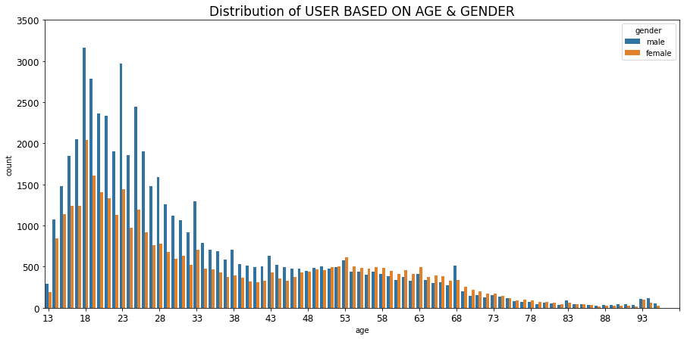
USER BASED ON AGE & GENDER

Slide 12
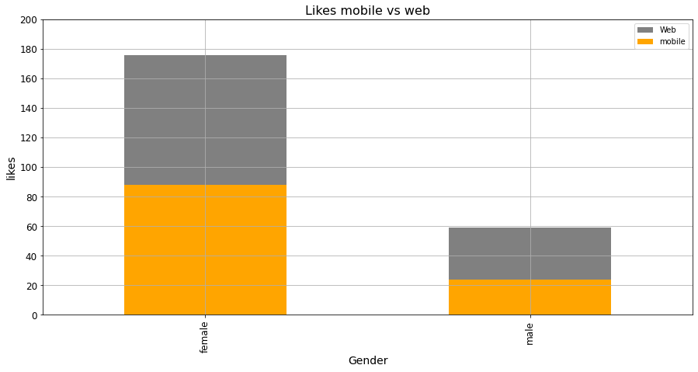
Likes mobile vs web'

Slide 13
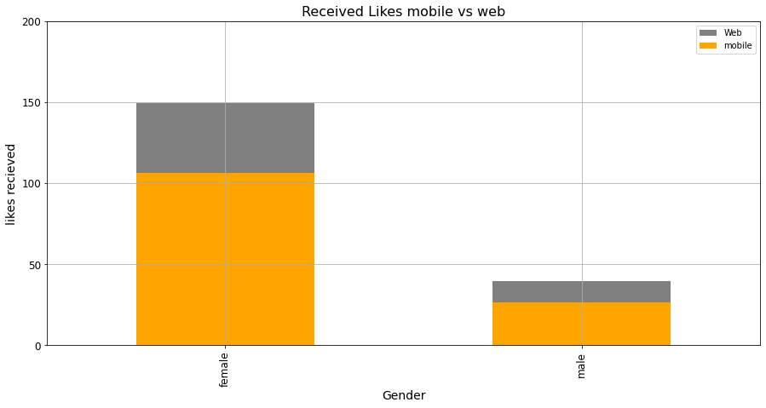
Likes Received mobile vs web'

Slide 14
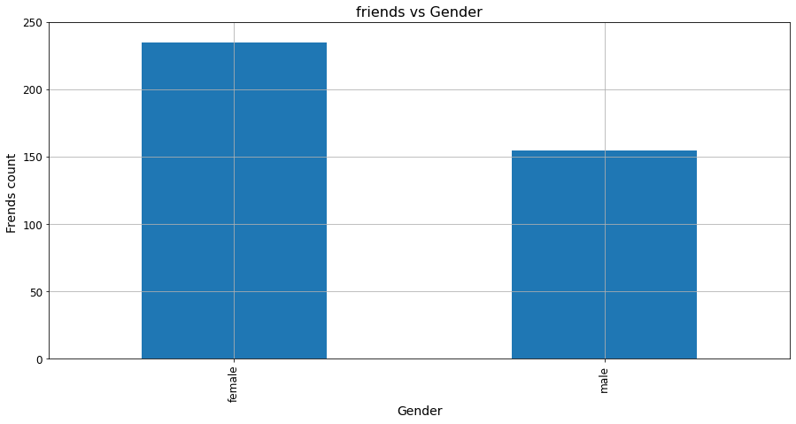
Friend with respect to vs Gender

Slide 15
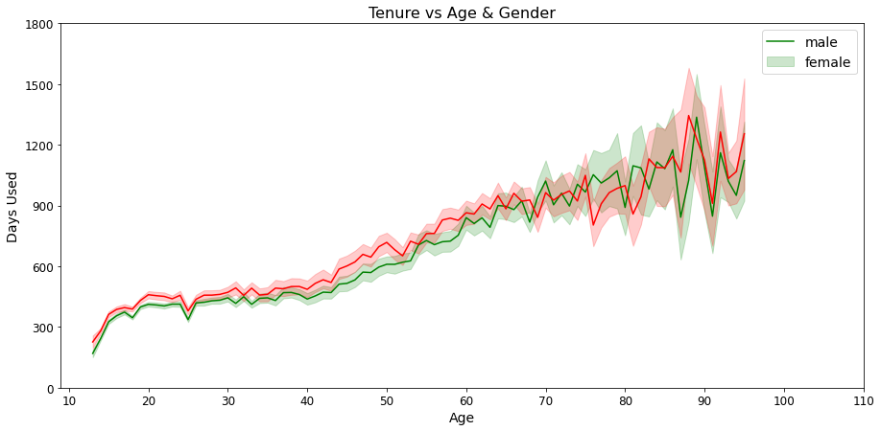
No of active Day’s

Slide 16
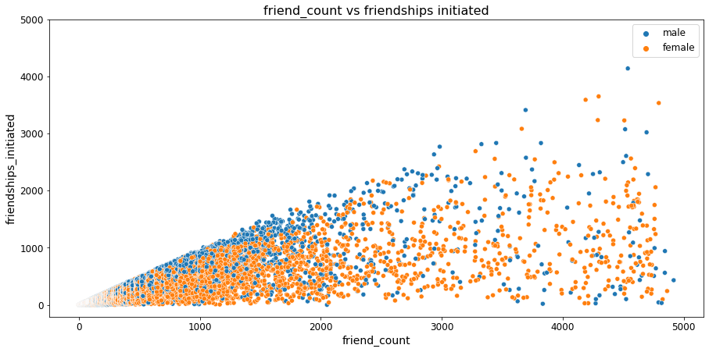
Friend count vs friendships initiated

Slide 17
Summarization
Male users are more[59.3%] then Female users[40.7%]
Users In age group between 15-30 are most.
For the Age group between 20-30 have more friends.
Mobile Likes are more in comparison to www.Likes
Mean of friends count for Female is high against the male users
Linear correlation between Tenure and active days.
Positive correlation between friend count vs friendships initiated

Slide 18
Conclusion
Male users are more
Female users have more friends
Mobile version is more accessible.
People in age group 15-to 30 are more likely to use Facebook

Slide 19
Thank you

