Slide 1

BTP PRESENTATION
Presented By : Group -B24NT04
BTP Guide - Dr. Nikhil Tripathi
Abhishek Manithia
Rishabh Sharma
Avinash Naik

Slide 2
1
Dataset
On obtaining dataset from academic office, it will be cross checked with the data from the registration form filled by the students.
If there is any mismatch or an error, admin will send a notification regarding the error to the student through autogenerated mail.

Slide 3
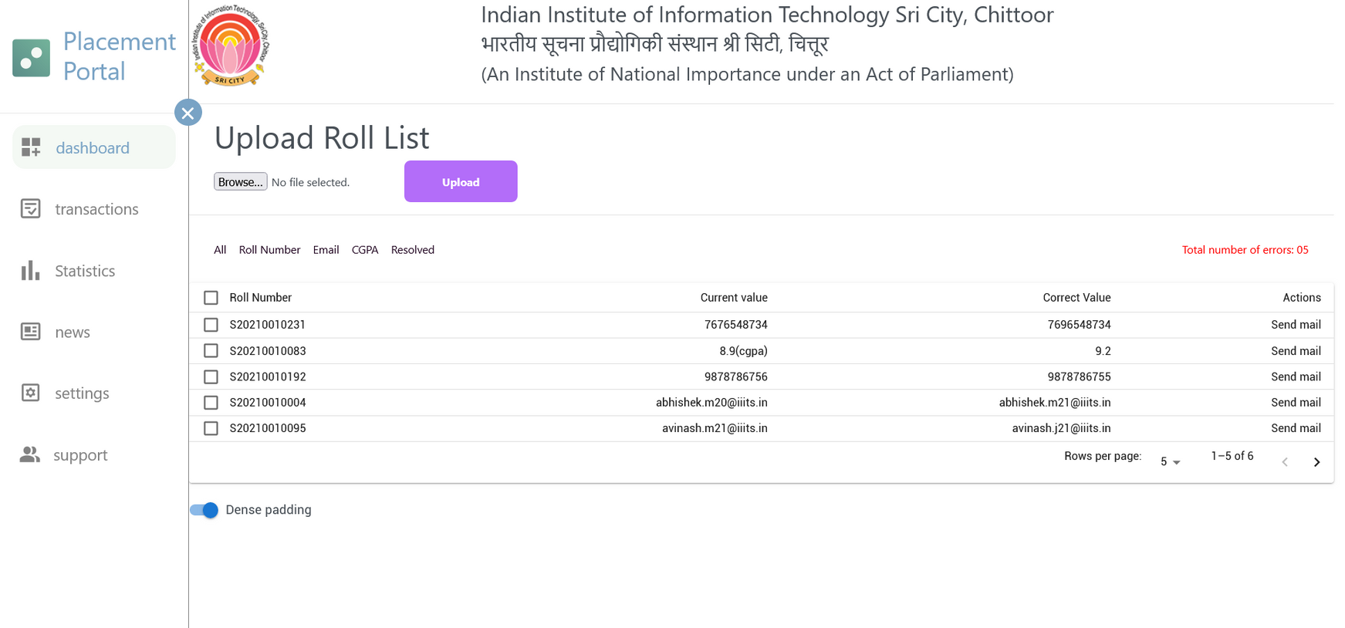
2
Admin Dashboard

Slide 4
3
JNF
When a company is interested in hiring students from our institute, they have to fill the form.
They are supposed to fill all the required fields. There are a few optional fields which the company can fill if they want to provide any additional information.
For instance, if a company fills the JNF then they have to specify eligibility criteria( CGPA > 7.0), job designation, CTC, work location etc.
Company has to also specify the selection process.

Slide 5
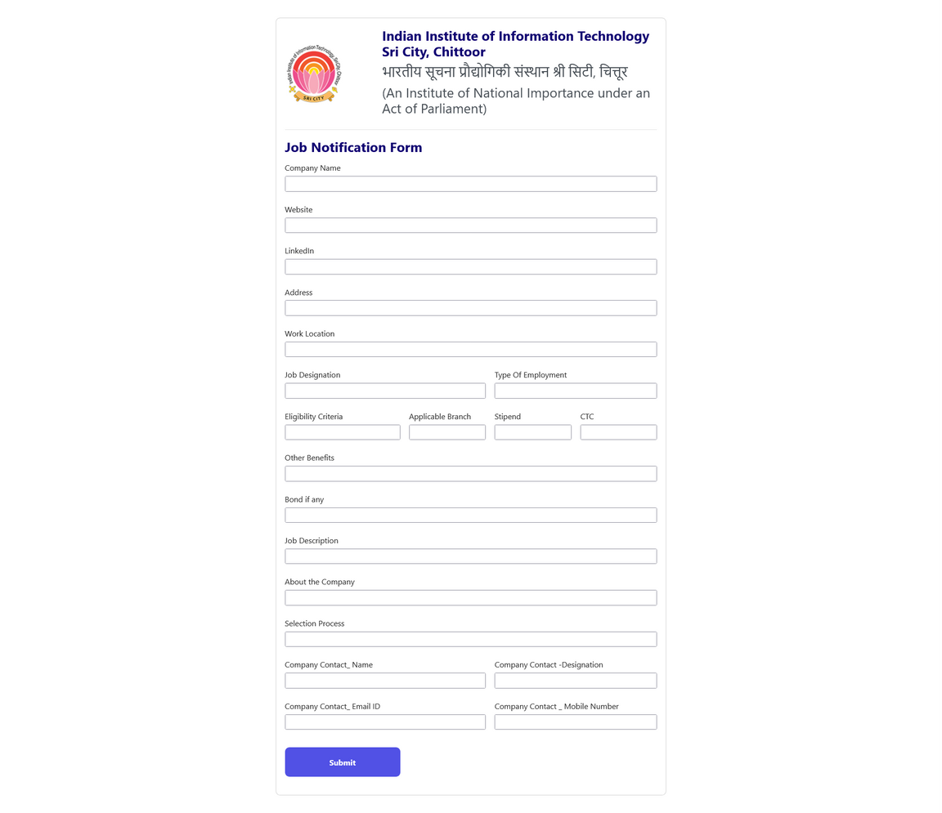
Job Notification Form
4

Slide 6
5
Student Dashboard
The EOI is shared with the eligible students in a standard format which is the true copy of what is mentioned in the JNF by the company.
Companies the student is eligible for will be shown in the student dashboard.
Interested students can apply for the job in the company.

Slide 7
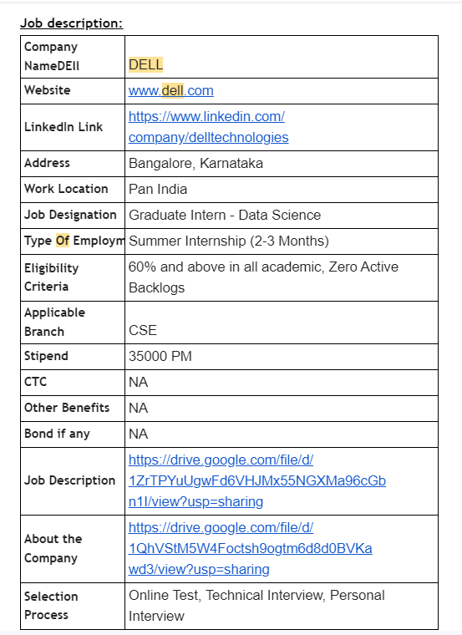
6
Expression
of
interest

Slide 8
7
Data Analysis
We will gather information such as CGPA, past internship experiences, and any other data points that can be used to assess placement readiness of a student.
We will analyze the collected data to identify patterns and correlations between different variables and successful placement outcomes.

Slide 9
8
Placement Probability Calculations
We have developed a model which generates some random student data and uses it to predict placement likelihood of a new student.
Parameters considered - CGPA, DSA topics, fundamental topics, languages, internship experience, projects and soft skills.
When we get access to the actual student data, every student will have a section of this model in their dashboard.

Slide 10
9
Placement Probability Calculations
Student will have to select the topics, the level to which the student understands it and also need to provide project and internship details to get the prediction score.
Student can also check the prediction based on his skills compared to the skills required for a new EOI.

Slide 11
10
Plan Generation
Will generate a personalized action plan for each student by identifying areas of strength and weaknesses that the student might want to improve for a better success rate.
Also recommends required improvements if there are any, like resume modifications and skill enhancement by suggesting courses and guides for those skills.

Slide 12
THANK YOU

