Slide 1

CAMPUS PLACEMENT ONLINE DIGITISATION AND AUTOMATION PLATFORM
Guide - Dr. Nikhil Tripathi
Group - B24NT04

Slide 2
Introduction
"Welcome to our Placement Portal project, a dedicated platform designed to simplify the placement process for our college. It includes a student registration form, an admin portal for managing registered students, Expression of Interest submissions, and job notification forms. This centralized system ensures seamless communication between students, administrators, and recruiters, enhancing the overall efficiency of campus placements."

Slide 3
Progress
ADMIN PORTAL
Registered students
Option to send mail
Roll list
Placement Process
JNF
EOI

Slide 4
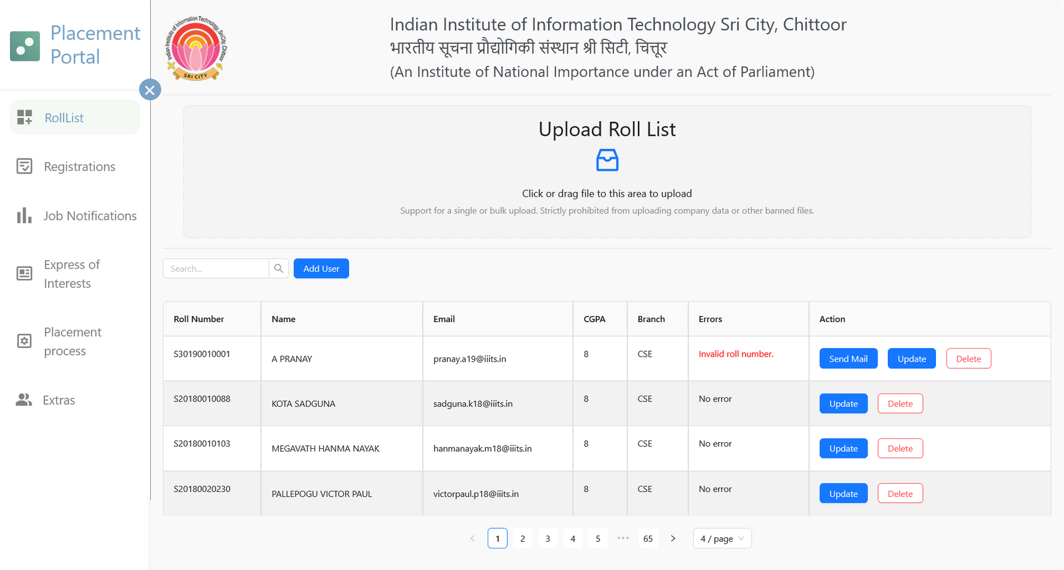
Progress - Admin Portal
ROLL LIST

Slide 5
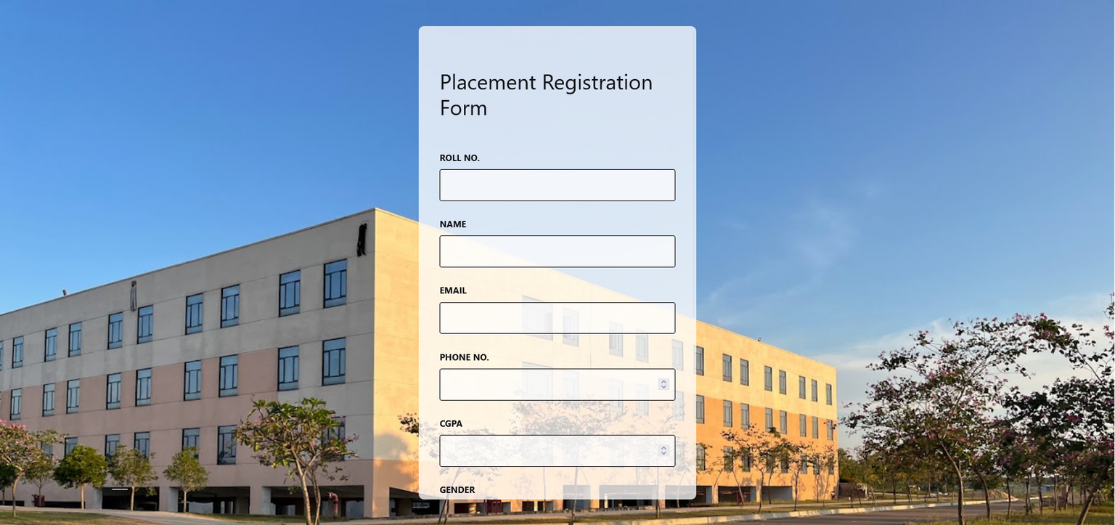
Registration Form

Slide 6
Progress
STUDENT REGISTRATION
Student registration form is now connected to the backend and is responsive.
Registered student’s data is collected and displayed in the admin portal where the admin can perform certain actions.

Slide 7
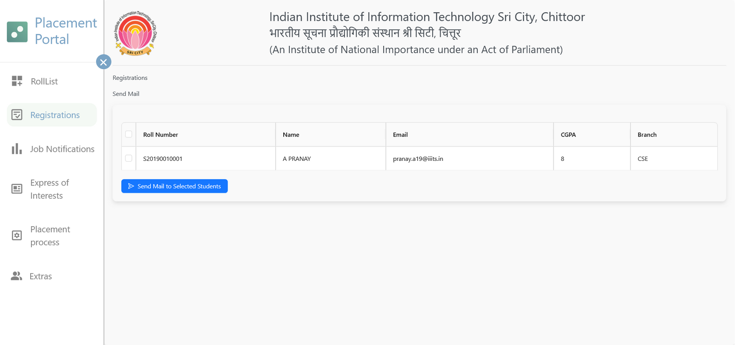
Progress - Admin Portal
REGISTERED STUDENTS

Slide 8
Progress
Progress - Admin Portal
DATA CORRECTION
Cross checking the registered student’s data with data uploaded by the admin (Roll list) and then pointing out the differences(error in data) in the registration form.
If the entered data matches the roll list then the student data will be added to the master database and will also be displayed in the registrations tab of the admin panel.

Slide 9
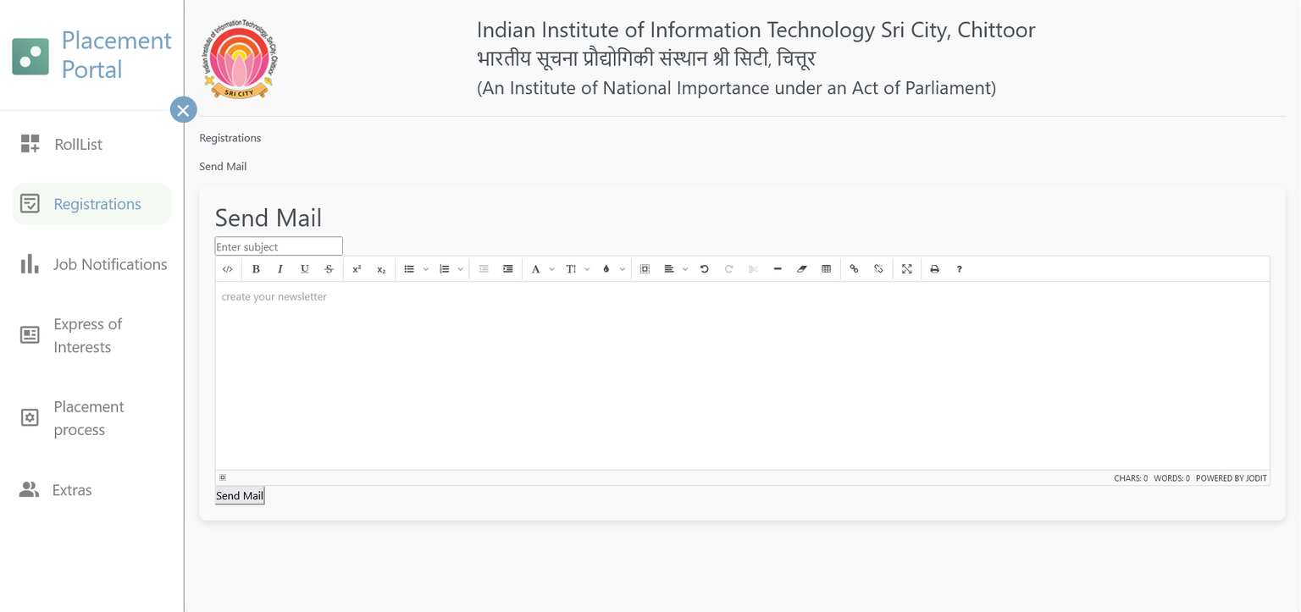
Progress - Admin Portal
SEND EMAIL

Slide 10
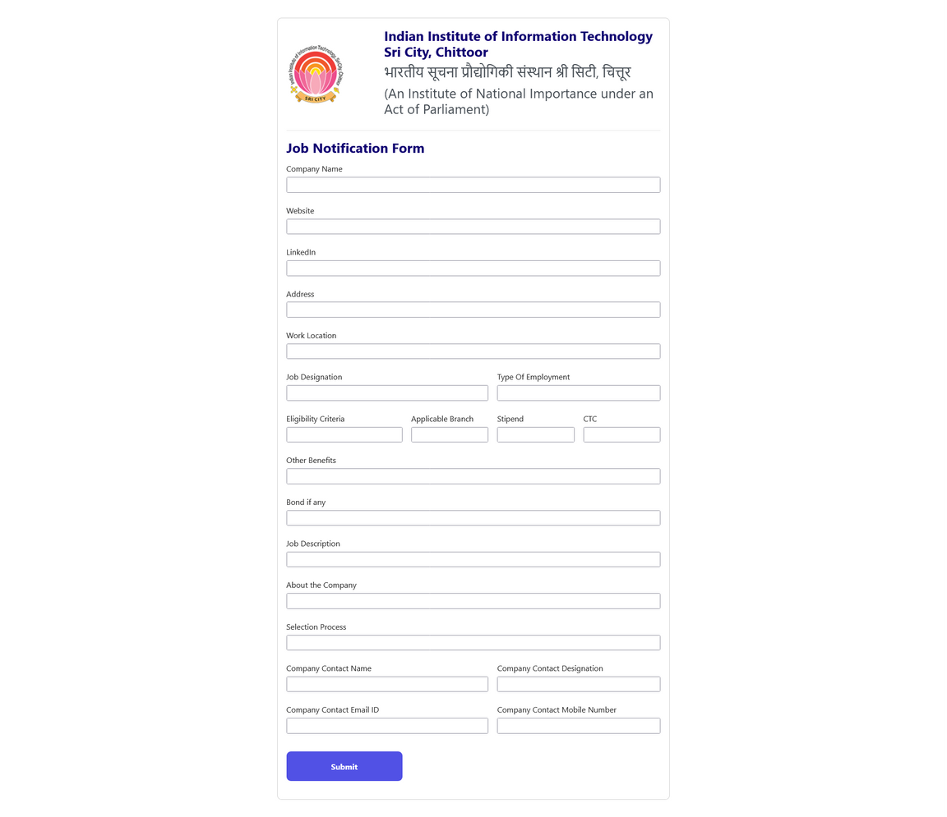
Progress - Admin Portal
JNF

Slide 11
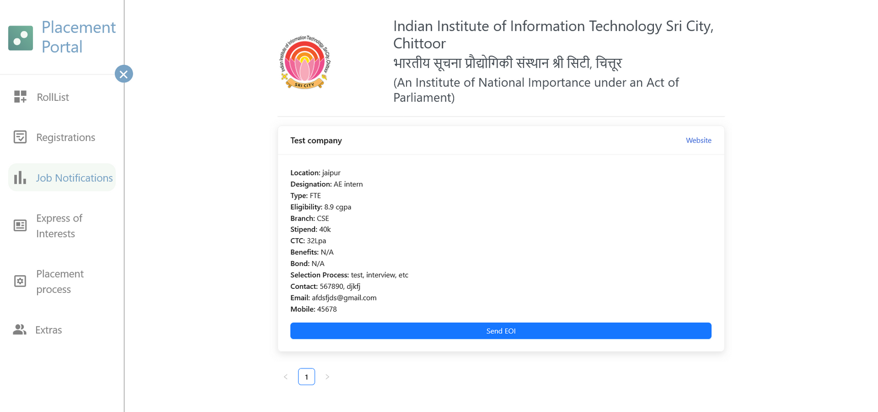
Progress - Admin Portal
JNF

Slide 12
Progress
Progress - Admin Portal
JNF
Admin can send the Job notification form to the companies.
Filled JNFs by the companies are displayed in the admin portal.

Slide 13
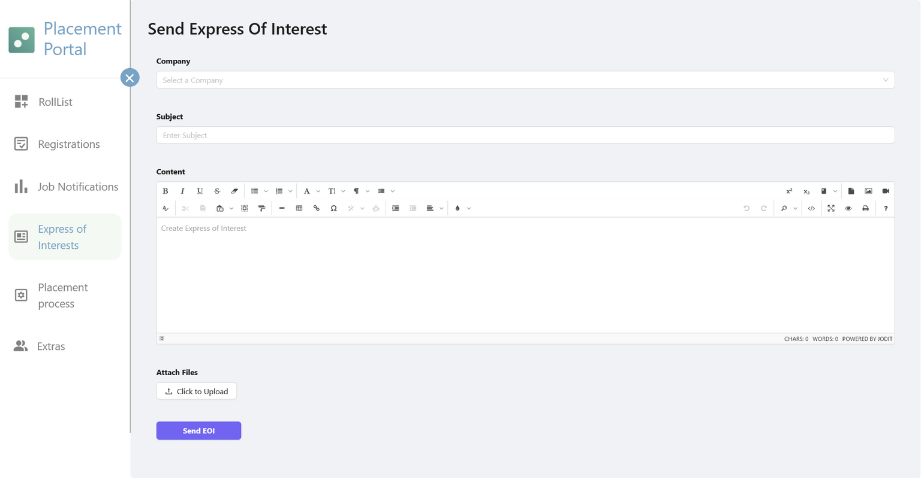
Progress - Admin Portal
EOI

Slide 14
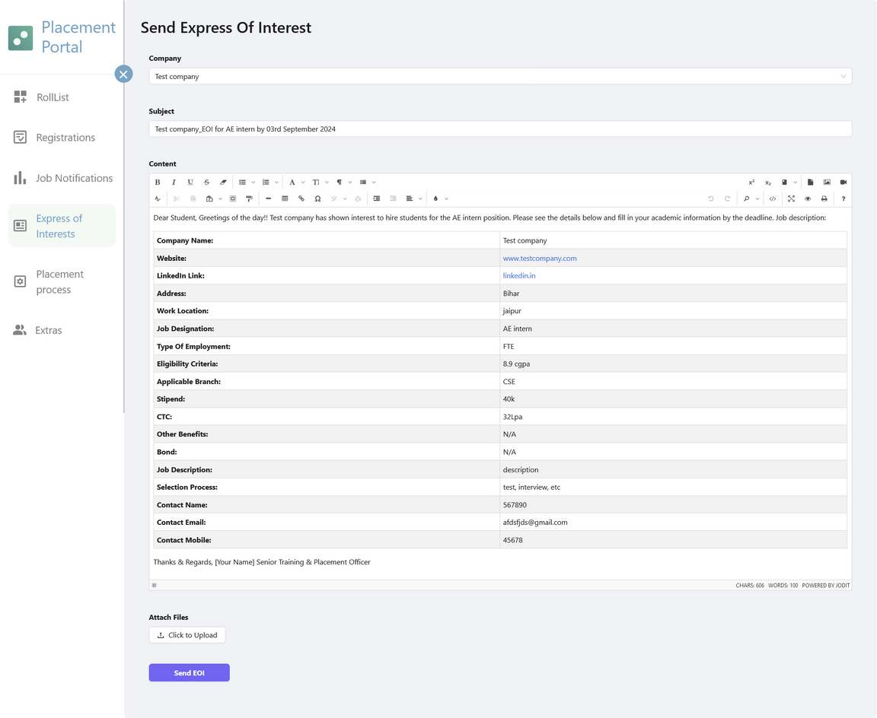
Progress - Admin Portal
EOI

Slide 15
Progress
Progress - Admin Portal
EOI
Admin can directly convert the received JNFs into EOIs.
Can also choose to send over the EOIs to the students via email.

Slide 16
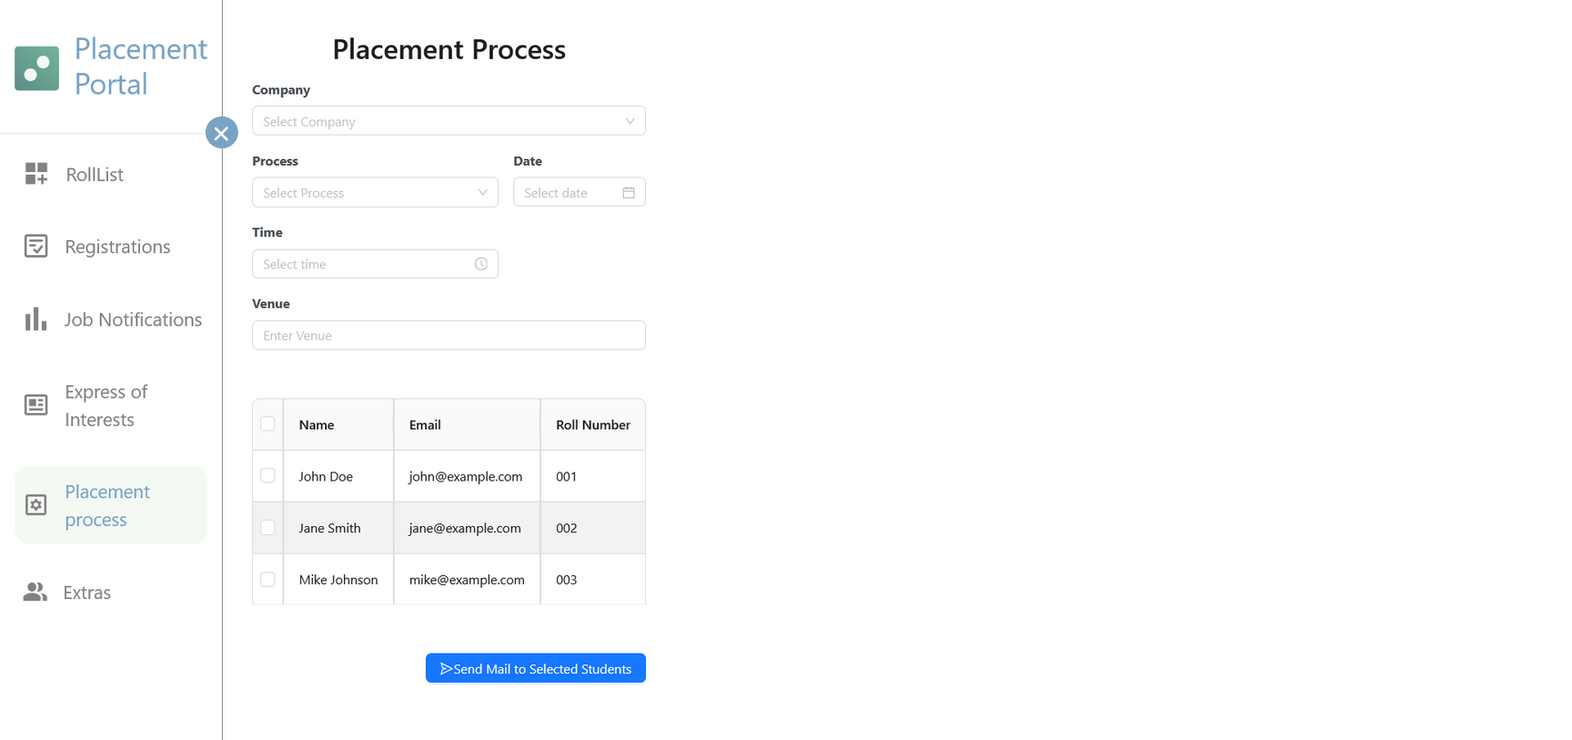
Progress
Progress - Admin Portal
PLACEMENT PROCESS

Slide 17
Progress
Progress - Admin Portal
PLACEMENT PROCESS
Different companies have different placement processes, so the admin can make necessary selections.
Then send it to the selected students via email.
Admin can inform the student about the venue, timing, and process/round.

Slide 18
Thank You

