Slide 1
Devlopment of Assember
To Build Assember GUI (graphical user interface ) is used in C++ language.
The structure of the code to design the Assembler is -

Slide 2

Struct program Struct Data Struct Register Struct Memory void saveLine(); void printLines(); void printErrorMessage(); Void getDataLines(); Void printDataLines(); Void displayMemory(); bool numbeSort();

Slide 3
Support for Assember Function
Pass1() : void
Scan the source code and creates intermediate file.
Pass2() : void
It generate the object code .
Its output is object code.
CheckError() : void
It help to check the error.

Slide 4
Instruction used
LDA ,LDX , STA , STX , LDS,MOVAS,MOVSA ,MOVAX ,MOVXA ,MOVAB ,MOVBA , TIX,JEQ,JLT,JGT, J ,ADD ,SUB ,MUL ,ADDF ,MULF , SUBF ,CMP ,CMPS,READ, READMEM,WRITE ,SORT ,STAM,STXM ,WRITEMEM ,

Slide 5
simulator
Diagram-
Machine code
Simulator
output

Slide 6
Final Result
Gui implemented program has output as : Symbol table ,register content and
memory content.

Slide 7
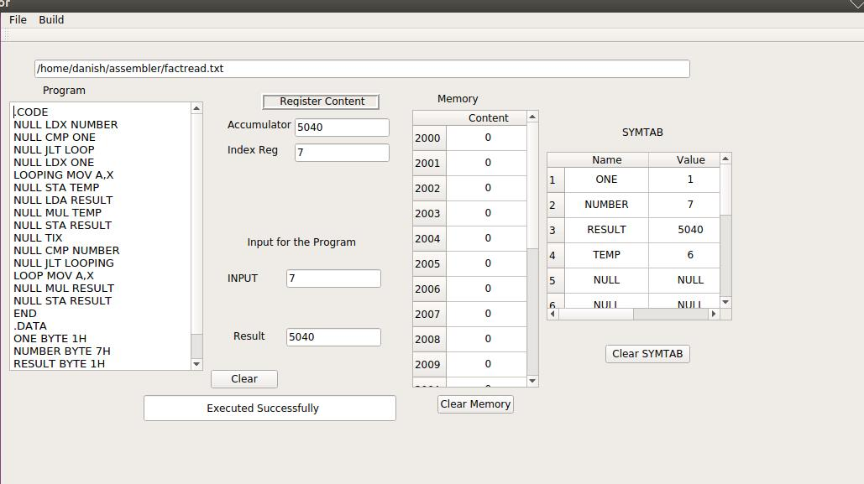
Factorial

Slide 8
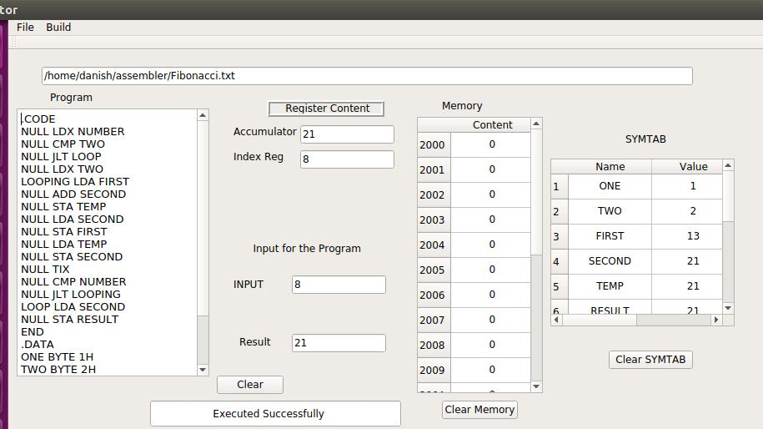
Fibonnaci

Slide 9
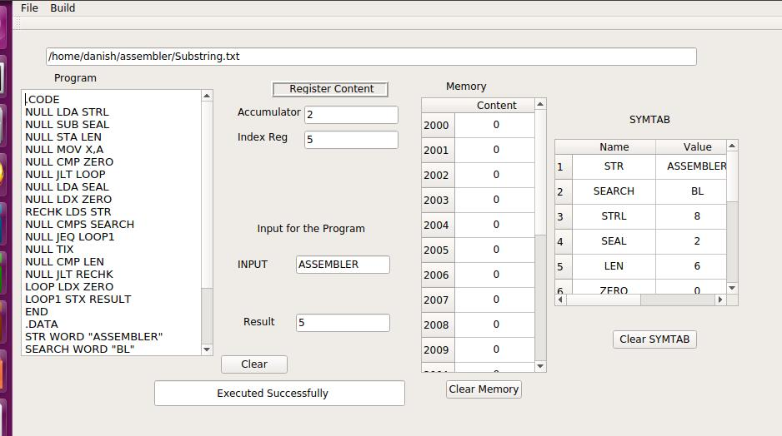
Substring Search

Slide 10
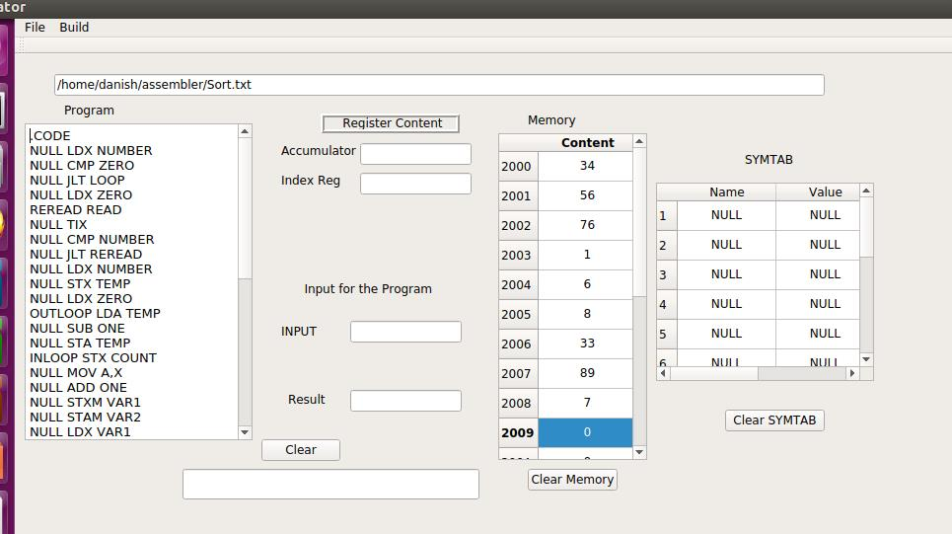
Selection Sort(before sort)

Slide 11
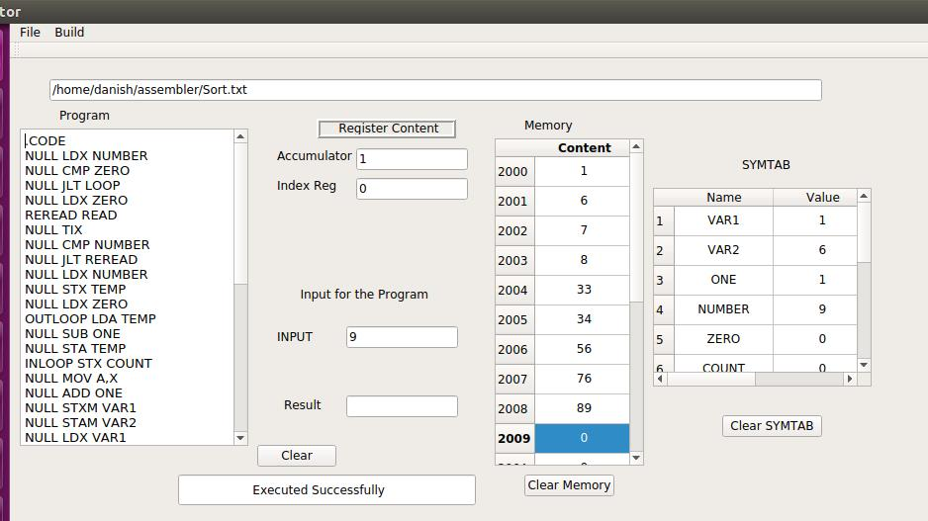
After Sort

