Slide 1
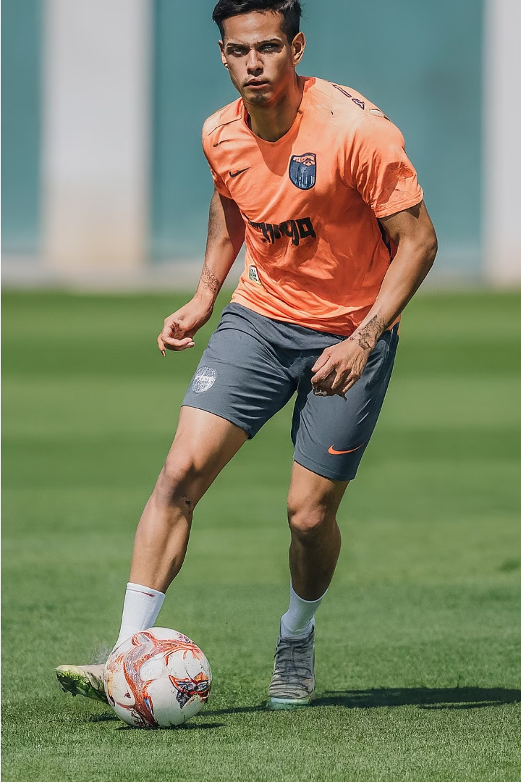
Scalable and Secure Sports Club E-Commerce Platform
Heet Gala
Abhishek Shinde
Divyaraj Sarvaiya
Our team has developed a comprehensive e-commerce platform tailored specifically for a sports club. This platform provides a safe, scalable, and high-performing online store to sell club merchandise and engage with members.

Slide 2
Project Goals
1
Safe and Secure
2
Scalable and High-Performing
3
Seamless User Experience
Maintain strong security protocols to protect user information and financial transactions.
Ensure high availability and scalability to handle increasing traffic volumes.
Provide a smooth and intuitive e-commerce experience for sports club members and fans.

Slide 3
Front-End Technologies
HTML
CSS
JavaScript
Crafting the basic structure and layout of the web pages.
Styling the appearance and ensuring responsive design.
Enhancing user interaction and adding dynamic functionality.

Slide 4


Cloud Services
Azure SQL Server
Azure Data Studio
Azure Web app
Hosting the relational database with automated backups and scaling.
Azure Data Studio can be utilized for web application back-end development through its capabilities for managing databases, querying data, and collaborating on code.
Azure Web App Service streamlines web application development and deployment.

Slide 5
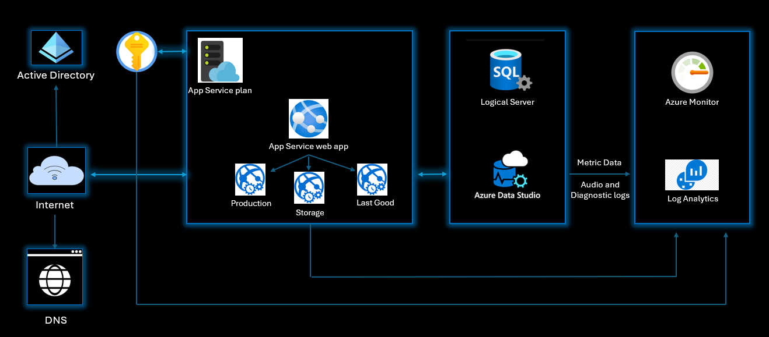
Architecture Diagram

Slide 6
Key Benefits
Scalability
Security
Easily handle increasing and fluctuating traffic volumes to accommodate the growing needs of the sports club.
Robust security protocols to safeguard user information and financial transactions.
High Availability
Ensure the website is accessible and responsive at all times, providing a seamless user experience.

Slide 7




Future Enhancements
Payment Integrations
Authentication & Authorization
Analytics & Insights
Mobile Optimization
Integrate with popular payment gateways to enable seamless and secure financial transactions.
Implement user authentication and authorization mechanisms to enhance security and personalization.
Integrate with analytics tools to gain valuable insights into user behavior and optimize the platform.
Expand the platform's reach by optimizing the design for mobile devices or developing dedicated mobile apps.

Slide 8

Conclusion
The sports club e-commerce platform we have developed provides a scalable, secure, and high-performing solution to meet the growing needs of the sports club and its members. We are excited to continue enhancing the platform and helping the club achieve its business goals.

