Slide 1

Energy Demand Forecasting and Reduction: Strategies in the Face of Global Warming
Bhavika | Abhishek | Gowtham | Prasanna | Minnie

Slide 2
Data Set Used:
Static House Data
Energy Usage Data
Meta Data
Weather data
Contains data on about 5,000 single-family homes that use eSC energy.
Provides hourly energy consumption statistics for each residence in the Static residence Data.
A data description file that describes the fields used in the various housing data files.
Hourly weather data, with one file for each geographic area (county).

Slide 3
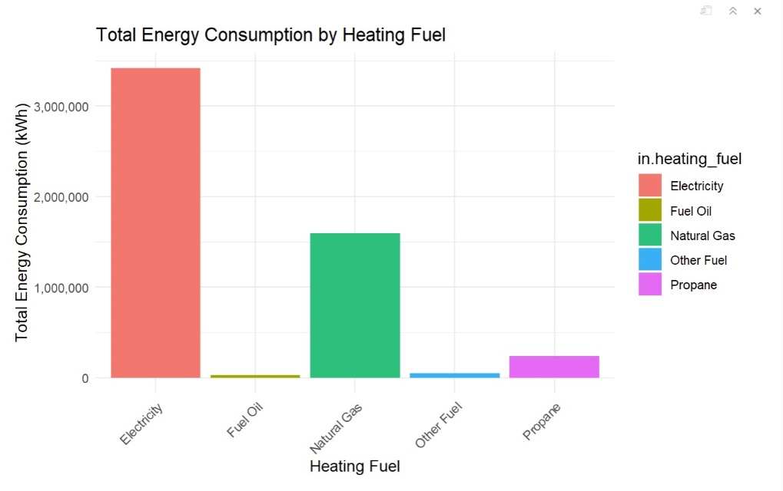
Energy Consumption by Heating Fuel

Slide 4
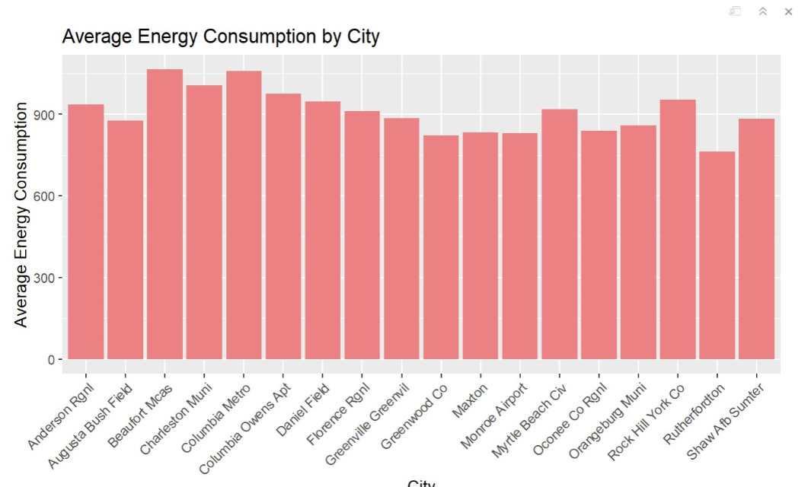
Energy Prediction by City

Slide 5
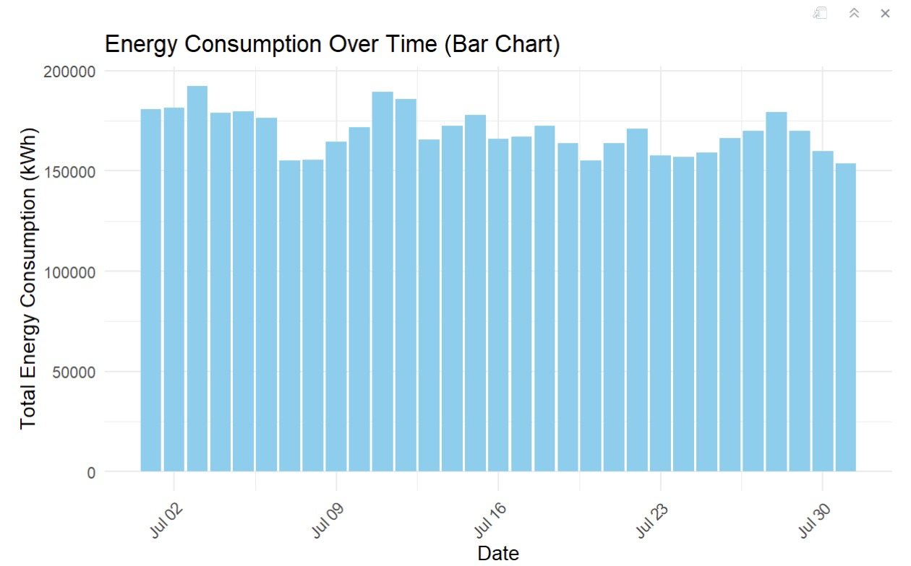

Slide 6
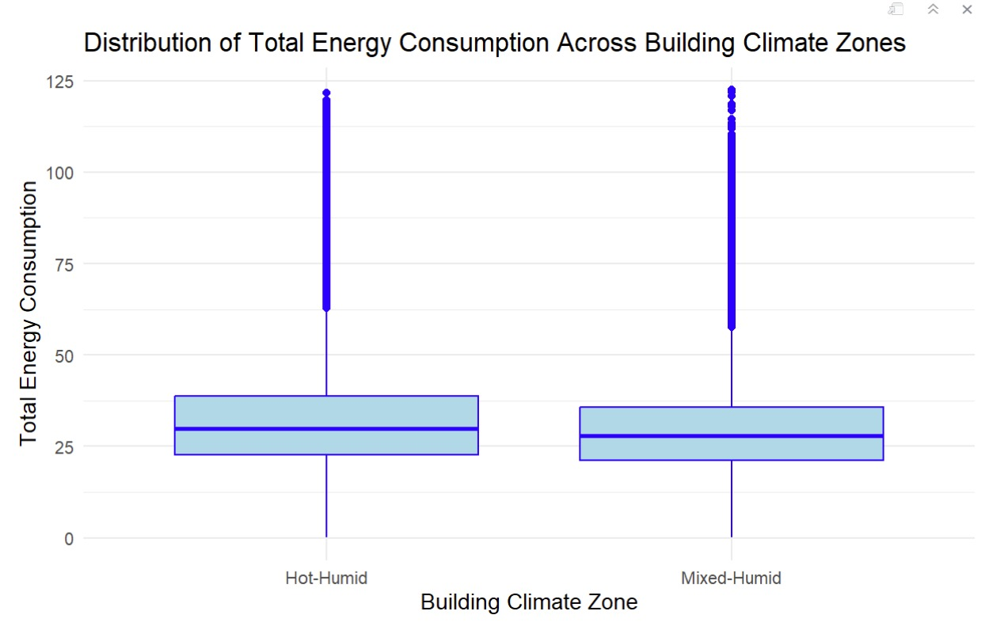


Slide 7
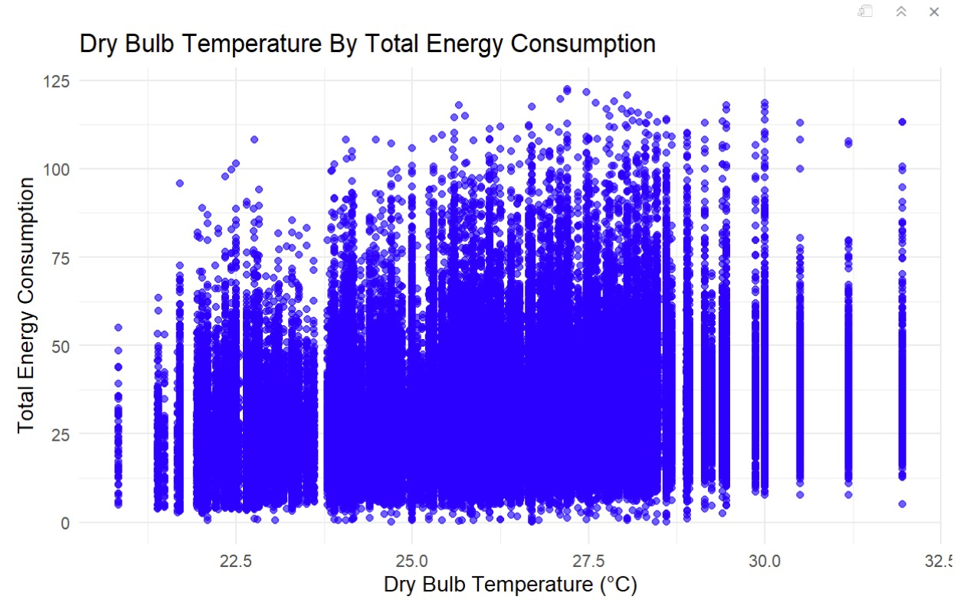

Slide 8

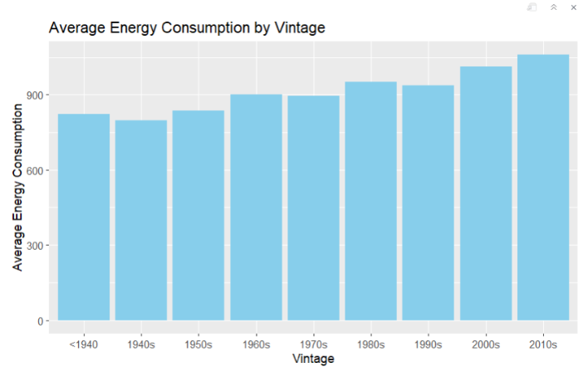
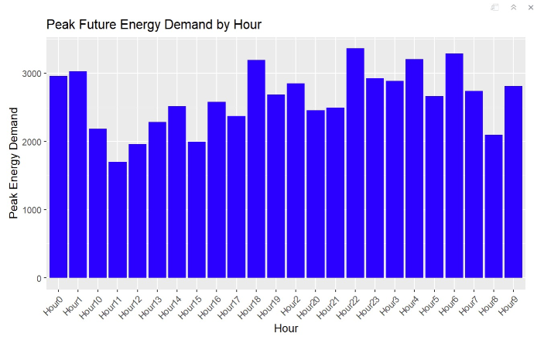
s
Understanding Future Peak Energy Demand
1
Forecasting Growth
2
Identifying Peak Hours

Slide 9

Addressing Future Energy Needs
1
Investing in Renewable Energy like solar power plants
2
Energy Storage Technologies like pumped storage hydropower
3
Advancements in Demand Response by integration of smart grid technology and automated systems, enhancing real-time energy management and efficiency.

Slide 10
Reducing Peak Energy Demand
Data-Driven Insights
Smart Grid Implementation
Public Awareness Campaigns
Through the analysis, we have higher consumption depending on population, insulation and industrial regions.
Deployment of smart meters and other sensor technologies for real-time monitoring and management of energy flow.
Social media, community meetings, informational websites, and collaborations with local organizations to reach a broad audience

Slide 11
Thank You!

