Slide 1


Department of Information Science and Engineering
THE OXFORD COLLEGE OF ENGINEERING
INTERNSHIP EXTERNAL REVIEW
Abhishek IJ
1OX22IS003
8th sem - ISE
Guide Name : Ms. Visalini S
Asst . Professor
Dept. of ISE

Slide 2

Agenda
Introduction
About KodNest
Internship Domain & Training Program
Learning Phases During Internship
Soft Skills & Aptitude Development
Core Java & Programming Training
Technologies & Tools Learned
Project Overview – Inventory Management System
System Design & Architecture
Tasks, Contributions & Present Status
Conclusion & Key Takeaways

Slide 3
Internship is a part of the academic curriculum in the 8th semester.
Joined KodNest as a Java Developer Intern.
The internship focused on enhancing both technical and professional skills.
Training included soft skills, aptitude development, Core Java, and project-based learning.
Gained hands-on experience in frontend development, UI/UX enhancement, and application development.
Introduction

Slide 4
Company Overview
KodNest is a software development and training company based in Bengaluru.
Founded in 2017 by Akash Pandey and Prabhakaran Ganeshan.
Focuses on skill development in emerging technologies and industry-ready training.
Provides training in Full Stack Development, Software Testing, and programming technologies.
Helps students gain practical exposure through real-world projects and hands-on learning.
Aims to bridge the gap between academic learning and industry requirements

Slide 5
Internship Domain
Role: Java Developer Intern.
Focus areas:
  Full-Stack development using Java
  Front-End basics (HTML, CSS, JS )
  Problem solving and logical thinking
Objective: To become industry-ready developer

Slide 6
Training Phases
Phase 1: Learn How to Build Startups – focused on startup culture, communication skills, teamwork, and industry readiness.
Phase 2: Java using Generative AI – covered Core Java, OOP concepts, problem solving, and AI-assisted development.
Phase 3: Front-End Technologies – focused on HTML, CSS, JavaScript, responsive UI/UX, and dashboard development.
Phase 4 (Upcoming): Advanced Java & Full Stack Development – includes backend development, APIs, databases, and full stack application development

Slide 7
Soft Skills Training
Communication skills
Teamwork and collaboration
Time management
Presentation skills
Professional behavior in workplace
Outcome:
Improved confidence and communication abilities

Slide 8
Aptitude Training
Quantitative aptitude
Logical reasoning
Problem-solving techniques
Time-based test practice
Outcome:
Enhanced analytical thinking and problem-solving speed

Slide 9
Core Java Training
Basics of Java
Data Types and Variables
Conditional Statements (if-else)
Loops (for, while)
Methods and Functions
Object-Oriented Programming Concepts
Collections in Java
Exception Handling and File Handling
Status: Core Java training successfully completed.

Slide 10
Modern web-based inventory management application
Developed using HTML, CSS, and JavaScript
Designed with a professional SaaS-style UI
Manages products, stock, orders, vendors, and customers
Includes Admin, Vendor, and Customer modules
Provides analytics dashboards and stock monitoring
Project Overview – Inventory Management System

Slide 11
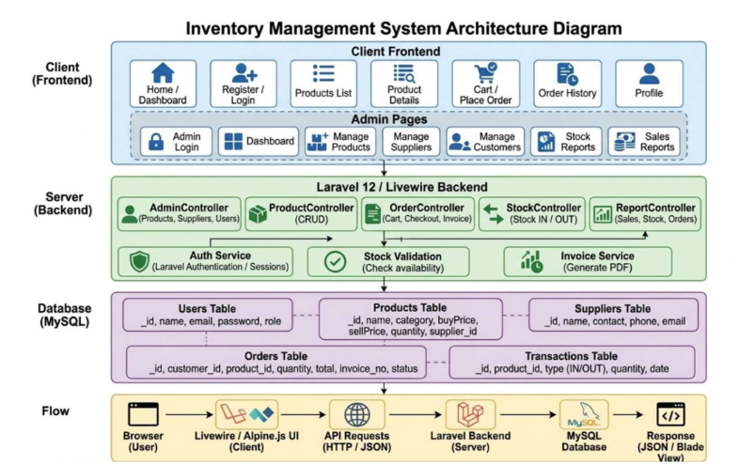
System Architecture Diagram

Slide 12
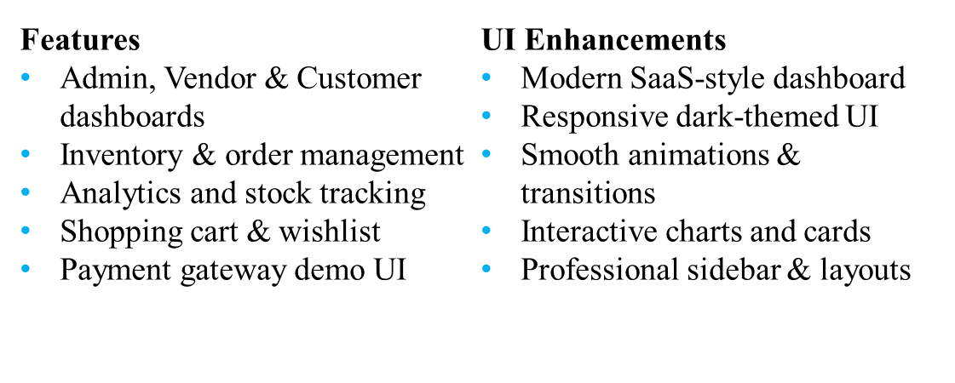
Project Features & UI Enhancements

Slide 13
Gained practical industry exposure through internship training
Improved skills in Core Java and frontend development
Learned UI/UX design and responsive dashboard development
Enhanced problem-solving and analytical thinking abilities
Successfully developed the Inventory Management System project
Improved professional communication and teamwork skills
Conclusion

Slide 14
THANK YOU

