Slide 1
Sonar Fix Agent – Automating Code Quality Fixes with GitHub Actions
Presented By: Abhishek Kumar

Slide 2
Introduction
Manual fixing of SonarQube issues is time-consuming.
Developers often skip minor code smells.
Lack of automation leads to delays in code reviews.
Goal: Automate the fixing of code issues using AI + GitHub Actions.

Slide 3
Goal
Integrate SonarQube, GitHub, and AI into a pipeline.
Detect → Fix → Validate → Commit cycle.
Reduce developer effort.
Deliver cleaner code automatically.

Slide 4
Objectives
Read SonarQube issues using API.
Use LLM (AI model) to generate code fixes.
Validate fixed code with Python scripts.
Automatically commit fixes to GitHub.
Provide a reusable automation framework.

Slide 5
Existing Approach (Before Automation)
Developers analyze SonarQube issues manually.
Fixes are done individually.
Risk of missing issues.
Slower review and merge process.

Slide 6
Proposed Approach (After Automation)
Issues are fetched automatically from SonarQube.
Fix suggestions from LLM (AI-based agent).
Code validated before commit.
Fixes pushed automatically to GitHub repository.

Slide 7
Technologies Used
- Python 3
- SonarQube API
- GitHub API
- Large Language Models (LLMs)
- GitHub Actions (CI/CD)

Slide 8
System Flow
- Developer pushes code to GitHub.
GitHub Actions triggers workflow.
Sonar Fix Agent fetches issues.
AI generates fixes.
Validator checks correctness.
Commit pushed to repo.

Slide 9
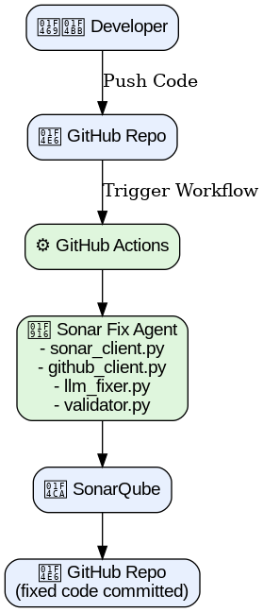
High-Level Design (HLD Diagram)

Slide 10
Implementation Steps
Create Python project (sonar_fix_agent/).
Add config, sonar_client, github_client, llm_fixer, validator.
Write workflow (.github/workflows/run-sonar-agent.yml).
Configure GitHub Secrets (Sonar token, GitHub token, OpenAI key).
Push project to GitHub → Actions run automatically.

Slide 11
Workflow in Action)
Developer commits code.
GitHub Actions runs Sonar Fix Agent.
AI suggests and applies fixes.
Validator checks compilation/logic.
Auto-commit to repo.

Slide 12
Key Learnings
Integration of SonarQube + GitHub + AI.
Writing GitHub Actions workflows.
Using API tokens securely.
Automating repetitive developer tasks.
Building reusable frameworks.

Slide 13
Future Enhancements
Support for multiple languages (Java, JS, etc.).
Integration with Jenkins / Azure DevOps.
Use advanced AI models for better fixes.
Automated unit test generation.
Dashboard for visualizing fixes.

Slide 14
Results
Automated fixing of Sonar issues.
Reduced manual developer effort.
Ensures faster code reviews.
Cleaner code committed automatically.

Slide 15
Thank You
Thank You! 🙏
Any suggestions? I would love that.
Questions? Happy to answer!

