Slide 1
Sonar Fix Agent – Automating Code Quality Fixes with LLMs
Presented By: Abhishek Kumar

Slide 2
Introduction
Manual fixing of SonarQube issues is time-consuming.
Developers often skip minor code smells.
Lack of automation leads to delays in code reviews.
Goal: Automate the fixing of code issues using AI + GitHub Actions.

Slide 3
Goal
Integrate SonarQube, GitHub, and AI into a pipeline.
Detect → Fix → Validate → Commit cycle.
Reduce developer effort.
Deliver cleaner code automatically.

Slide 4
Objectives
Read SonarQube issues using API.
Use LLM (AI model) to generate code fixes.
Validate fixed code with Maven Build.
Automatically commit fixes to GitHub.
Provide a reusable automation framework.

Slide 5
Existing Approach (Before Automation)
Developers analyze SonarQube issues manually.
Fixes are done individually.
Risk of missing issues.
Slower review and merge process.

Slide 6
Proposed Approach (After Automation)
Issues are fetched automatically from SonarQube API.
Fix suggestions generated by LLM (AI-based agent).
Fixes applied on feature branch.
Code validated with Maven build & tests before commit.
Fixes committed and pushed automatically to GitHub repository.
Pull Request created with a clear summary of changes.

Slide 7
Technologies Used
- Python 3
- SonarQube API
- GitHub API
- Large Language Models (LLMs)
- GitHub Actions (CI/CD)

Slide 8
System Flow
GitHub Actions triggers workflow.
Sonar Fix Agent fetches issues from SonarQube API.
AI generates fix suggestions for selected issues.
Fixes applied on a feature branch.
Validator (Maven build & tests) checks correctness.
Commit pushed to repo on feature branch.
Pull Request created automatically with fix summary..

Slide 9
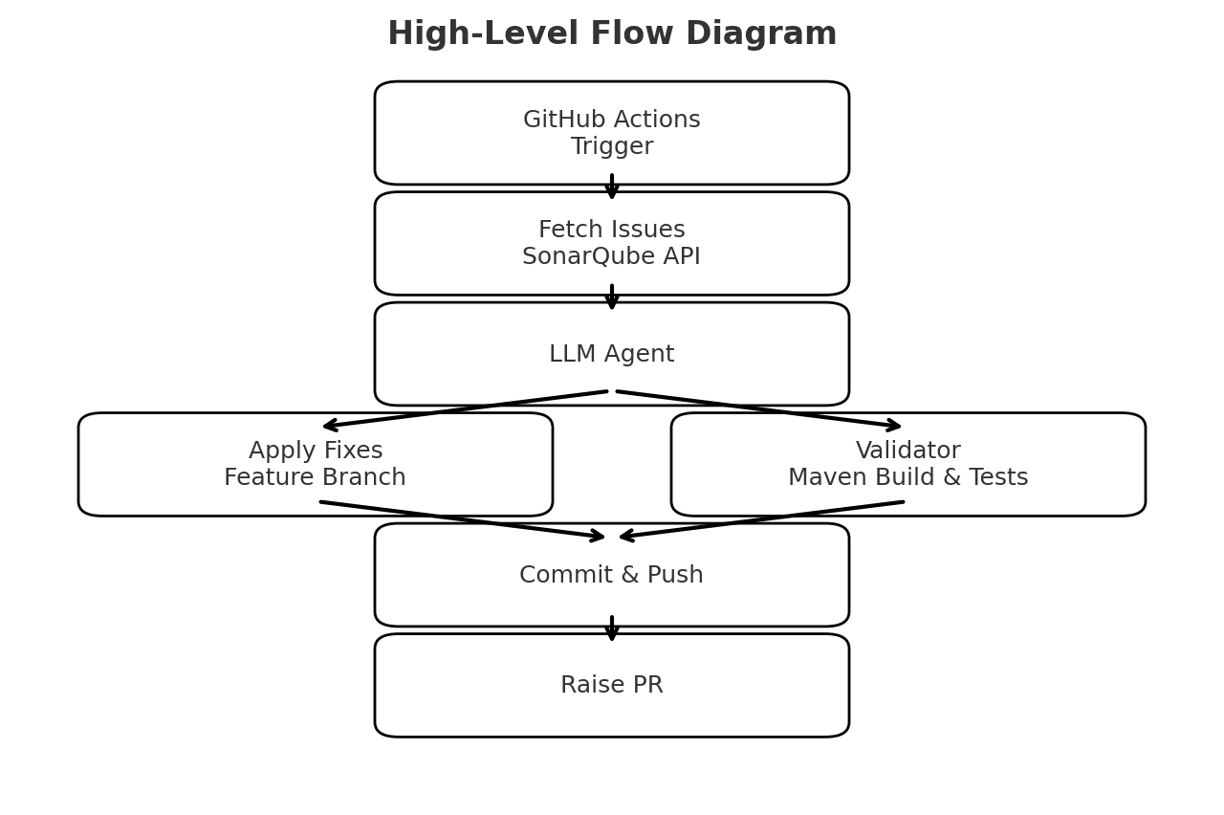
High-Level Design (HLD Diagram)

Slide 10
Implementation Steps
Create Python project (sonar_fix_agent/).
Add config, sonar_client, github_client, llm_fixer, validator.
Write workflow (.github/workflows/run-sonar-agent.yml).
Configure GitHub Secrets (Sonar token, GitHub token, OpenAI key).
Push project to GitHub → Actions run automatically.

Slide 11
Key Learnings
Integration of SonarQube + GitHub + AI.
Writing GitHub Actions workflows.
Using API tokens securely.
Automating repetitive developer tasks.
Building reusable frameworks.

Slide 12
Limitations 1
AST-Based Fixes
What: Uses Abstract Syntax Tree analysis to understand and modify code structure
How it works:
Parses code into a tree structure
Analyzes the structure to understand relationships
Makes precise, targeted changes
Preserves code formatting and style
LLM-Based Fixes
What: Uses Large Language Models (like GPT) to generate fixes
How it works:
Sends code and issue context to an LLM
LLM generates a fix suggestion
Applies the suggested changes
Current Behavior in Your Workflow
From the logs you shared earlier, I can see:
AST Fixes Attempted First:
[AST] Attempting to fix java:S1488 in AdminServices.java [AST] Could not fix java:S1488 in AdminServices.java
LLM Fallback When AST Fails:
🔄 [LLM] Attempting LLM fix for java:S1488 in AdminServices.java ❌ [LLM] Could not fix java:S1488 in AdminServices.java

Slide 13
Limitations 2
Key Points:
The agent tries AST fixes first because they're more reliable and precise
Only if AST fails does it fall back to LLM
Some issues still fail with both approaches due to:
Complex code patterns
Limited context in the LLM prompt
Issues requiring broader codebase understanding
Example of a Successful Fix:
[AST] Fixed java:S1118 in Utils.java: Added private constructor
This shows the AST fixer successfully added a private constructor to a utility class.

Slide 14
Future Enhancements
Support for multiple languages (Java, JS, etc.).
Integration with Jenkins / Azure DevOps.
Use advanced AI models for better fixes.
Automated unit test generation.
Dashboard for visualizing fixes.

Slide 15
Results
Automated fixing of Sonar issues.
Reduced manual developer effort.
Ensures faster code reviews.
Cleaner code committed automatically.

Slide 16
Thank You
Thank You! 🙏
Any suggestions? I would love that.
Questions? Happy to answer!

