Slide 1

SECUREAPP PIPELINE
End-to-End DevSecOps Security Across Every Layer of the SDLC
8 Security Layers 12 Vulnerabilities Fixed 1 Fully Automated Pipeline
Presented by: Abhi | B.Tech CSE — Cybersecurity & Digital Forensics

Slide 2


THE PROBLEM
Security Is Usually Bolted On, Not Built In
Most teams write code first and think about security right before release — by then, fixes are expensive, rushed, and often skipped under deadline pressure.
Traditional SDLC
SecureApp Pipeline (Shift-Left)
Security testing happens after development is “done”
Vulnerabilities found in staging or production
Manual, inconsistent reviews — easy to skip
No visibility into dependency or container risk
Attacks discovered only after real damage
Security gates run at every stage — commit to deploy
Vulnerabilities caught before they ever ship
Automated, repeatable, cannot be skipped
Full visibility: code, dependencies, containers, cloud
AI-assisted monitoring flags attacks in real time
SecureApp Pipeline
2 / 10

Slide 3







ARCHITECTURE
Eight Layers, One Automated Pipeline
Every commit passes through all eight gates before it can reach production.
1. Pre-Commit
2. Dependencies
3. CI/CD
4. Container
Bandit, Semgrep, detect-secrets
pip-audit, Safety, SBOM
GitHub Actions, gated stages
Hardened Docker, Trivy, Hadolint
5. Infrastructure
6. DAST
7. Network
8. Monitoring + AI
Terraform AWS, Checkov, tfsec
OWASP ZAP spider + active scan
Nmap + Shodan exposure checks
Prometheus, Grafana, Ollama
SecureApp Pipeline
3 / 10

Slide 4
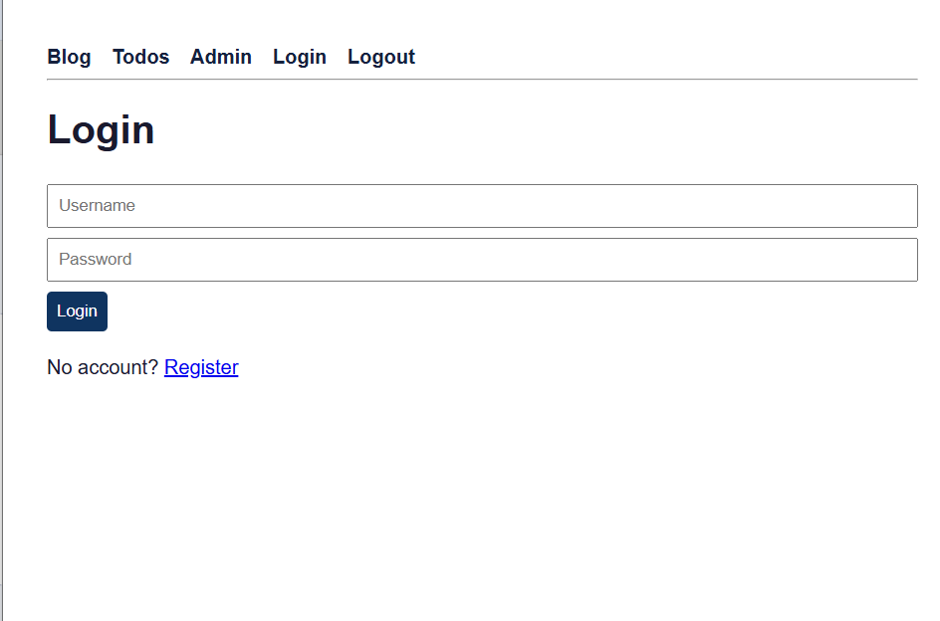

LEVEL 0 — THE TARGET APPLICATION
A Real Flask App, Deliberately Vulnerable
Every other layer needs something real to catch. The baseline app is a full-featured Flask application with 12 documented, working vulnerabilities.
Features
Login & Registration
Blog (posts + comments)
Todo manager
Admin panel
REST API + JWT auth
SQLite persistence
SCREENSHOT
Blog / login page of the running vulnerable app in the browser
12 intentional vulnerabilities — SQLi, XSS, IDOR, weak crypto,
broken access control, unsafe upload, and more.
SecureApp Pipeline
4 / 10

Slide 5
LEVELS 1 – 2
Shift-Left: Stop Issues Before They're Committed
Pre-Commit Hooks
Bandit + Semgrep (SAST) and detect-secrets scan every file before a commit is allowed — SQLi, hardcoded secrets, weak crypto, eval/exec all block locally.
Dependency Security
pip-audit and Safety cross-check every package against live CVE databases; a CycloneDX SBOM is generated on every run and the build fails on HIGH/CRITICAL findings.
Result: a commit containing the app's known vulnerabilities is rejected automatically — proven, not assumed.
SecureApp Pipeline
5 / 10

Slide 6
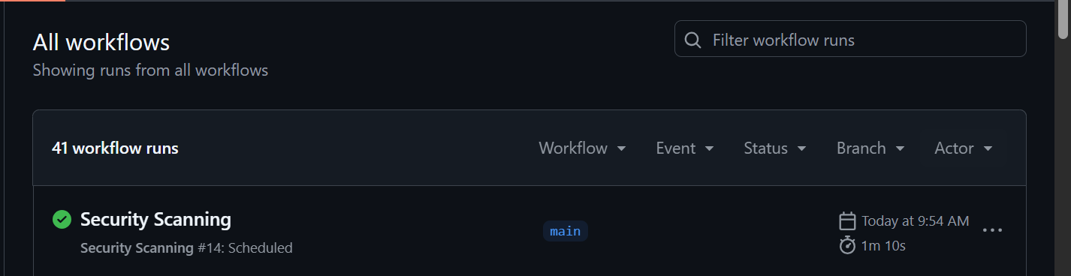
LEVEL 3
One Pipeline, Seven Gated Jobs
GitHub Actions chains every check together — a failure anywhere stops the build before it can reach production.
Test
→
SAST /
Secrets /
Deps
→
Build &
Scan Image
→
DAST
(ZAP)
→
Push
Image
→
Deploy
Parallel gates after Test: Bandit + Semgrep, detect-secrets, and pip-audit + SBOM all run concurrently — Build only starts once all three pass.
SCREENSHOT
GitHub Actions run summary — all 7 jobs, showing pass/fail status
SecureApp Pipeline
6 / 10

Slide 7
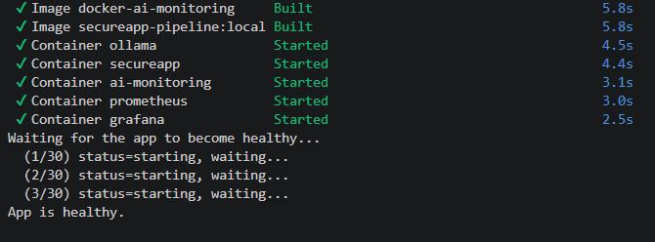
LEVELS 4 – 5
Hardened Container, Hardened Cloud
Container Security
Multi-stage build — build tools never ship
Runs as non-root (UID 10001), never root
Read-only root filesystem + dropped capabilities
Trivy, Hadolint, Docker Bench all gate the build
Infrastructure Security
SCREENSHOT
docker compose ps output / Terraform apply summary
Terraform: VPC, EC2, IAM, S3, CloudWatch
SSH restricted by policy — 0.0.0.0/0 is rejected
S3 fully blocked from public access + KMS-encrypted
Checkov + tfsec gate every plan before apply
SecureApp Pipeline
7 / 10

Slide 8
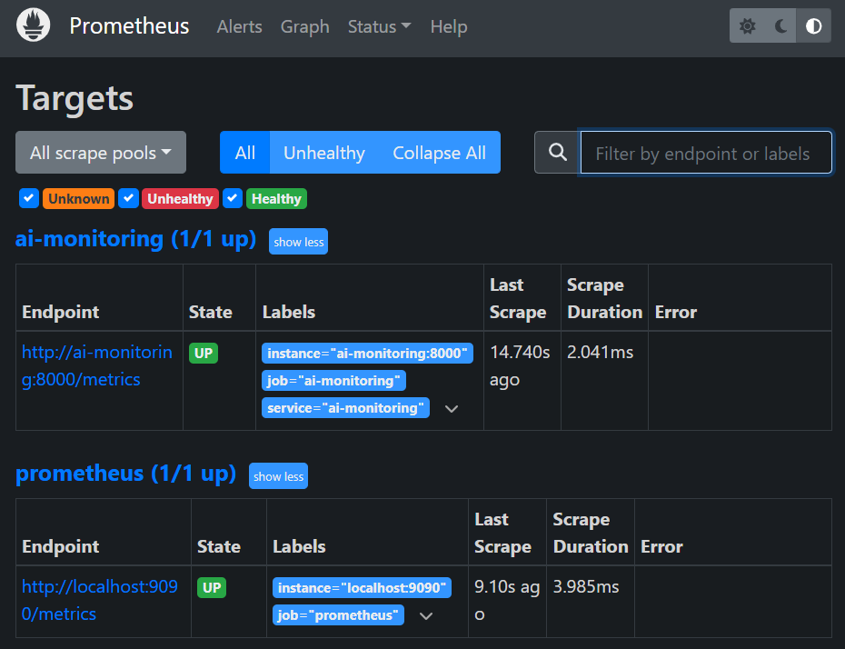

LEVEL 8 — THE FINAL LAYER
Monitoring + AI: From Logs to Incident Reports
Prometheus + Grafana
Live metrics: request rate, latency, login failures
7-panel dashboard auto-provisioned on startup
Alert rules fire on brute-force-rate and error-rate spikes
AI Incident Analysis (Ollama)
SCREENSHOT
Deterministic engine detects brute force by IP + user
LLM narrates findings in plain English — never recomputes them
Auto-generates remediation suggestions for each incident
Grafana dashboard / AI-generated incident report (JSON or /docs UI)
SecureApp Pipeline
9 / 10

Slide 9


WRAPPING UP
Future Scope & Conclusion
Future Scope
8
Kubernetes orchestration with OPA/Gatekeeper policies
WAF + rate limiting in front of the application
SOAR-style automated response to AI-flagged incidents
Multi-cloud Terraform modules (Azure / GCP)
Mobile app + expanded Zero Trust access model
Security Layers
12
Vulnerabilities Documented
7
Conclusion
CI/CD Gated Jobs
SecureApp Pipeline demonstrates that security can be embedded at every stage of the SDLC — from the first commit to a live, AI-monitored deployment — without slowing development down. It's a complete, working reference for DevSecOps, Cloud Security, and AppSec practice.
1
Command to Run Everything
Thank you
10 / 10

