Slide 1
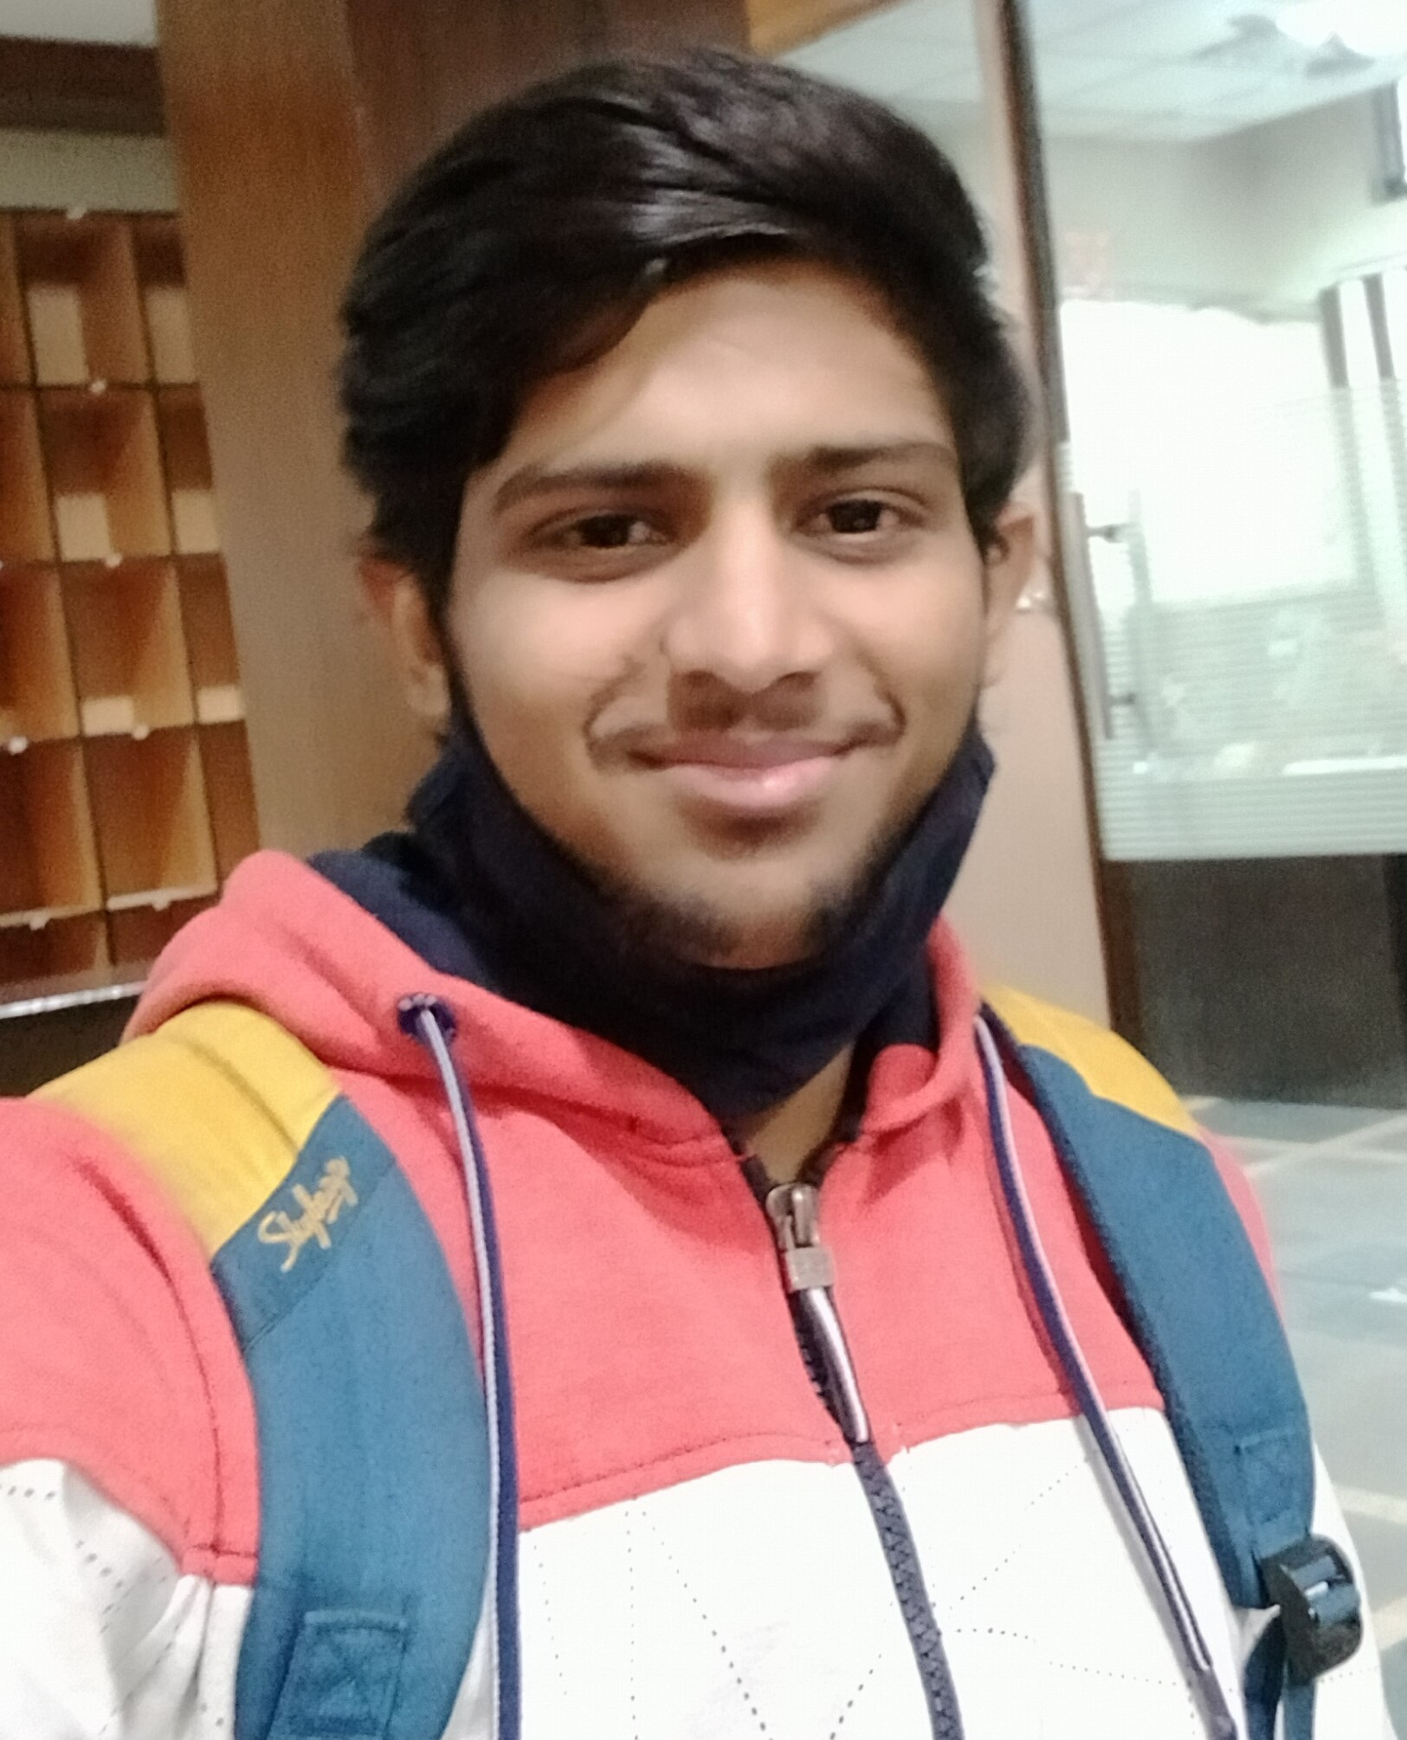
Abhishek Goyal | Analyst
Professional Experience
Trained in Sterling B2B Integrator and its operations.
In Globalscape application, specializes in job development, automated application installation, auditing and monitoring process.
Hands-on experience on event rules , Groups , basics of (Advance Workflows), development (Schedule, folder-monitoring , event-based trigger) , Report generation , EFT application installation and parametric job development in EFT.
I am Done some task in EFT tool like create simple pgp encryption and decryption , Transfer 1 file to different extension( using Event Rules).
POC (Schedule Business Process using REST API Services) – Create Map to translate csv file to xml. Then a Business Process was created through which a map was run. Then another Business Process was created through which the Business Process was Scheduled.
Created Business Process , Used Map Editor , Included REST API Services for Schedule BP.
Created and handled Organisation, Trading Partner and Relationship with AS2 Protocol using Keys, Several Digital certificate(CA, Trusted, System) Mailbox for partner, virtual root.
Created server and client adapter worked on Mailbox services, Translation services, SFTP, FTP and so on.
Created the MAP – For Translation CSV-XML , XML-CSV…... , all functions in Map Editor.
Worked on – Trading Partner , BP , Database , Password Policy , User A/c Handling , Report , Schedule , Health Check.
• Working on Agile Methodology and work within Scrum Framework.
• Hands on experience in building APIs and Connector-based integrations for end points like Salesforce, Files, Database etc using Boomi.
Technical Skills: Business Process, Map Editor, REST API
Integration Tools: EDI, Dell Boomi
Testing Tools: WinSCP, PuTTY and Dell Boomi
Name Abhishek Goyal
Title Analyst
Location Mumbai, India
Skills
Abhishek Goyal is a dedicated professional possessing knowledge of GlobalScape EFT. He has created Event Rules , digital Certification and logs monitoring and application maintenance.
In EDI Hands on experience in building Business Processes and Different Format integrations for end points like Business Process , Maps, REST API Services etc..
Competencies
Created Groups , Event Rules , basics of (Advance workflows) and Logs In Globalscape EFT.
Created Business Process , Used Map Editor , Included REST API Services for Schedule BP.
Certifications
Associate Integration Developer.
Professional Integration Developer is being pursued.
Agile Software Development.

