Slide 1









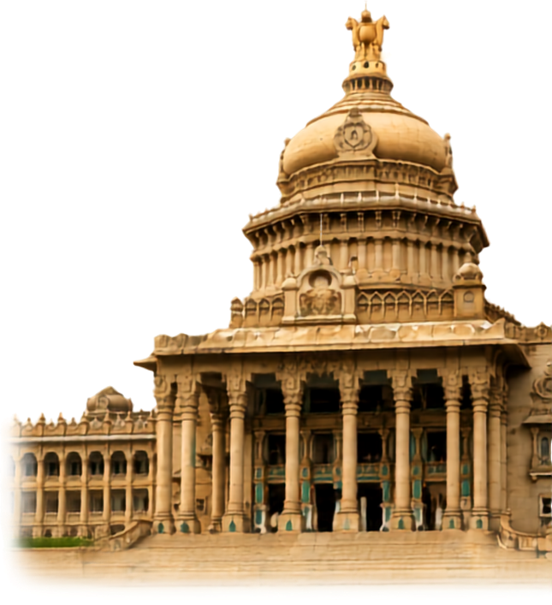



MANIPAL
  ACADEMY OF HIGHER EDUCATION
  Institution of Embrace Diamant in the University
HackSprint
24-Hour Hackathon
17-18
VENUE DETAILS
Manipal Academy of Higher Education (MAHE)
SATURDAY
OCTOBER
09 A.M. Onwards
YOUR NAME: Anusha K, Abhishek Anil Kumar, Aryan Singh, Adarsh B Acharya
TEAM NAME: Stack Overflow
TRACK NO: T.01 FinTech & Commerce
REGISTER NOW
Team Size
1-4 Members
ORGANIZED BY:
MANIPAL
  ACADEMY OF HIGHER EDUCATION
  Institution of Embrace Diamant in the University

Slide 2
The Problem
A small merchant may have ₹1–5 lakh of stock sitting in the shop.
They often do not know which products are silently becoming dead stock until it is too late.
Demand keeps changing: local festivals, school and college seasons, weather, nearby events, competitor discounts.
Popular is not the same as profitable. Product A sells 100 units at ₹10 profit: ₹1,000. Product B sells 30 units at ₹100 profit: ₹3,000.
Example, a clothing shop with ₹5 lakh of stock. Jackets: ₹1L in, ₹10K a month out. Shoes: ₹80K in, ₹5K a month out.
Jackets are becoming dead stock. Shoes already are.

Slide 3
Solution
An AI-powered Merchant Inventory Intelligence System – Mercura AI.
Mercura AI is an AI-assisted inventory intelligence platform that converts merchant sales, inventory, purchasing, pricing, supplier lead-time and seasonal information into simple recommendations.
It tells the shopkeeper what to buy, what to stop buying, what to discount and what to sell together.
It shows what is likely to become dead stock, which product only looks popular, and where the next ₹10,000 should go.
Detect → Predict → Explain → Recommend → Act → Monitor.
Example. Jacket X: 47 units unsold for 63 days. ₹38,000 invested. Sales down 42%. Margin 18%. Risk: High.
T-shirt Y: 8 units left, selling 5 a day, margin 32%. Recommendation: reorder soon.
It does not just say what is happening. It says what is likely to happen, and what to do about it.

Slide 4
Core Features
Top five features, in priority order
1. Dead Stock Risk Prediction. Predicts the problem before it becomes serious.
2. Smart Reorder System. Stops more money going into products that are not performing.
3. AI Action Recommendation. Does not stop at “this is dead stock”. Says what to do next.
4. Profit + Demand Analysis. Separates popular products from profitable ones.
5. Cash Recovery Calculator. Shows how much money is trapped and how much could come back.
Also planned: festival alerts, supplier reorder with merchant approval, digital ledger, cash-flow tracking.

Slide 5
Adaptive AI model
Historical data is not mandatory. The system learns as the shop is used.
Level 1. No history. “I have 50 packets.” We use stock, prices, supplier lead time and the next festival, and say: limited data.
Level 2. Simple questions. Product, current stock, typical sales (1–5, 5–10, 10–20 a day, or don’t know), and when sales rise.
Level 3. It learns. Day 1: limited. Day 10: real sales velocity. Day 60: a much better prediction.
Ways to enter: one-tap quick sale. Voice: “I sold 5 packets of biscuits”, then yes or edit. Invoice photo with OCR, later.
Never pretend the AI knows something it does not.

Slide 6
Tech Stack
What each piece is for
Frontend. React.js + Tailwind CSS.
Backend. Python + FastAPI.
Database. PostgreSQL.
Data analysis. Pandas + NumPy.
Machine learning. Scikit-learn.
Charts. Recharts. Version control. Git + GitHub.
Five models, in the backend
1. Sales Trend Analysis.
2. Dead-Stock Risk Model.
3. Demand Forecasting Model.
4. Inventory Classification.
5. Recommendation Engine.
Their output shows on the dashboard: risk, reason, action.

Slide 7
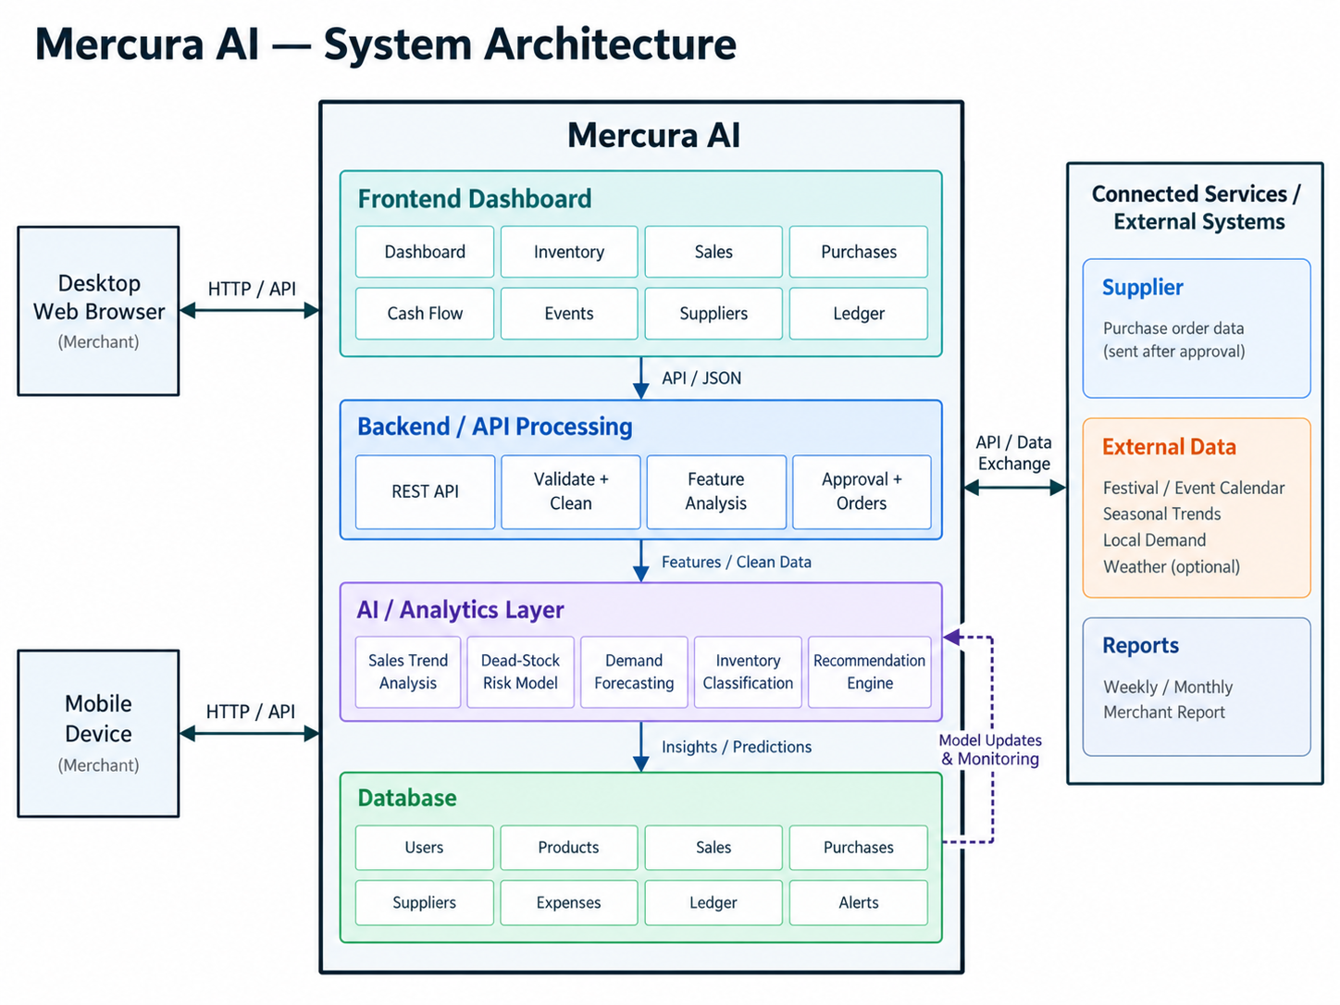
System Architecure

Slide 8
Data Flow
1
2
3
4
5
6
Input
Backend
Features
AI risk
Advice
Dashboard
Quick sale, voice or simple product entry. No history needed.
FastAPI cleans, checks and stores every entry.
Sales velocity, inventory age, margin and season.
Models score the stock risk and explain why.
The engine suggests the next best action.
Risk, reason and report. The merchant acts.
“Sold 5 biscuits.”
Validated data
63 days unsold
Jacket X: High
Discount it
₹42,000 at risk
THE LOOP CLOSES
Merchant approves the order → stock updates → new sales arrive → AI analyses again

Slide 9
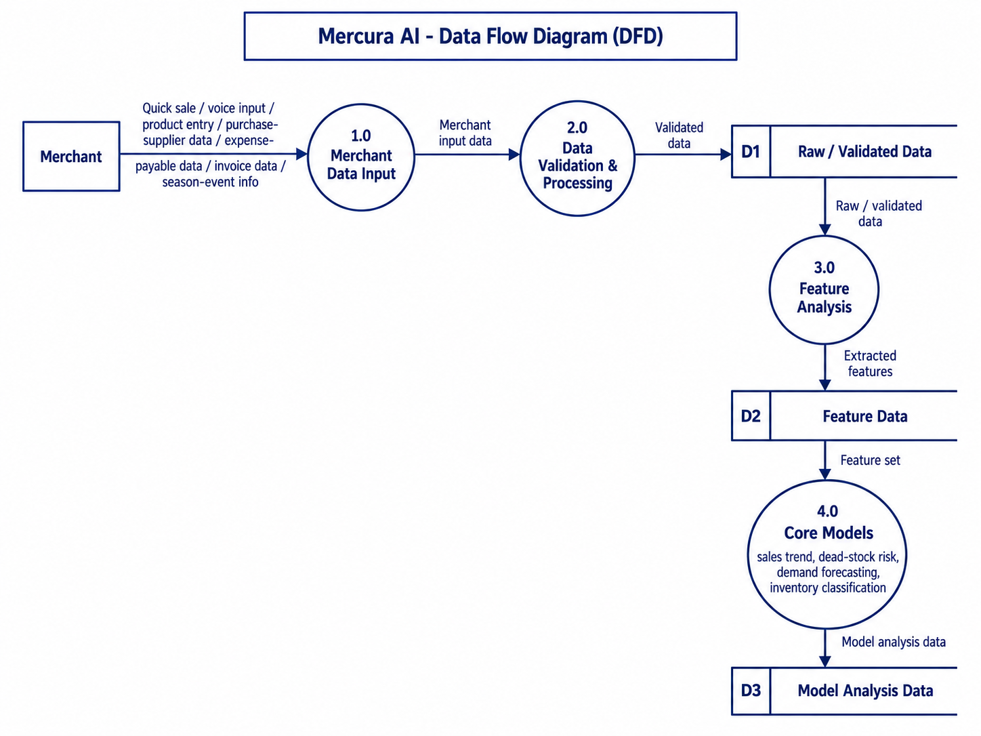
Data flow diagram

Slide 10
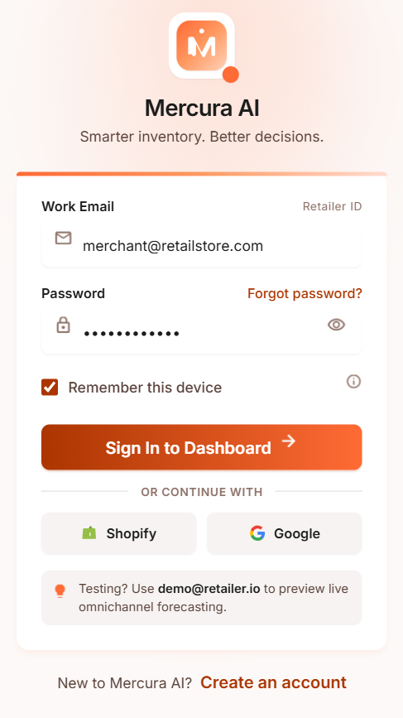
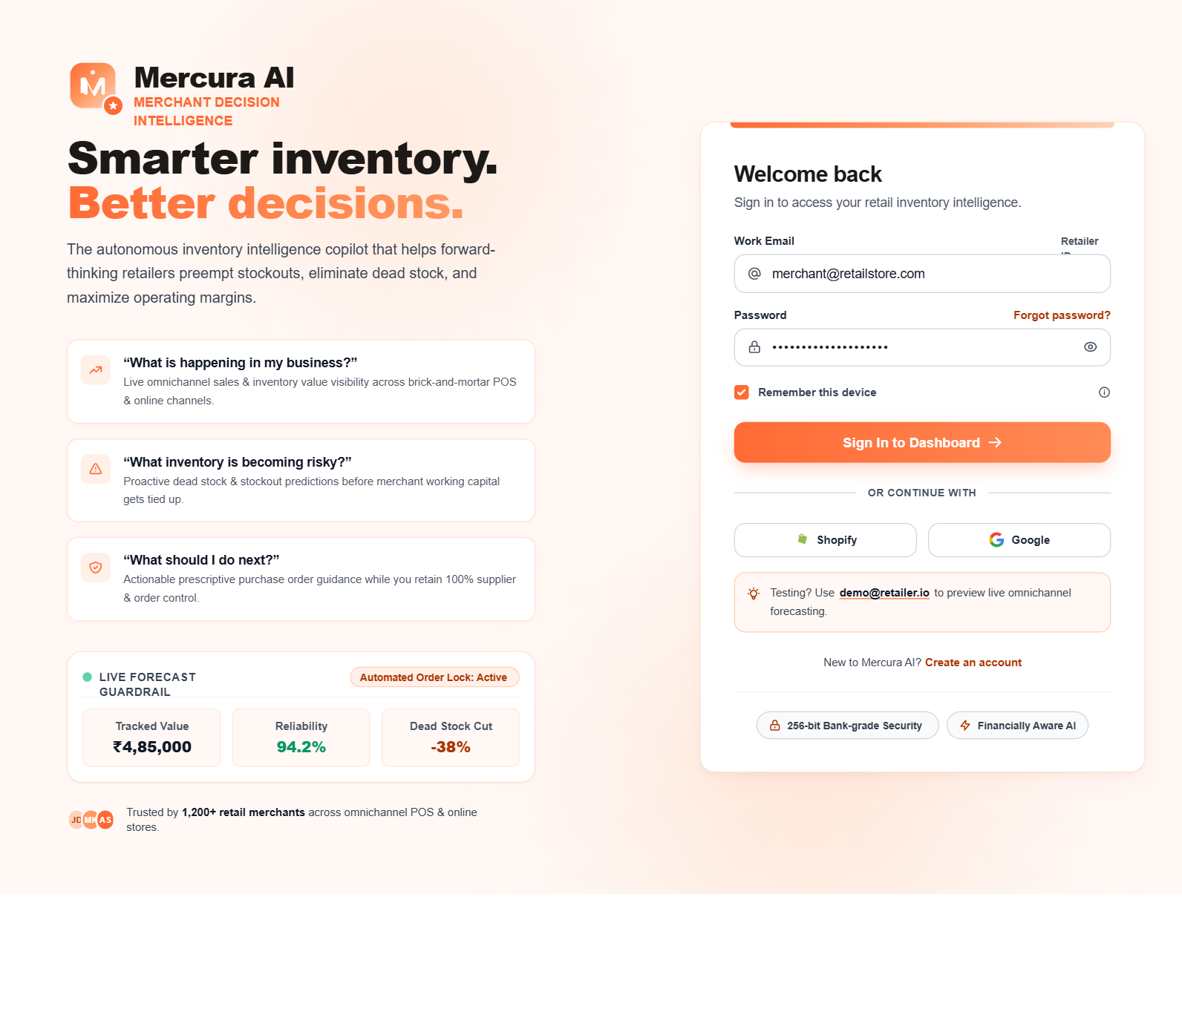
Screenshot – Registration and Login

Slide 11
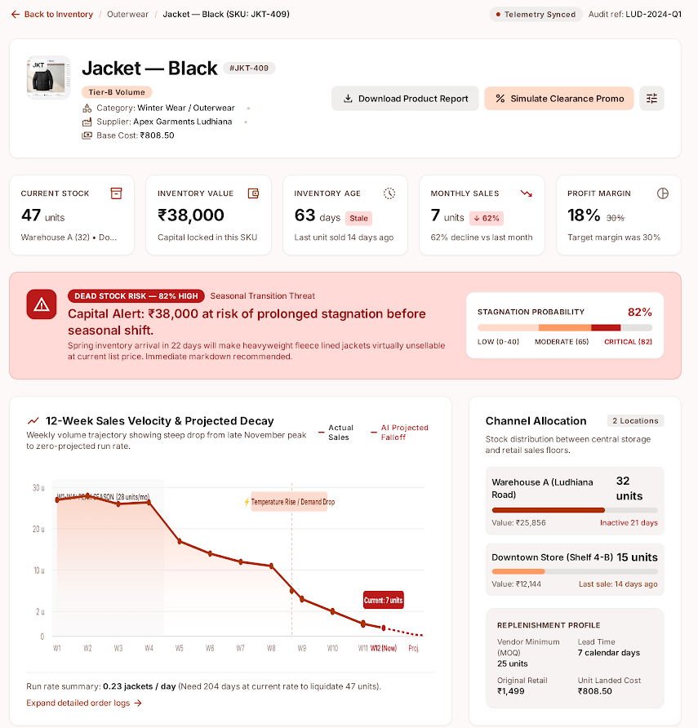
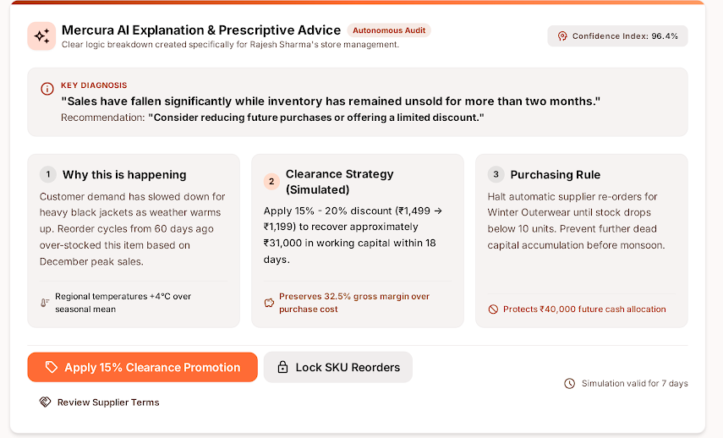
Screenshot – Product Screen
Risk, reason, action
82% dead-stock risk, ₹38,000 locked, and a plain reason with the next step.

Slide 12
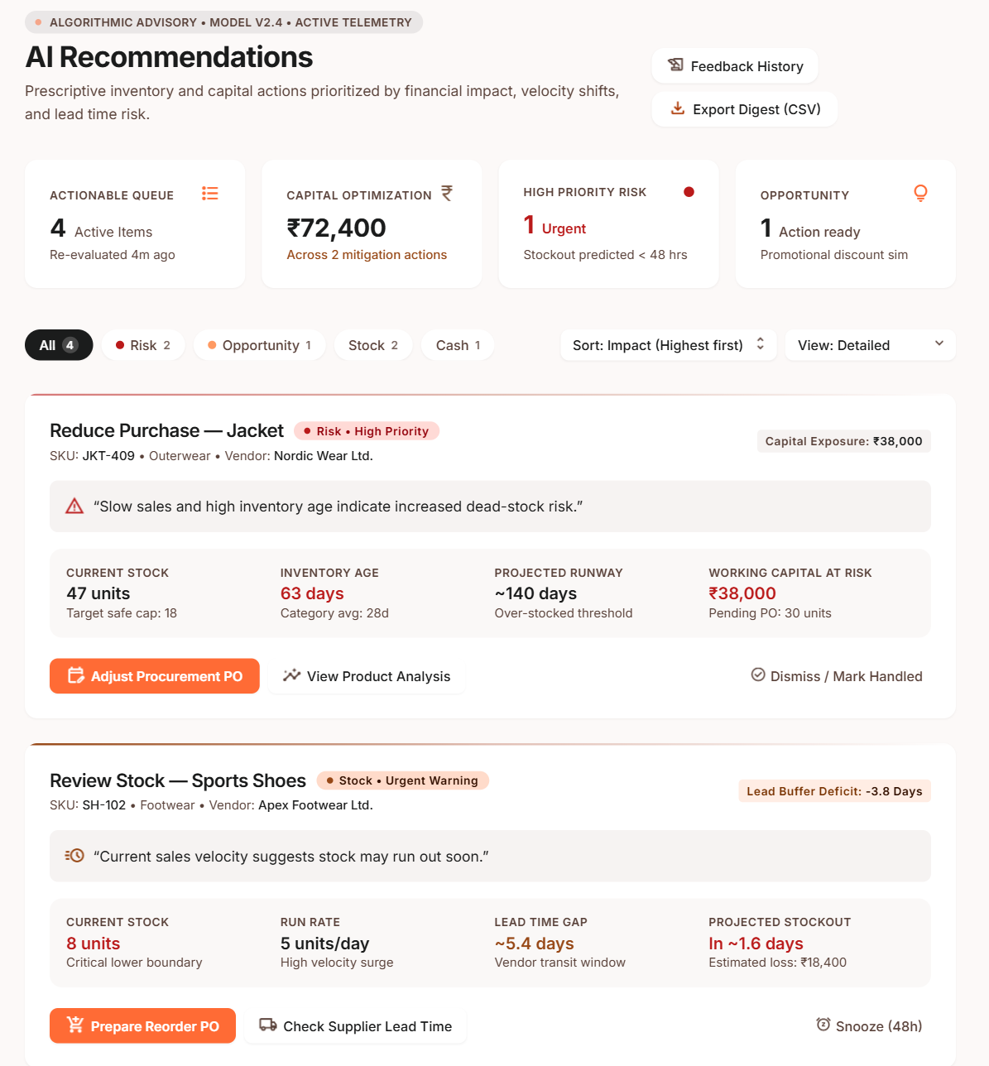
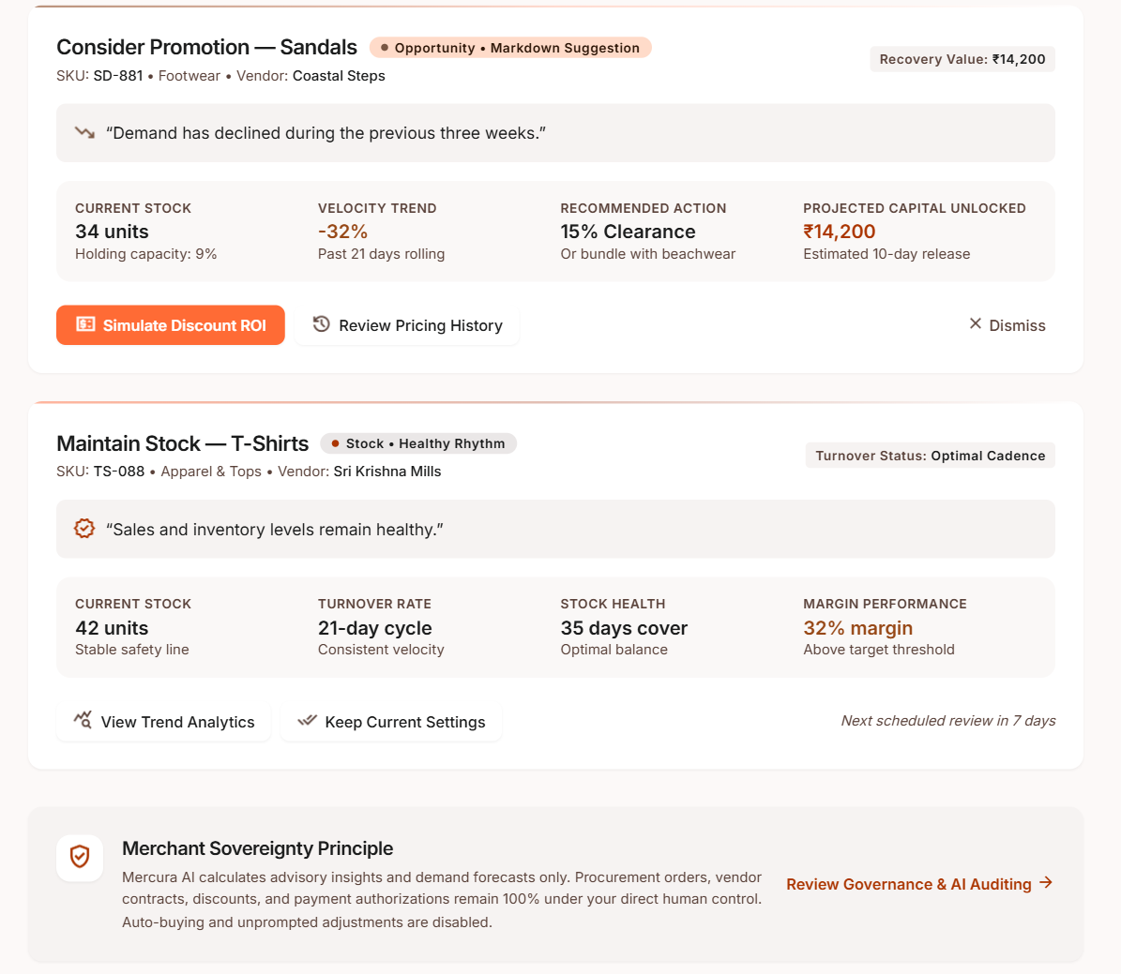
Screenshot – AI Recommendations

Slide 13
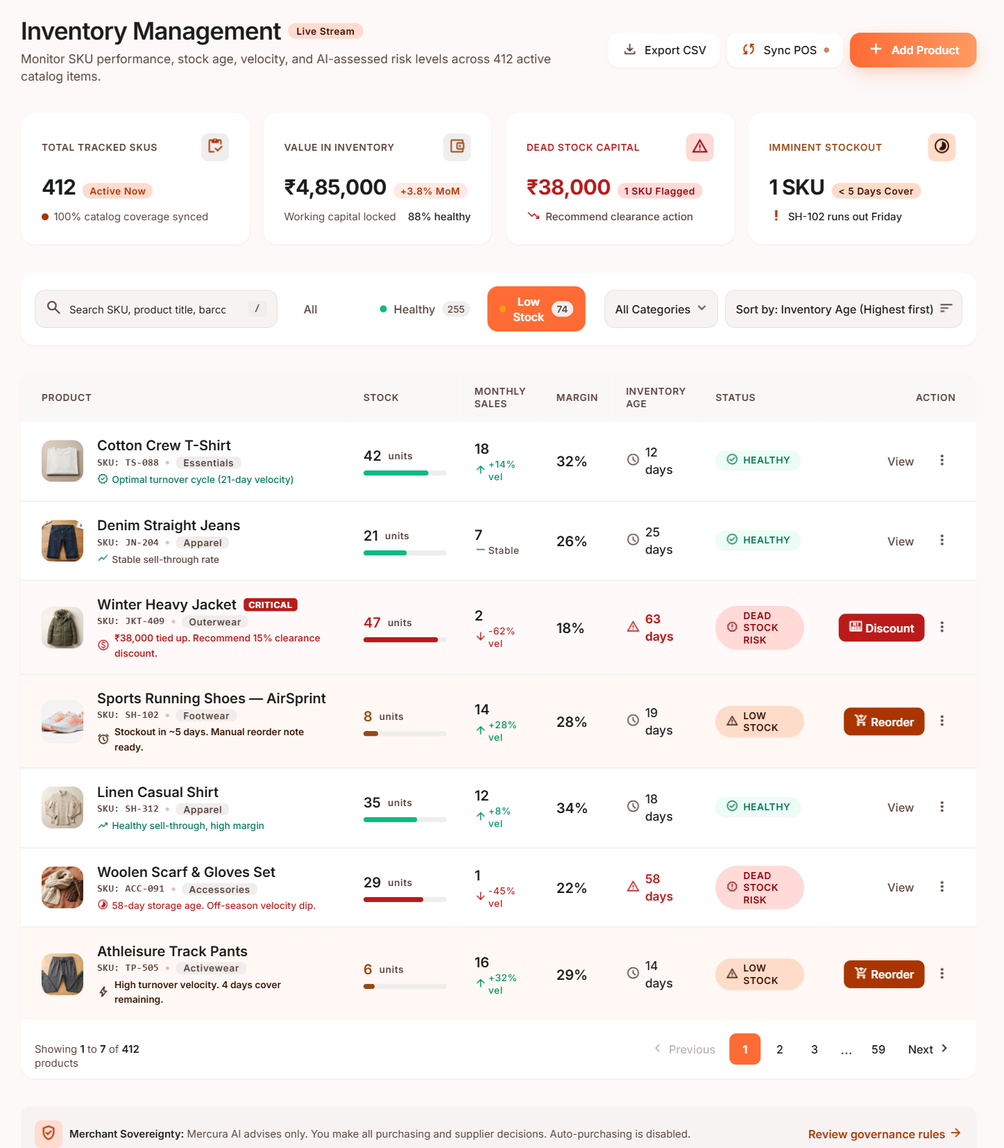
Screenshot – Inventory Dashboard
₹4,85,000 in stock
412 products tracked. 88% of the money is in healthy stock.
₹38,000 is dead stock
The Winter Jacket is 63 days old. The screen says: discount 15%.
1 product runs out soon
Sports Shoes: 8 units left, about 5 days. Reorder button ready.

Slide 14
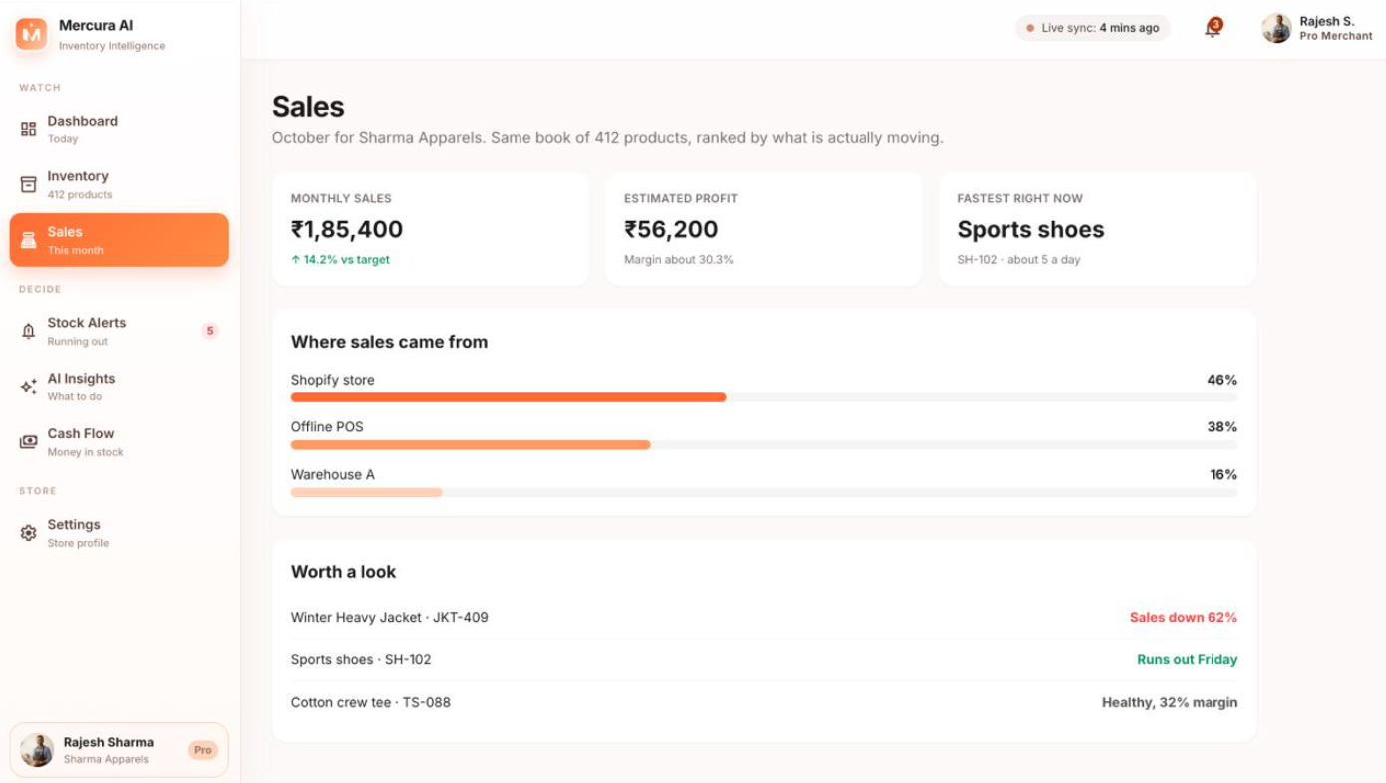
Screenshot – Sales
₹1,85,400 in monthly sales
Sales are currently 14.2% above target, showing strong overall performance.
₹56,200 estimated profit
The business is operating at approximately a 30.3% profit margin.
Sports Shoes are selling fastest
SH-102 is selling at about 5 units per day and may run out by Friday. Consider reordering soon.

Slide 15
Final Demo
Final demo flow
Merchant opens the dashboard. ₹42,000 of risky inventory is detected.
AI explains why, and suggests a discount or a stop on reorder.
Another product is predicted to stock out. AI recommends 40 units.
Merchant approves the supplier order. Cash flow updates.
Outcome: more sales, less dead stock, less wasted cash, fewer stockouts, less manual work, better decisions.

Slide 16
Github Repo Link
https://github.com/aryansingh7877/mercula-Ai

