Slide 1

EXECUTIVE CORPORATE PROFILE &bull; 2026 EDITION
Powering Decisions. Accelerating Clean Energy.
Renewable Asset Management, Nationwide Power Trading, C&I Open Access, Turnkey EPC, and 24/7 ENOC SCADA Telemetry for 1,180+ MW of Clean Energy Assets.
ABHIVANTA ENERGY INTELLIGENCE | Founder & MD: Abhishek Singh | HQ: Pune, Maharashtra, India
Operating Scale: 1,180 MW Managed Fleet &bull; 99.2% Target Availability &bull; Compliance: IEC 61724-1, IEC 61850, NFPA 855

Slide 2
01 / CORPORATE SNAPSHOT
Executive Summary: Integrated Clean Energy & Trading
OUR INTEGRATED VALUE PROPOSITION
ABHIVANTA combines end-to-end technical asset management, nationwide power trading, and C&I open access with high-voltage turnkey EPC and industrial SCADA telemetry, maximizing financial IRR and operational generation for independent power producers across India.
1,180 MW
Operating Assets
Solar, Wind & BESS managed across India
~38%
Tariff Reduction
C&I Open Access savings vs state DISCOMs
325 MWh
Grid BESS Storage
4-hour peak price arbitrage & synthetic inertia
99.2%
Target Availability
Guaranteed by 24/7 Pune ENOC SCADA
ABHIVANTA Energy Intelligence &bull; Confidential &bull; Slide 2 of 12

Slide 3
02 / PROBLEM & OPPORTUNITY
Solving High Tariffs & Operational Leakages
01. High Industrial DISCOM Tariffs
Challenge: Manufacturing & C&I clients pay steep grid tariffs (₹8.50–₹10.50/kWh) with high cross-subsidy surcharges.
Abhivanta Solution: Green Group-Captive & Bilateral Open Access cutting power costs to ₹4.80–₹5.20/kWh (~38% net savings).
02. Curtailment & Power Spillage
Challenge: Midday solar peaks collide with SLDC backdowns, wasting clean generation and merchant revenue.
Abhivanta Solution: Dynamic Power Trading on IEX (DAM/RTM/GDAM) and 325 MWh BESS absorbing midday surplus for peak export.
03. Undetected Inverter & Cell Faults
Challenge: DC ground insulation leaks, fuse blows, and hot-spots go undetected, depressing plant PR by 5%–8%.
Abhivanta Solution: Sub-second string telemetry, drone thermal scanning, and predictive IEC 61724 heat-loss triage.
04. DSM Regulatory Penalties
Challenge: Inaccurate scheduling causes severe Deviation Settlement Mechanism (DSM) fines under CERC/SERC.
Abhivanta Solution: 24/7 ENOC AI scheduling and automated 1-click audit-grade compliance reporting.
ABHIVANTA Energy Intelligence &bull; Confidential &bull; Slide 3 of 12

Slide 4
03 / CAPABILITY MATRIX
Full-Spectrum Renewable & Power Market Offerings
VERTICAL 01
Renewable Asset Management
Technical & financial oversight, AMC/warranty oversight, CERC/SERC DSM scheduling, and ABT smart metering.
VERTICAL 02
Power Trading & Exchange Ops
Inter-state trading, bilateral PPA contracts, energy banking, and IEX market operations (DAM, RTM, GDAM).
VERTICAL 03
C&I Green Open Access
Group-Captive and Third-Party Open Access procurement saving industrial consumers 25%–40% on power costs.
VERTICAL 04
Turnkey Solar & Wind EPC
End-to-end design, single-axis tracker layout, 33kV/220kV pooling substations, and grid tie-in with guaranteed COD.
VERTICAL 05
325 MWh Grid-Forming BESS
Containerized liquid-cooled LFP arrays, sub-second synthetic inertia, frequency response, and peak tariff arbitrage.
VERTICAL 06
24/7 ENOC SCADA Telemetry
IEC 61850 substation Ethernet & Modbus TCP gateways connecting edge RTUs with sub-second polling from Pune ENOC.
VERTICAL 07
Preventive O&M & Robotic Wash
100% waterless dry robotic cleaning fleets, drone IR thermography, and guaranteed 99.2% plant availability.
VERTICAL 08
Agro-PV & Transaction Advisory
Dual-use agricultural solar engineering, Technical Due Diligence (TDD), Lender's Engineer audits, and carbon trading.
ABHIVANTA Energy Intelligence &bull; Confidential &bull; Slide 4 of 12

Slide 5
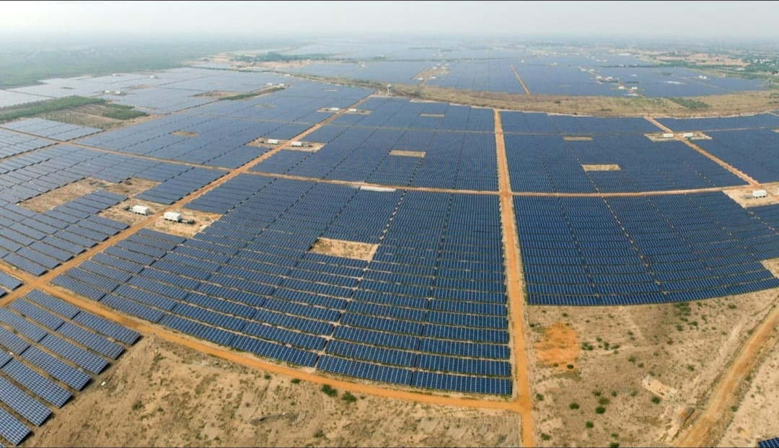
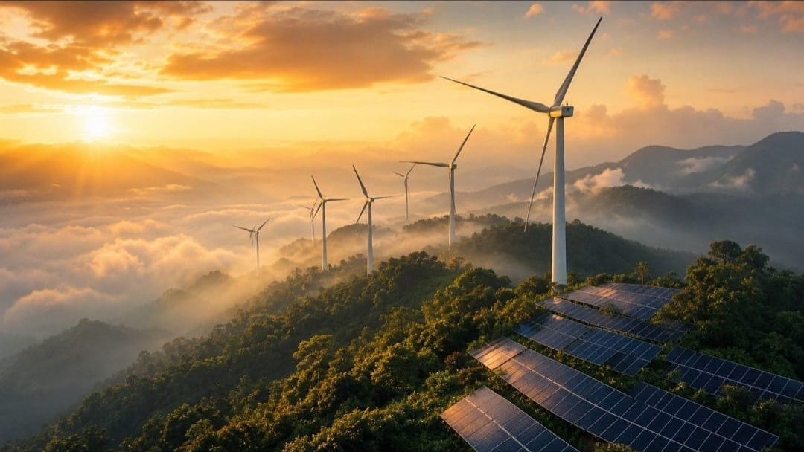
04 / ASSET DEPLOYMENTS (PART 1)
Utility Portfolio: Solar & Wind Infrastructure
Thar Ultra-Mega Solar Park (660 MW)
Location: Bhadla, Rajasthan | Operating PR: 83.1% | Daily: 3,420 MWh
Bifacial monocrystalline TOPCon modules on single-axis trackers with autonomous dry robotic cleaning fleets saving 42M liters of water annually.
Muppandal Pass Wind Corridor (195 MW)
Location: Tamil Nadu High Pass | Fleet CUF: 37.4% | Grid Uptime: 99.1%
120m hub-height direct-drive turbines capturing seasonal high velocities, integrated with active pitch harmonics control.
ABHIVANTA Energy Intelligence &bull; Confidential &bull; Slide 5 of 12

Slide 6
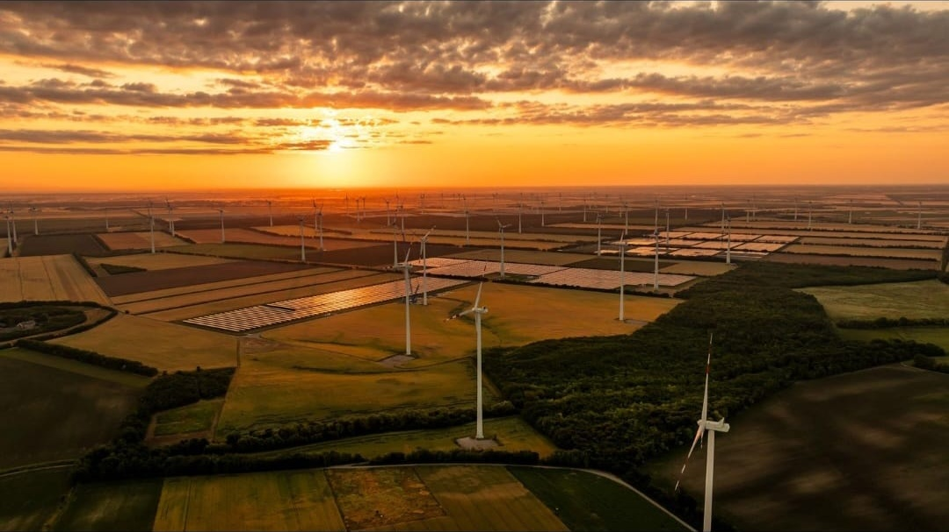
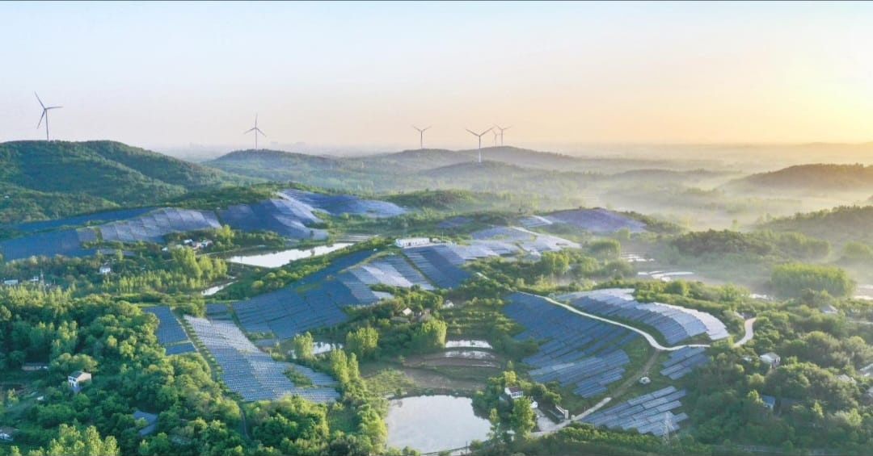
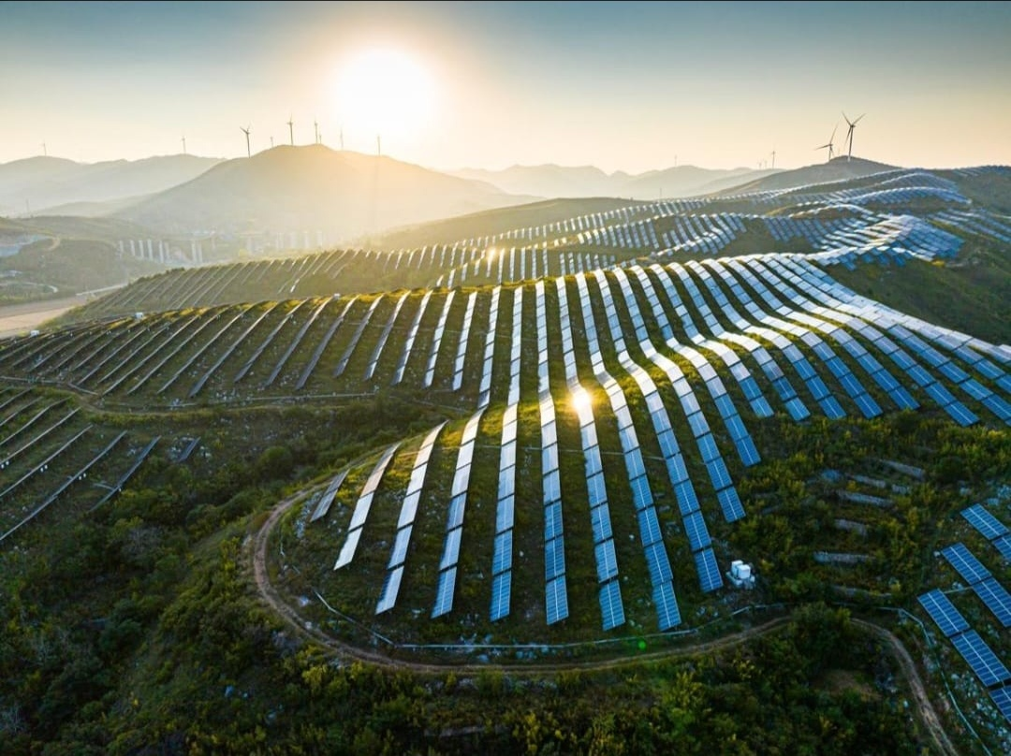
05 / ASSET DEPLOYMENTS (PART 2)
Hybrid Storage, Agro-PV & Mountain Slope Assets
Khavda 325 MWh BESS Storage
Kutch, Gujarat &bull; 92.5% Round-Trip Efficiency
Liquid-cooled containerized LFP storage providing 4-hr peak shaving & IEX arbitrage.
Deccan Agro-PV Ecological Basin
Satara, Maharashtra &bull; 280 MW &bull; +14% Crop Yield
Elevated tracker superstructures combining clean power with sustainable agriculture.
Aravalli Mountain Slope Array
Rajasthan Ridge &bull; 150 MW &bull; 99.4% String Uptime
Terrain-adaptive racking capturing high-altitude solar angles with string MPPT.
ABHIVANTA Energy Intelligence &bull; Confidential &bull; Slide 6 of 12

Slide 7
06 / ARTIFICIAL INTELLIGENCE
Proprietary Intelligence: Abhivanta AI™ Engine
MODULE 01
Computer Vision Optical Diagnostics
Sub-millimeter optical & thermal IR neural net analyzing drone captures for cell microcracks, diode failure, and dust crust severity with 96%+ accuracy.
Result: Pinpoint module replacement before thermal runaway; +4.2% annual generation retention.
MODULE 02
Inverter Degradation & Loss Triage
Physics-informed neural networks continuous modeling IEC 61724 heat losses, IGBT switching degradation, and harmonic distortion.
Result: 48-hour advance warning before inverter bridge failure; 0 unscheduled inverter outages.
MODULE 03
Autonomous BESS Arbitrage Algorithm
Reinforcement learning dispatch optimizer predicting Indian Energy Exchange (IEX) market clearing prices (DAM/RTM).
Result: Daytime solar charging and evening peak dispatch yielding +14.6% merchant power revenue.
ABHIVANTA Energy Intelligence &bull; Confidential &bull; Slide 7 of 12

Slide 8
07 / TELEMETRY ARCHITECTURE
24/7 Central ENOC SCADA Command Architecture
Step 1: Edge Acquisition
Industrial edge gateways & Modbus RTUs capture sub-second string voltages, tracker positions, pyranometers, and inverter telemetry.
Step 2: Encrypted Pipeline
TLS 1.3 industrial VPN channels stream encrypted sensor packets to Abhivanta's central telemetry data lake under IEC 61850.
Step 3: Neural Processing
The AI Engine triages incoming alarms, checks degradation thresholds, and calculates plant-specific PR and CUF in real-time.
Step 4: Automated Action
Immediate sub-second dispatch to local O&M field crews, robotic cleaner launch, or automated SLDC regulatory dispatch logging.
CENTRAL ENOC COMMAND FACILITY &bull; PUNE, MAHARASHTRA
&bull; Sub-Second Latency: 250ms average edge-to-screen response across nationwide facilities.
&bull; Automated PDF Reporting: Daily, weekly & monthly audit packages delivered to IPP asset managers at 06:00 IST.
&bull; Tier-4 High Availability: Redundant server infrastructure with 99.99% uptime guarantee.
ABHIVANTA Energy Intelligence &bull; Confidential &bull; Slide 8 of 12

Slide 9
08 / POWER PROCUREMENT
Power Trading & C&I Green Open Access Economics
STRUCTURE 01
Group-Captive Model
26% Equity &bull; 51% Consumption
Full exemption from Cross-Subsidy Surcharge (CSS) and Additional Surcharge. Cuts industrial tariffs from ₹8.50 to ₹4.80–₹5.20/kWh (~38% net savings).
STRUCTURE 02
Third-Party Open Access
Bilateral PPA Contracts
Short-to-medium term green power procurement with zero capital investment required from industrial off-takers. Fast 60-day onboarding.
STRUCTURE 03
Power Exchange Trading
IEX / PXIL Exchange Operations
Dynamic market procurement across Day-Ahead (DAM), Real-Time (RTM), and Green Day-Ahead (GDAM) markets capturing lowest clearing price blocks.
ABHIVANTA Energy Intelligence &bull; Confidential &bull; Slide 9 of 12

Slide 10
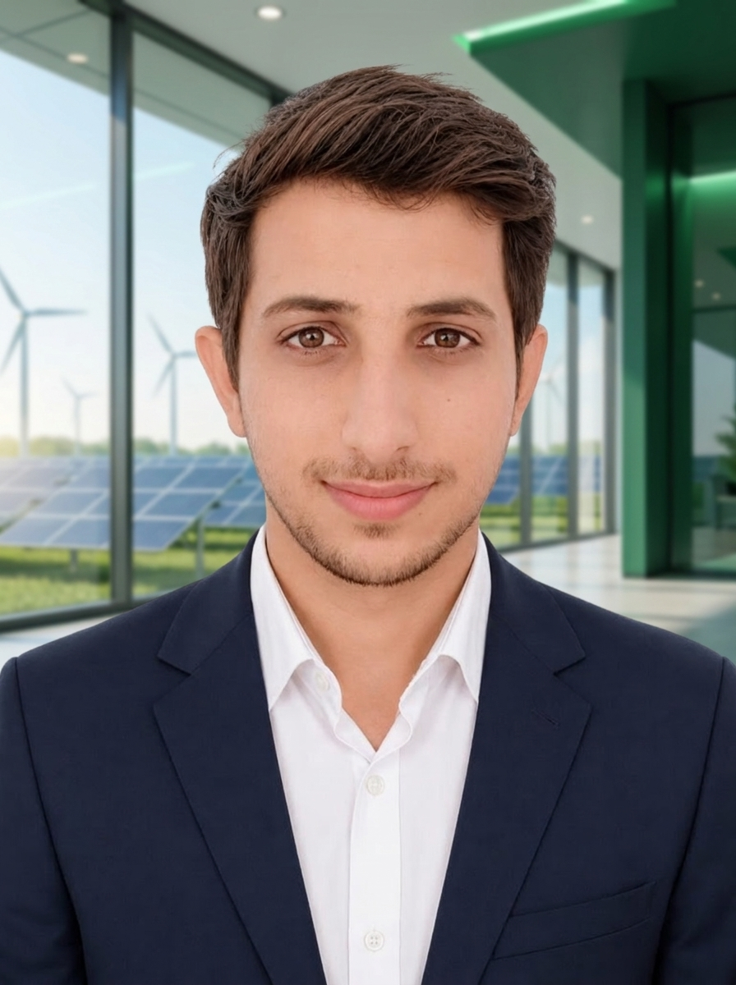
09 / LEADERSHIP & GOVERNANCE
Leadership: Driving Technological Excellence
Abhishek Singh
Founder, Managing Director & Chief System Architect
As the visionary behind ABHIVANTA, Abhishek Singh has spearheaded the engineering and operations of over 1,180 MW of utility solar PV, wind, and BESS capacity across India. Combining electrical power systems expertise with cutting-edge software telemetry, Abhishek has established Abhivanta as a trusted technology partner for tier-1 clean energy developers.
"Data without automated action is just noise. At Abhivanta, our mission is turning sub-second inverter telemetry and AI forecasting into guaranteed clean plant availability."
Core Specializations: Power Trading & Open Access &bull; High-Voltage Substation Engineering &bull; Industrial SCADA Telemetry &bull; Machine Learning Plant Diagnostics
ABHIVANTA Energy Intelligence &bull; Confidential &bull; Slide 10 of 12

Slide 11
10 / COMMERCIAL MODELS
Commercial Engagement Frameworks
MODEL 01
Turnkey EPC & Development
Complete lump-sum turnkey EPC build from groundbreaking to 220kV grid synchronization.
&bull; Guaranteed Commercial Operation Date (COD)
&bull; Fixed-price turnkey delivery
&bull; Tier-1 equipment procurement guarantee
&bull; Performance Ratio guarantee during handover
MODEL 02
Comprehensive Asset Mgmt & O&M
Full technical, financial, and operational asset management supervised by 24/7 ENOC.
&bull; Guaranteed 99.0%+ annual plant availability
&bull; Waterless autonomous robotic cleaning
&bull; CERC/SERC DSM scheduling & compliance
&bull; Sub-1 hour emergency on-site triage response
MODEL 03
Power Trading & Open Access PPA
Clean energy procurement and market advisory for C&I consumers and IPPs.
&bull; Group-Captive structuring (zero CSS)
&bull; IEX exchange operations (DAM/RTM/GDAM)
&bull; Renewable Energy Certificates (RECs)
&bull; Automated tariff billing & carbon accounting
ABHIVANTA Energy Intelligence &bull; Confidential &bull; Slide 11 of 12

Slide 12
11 / GET IN TOUCH
Partner with ABHIVANTA Energy Intelligence
Let's Accelerate India's Clean Energy Future Together
Whether you are seeking full-scope technical asset management, looking to procure cheaper green power via open access, deploying turnkey utility solar/wind infrastructure, or integrating grid-forming BESS storage, ABHIVANTA delivers the technology, engineering precision, and operational excellence your balance sheet demands.
CORPORATE HEADQUARTERS
Abhivanta Green Tower, High-Tech City
Pune, Maharashtra 411057, India
DIRECT ENQUIRIES & TENDERS
contact@abhivanta-energy.in
epc.tenders@abhivanta-energy.in
24/7 ENOC Desk: enoc@abhivanta-energy.in
DIGITAL PLATFORM & LIVE SCADA
Website: www.abhivanta-energy.in
Fleet Dashboard: www.abhivanta-energy.in/dashboard.html
ABHIVANTA Energy Intelligence &bull; Confidential &bull; Slide 12 of 12

