Slide 1
Task-Constrained Workspace & Inverse Kinematics
for Surface-Tracing with the myCobot 280
A detailed study — where, how, and with what posture a 6-DOF arm can draw

Slide 2
Motivation
Two questions from the drawing project
• Reaching a point ≠ reaching it with the pen perpendicular to the surface
• Q1: which pen directions are feasible where? (front vs behind)
• Q2: can it trace on any surface anywhere — incl. a horizontal table?
• Thesis: the reachable and the DRAWABLE workspaces are different sets

Slide 3
Contributions
• A verified modified-DH model + velocity-propagation Jacobian
• A map of the task-constrained (drawable) workspace, vertical & horizontal
• A comparison of four inverse-kinematics solvers
• Manipulability / conditioning maps explaining the drawable region
• Redundancy resolution: same pen path, chosen arm posture
• Live ROS 2 / RViz demonstrations

Slide 4
Kinematic Model — Modified (Craig) DH
Verified to ~1e-15 m vs the URDF
• Link transform: Aᵢ = Rotx(αᵢ₋₁)·Transx(aᵢ₋₁)·Rotz(θᵢ)·Transz(dᵢ)
• Base-to-tool: T = A₁A₂A₃A₄A₅A₆
• DH table identified by fitting to the URDF (machine-precision match)
• αᵢ₋₁ link twist · aᵢ₋₁ link length · dᵢ offset · θᵢ joint angle

Slide 5
Jacobian & Dexterity Metrics
Velocity-propagation method
• Column i: Jᵢ = [ zᵢ × (pₑ − pᵢ) ; zᵢ ] (verified vs finite diff 2.5e-7)
• Twist: [v; ω] = J(q)·q̇
• Manipulability: w = √det(Jᵥ Jᵥᵀ) (0 at a singularity)
• Condition number: κ = σ_max / σ_min (1 = isotropic)

Slide 6
Task-Constrained Workspace — Definition
• Reachable set R = positions attainable within joint limits
• Drawable set D(n) = positions reachable with pen axis ẑ = ±n (surface normal)
• Estimated by testing DLS IK convergence with the perpendicular-pen constraint
• Key idea: D(n) ⊂ R, and the gap depends on the surface orientation

Slide 7
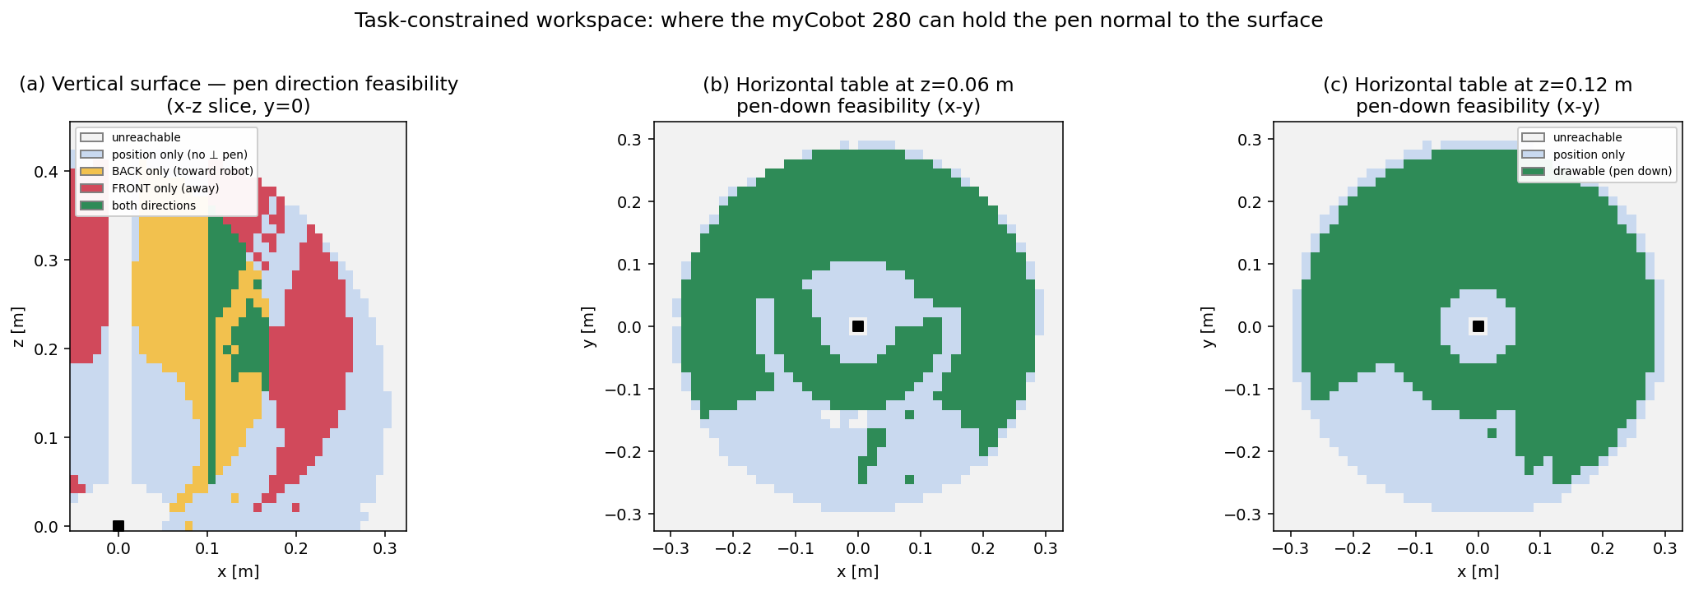
Feasibility Results
Where the pen can be held normal to the surface
• Vertical: 57.9% of R allows a ⊥ pen; only 35.2% front-facing
• Near base → only BACK; outer region → FRONT opens up
• Horizontal table: 63.5% drawable pen-down — an ANNULUS
• Dead zone directly above the base (wrist can't point straight down)

Slide 8
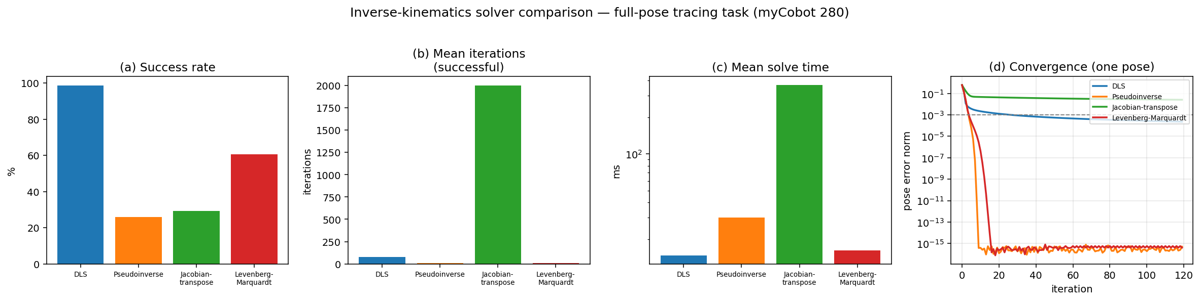
Inverse-Kinematics Comparison
Four Jacobian-based solvers
• Damped least squares: 98.7% success — most robust
• Pseudoinverse / Levenberg–Marquardt: quadratic but brittle near singularities
• Jacobian-transpose: always progresses, ~25× slower
• → DLS is the right default for surface tracing

Slide 9
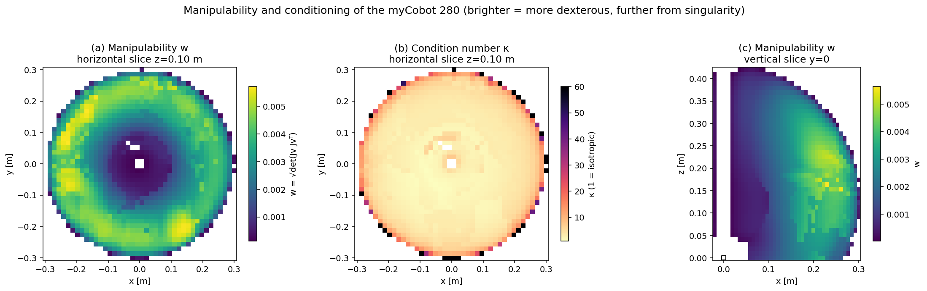
Manipulability & Conditioning
Why the drawable region has its shape
• Low-manipulability dead zone directly above the base
• Bright dexterous RING at mid-radius — best drawing region
• Condition number rises toward the workspace boundary
• The drawable annulus = the high-w, low-κ ring

Slide 10
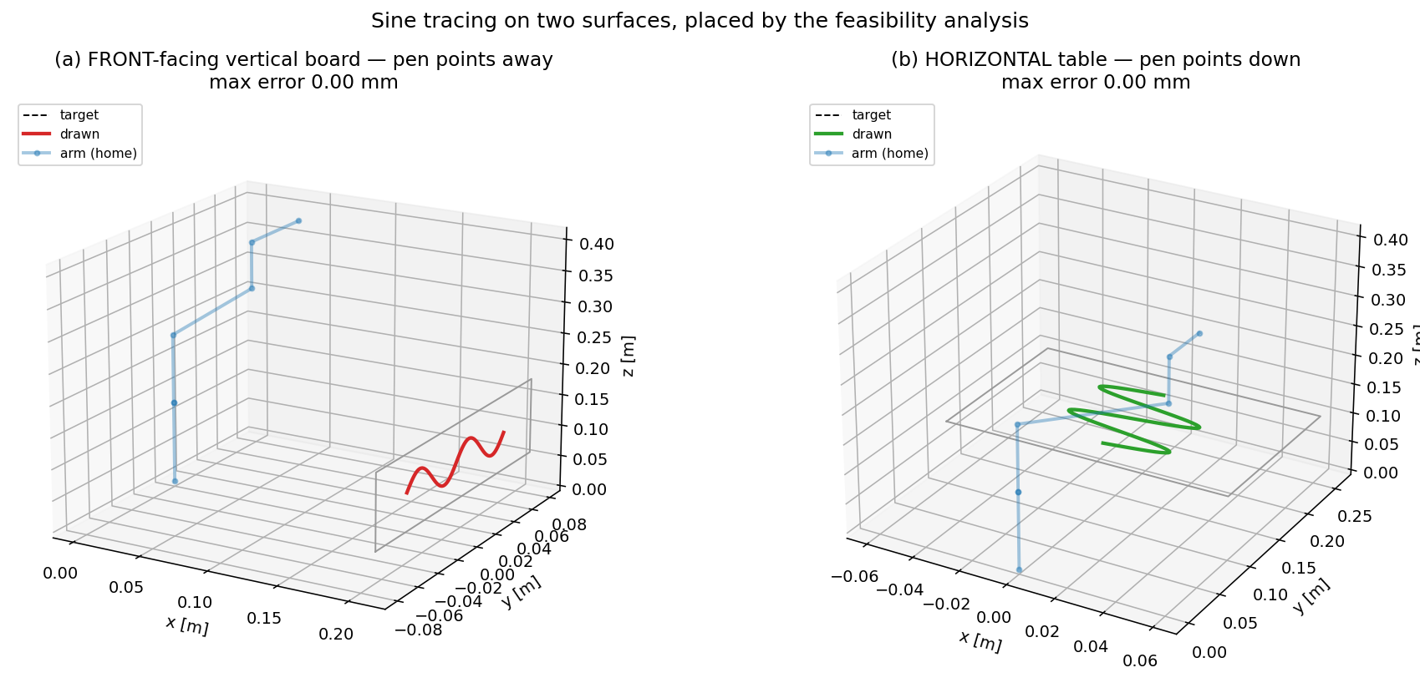
Demonstrations
Sine tracing on two surfaces (0.000 mm)
• Placements chosen from the feasibility & manipulability maps
• Front-facing vertical board — pen points away from the robot
• Horizontal table — pen points down, in the dexterous ring

Slide 11
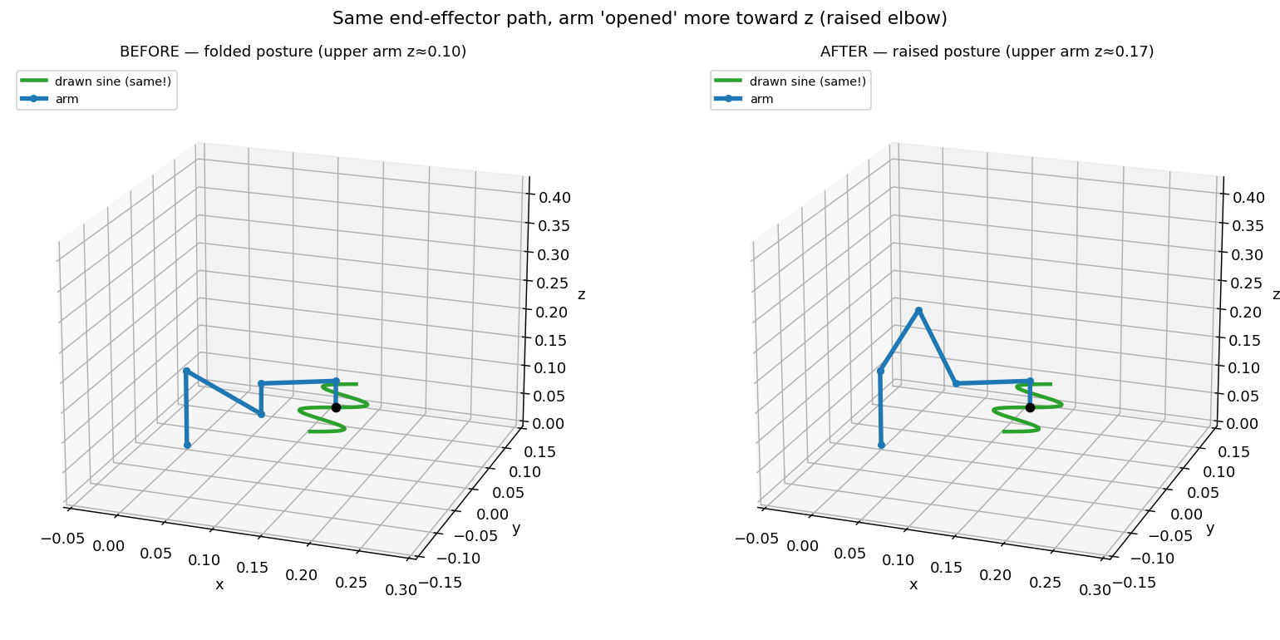
Redundancy — Same Path, Chosen Posture
Same end-effector, arm 'opened' toward z
• The 6-DOF arm reaches the same pen poses with different postures (IK branches)
• We select a RAISED (elbow-up) branch: upper arm 0.10 m → 0.17 m
• End-effector traces the IDENTICAL sine (EE z = 0.100 m unchanged)
• Smooth along the path (max 3°/frame, no posture jumps)

Slide 12
Conclusions & Future Work
• Reachable ≠ drawable; the gap depends on the surface normal
• Vertical 57.9% / horizontal 63.5% drawable; feasibility ↔ manipulability ring
• DLS is the most robust IK; redundancy sets the posture
• Next: tilted surfaces, manipulability-optimal drawing, real robot + Gazebo

Slide 13
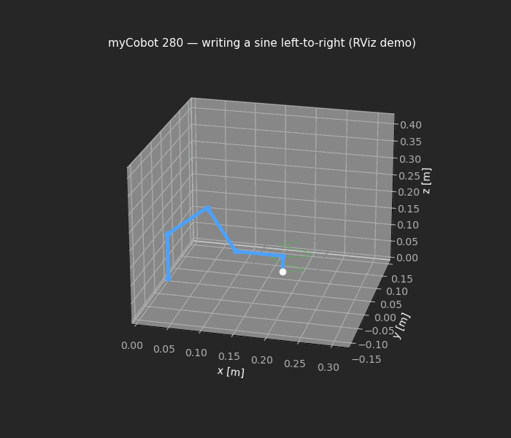
Live Demonstration — Writing Left-to-Right
ROS 2 / RViz (animation plays in slideshow)
• The locked 'paper' demo: front table, raised posture, left-to-right sine
• Command: ros2 launch mycobot_thesis thesis_draw.launch.py surface:=paper

