Slide 1
Task-Constrained Workspace & Inverse Kinematics
for Surface-Tracing with the myCobot 280
Where — and how well — can a 6-DOF arm draw on a surface?
Notes:
Open with the core idea: reaching a point is not enough — the tool must be held normal to the surface, and that shrinks the usable workspace.

Slide 2
Motivation
Two questions from the drawing project
• Reaching a point ≠ reaching it with the pen perpendicular to the surface
• Q1: which pen directions are feasible where? (front vs behind)
• Q2: can it trace on any surface anywhere — incl. a horizontal table?
• Thesis: the reachable and the DRAWABLE workspaces are different sets
Notes:
These two questions came from the myCobot drawing project and turn out to be a real research problem about task-constrained workspaces.

Slide 3
Kinematic Model
Modified-DH, verified to 1e-15 m
• Modified (Craig) DH: link transform Aᵢ = Rotx(α)·Transx(a)·Rotz(θ)·Transz(d)
• DH table identified from the URDF; FK matches URDF to ~1e-15 m
• Velocity-propagation Jacobian: Jᵢ = [ zᵢ×(pₑ−pᵢ) ; zᵢ ], verified 2.5e-7
• Dexterity: manipulability w=√det(Jv Jvᵀ), condition number κ
Notes:
Emphasize the model is verified, not assumed — FK matches the manufacturer model to machine precision.

Slide 4
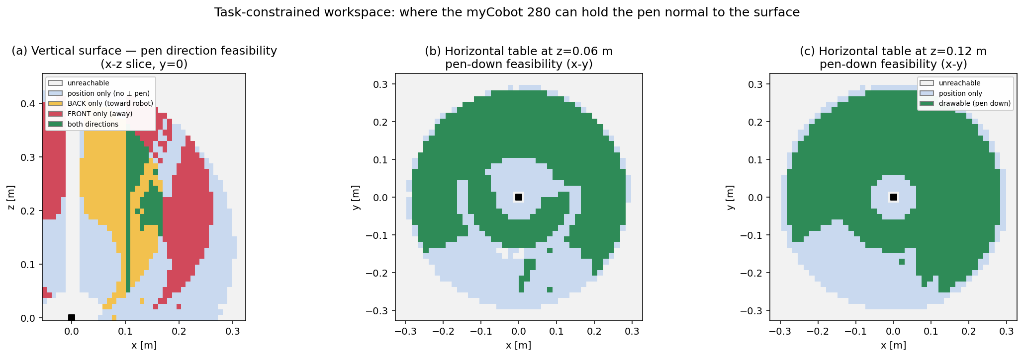
Task-Constrained Workspace — Results
Where the pen can be held normal to the surface
• Vertical: only 57.9% of reachable space allows a ⊥ pen; 35.2% front-facing
• Near the base only BACK works; FRONT opens up in the outer region
• Horizontal table: 63.5% drawable pen-down — an ANNULUS (dead zone above base)
Notes:
Panel (a): yellow = back-only near base, red = front-only farther out — that's the answer to the front/back question. Panels (b,c): the drawable ring on a table.

Slide 5
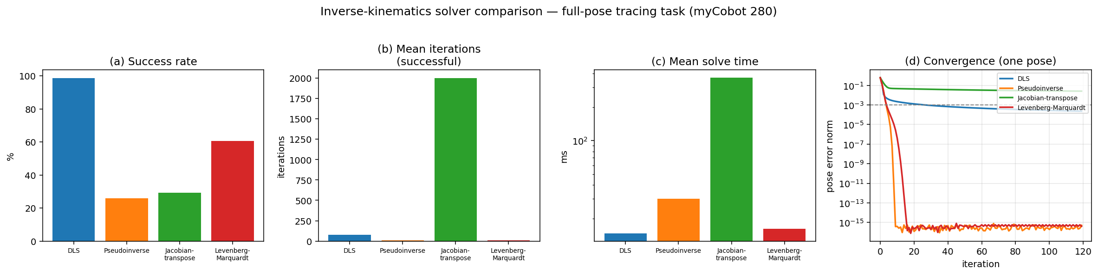
Inverse-Kinematics Comparison
Four Jacobian-based solvers on the tracing task
• Damped least squares: 98.7% success — most robust (damping caps accuracy)
• Pseudoinverse / Levenberg–Marquardt: quadratic but brittle near singularities
• Jacobian-transpose: always progresses, but ~25× slower
• → DLS is the right default for well-seeded surface tracing
Notes:
Panel (d) shows convergence rate on a good pose; the bars show robustness. The story is accuracy vs robustness — DLS wins on robustness.

Slide 6
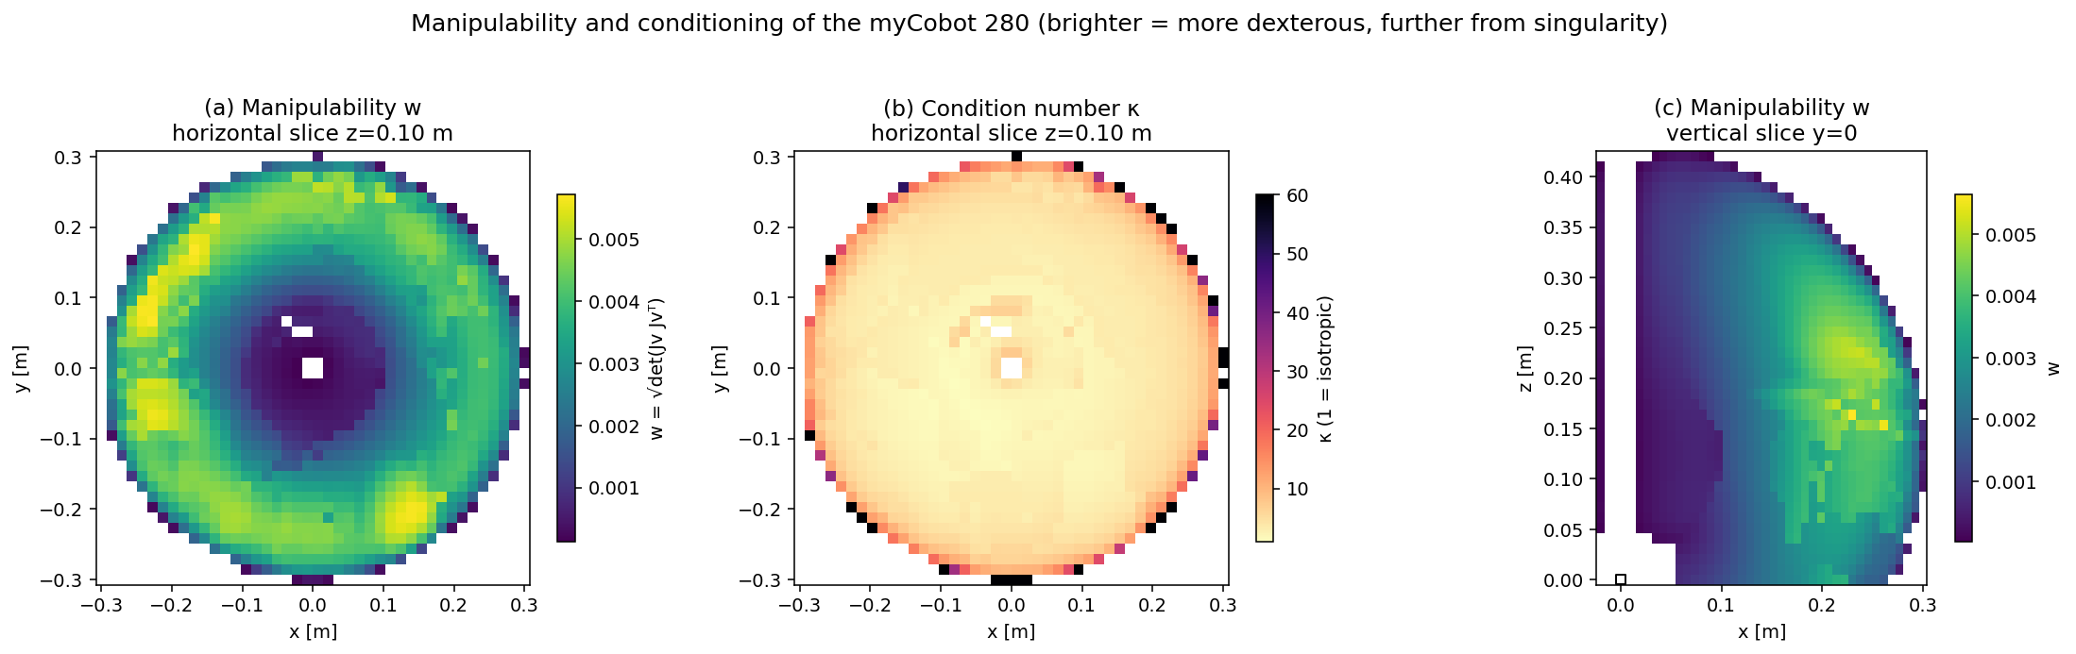
Manipulability & Conditioning
Why the drawable region has its shape
• Low-manipulability 'dead zone' directly above the base
• Bright dexterous RING at mid-radius — best place to draw
• Condition number rises toward the workspace boundary (near-singular)
• The drawable annulus coincides with the high-w, low-κ ring
Notes:
This explains the annulus in the feasibility map: feasibility and good conditioning are geometrically the same region.

Slide 7
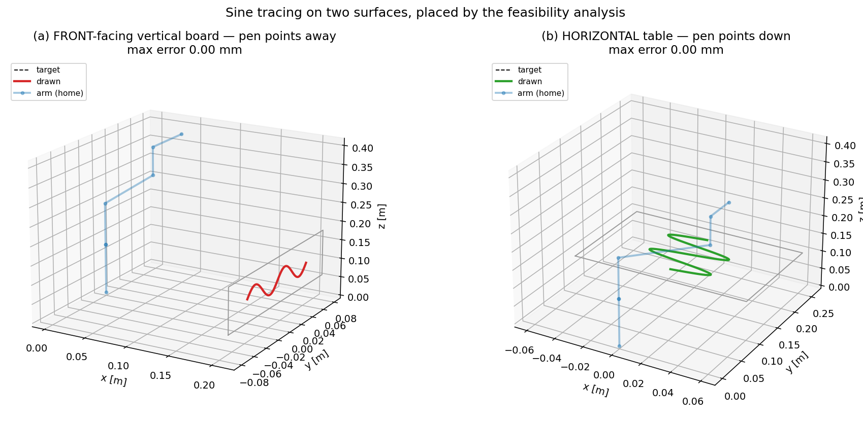
Demonstrations
Sine tracing on two surfaces (0.000 mm)
• Placements chosen using the feasibility & manipulability maps
• (a) FRONT-facing vertical board — pen points away from the robot
• (b) HORIZONTAL table — pen points down, in the dexterous ring
• Both track the target to 0.000 mm
Notes:
The maps predict where clean drawing is possible; these demos confirm it, including the front-facing and the horizontal cases.

Slide 8
Conclusions & Future Work
• Reachable ≠ drawable; the gap depends on the surface normal
• Vertical 57.9% / horizontal 63.5% drawable; feasibility ↔ manipulability ring
• DLS is the most robust IK for the task
• Next: tilted surfaces, redundancy for manipulability-optimal drawing, real robot + Gazebo
Notes:
Close on the contribution: a method to map the drawable workspace and place drawing tasks where they succeed.

