Slide 1
ARM-450 rev I.1 -- kinematics
DH table, forward and inverse kinematics, Jacobian, workspace -- in my convention:
Modified (Craig) DH + velocity-propagation Jacobian (after the myCobot 280 thesis and Rsine)
Geometry from the rev I.1 CAD: d1 = 90, a2 = 119, d4 = 221.369, d_T = 88.089 mm; spherical wrist
FK = CAD to 2.98e-13 mm, = URDF to 2.55e-13 mm (2000 poses)
Closed-form IK: 8 branches, exact, 0.2 ms; numerical solvers compared
Pen straight down impossible (172.5 deg of pitch) -> tilted pen on the table; vertical board works
Notes:
Motivation: same method as the myCobot thesis, applied to the arm I designed and printed.

Slide 2
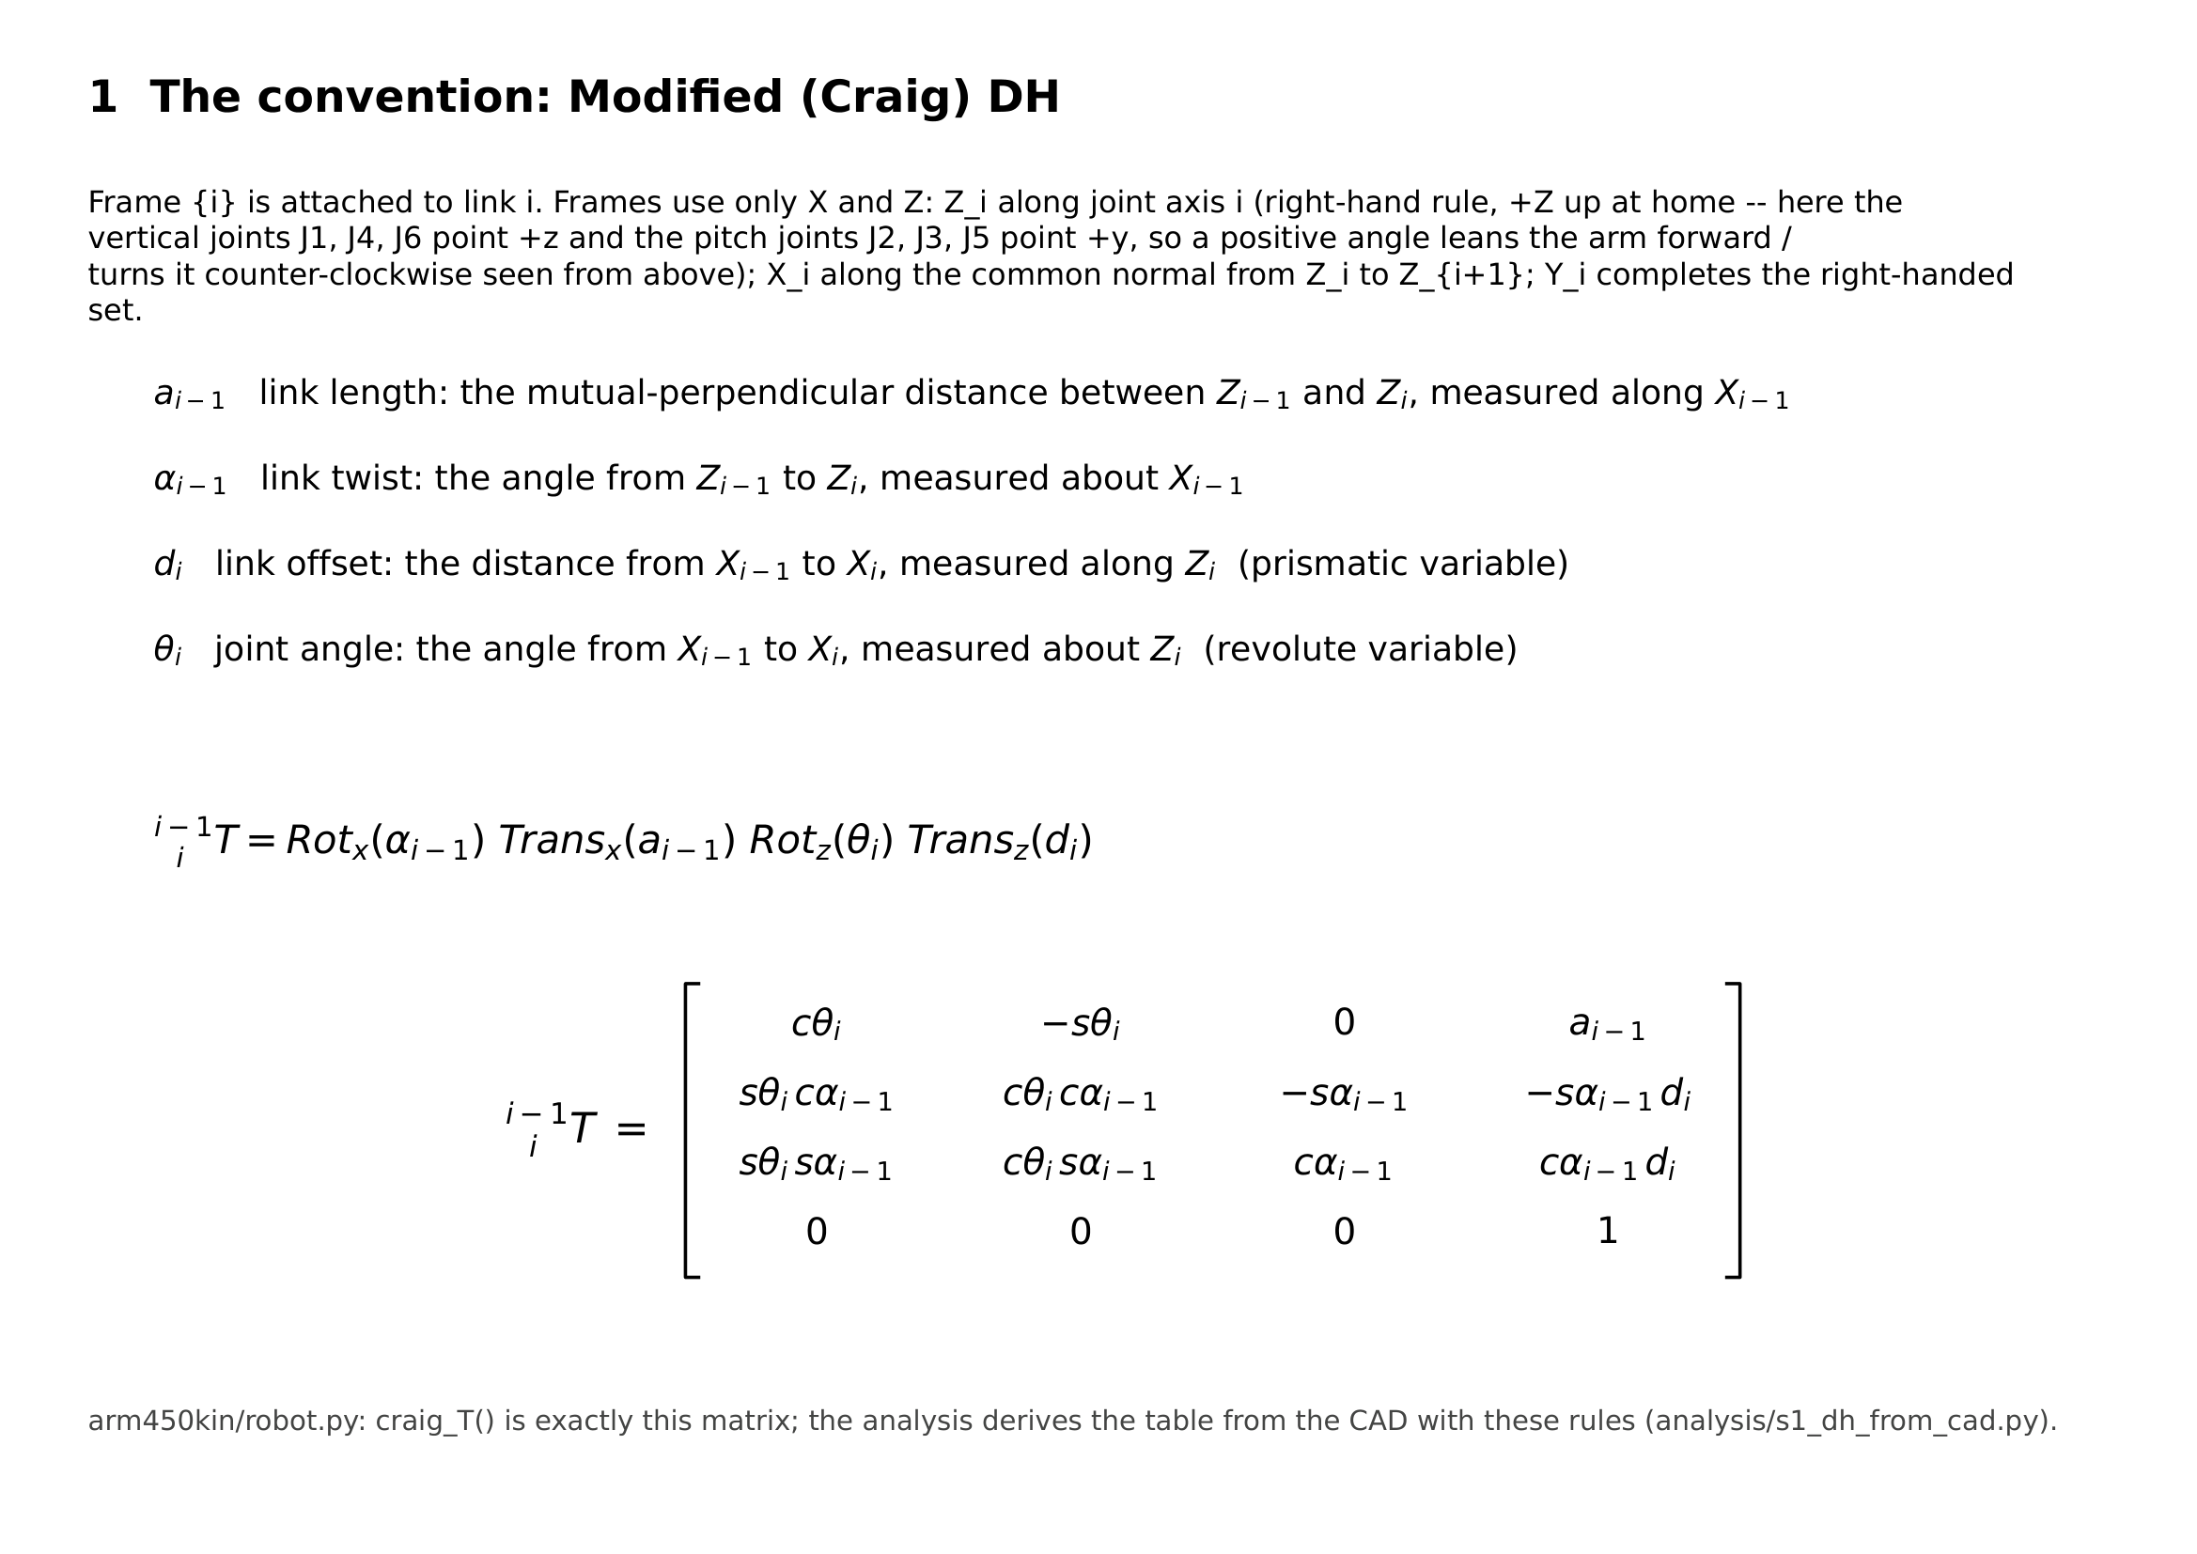
My convention: Modified (Craig) DH
Notes:
Frame i on link i; a and alpha measured along/about X_{i-1}; d and theta along/about Z_i.

Slide 3
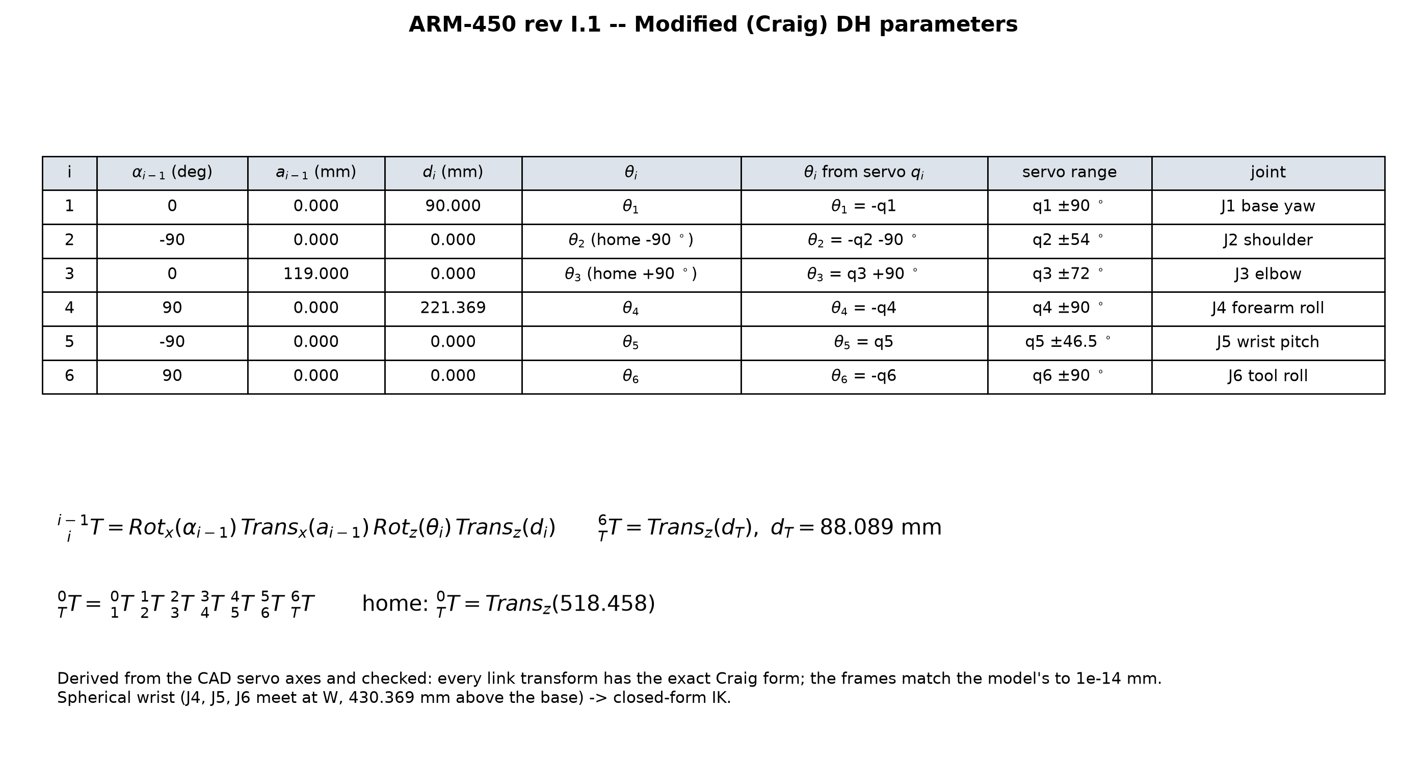
DH table (derived from the CAD servo axes)
Notes:
Every link transform read back from frames built by the rules; exact Craig form; matches the model to 1e-14 mm.

Slide 4
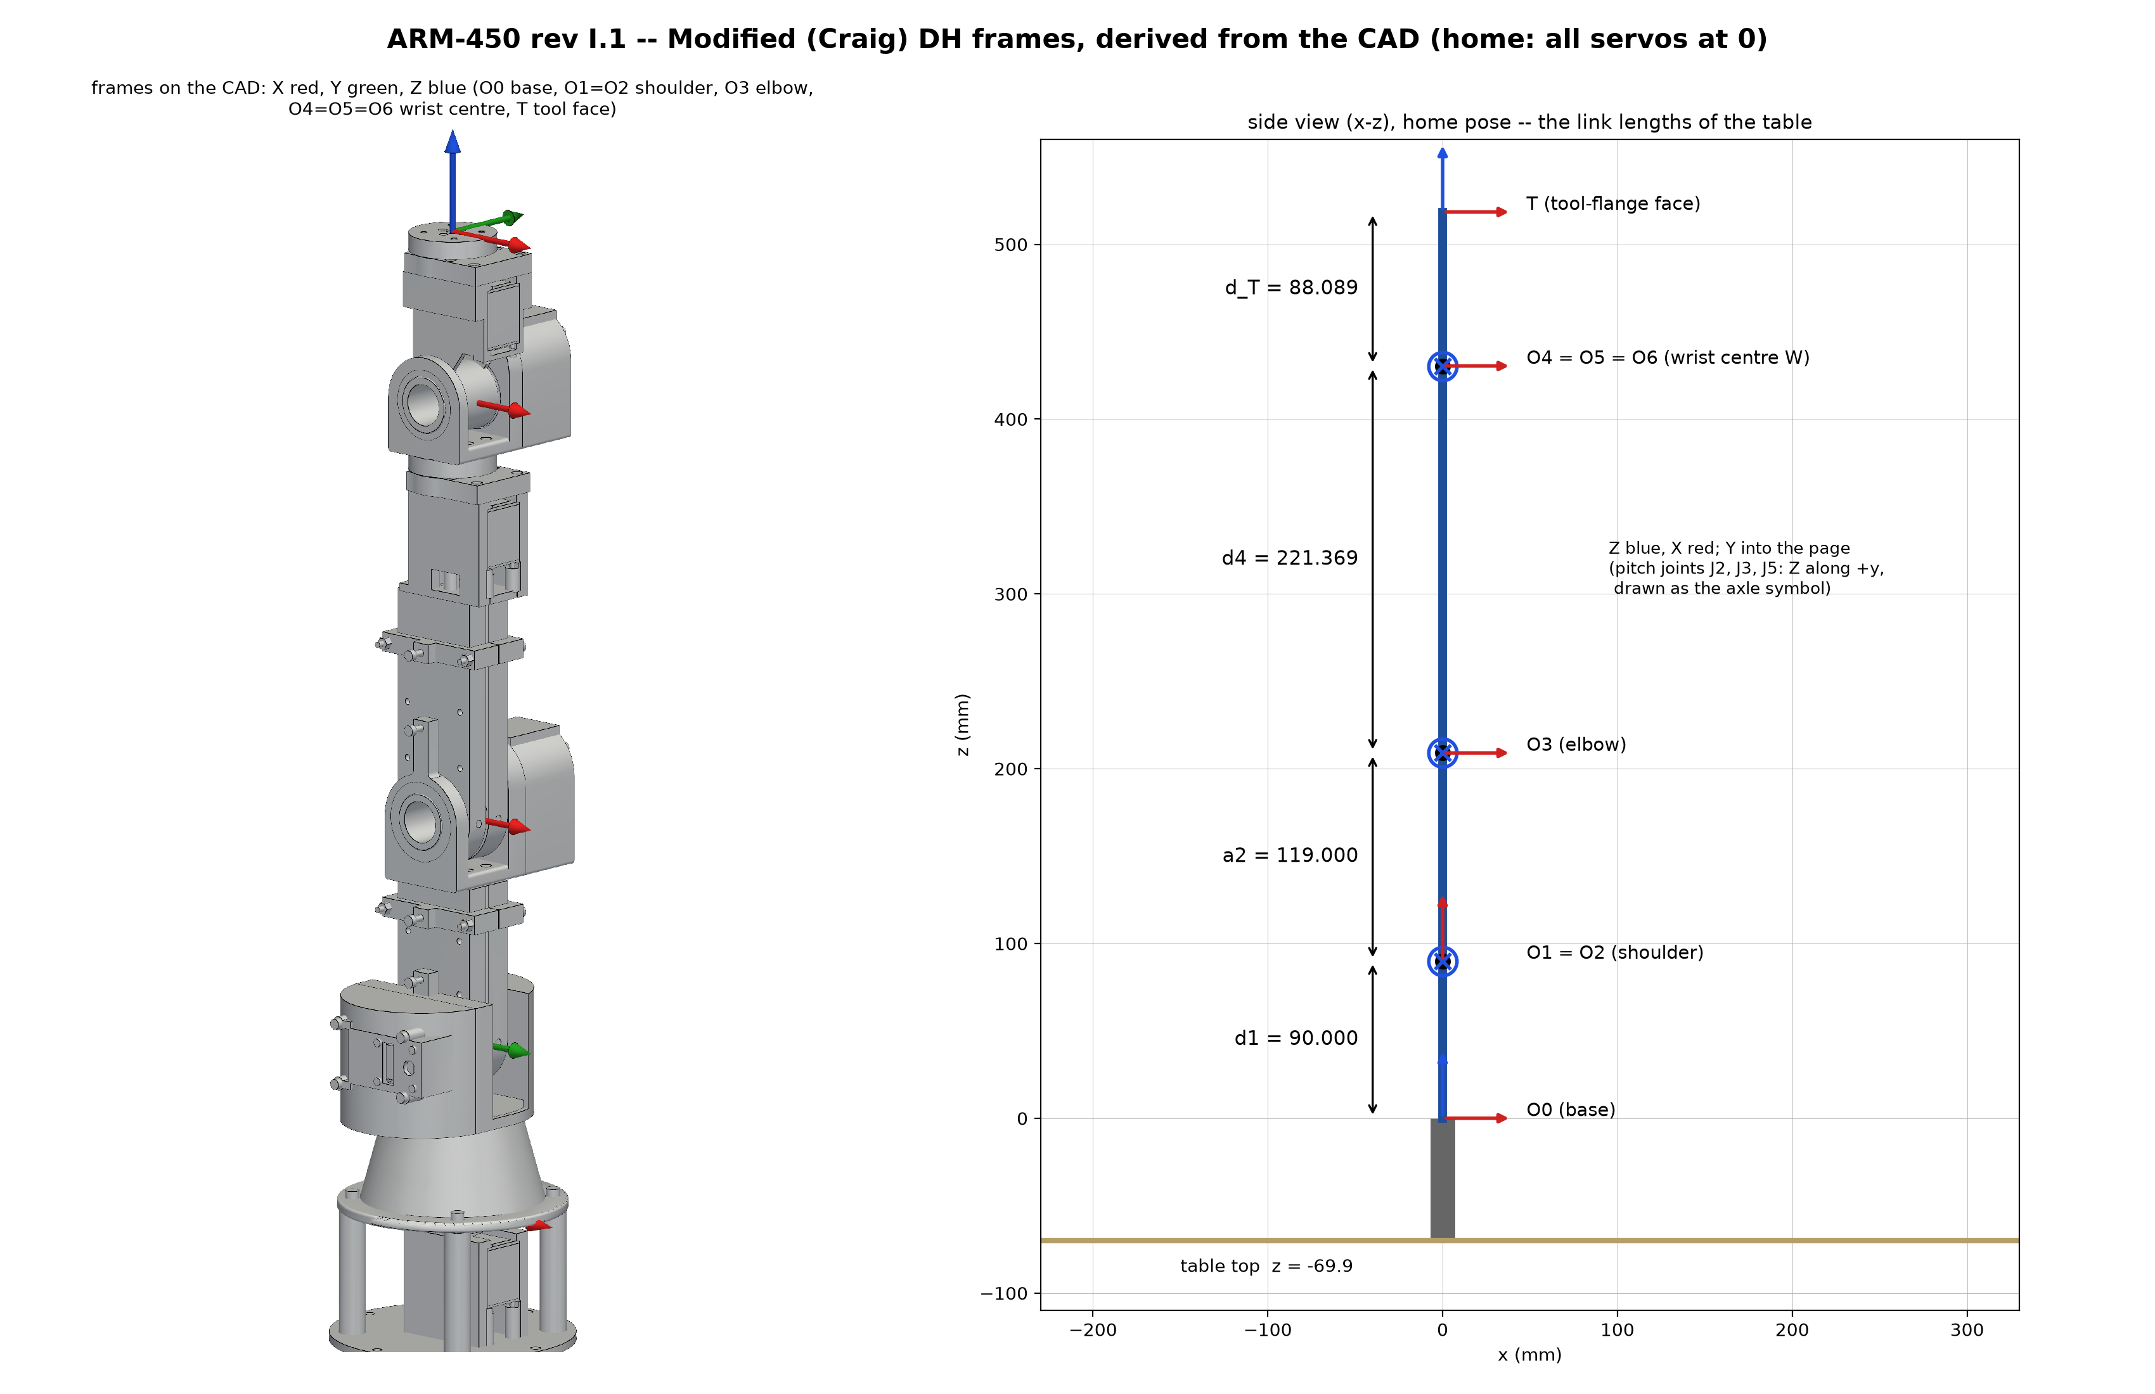
Frames and link lengths
Notes:
d4 = 221.369 is elbow to wrist centre: the wrist centre is where J4, J5, J6 meet.

Slide 5
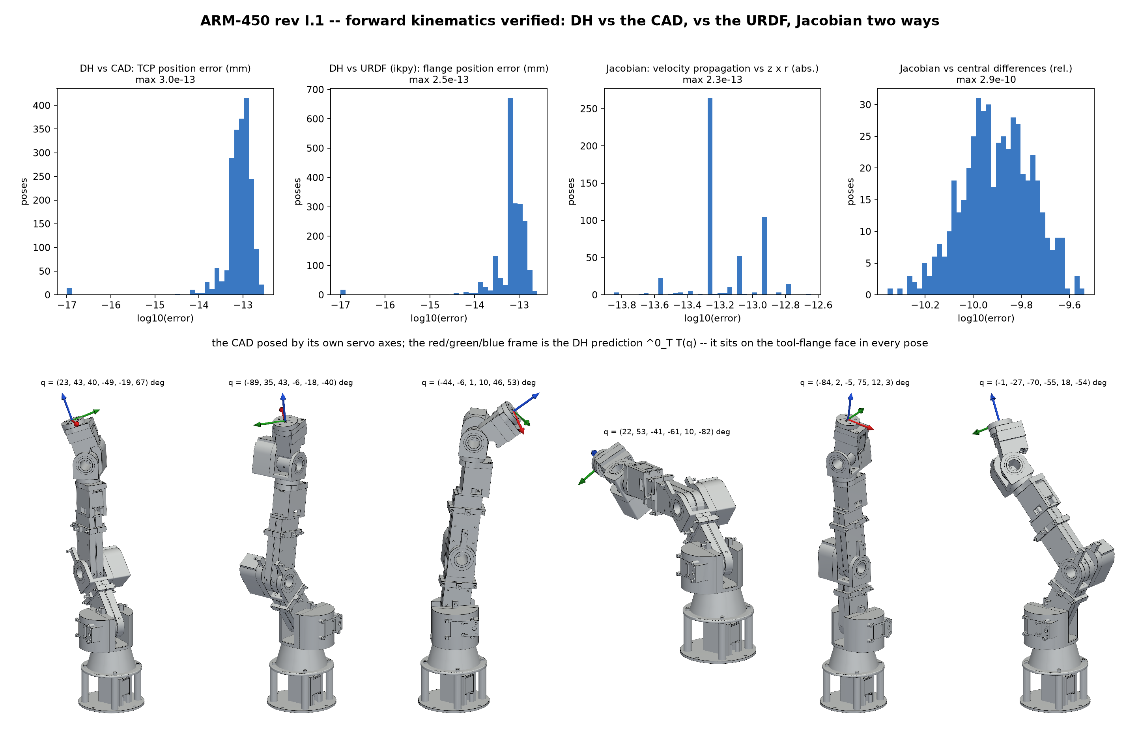
Forward kinematics -- verified three ways
Notes:
CAD by product of exponentials of the measured servo axes; URDF through ikpy; Jacobian vs z x r and finite differences.

Slide 6
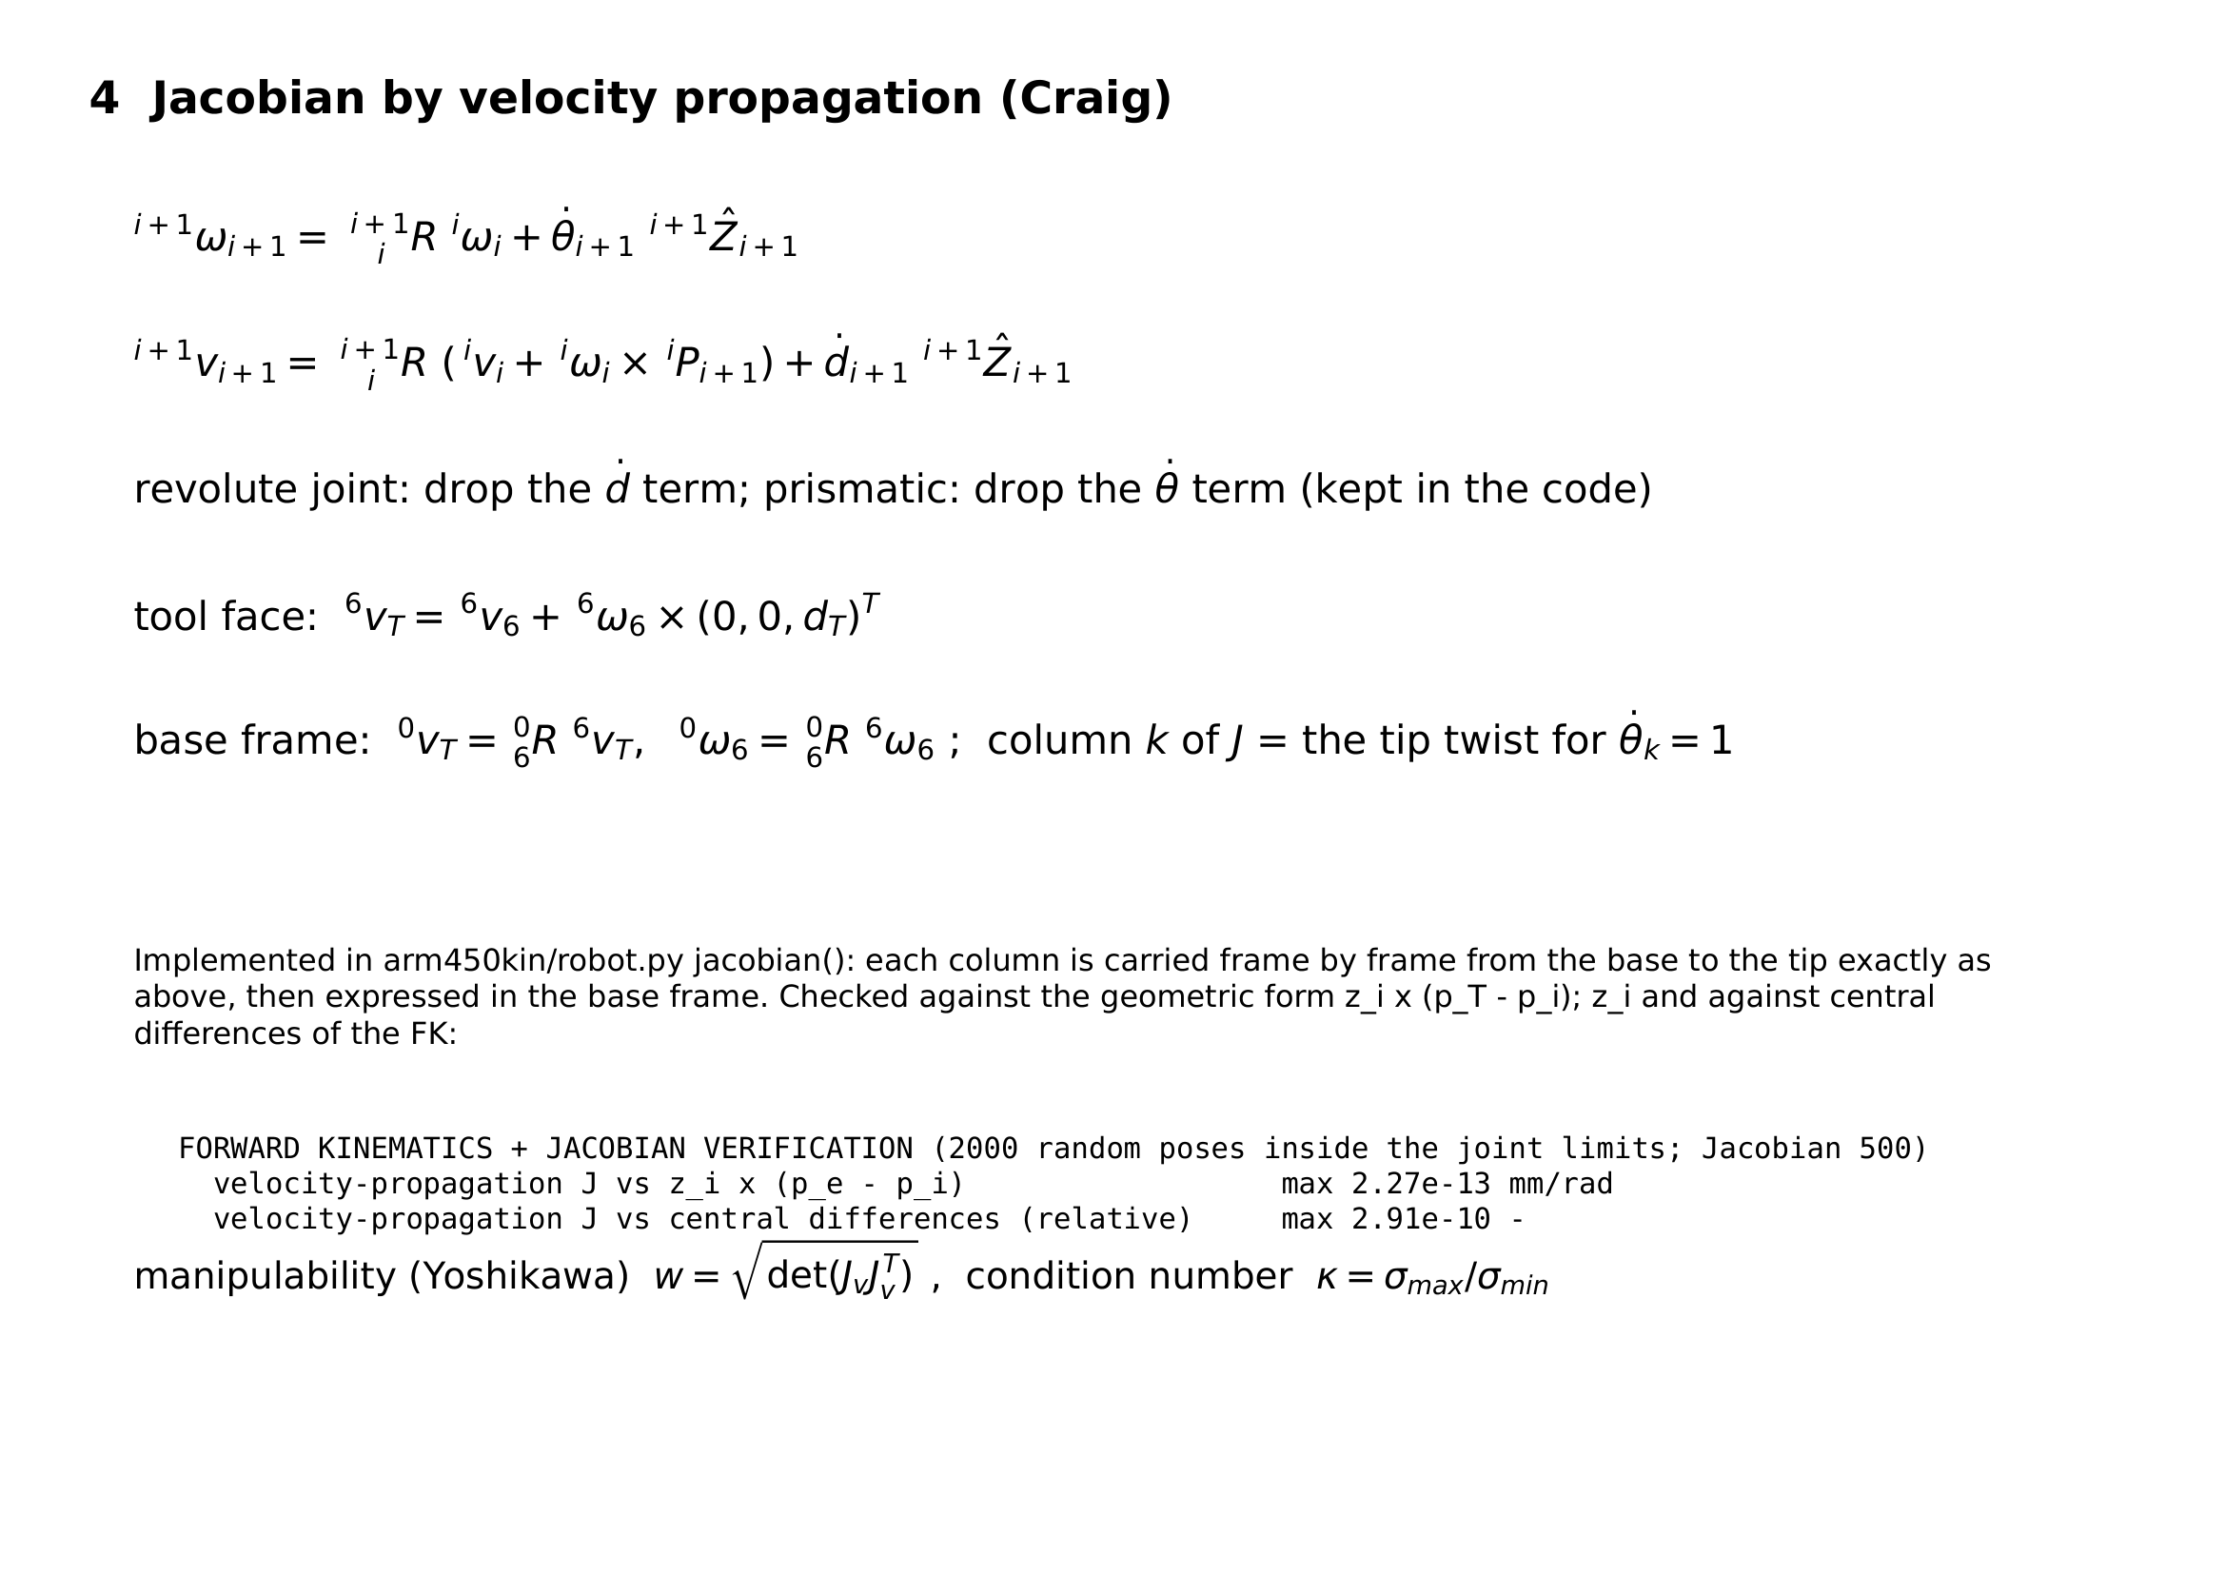
Jacobian by velocity propagation

Slide 7
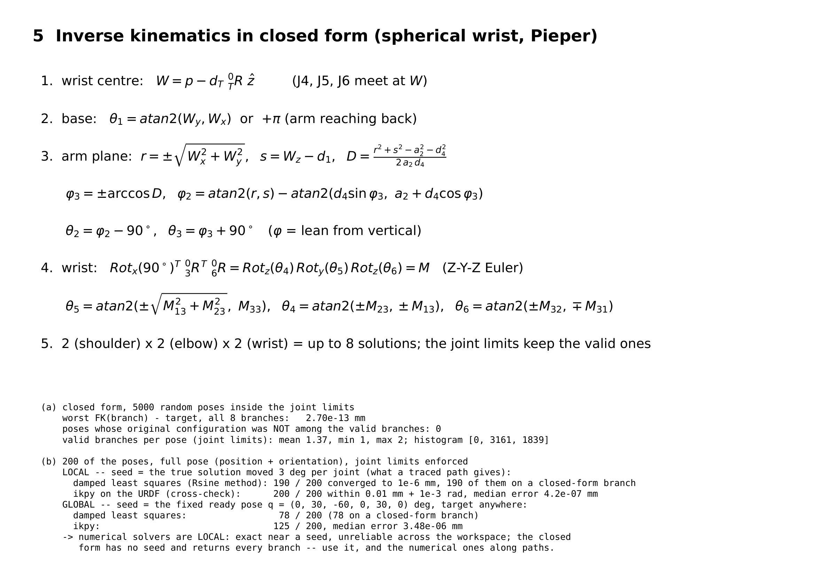
Inverse kinematics in closed form
Notes:
Wrist centre decouples position and orientation. 2 x 2 x 2 branches, then the joint limits.

Slide 8
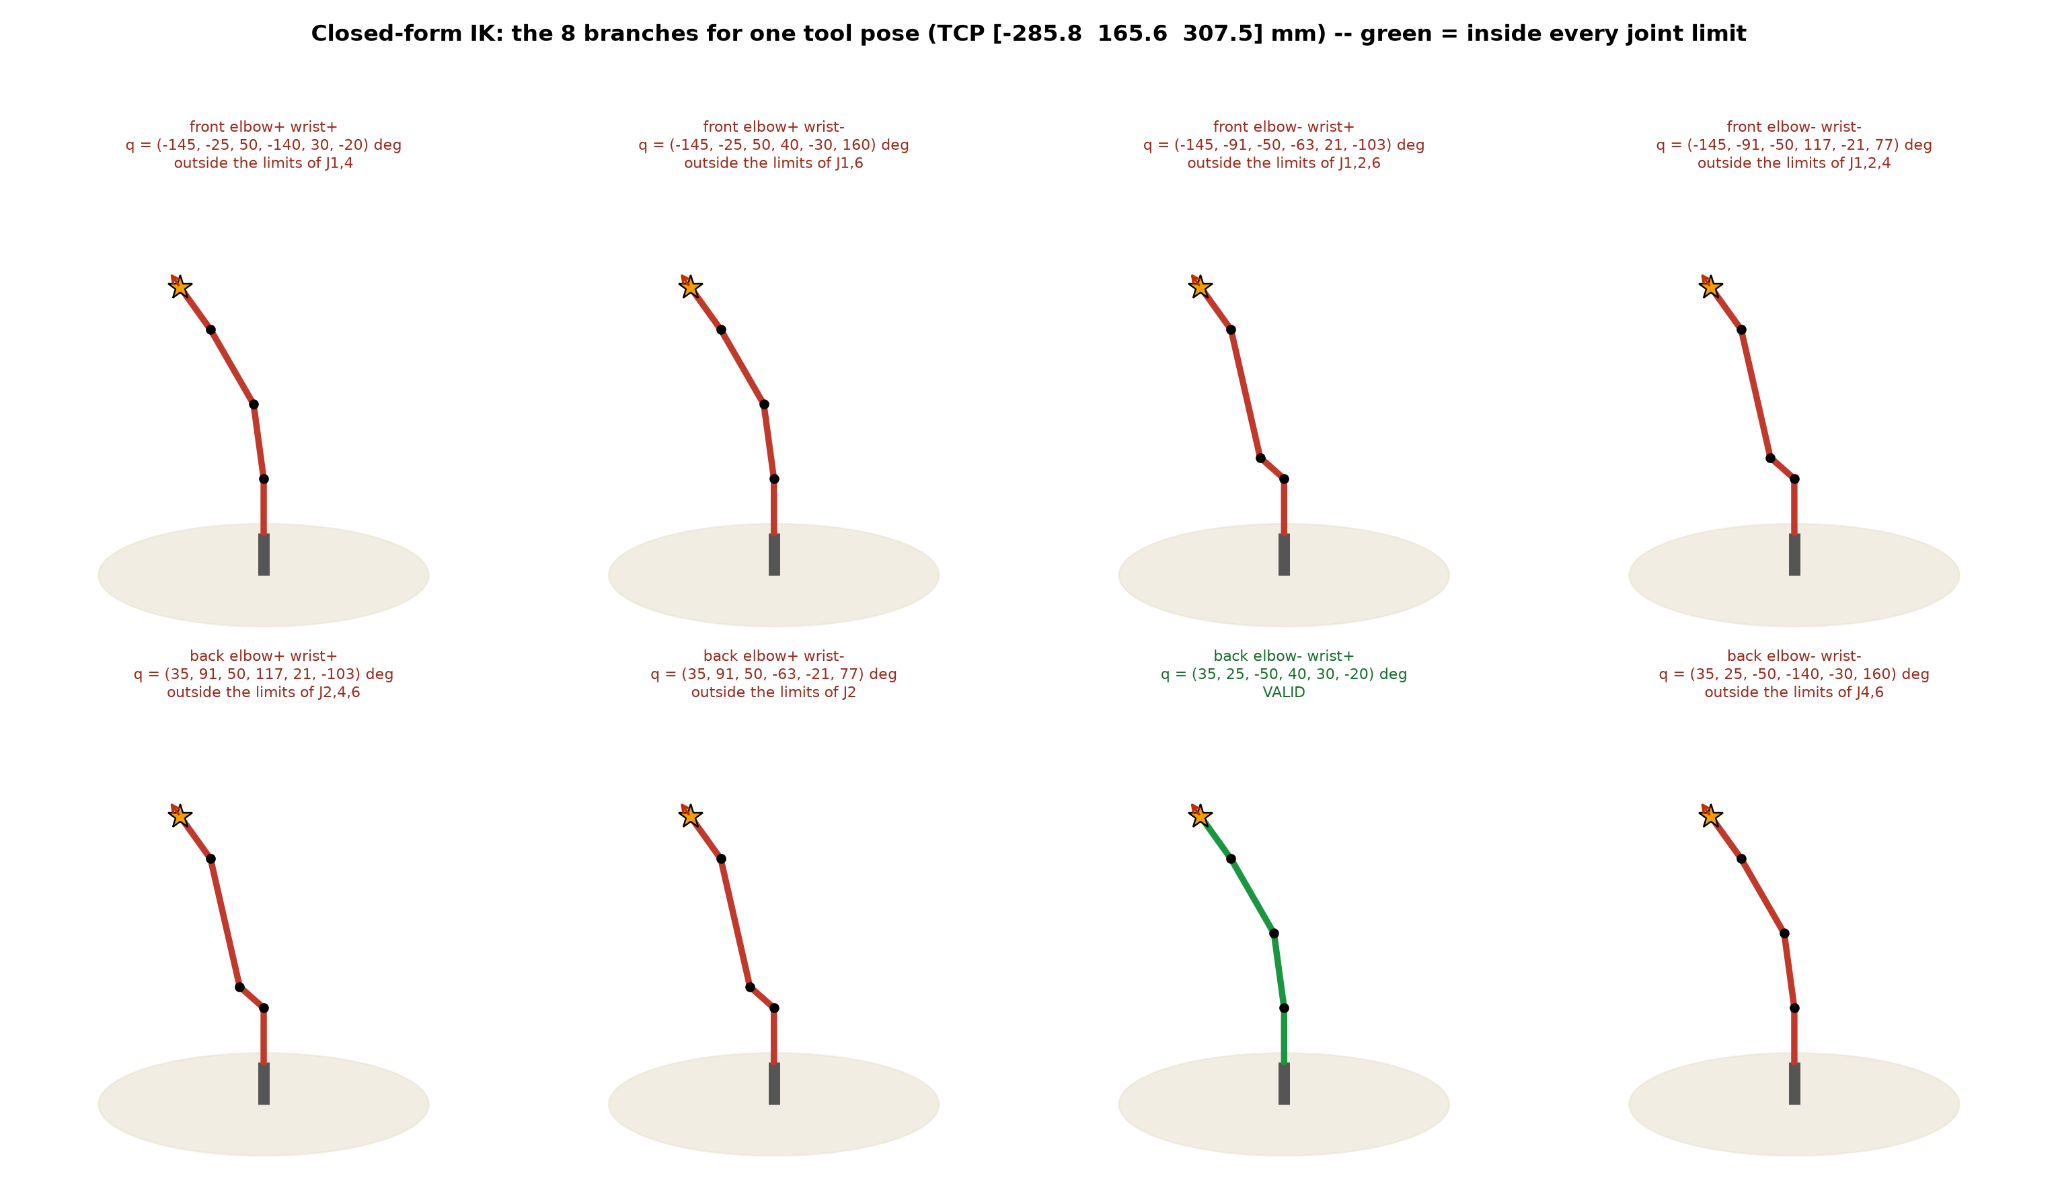
The 8 branches of one pose

Slide 9
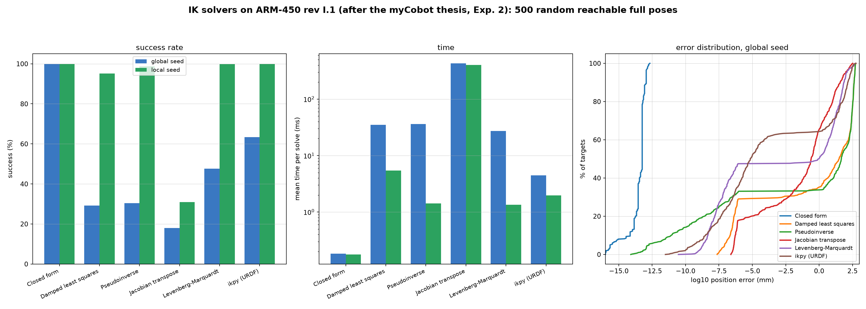
IK solvers compared (thesis Exp. 2)
Notes:
IK SOLVER COMPARISON -- 500 random reachable full poses, joint limits enforced
solver seed success mean iter mean ms median err mm
Closed form GLOBAL 100.0% 1.0 0.18 5.68e-14
Closed form LOCAL 100.0% 1.0 0.18 5.68e-14
Damped least squares GLOBAL 29.2% 221.6 34.89 3.12e+01
Damped least squares LOCAL 95.2% 34.6 5.43 2.59e-07
Pseudoinverse GLOBAL 30.4% 212.9 36.40 4.62e+01
Pseudoinverse LOCAL 98.8% 8.7 1.42 1.09e-09
Jacobian transpose GLOBAL 18.0% 2831.4 430.78 2.52e-01
Jacobian transpose LOCAL 31.0% 2650.4 402.98 4.81e-04
Levenberg-Marquardt GLOBAL 47.6% 165.5 27.15 9.10e-01
Levenberg-Marquardt LOCAL 99.8% 8.6 1.35 5.89e-08
ikpy (URDF) GLOBAL 63.4% - 4.46 7.08e-06
ikpy (URDF) LOCAL 100.0% - 1.97 4.52e-07
GLOBAL = seed at the ready pose, LOCAL = seed 3 deg from the answer (a traced path).
The closed form needs no seed and is exact; the seed only picks among its valid branches.

Slide 10
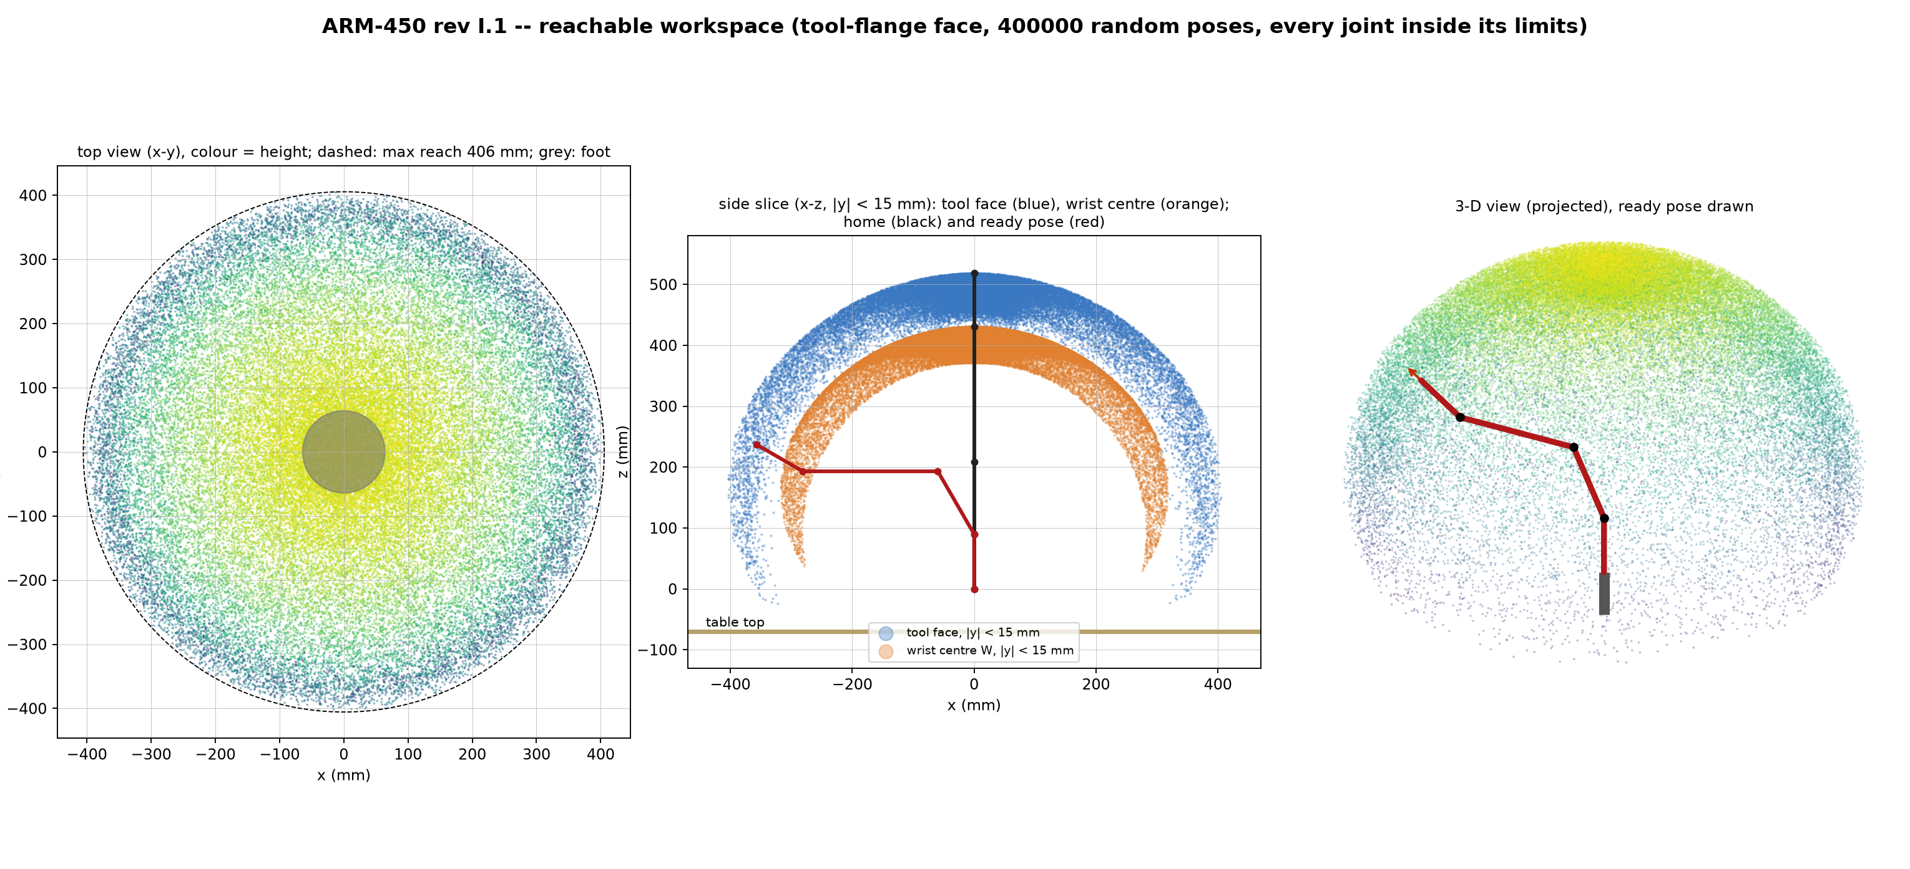
Reachable workspace
Notes:
WORKSPACE
self-checks: batch FK vs model FK 0.0e+00 mm; pen feasibility batch vs full IK (roll swept 5 deg) agree on 100.0 % of 400 pens (200 held by real poses + 200 random; 201 vs 201 feasible)
REACHABLE (tool-flange face, 400000 random poses inside the joint limits)
horizontal reach from the J1 axis: max 405.5 mm
distance from the shoulder (0, 0, 90): max 428.5 mm (a2 + d4 + d_T = 428.5)
height: -49.5 .. 518.4 mm; below the table top (z < -69.9): 0.0 % of poses
volume above the table (occupied 10 mm voxels): 74.59 litres
wrist centre: r max 317.6 mm, z 30.5 .. 430.4 mm

Slide 11
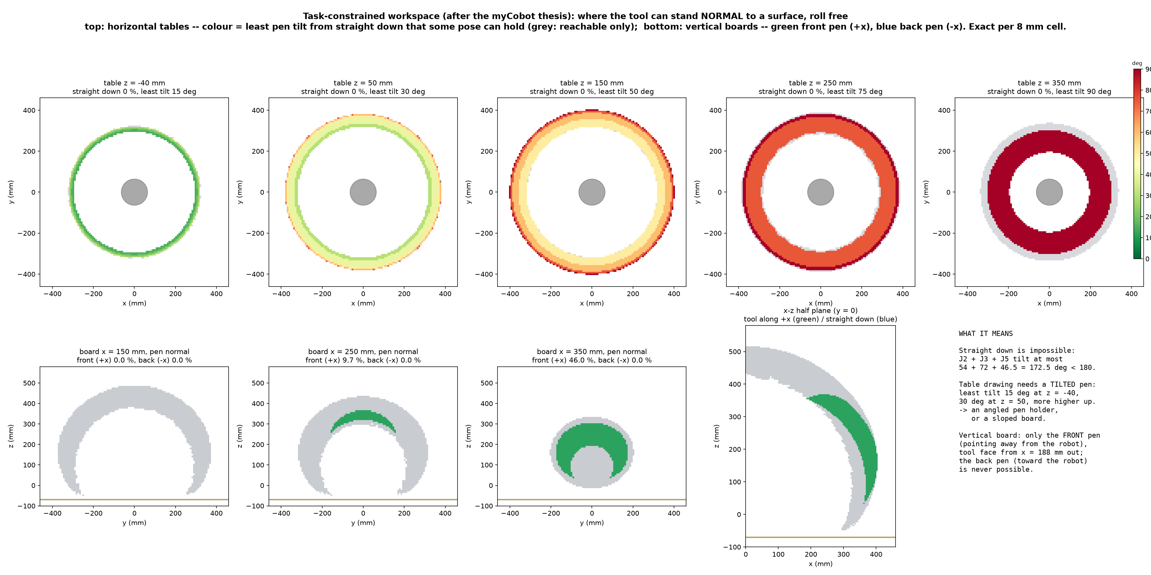
Task-constrained workspace (thesis Exp. 1)
Notes:
Straight down needs 180 deg of pitch; J2 + J3 + J5 give 172.5. Table: tilted pen on a ring. Board: front pen only.

Slide 12
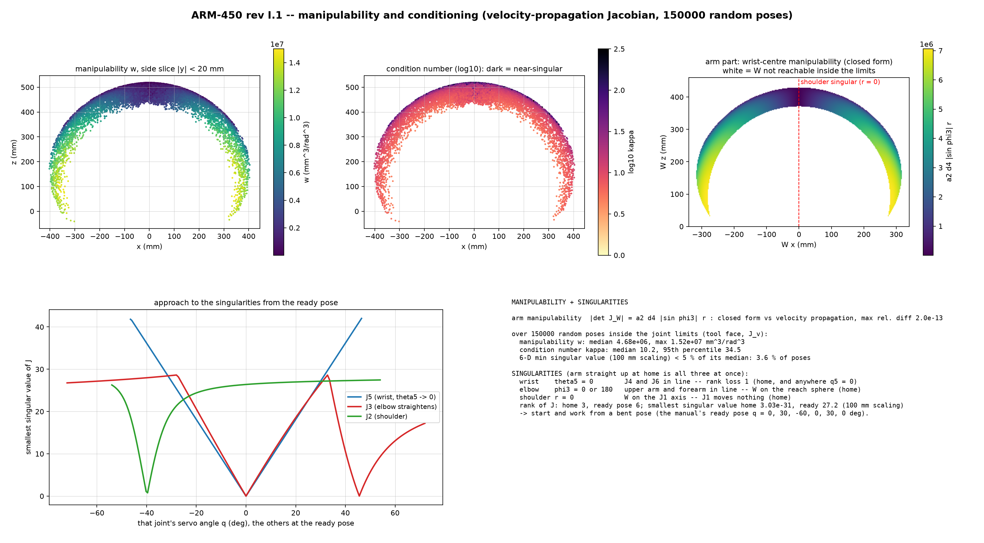
Manipulability and singularities (thesis Exp. 3)
Notes:
Home is singular three ways: shoulder, elbow, wrist. Work from the ready pose.

Slide 13
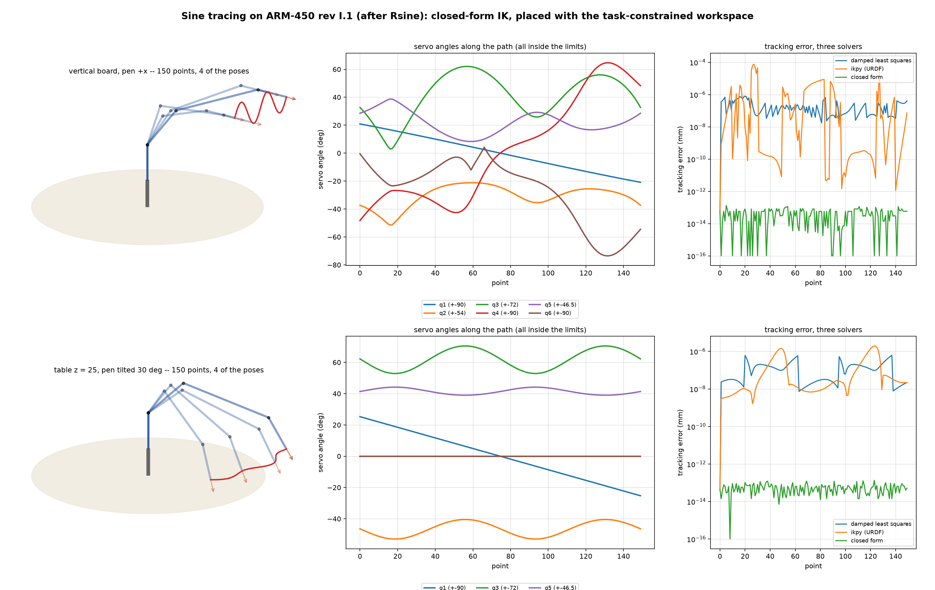
Sine tracing (after Rsine)
Notes:
SINE TRACING (closed-form IK, continuity = nearest valid branch)
VERTICAL: board x = 350, pen normal +x (away from the robot)
sine: centre (350, 0, 260) mm, width 200 mm, amplitude 33 mm, 2 cycles, 150 points
closed form: FK error max 1.3e-13 mm, pen axis error 2.6e-16; all points inside the joint limits: True
motion: largest joint step between points 2.82 deg; smallest margin to a limit 2.5 deg (pen roll free)
DLS re-trace (seed = previous point): max error 7.9e-07 mm, mean 8.0 iterations
ikpy re-trace (URDF): max error 9.3e-05 mm
TABLE: table z = 25, pen tilted 30 deg from straight down, leaning out along the radius
sine along an arc of radius 340 mm (the drawable ring), arc length 300 mm, radial amplitude 12 mm, 2 cycles, 150 points
closed form: FK error max 1.3e-13 mm, pen axis error 2.9e-16; all points inside the joint limits: True
motion: largest joint step between points 0.74 deg; smallest margin to a limit 1.0 deg (pen roll free)
DLS re-trace (seed = previous point): max error 6.2e-07 mm, mean 4.4 iterations
ikpy re-trace (URDF): max error 1.9e-06 mm

Slide 14
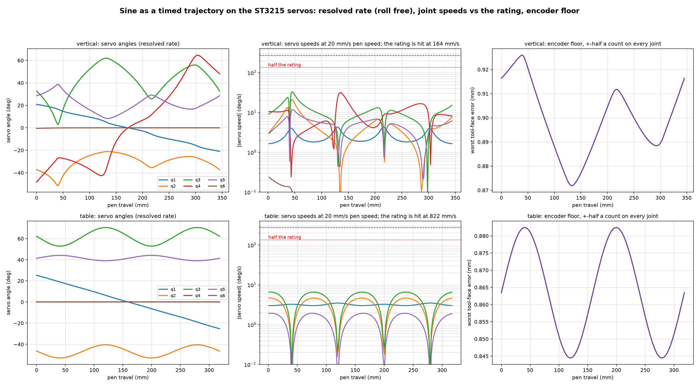
The sine on the real servos: timing and encoder floor
Notes:
TIMED TRAJECTORIES + ENCODER RESOLUTION
ST3215 (Waveshare wiki): 0.222 s/60 deg at 12 V = 270 deg/s no-load; 4096 counts/rev = 0.0879 deg/count
VERTICAL sine (board x = 350): path 345 mm
resolved rate (5-D task, roll free, null space to the joint centres): error 9.3e-11 mm, pen axis 9.2e-13; inside the limits: True
largest joint rate per mm of pen travel 1.65 deg/mm (joint 3); closed-form path of step 7: largest step 2.82 deg
pen speed at which a servo reaches its no-load rating: 164 mm/s; at half the rating: 82 mm/s
one pass of the sine at half the rating: 4.2 s
encoder floor (every joint off by half a count): tool face 0.87 .. 0.93 mm along the path
TABLE sine (table z = 25, pen tilt 30 deg): path 318 mm
resolved rate (5-D task, roll free, null space to the joint centres): error 1.8e-13 mm, pen axis 5.0e-16; inside the limits: True
largest joint rate per mm of pen travel 0.33 deg/mm (joint 3); closed-form path of step 7: largest step 0.74 deg
pen speed at which a servo reaches its no-load rating: 822 mm/s; at half the rating: 411 mm/s
one pass of the sine at half the rating: 0.8 s
encoder floor (every joint off by half a count): tool face 0.84 .. 0.88 mm along the path
-> drawing faster than about half the no-load pen speed above leaves the servos no margin (the rating is
no-load; under the arm's own weight they are slower). The encoder alone limits a drawn line to about
the floor above -- a real line is also limited by gear backlash and the printed parts' play.

Slide 15
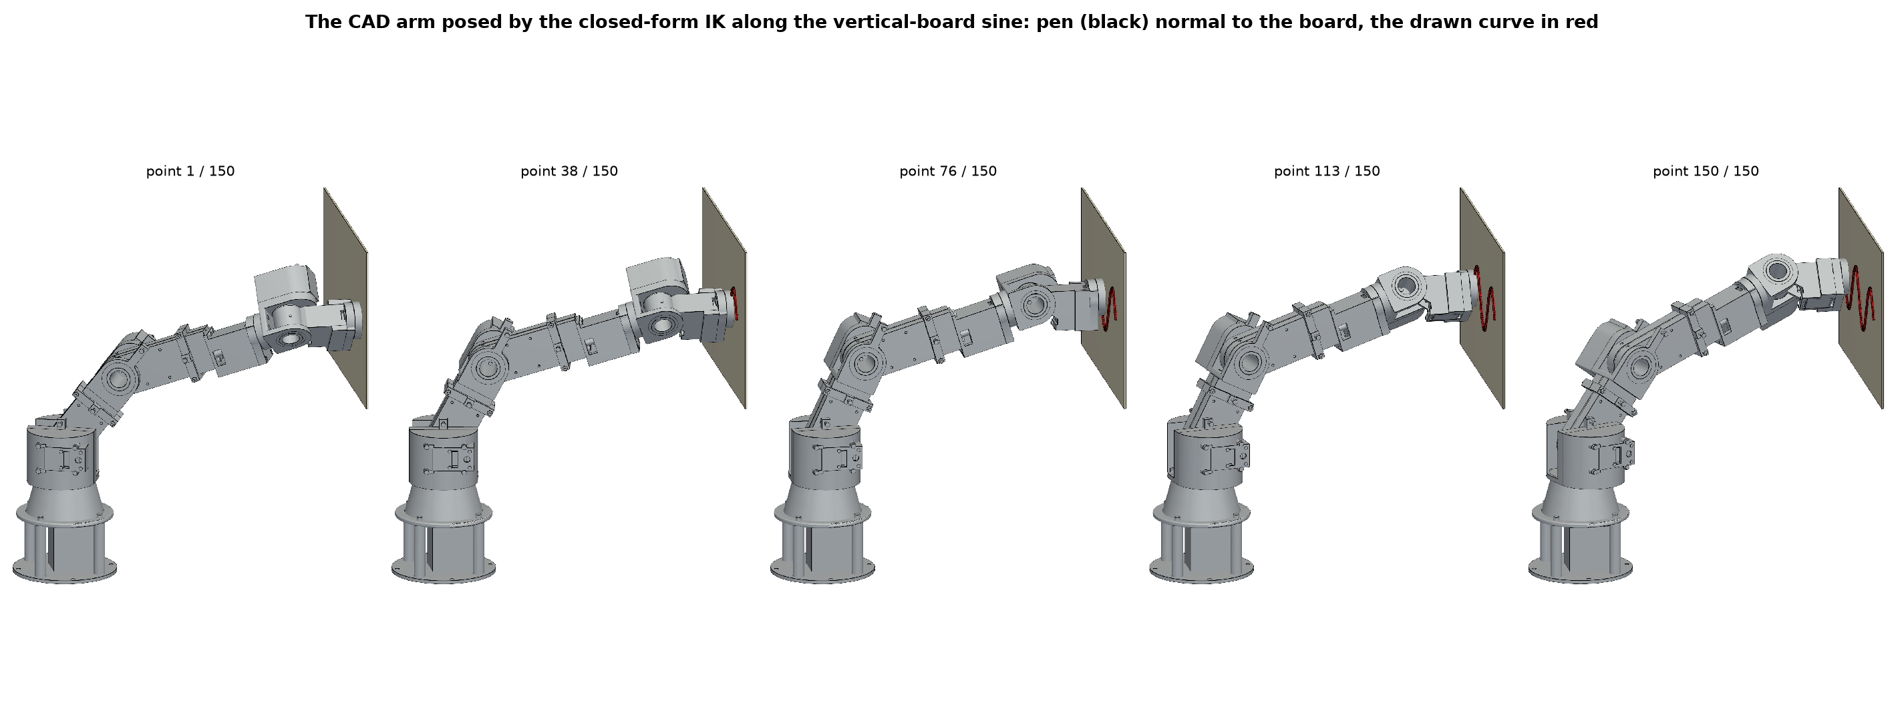
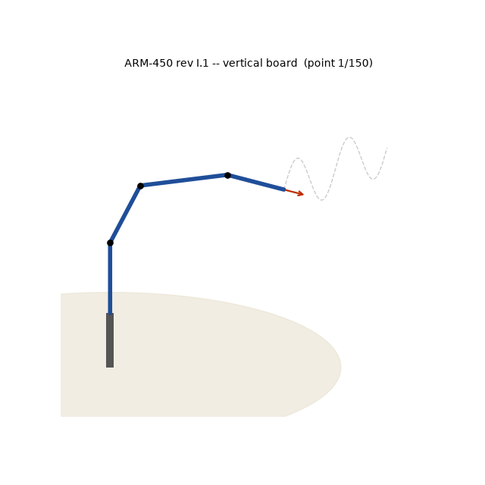
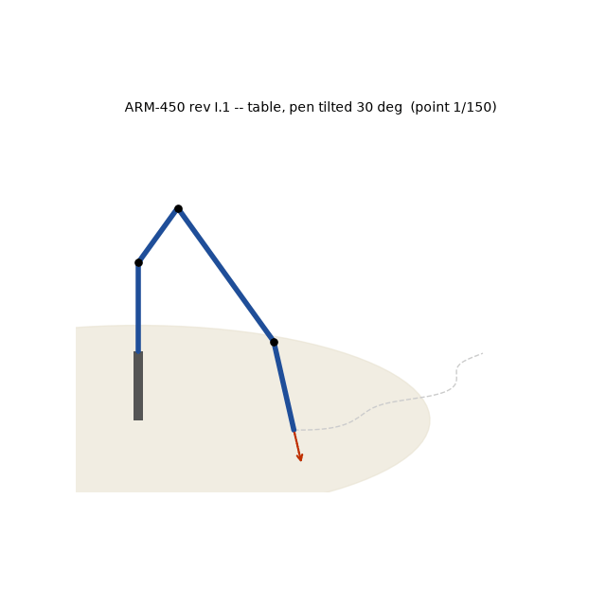
The CAD arm drawing

Slide 16
Conclusions
DH table follows from the CAD with my frame rules; FK = CAD = URDF to 1e-13 mm
Velocity-propagation Jacobian = geometric form; manipulability / conditioning mapped
Spherical wrist -> closed-form IK (exact, all branches); numerical solvers are local: use them along paths
Home is triply singular: start from the bent ready pose
Joint limits cap the pitch at 172.5 deg: no pen straight down; tilted pen on a ring; board from ~190 mm
Free pen roll keeps the traced motion smooth (largest step < 3 deg) -- redundancy, as in the thesis
On the ST3215: board sine at ~80 mm/s with the servos at half their rating; encoder floor ~0.9 mm

