Slide 1

Udyam Saathi
A phone-first, multilingual journey that takes a small business from “what do I need?” to “everything is live” in one sitting
Track A · Project Udyam Digital (Accel Business)
Team DevSquad_VITVellore
Abhishek Anand · Utsav Chauhan
Vellore Institute of Technology, Vellore

Slide 2

The problem isn’t demand. It’s four human hand-offs.
What 5,000 SMB leads (Apr–Jun 2026) tell us - every number below is computed from smb_leads.csv
1,632 leads (33%) lost before any conversation
Unreachable after 3 attempts (805), owner had no time for a visit (531), visit never scheduled (296). The sales visit is the bottleneck.
385 lost to the quote itself
“Quote too complex” (206) + “took too long” (179). A 3–5 day PDF with product codes loses the owner.
5,000 Leads
3,406 Contacted
1,974 Needs assessed
Referrals convert 5× better
Referral 14.8% vs WhatsApp campaign 2.8% and web form 4.3%. Trust travels shop-to-shop, not through ads.
Chasing status drives churn
>3 follow-up calls → 23% churn in 6 months and NPS 6.4; ≤1 call → 5.9% churn, NPS 7.5. Silence after purchase is the real cost.
861 Quote accepted
588 KYC complete
368 Activated
GSTIN = 4.7× activation
9.6% with GSTIN vs 2.0% without. KYC & GST-gated products block the long tail.
Micro is 54% of leads but loses money
4.1% conversion, ₹2,470 median bundle, 22.7% churn - at ₹15k CAC it never pays back.
7.4% lead→activation · 17.6 days · 3 status-chase calls · ₹15,053 CAC per activated SMB
Our bet: remove the hand-offs (visit, PDF quote, paper KYC, status calls) with software - and turn the field force and partners into paid “Saathis” instead of competitors.

Slide 3
Udyam Saathi: discover → buy → verify → track, on a phone, in ~10 minutes
One journey, in the owner’s language, with a human one tap away - never in the way
① Advisor
6 tap-questions or one sentence in Hindi/Hinglish (“kirana hai, 3 log, UPI aur CCTV chahiye”). GSTIN lookup pre-fills the business. Rules engine builds an eligible bundle and explains every item in plain words.
② Quote & checkout
One monthly price incl. GST. Toggle add-ons, live re-price. One-Bill discount (5–10%), 24-month option waives setup. Ineligible items shown with the reason and how to unlock.
③ Consent + Smart KYC
DPDP consent screen first. Snap 4 documents (or DigiLocker). OCR + GSTIN checksum + registry cross-checks give a verdict in seconds; only flagged items go to a human.
④ Tracker
A promised live-date from install days, site survey booked at checkout (parallel to KYC), milestone timeline, automatic bill credit for every late day, one-tap consent withdrawal.
What makes it different (and hard to copy)
Bill-Swap mirror
Shows the same services bought separately vs. one Accel bill - e.g. Dukaan bundle saves ₹1,759/month and collapses 3 vendors into 1.
Rules-first GenAI
Deterministic engine enforces tier, size, GSTIN and requires_one_of; language layer only explains. No hallucinated SKUs - every judge scenario is reproducible.
Parallel activation + late-day credit
Survey booked at checkout, not after KYC. Missed promise date = automatic credit, so the owner never needs to call.
Saathi partner co-pilot
Field reps and local partners share advisor links with their code and earn 8% of year-1 MRR on digital closes.
Win-back propensity queue
LightGBM on lead-time features ranks dropped leads with SHAP reasons, so reps call the right 20% first (1.74× lift).
Shop-to-shop referral loop
Every live customer gets a WhatsApp referral link - both get a free month. Leans into the 14.8% referral channel.

Slide 4
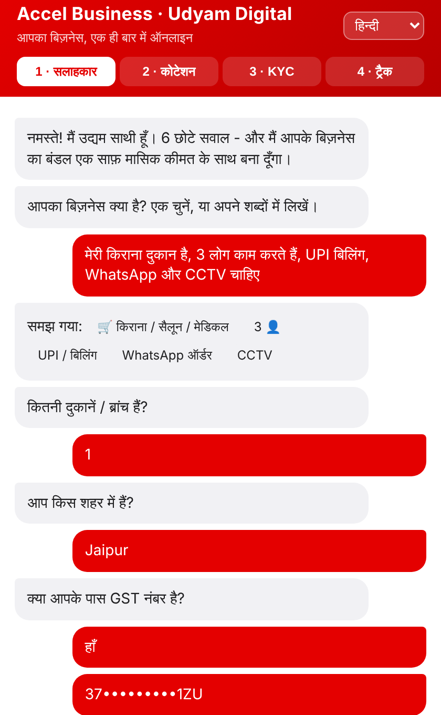
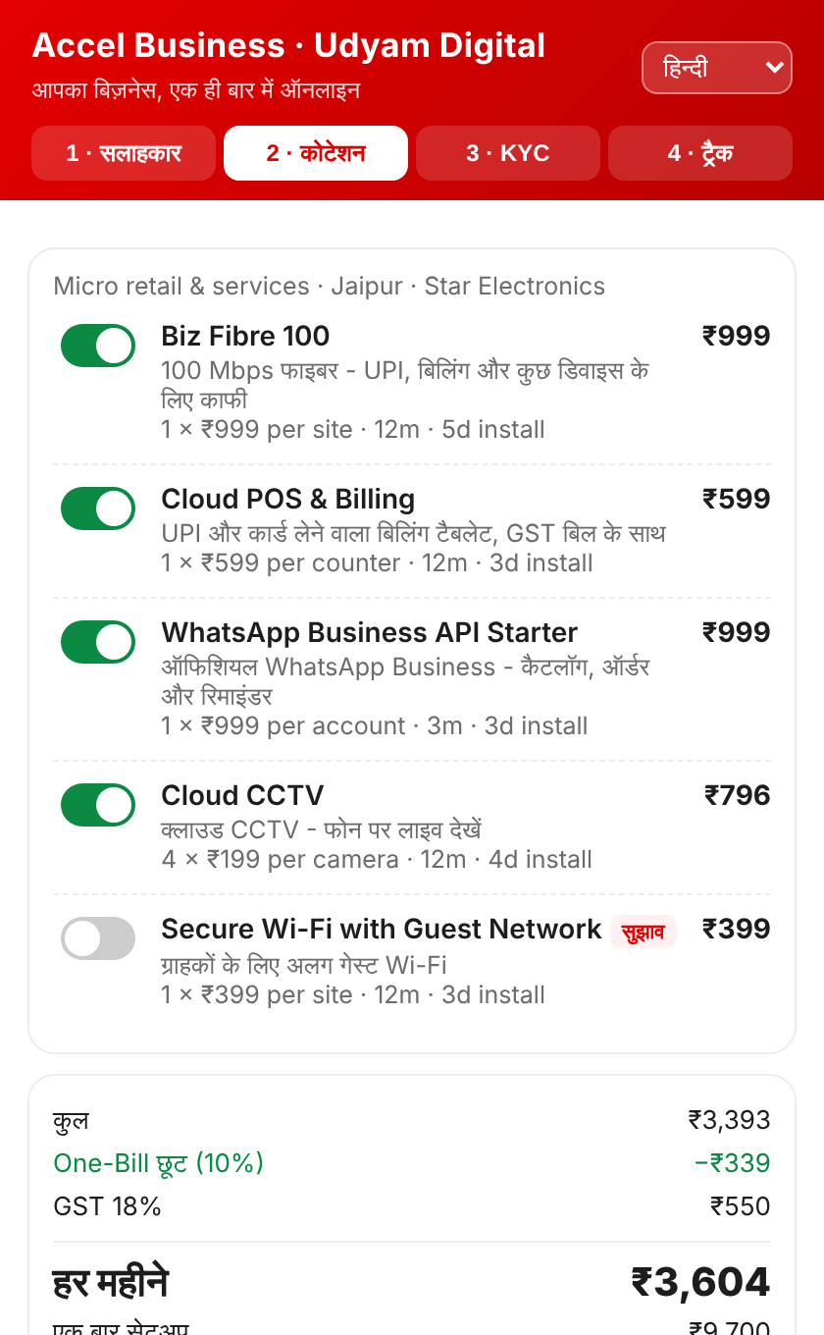
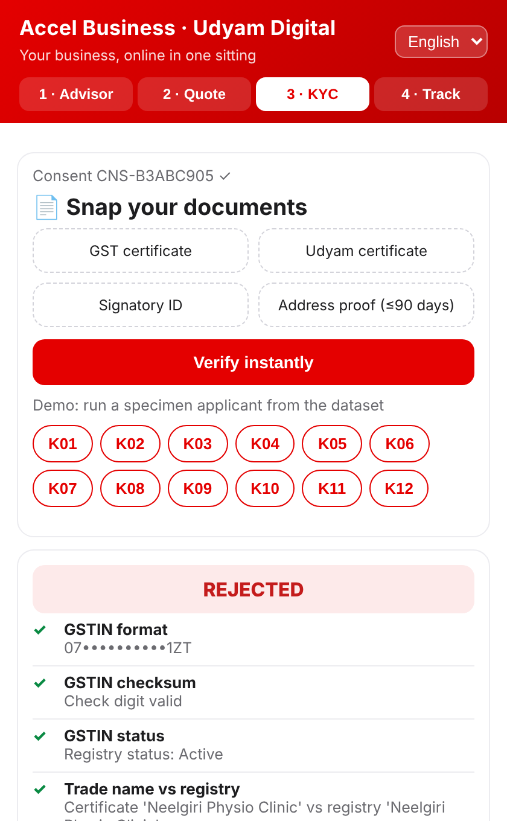
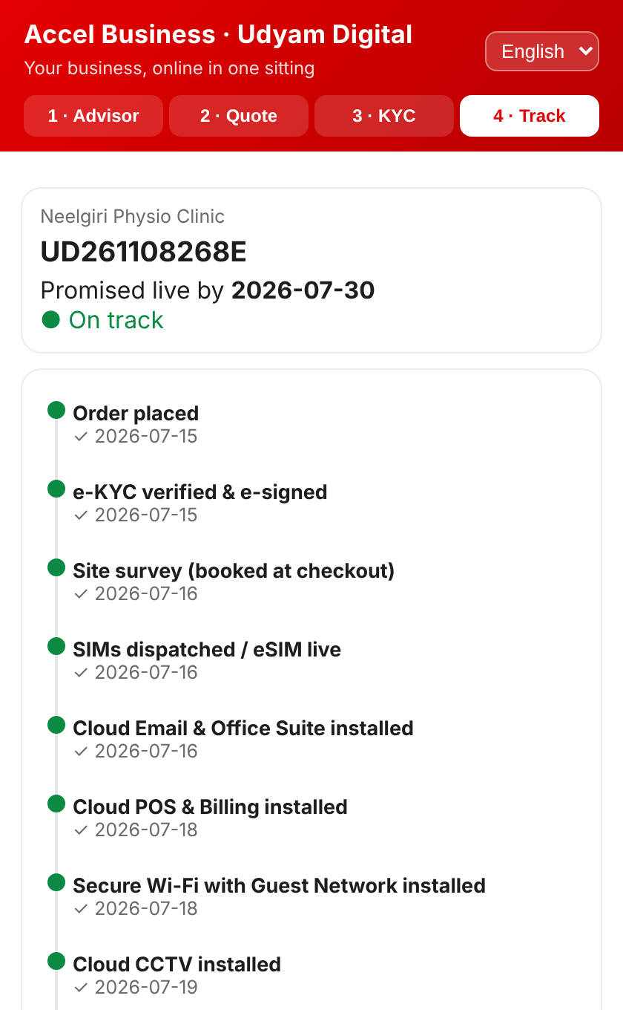
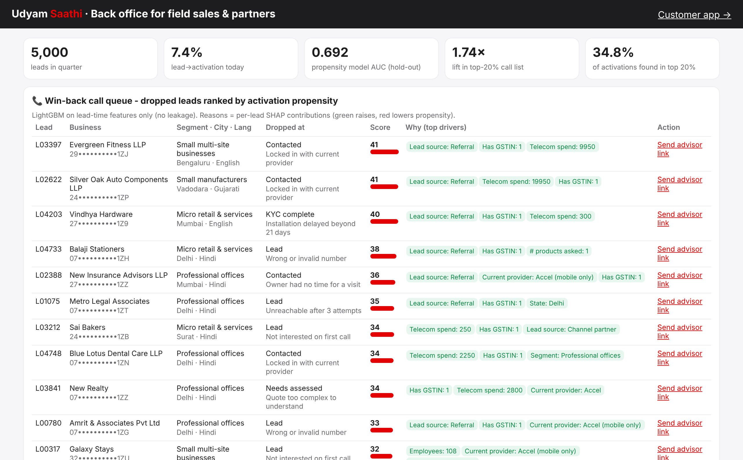
Working prototype - built and tested on the hackathon dataset
FastAPI + Tesseract OCR + LightGBM + mobile web app · repo: github.com/Abhishek5020/Udyam_Airtel_Digital
Saathi back office: win-back queue with SHAP reasons
Hindi advisor: free text parsed, GSTIN pre-fills business
Transparent quote, toggles, One-Bill discount, Bill-Swap savings
Smart KYC catches tampered legal name (K07)
Tracker: promise date, milestones, auto-credit if late
4 required modules + 2 stretch goals
Advisor, Quote & checkout, Smart KYC, Tracker + Saathi back office and lead propensity score; WhatsApp share & deep-links
Smart KYC on the 12 specimen applicants
Flags cancelled GSTIN (K01), skewed photo (K02), blurred certificate (K04), missing Udyam (K05), altered legal name (K07), 257-day-old bill (K11); signatory authority checks
Advisor eligibility, provably
No-GSTIN micro shop: WhatsApp API, SMS, firewall withheld with reasons + free GST-help path; dependencies (CCTV needs broadband) auto-checked
Propensity model, honestly evaluated
Hold-out AUC 0.69; top-20% call list captures 35% of activations (1.74× lift). Lead-time features only - no leakage

Slide 5
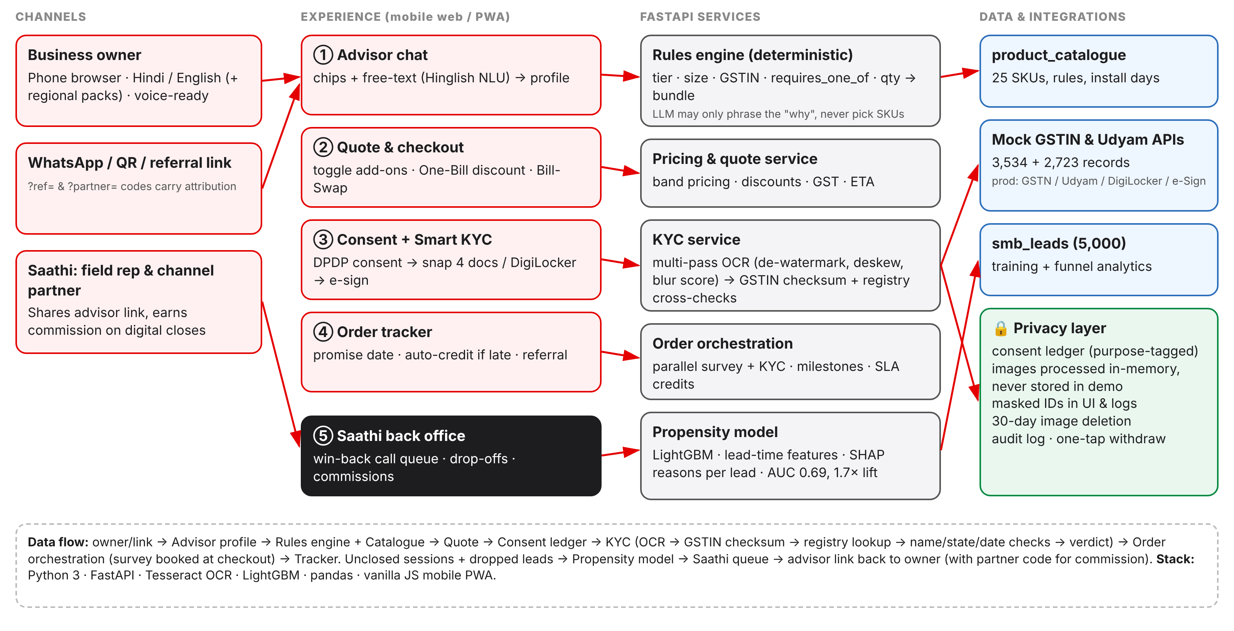
Architecture, Smart KYC and privacy-by-design
Every component below runs in the prototype; mocked registries swap for GSTN / Udyam / DigiLocker / e-Sign APIs in production
Smart KYC pipeline
1. Multi-pass OCR: watermark removal, deskew (±8°), blur score
2. GSTIN grammar fix + official mod-36 check digit
3. Mock GSTIN/Udyam lookup: status, legal & trade name, state
4. Cross-document: ID & bill name, bill ≤90 days, PIN/city, ID expiry, signatory authority
→ APPROVED / NEEDS REVIEW / REJECTED, each with a reason
DPDP Act 2023 choices
• Consent screen before any upload; purpose-tagged ledger; marketing opt-in OFF by default
• Minimisation: only 4 legally required docs; images processed in memory
• GSTIN / ID / Udyam masked in UI, API and logs (37••••••1ZU)
• Retention: images deleted 30 days after activation; fields kept only as law requires
• One-tap withdrawal + audit log of every lookup
Design rule: the catalogue rules decide WHAT is sold; GenAI decides only HOW it is explained. This keeps recommendations auditable, compliant and identical across all 15 live test scenarios.

Slide 6
Who first, what bundle, at what price
Bundles priced by the prototype’s engine from product_catalogue.csv (excl. 18% GST); segment economics from smb_leads.csv
Segment
Data (conv · MRR · 6m churn · CAC)
Priority & channel
Hero bundle
₹/month
Contract
Professional offices
clinic, CA, coaching
11.1% · ₹6,575 · 13.8% · ₹4.2k
#1 - fully digital, highest volume × value
Clinic & Office Pro: Fibre 300, 2 SIMs, email + antivirus ×10, 1 TB backup, failover, guest Wi-Fi
5,917
12–24m
Small multi-site
restaurant / store chain
11.0% · ₹28,080 · 10.8% · ₹9.1k
#2 - digital quote, Saathi-assisted close
Chain One-Bill (5 outlets): fibre, POS, 10 CCTV, guest Wi-Fi + failover per site, email ×10
32,269
24m
Micro retail & services
kirana, salon, pharmacy
4.1% · ₹2,470 · 22.7% · ₹2.7k
#3 - self-serve only (CAC must be <₹1.5k); referral loop
Dukaan Digital: Fibre 100, 2 SIMs, UPI POS, WhatsApp API, 2 CCTV · Lite (no GSTIN): AirFiber, SIM, POS ₹1,707
3,234
12m (24m = setup free)
Small manufacturers
auto-parts, textile
12.8% · ₹15,910 · 8.1% · ₹9.6k
#4 - partner-led; advisor used as a sizing tool
Factory Connect: Leased Line 100, 5 SIMs, 10 IoT sensors, firewall, email ×10
33,861
24m
Value to the owner
One bill, one helpline, one app instead of 3–6 vendors
Bill-Swap: 18–35% cheaper than buying the same services separately
Live in ~6 days (vs 17.6) with a dated promise
Value to Accel (assumptions labelled)
Self-serve CAC est. ₹1.5–3k vs ₹15k blended today
At 40% contribution margin*, micro payback falls from ~15 months to ~2–3
Suggested add-ons lift attach: target 5.5 products per bundle vs 4.5 today
Role of field force & partners
Saathis: share advisor links, earn 8% of yr-1 MRR on digital closes
Field sales: multi-site & manufacturers + top-20% win-back queue
Partners do installs and doorstep KYC help for the non-digital owner
*Assumed margin for illustration; not in the dataset.

Slide 7
How we’ll measure it, roll it out, and what could go wrong
Targets set against the Apr–Jun 2026 baseline from smb_leads.csv
Metric
Today
6-month target
Risks & mitigations
Lead → activation
7.4%
15%
OCR misreads / forged documents
Registry is the source of truth; checksum + name/state/date cross-checks; NEEDS REVIEW queue with 2-hour human SLA; DigiLocker pull removes uploads
Avg time to activate
17.6 days
≤ 6 days
Partners see digital as a threat
Partner code on every link, commission on digital closes, leaderboard; partners own installs & doorstep help
Blended CAC / activated SMB
₹15,053
≤ ₹6,000
6-month churn
15.2%
≤ 9%
GenAI recommends something ineligible
LLM never selects SKUs; rules engine + dependency check is the only path to a quote; regression-tested scenarios
Status-chase calls / customer
3
≤ 0.5
Promise dates missed (install capacity)
ETA from real install slots per city; auto-credit makes delays costly internally, so ops fixes capacity
North star: activated MRR per ₹ of acquisition spend. Guardrails: NPS ≥ 7.5, KYC false-approve rate < 0.5%.
DPDP non-compliance / data breach
Consent ledger, purpose limits, masking, 30-day image deletion, audit log, encryption at rest & in transit
Rollout
Wk 0–8 · Pilot: Pune (T1) + Jaipur (T2), professional offices + micro, Hindi/Marathi, 20 partner Saathis
Q2 · 10 cities, 6 languages, WhatsApp front end, DigiLocker + e-Sign live
Q3–Q4 · National; voice advisor; partner app; propensity-led outbound
Micro churn stays high
Proactive tracker + one helpline (≤1 chase call = 5.9% churn); usage nudges on WhatsApp after go-live

