Slide 1
IBM Applied Data Science Capstone
Winning Space Race
with Data Science
Falcon 9 First-Stage Landing Prediction
Data collection • EDA • SQL • Folium • Plotly Dash • Classification
Abhishek Kulkarni
Final Project Report

Slide 2
EXECUTIVE SUMMARY
Executive Summary
Launch records
Landing success
Top launch site
Best classifier
90
66.7%
KSC LC 39A
Decision Tree
Falcon 9 missions
60 successful / 90
77.3% success rate
87.5% CV / 83.3% test
• Collected launch data through the SpaceX REST API and web-scraped launch records.
• Cleaned the data, handled missing values, and engineered a binary landing-success Class label.
• Used Python visualization and SQL to identify relationships among flight number, payload, launch site and orbit.
• Added interactive analytics with Folium and Plotly Dash, then compared four tuned classification models.
• Landing success increased strongly with flight experience; the Decision Tree led cross-validation (87.50%) with all four models achieving 83.33% test accuracy.
IBM Applied Data Science Capstone • Falcon 9 First-Stage Landing Prediction

Slide 3
INTRODUCTION
Introduction & Business Problem
Why landing prediction matters
Questions addressed
• Falcon 9 reusability is a major contributor to SpaceX's lower launch economics.
• A competing launch provider needs to estimate recovery probability before bidding on a mission.
• The analytical question: given launch characteristics, can we predict whether the first stage will land successfully?
• How does landing success change with flight number?
• Which launch sites and orbit types have higher success rates?
• Does payload mass show a meaningful relationship with recovery?
• Which classification model performs best?
IBM Applied Data Science Capstone • Falcon 9 First-Stage Landing Prediction

Slide 4
METHODOLOGY
End-to-End Methodology
1
2
3
4
5
6
Collect
Wrangle
Explore
Visualize
Predict
Decide
SpaceX REST API
+ web scraping
Clean, filter,
engineer Class
Pandas/Matplotlib
+ SQL
Folium
+ Plotly Dash
LR • SVM
• Tree • KNN
Compare metrics
& select model
Output: a stakeholder-oriented prediction of Falcon 9 first-stage landing success.
IBM Applied Data Science Capstone • Falcon 9 First-Stage Landing Prediction

Slide 5
METHODOLOGY
Data Collection — SpaceX REST API
API workflow
• GET historical launch records from the SpaceX REST API.
• Normalize nested JSON into a pandas DataFrame.
• Filter to Falcon 9 launches and enrich launch-site, payload and booster fields.
• Standardize missing payload values for downstream analysis.
GET
JSON
DataFrame
Falcon 9
→
→
→
REST endpoint
nested response
json_normalize
filter + enrich
Resulting analysis table: 90 Falcon 9 launch records × 17 fields.
IBM Applied Data Science Capstone • Falcon 9 First-Stage Landing Prediction

Slide 6
METHODOLOGY
Data Collection — Web Scraping
Wikipedia launch-record extraction
• Retrieve the Falcon 9 launch-history table from Wikipedia.
• Parse HTML tables with Requests and BeautifulSoup.
• Normalize column headers, dates, payload units and landing-outcome labels.
• Use the scraped records to complement and validate API-derived fields.
HTML
Parse
Clean
Merge
→
→
→
launch table
BeautifulSoup
headers + values
analysis dataset
Complementary sources reduce gaps and provide a richer launch-history view.
IBM Applied Data Science Capstone • Falcon 9 First-Stage Landing Prediction

Slide 7
METHODOLOGY
Data Wrangling
• Filtered the launch history to Falcon 9 missions.
• Reviewed missing values; LandingPad contains the principal missingness in the course dataset.
• Created the binary Class target: 1 = successful first-stage landing, 0 = unsuccessful / no recovery.
• Prepared numerical and categorical predictors for machine-learning models using feature selection and encoding.
• Final modeling dataset retains 90 observations with a 66.67% positive landing rate.
Records
Success
90
60
Falcon 9
Class = 1
Failure
Baseline
30
66.7%
Class = 0
landing success
IBM Applied Data Science Capstone • Falcon 9 First-Stage Landing Prediction

Slide 8
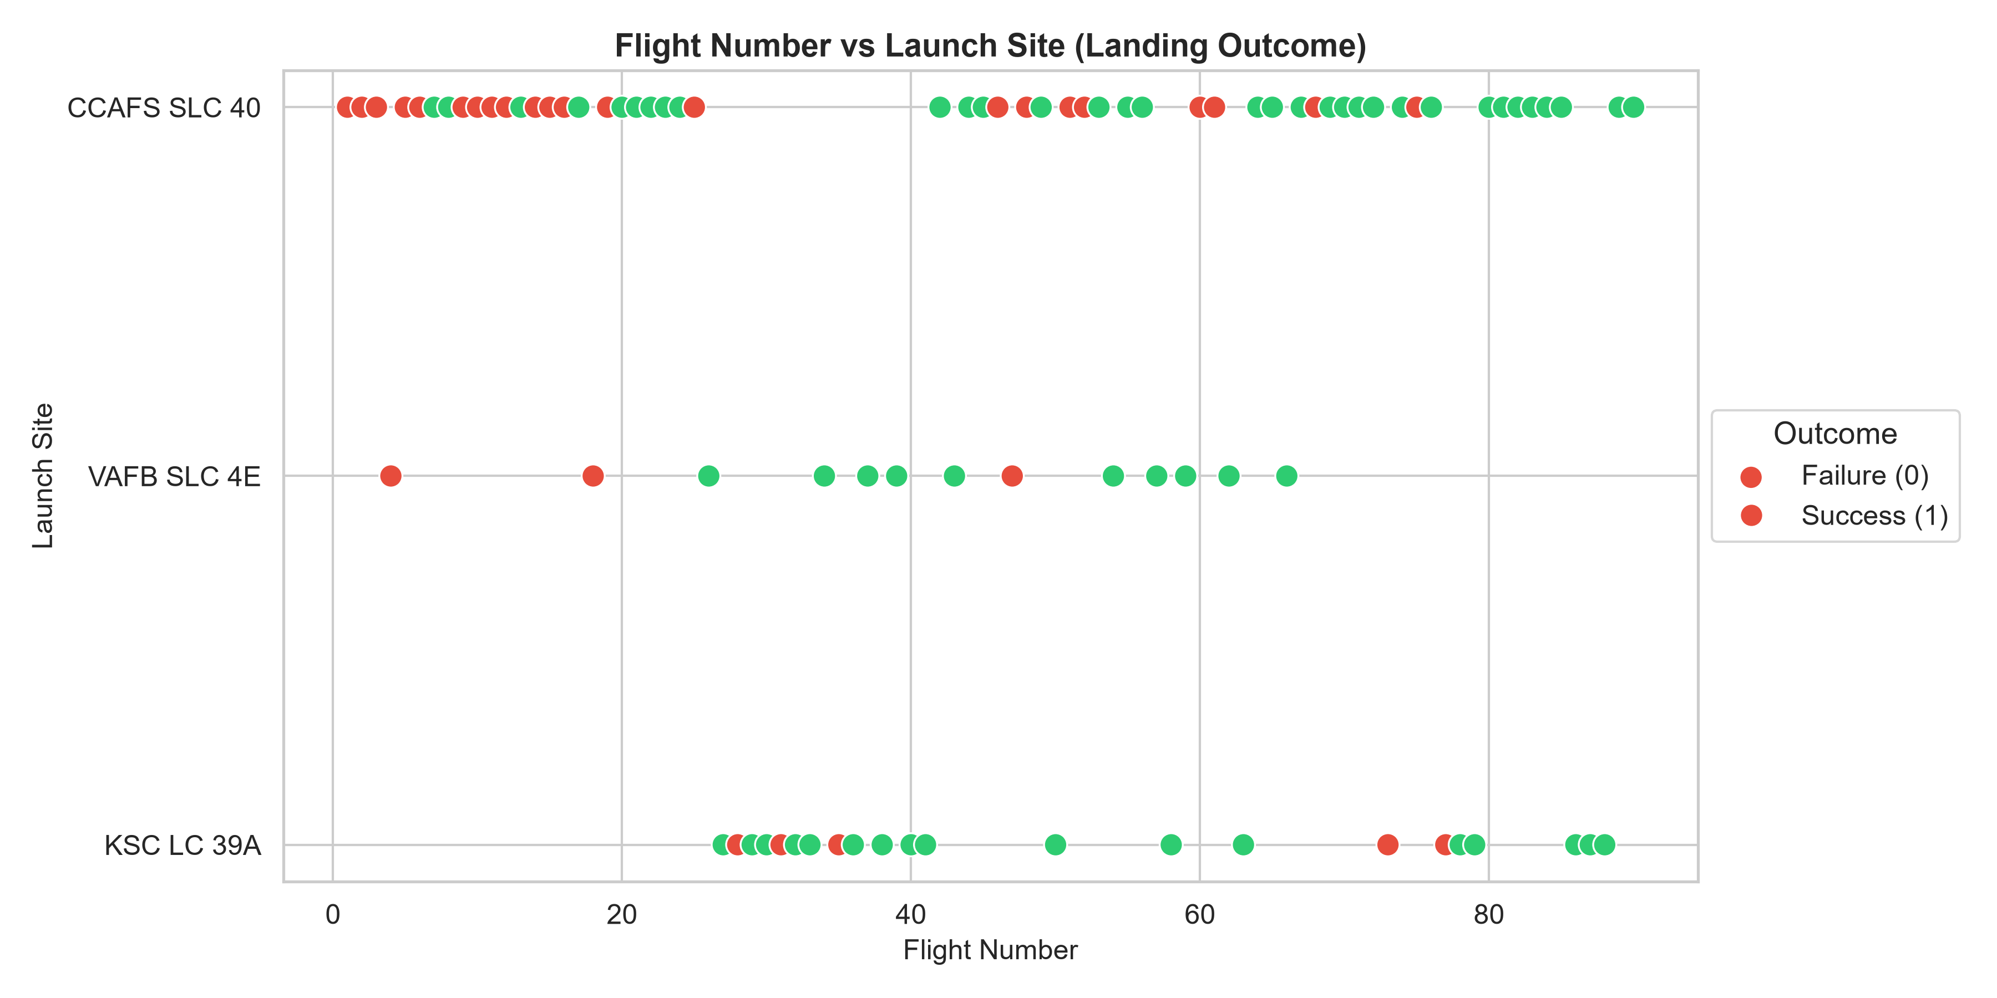
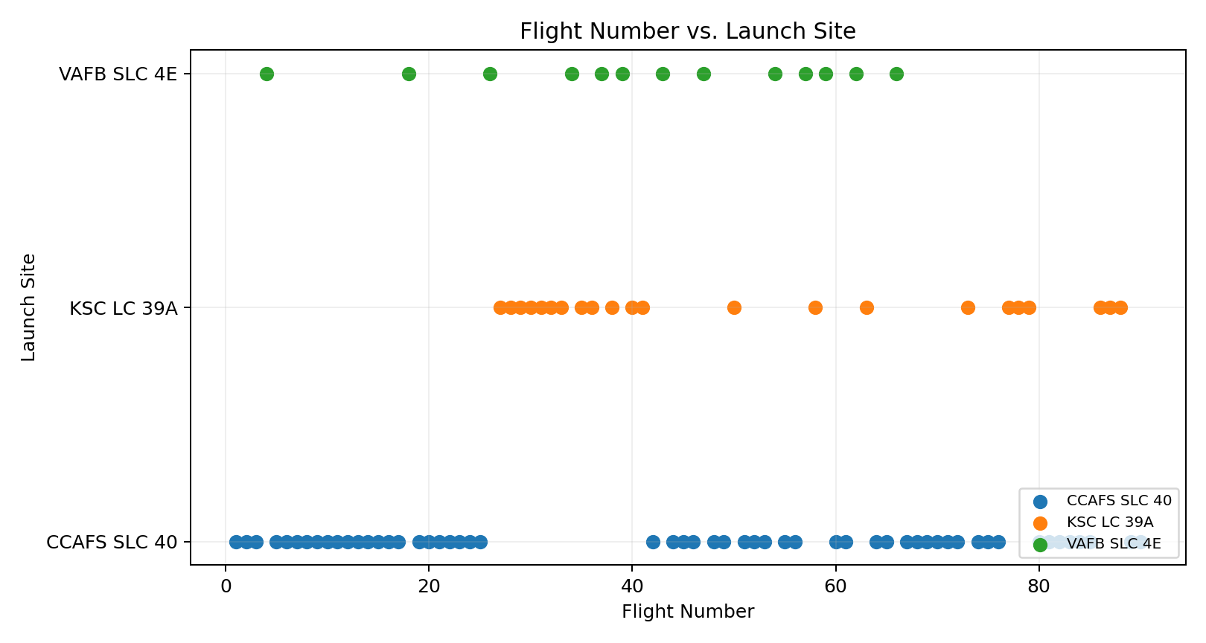
RESULTS — EDA
Flight Number vs. Launch Site
• CCAFS SLC 40 dominates the launch history across the full timeline.
• KSC LC 39A enters later and becomes a major site.
• Early flight numbers contain more failures; later flights cluster strongly toward successful landings.
EDA objective: identify variables and patterns that are useful for prediction and business interpretation.
IBM Applied Data Science Capstone • Falcon 9 First-Stage Landing Prediction

Slide 9
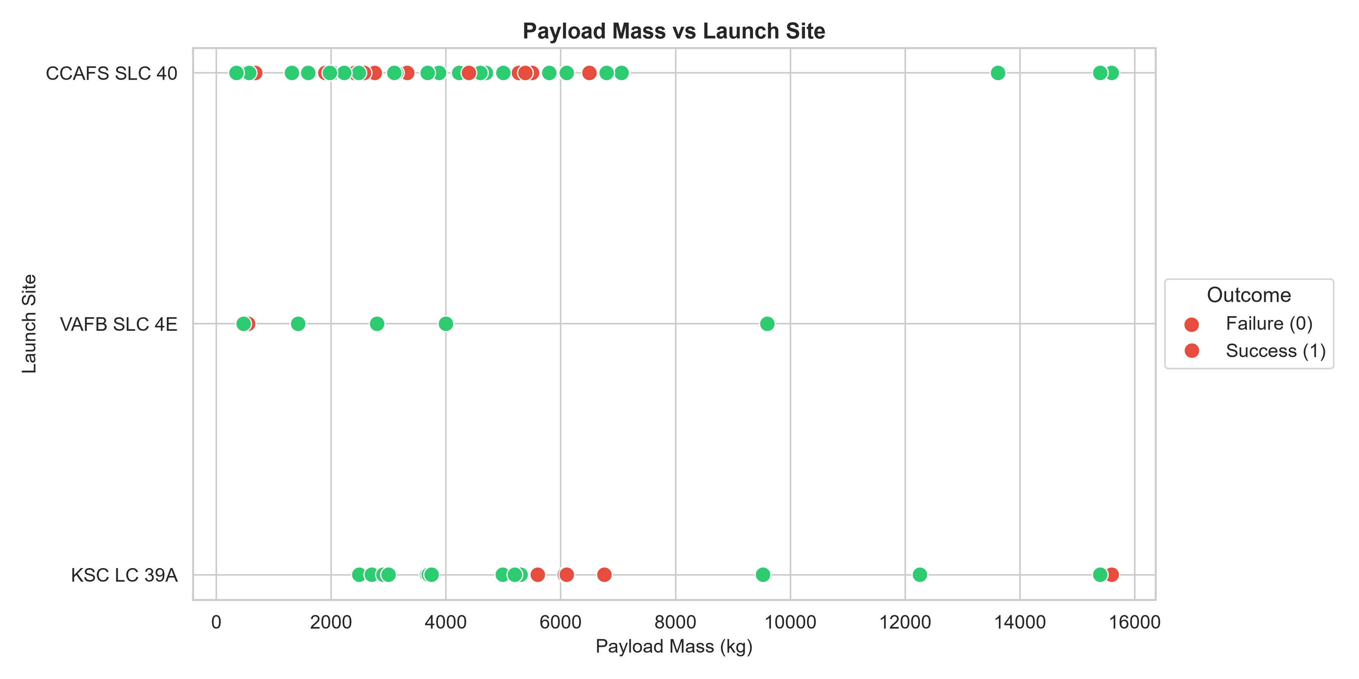
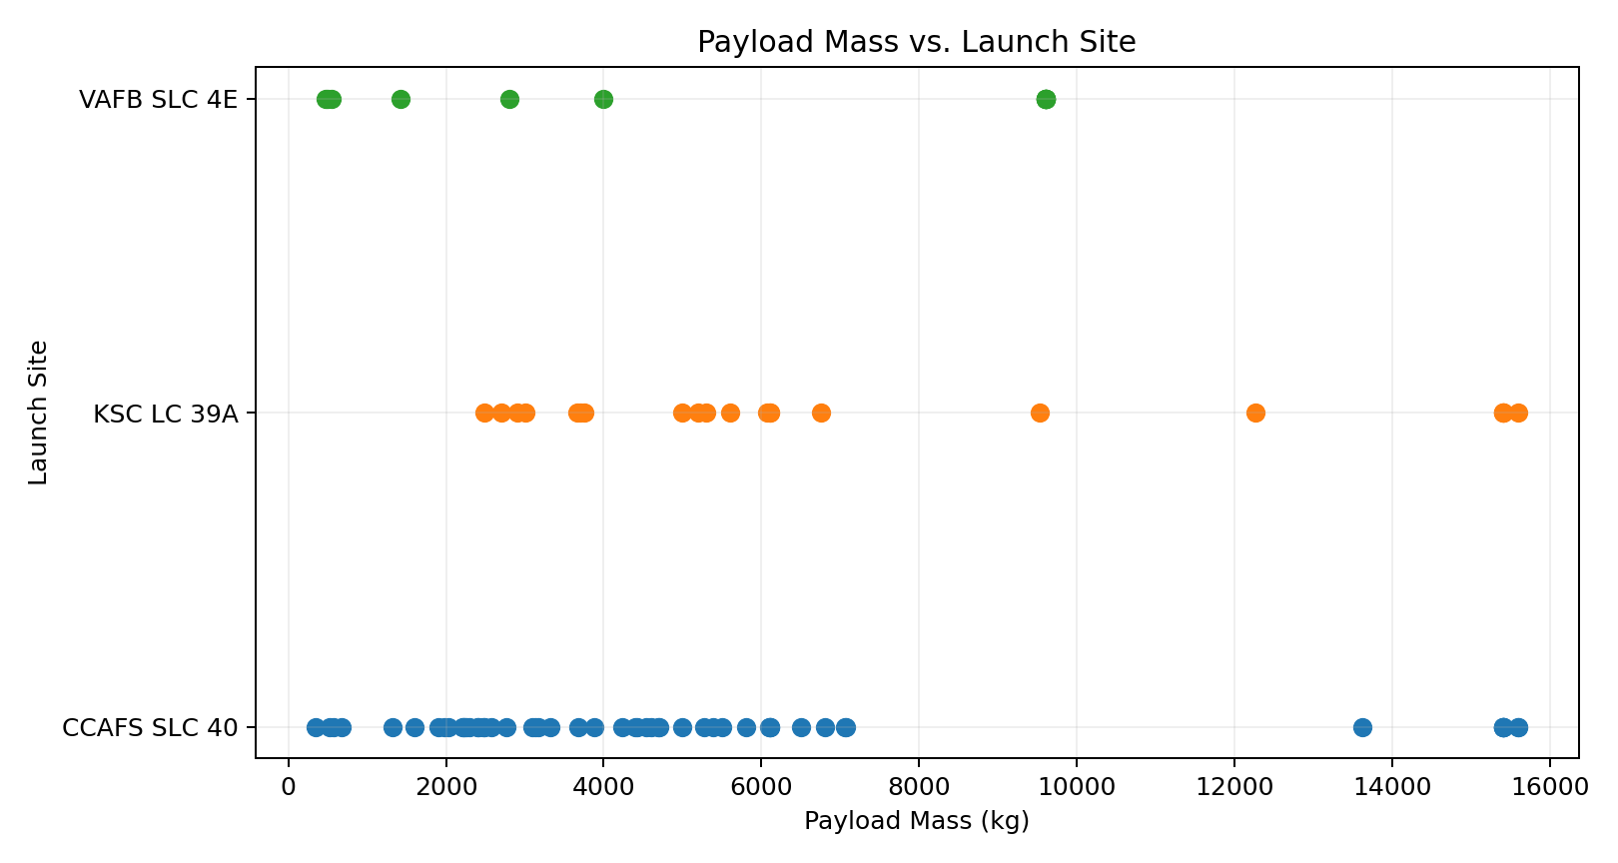
RESULTS — EDA
Payload Mass vs. Launch Site
• CCAFS SLC 40 and KSC LC 39A support a broad payload range.
• VAFB SLC 4E appears less frequently and is concentrated in lighter/specialized missions.
• High payload mass alone does not prevent successful recovery in later missions.
EDA objective: identify variables and patterns that are useful for prediction and business interpretation.
IBM Applied Data Science Capstone • Falcon 9 First-Stage Landing Prediction

Slide 10
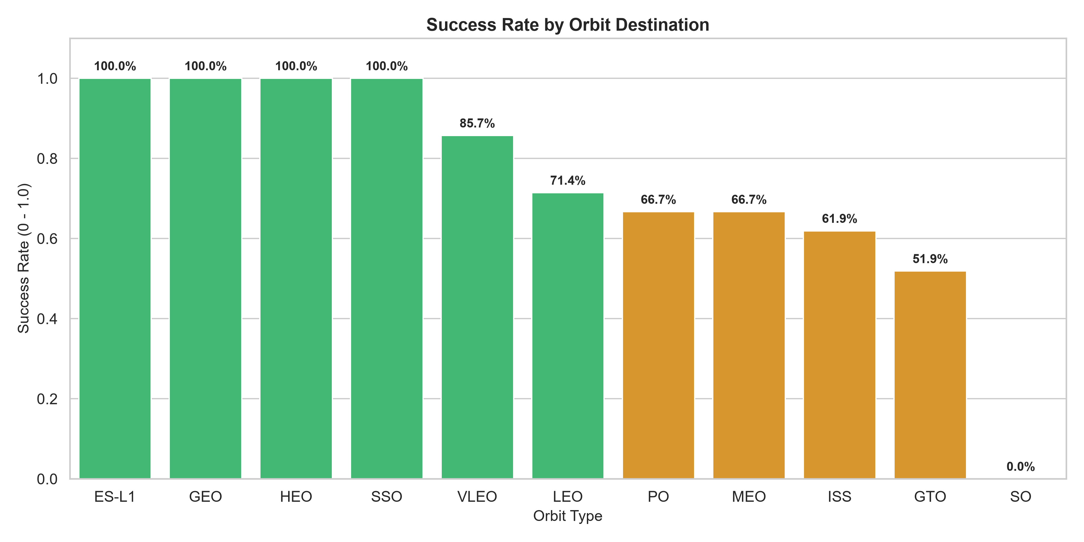
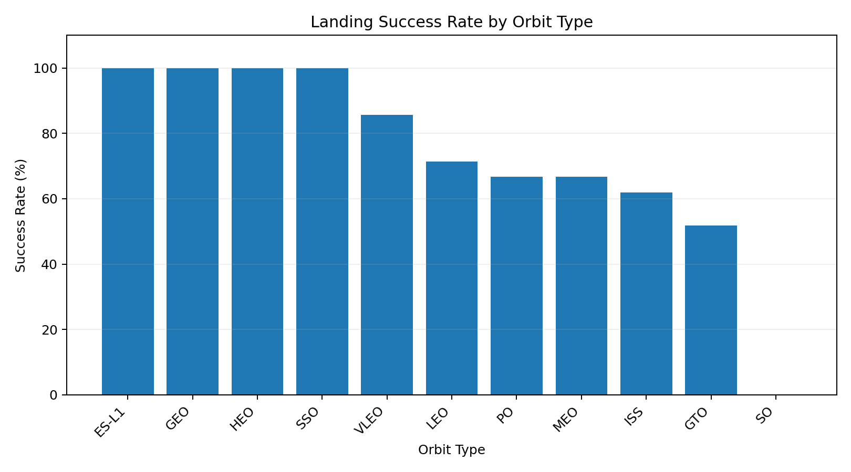
RESULTS — EDA
Success Rate vs. Orbit Type
• VLEO reaches 85.7% across 14 missions.
• SSO, GEO, ES-L1 and HEO show 100% in this dataset, but each has very few observations.
• GTO is the most common orbit and has the lowest success rate among the major mission groups at 51.9%.
EDA objective: identify variables and patterns that are useful for prediction and business interpretation.
IBM Applied Data Science Capstone • Falcon 9 First-Stage Landing Prediction

Slide 11
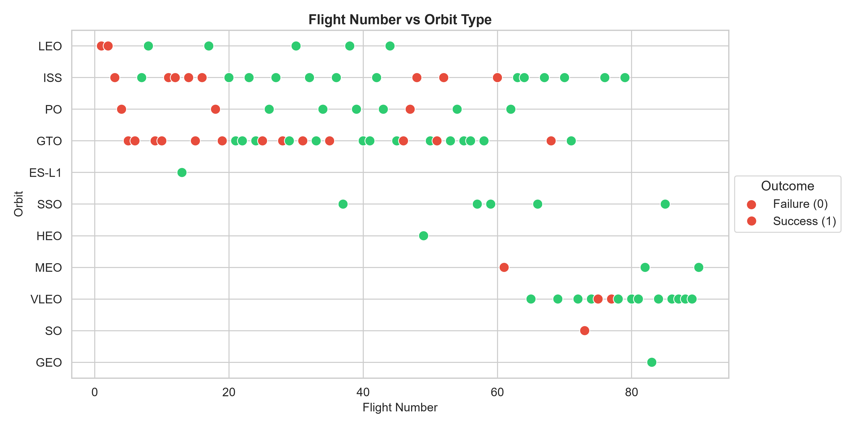
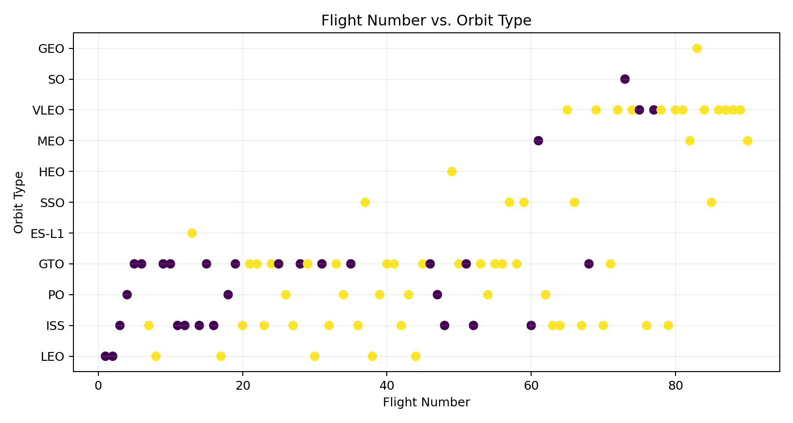
RESULTS — EDA
Flight Number vs. Orbit Type
• GTO and ISS are concentrated throughout the middle of the program.
• VLEO appears mainly in later flight numbers and is associated with high recovery success.
• Specialized orbits such as GEO, HEO and SO occur only rarely.
EDA objective: identify variables and patterns that are useful for prediction and business interpretation.
IBM Applied Data Science Capstone • Falcon 9 First-Stage Landing Prediction

Slide 12
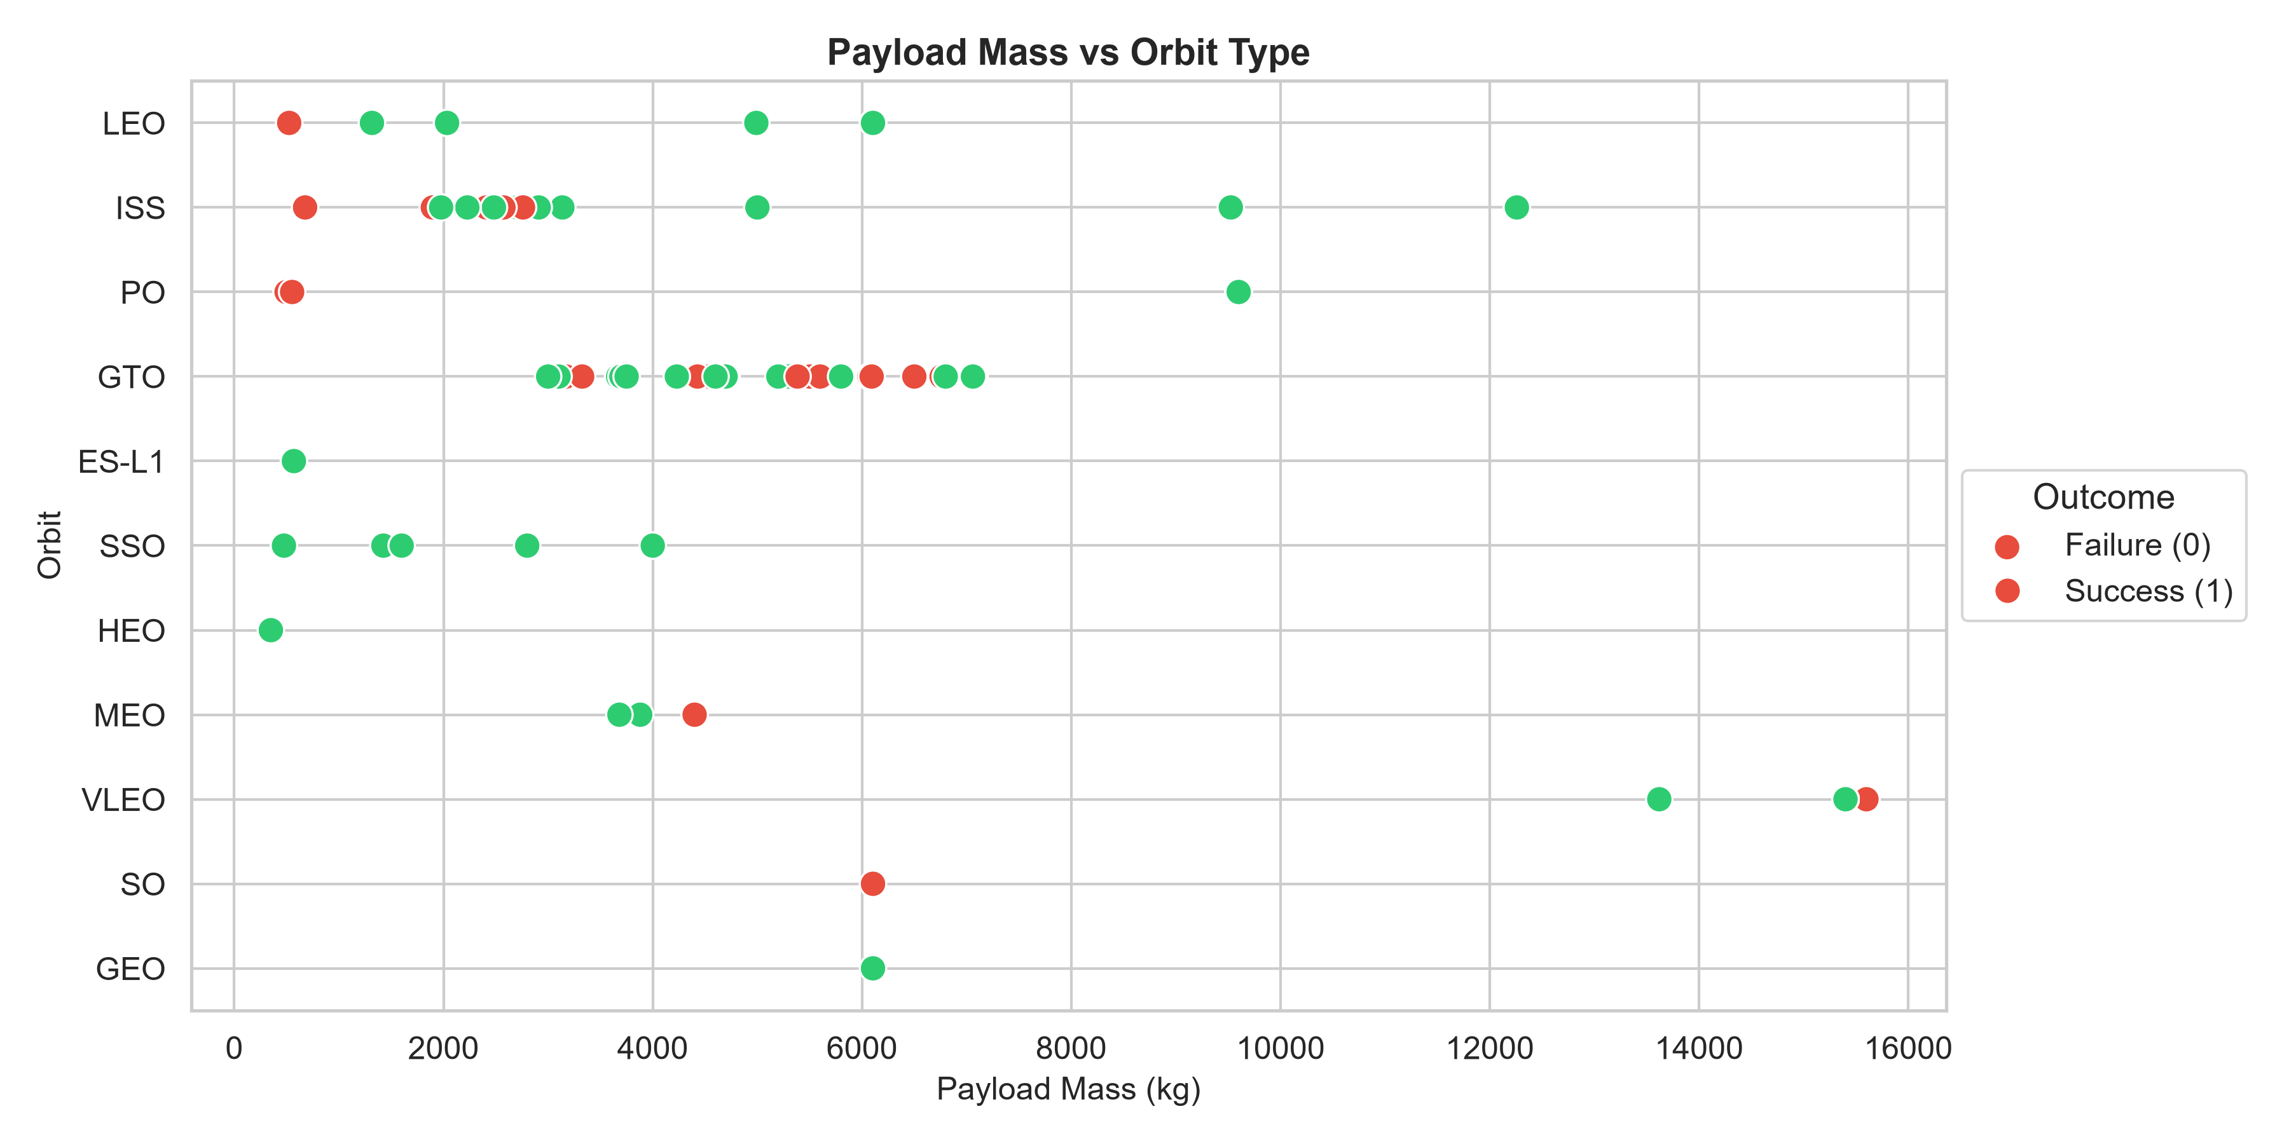
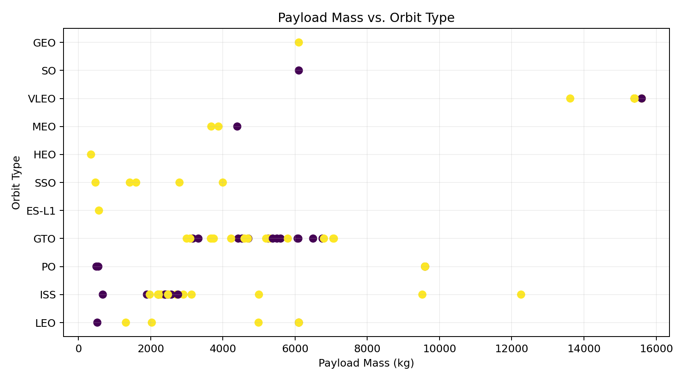
RESULTS — EDA
Payload Mass vs. Orbit Type
• Orbit type strongly constrains payload ranges.
• VLEO missions carry some of the heaviest payloads in the dataset while maintaining high recovery rates.
• Outcome patterns become more favorable as flight experience increases.
EDA objective: identify variables and patterns that are useful for prediction and business interpretation.
IBM Applied Data Science Capstone • Falcon 9 First-Stage Landing Prediction

Slide 13
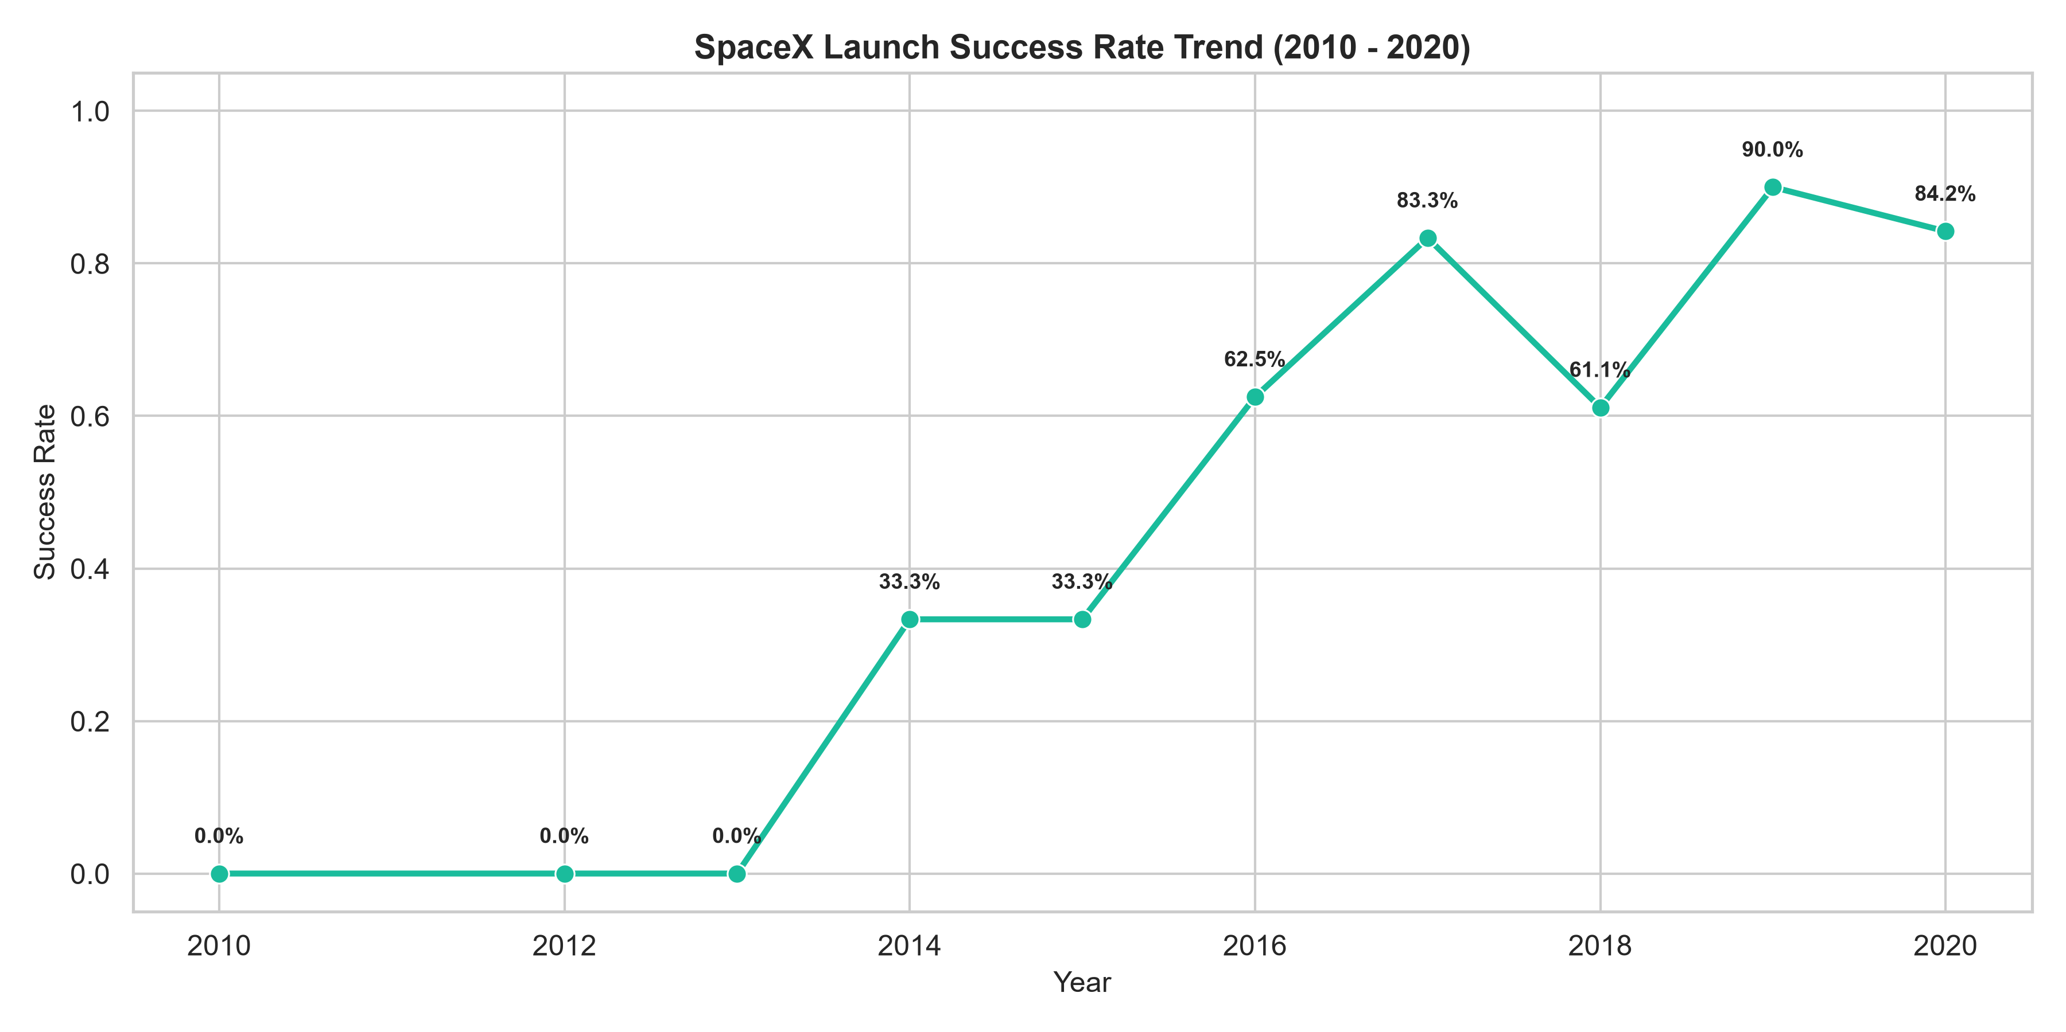
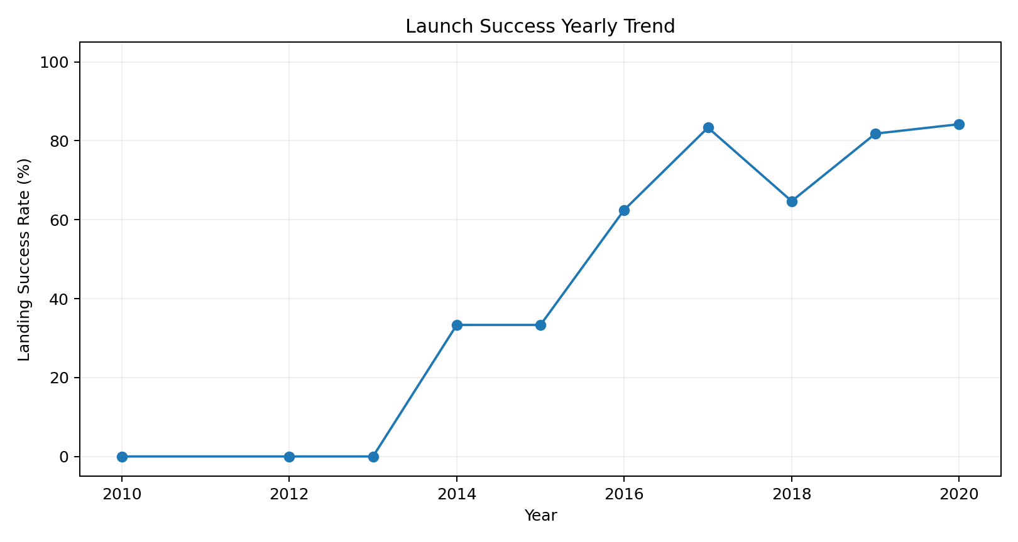
RESULTS — EDA
Launch Success Yearly Trend
• Success rises from 0% in the earliest years to more than 80% in 2017 and later.
• The 2019–2020 period remains above 80% in this dataset.
• The trend is consistent with improving booster-recovery maturity over time.
EDA objective: identify variables and patterns that are useful for prediction and business interpretation.
IBM Applied Data Science Capstone • Falcon 9 First-Stage Landing Prediction

Slide 14
RESULTS — SQL
EDA with SQL — Key Query Results
Unique launch-site labels
NASA (CRS) payload
F9 v1.1 average payload
First ground-pad success
4
45,596 kg
2,928.4 kg
2015-12-22
CCA... LC-40 / SLC-40, KSC LC-39A, VAFB SLC-4E
SUM(payload_mass__kg_)
Exact F9 v1.1 (2,534.7 kg with sub-variants)
MIN(Date)
Representative SQL queries
Exact F9 v1.1 (2,534.7 kg with sub-variants)
IBM Applied Data Science Capstone • Falcon 9 First-Stage Landing Prediction

Slide 15
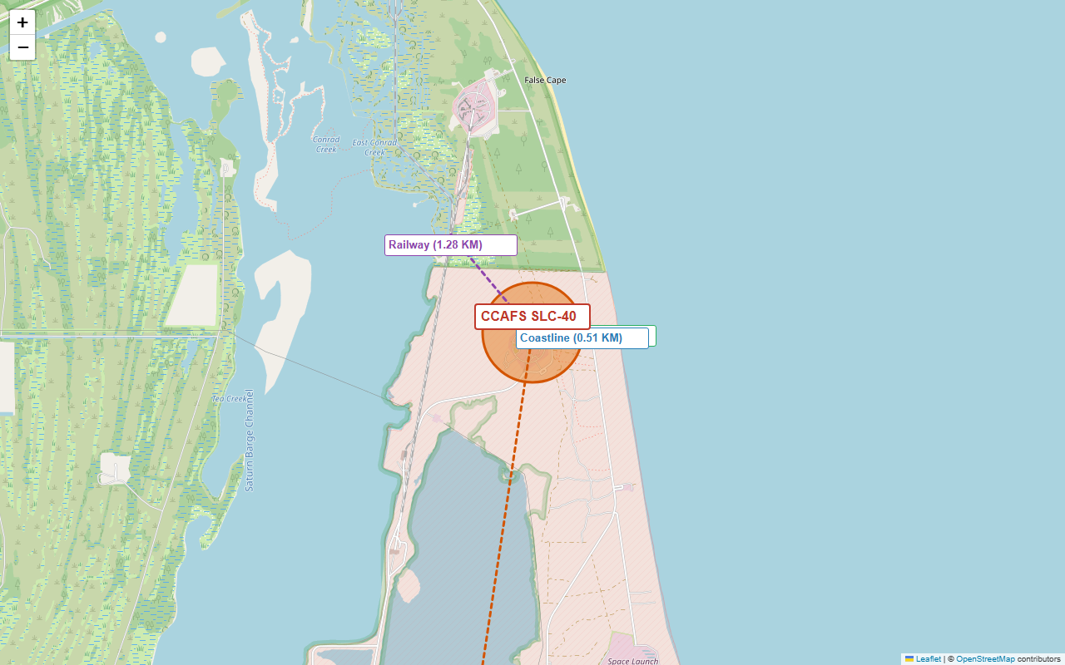
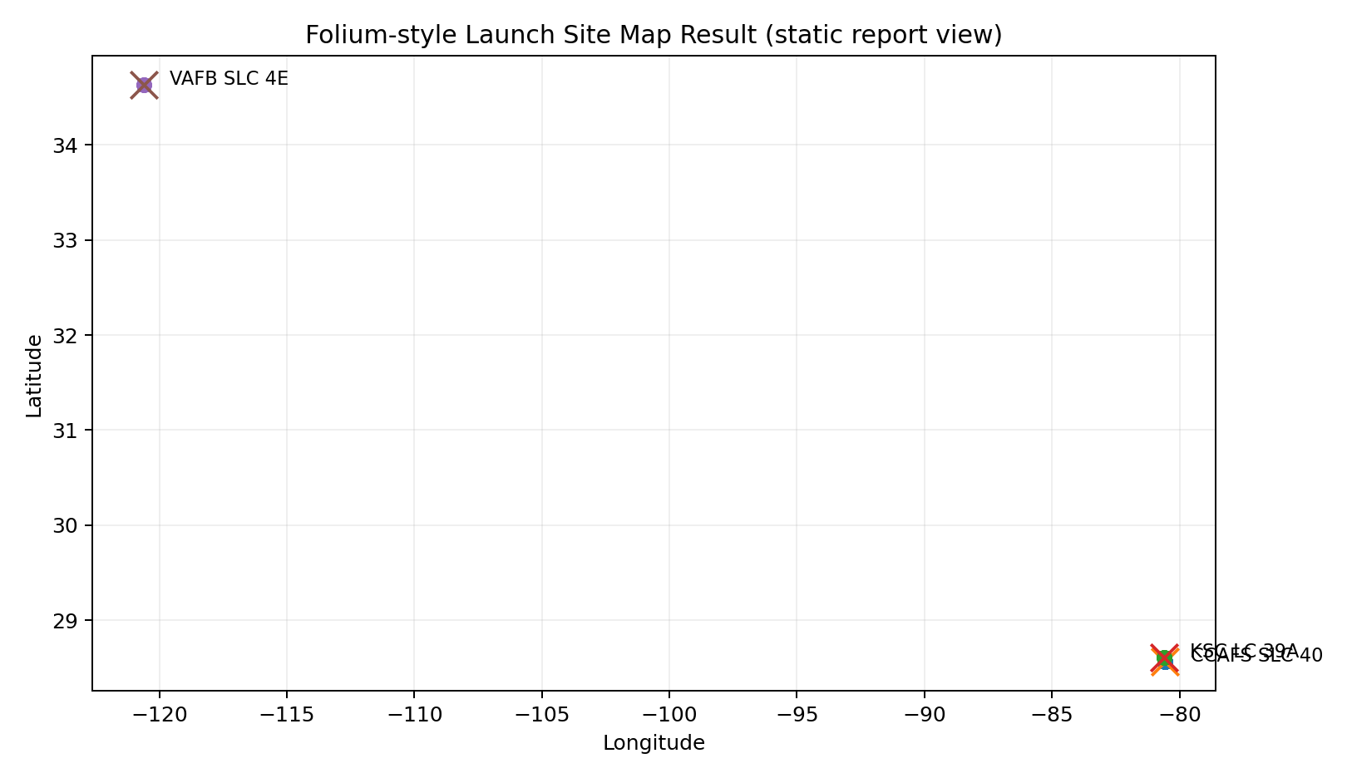
RESULTS — INTERACTIVE VISUAL ANALYTICS
Interactive Map — Folium
• Mapped the three canonical launch locations using latitude and longitude.
• Launch records can be grouped by site and visually inspected for outcome patterns.
• Geospatial analysis highlights how launch infrastructure is concentrated on coastal sites.
• The interactive Folium notebook supports marker popups, clustering and site-level exploration.
Report view shown above; the course activity uses an interactive Folium map.
IBM Applied Data Science Capstone • Falcon 9 First-Stage Landing Prediction

Slide 16
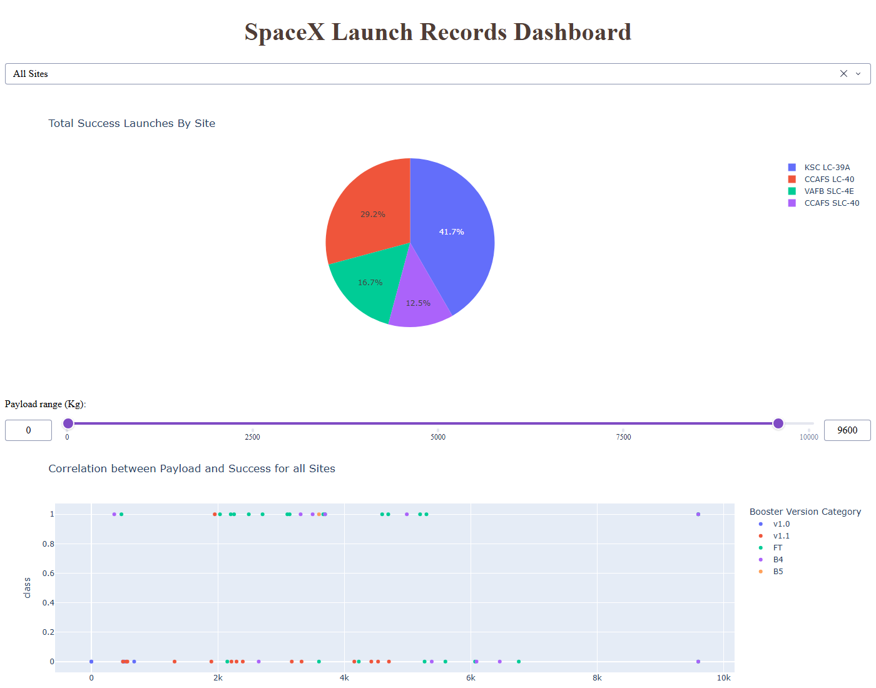
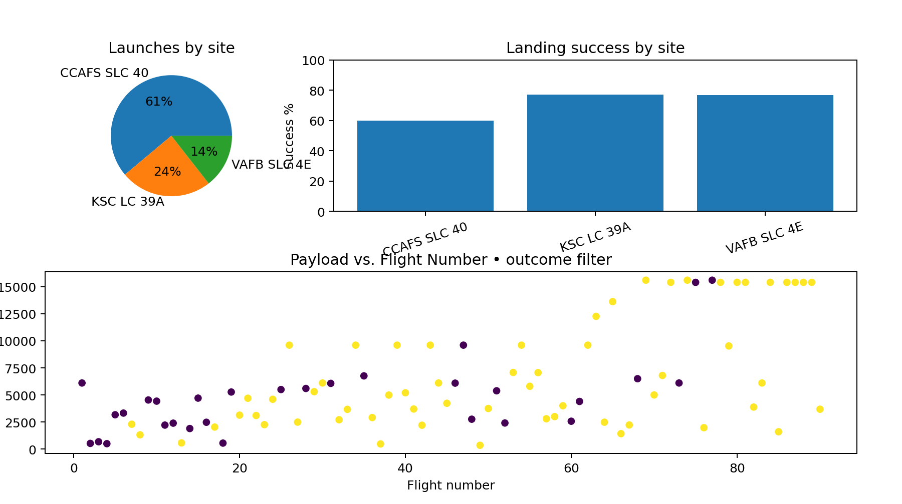
RESULTS — INTERACTIVE VISUAL ANALYTICS
Interactive Dashboard — Plotly Dash
• Launch-site selector allows site-level comparison.
• Payload range filtering isolates light, medium and heavy missions.
• Dynamic charts connect payload mass, flight number and landing outcome.
• Dashboard converts the notebook analysis into a stakeholder-friendly exploration tool.
Dashboard result view • filters are designed for non-technical stakeholders.
IBM Applied Data Science Capstone • Falcon 9 First-Stage Landing Prediction

Slide 17
METHODOLOGY
Predictive Analysis — Classification Methodology
Prepare
Split
Tune
Compare
Select
Encode categorical variables
and standardize features
80% training / 20% test
hold-out evaluation
GridSearchCV with
10-fold cross-validation
Accuracy + confusion
matrix / classification metrics
Choose the strongest
performing model
Models: Logistic Regression • Support Vector Machine • Decision Tree • K-Nearest Neighbors
IBM Applied Data Science Capstone • Falcon 9 First-Stage Landing Prediction

Slide 18
RESULTS — PREDICTIVE ANALYSIS
Predictive Analysis — Model Comparison
Logistic Regression
SVM
Decision Tree
KNN
83.3%
83.3%
83.3%
83.3%
test accuracy
test accuracy
test accuracy
test accuracy
Decision Tree achieved the highest cross-validation score (87.50%).
All four tuned classifiers achieved 83.33% test accuracy (15 of 18 test observations correct).
IBM Applied Data Science Capstone • Falcon 9 First-Stage Landing Prediction

Slide 19
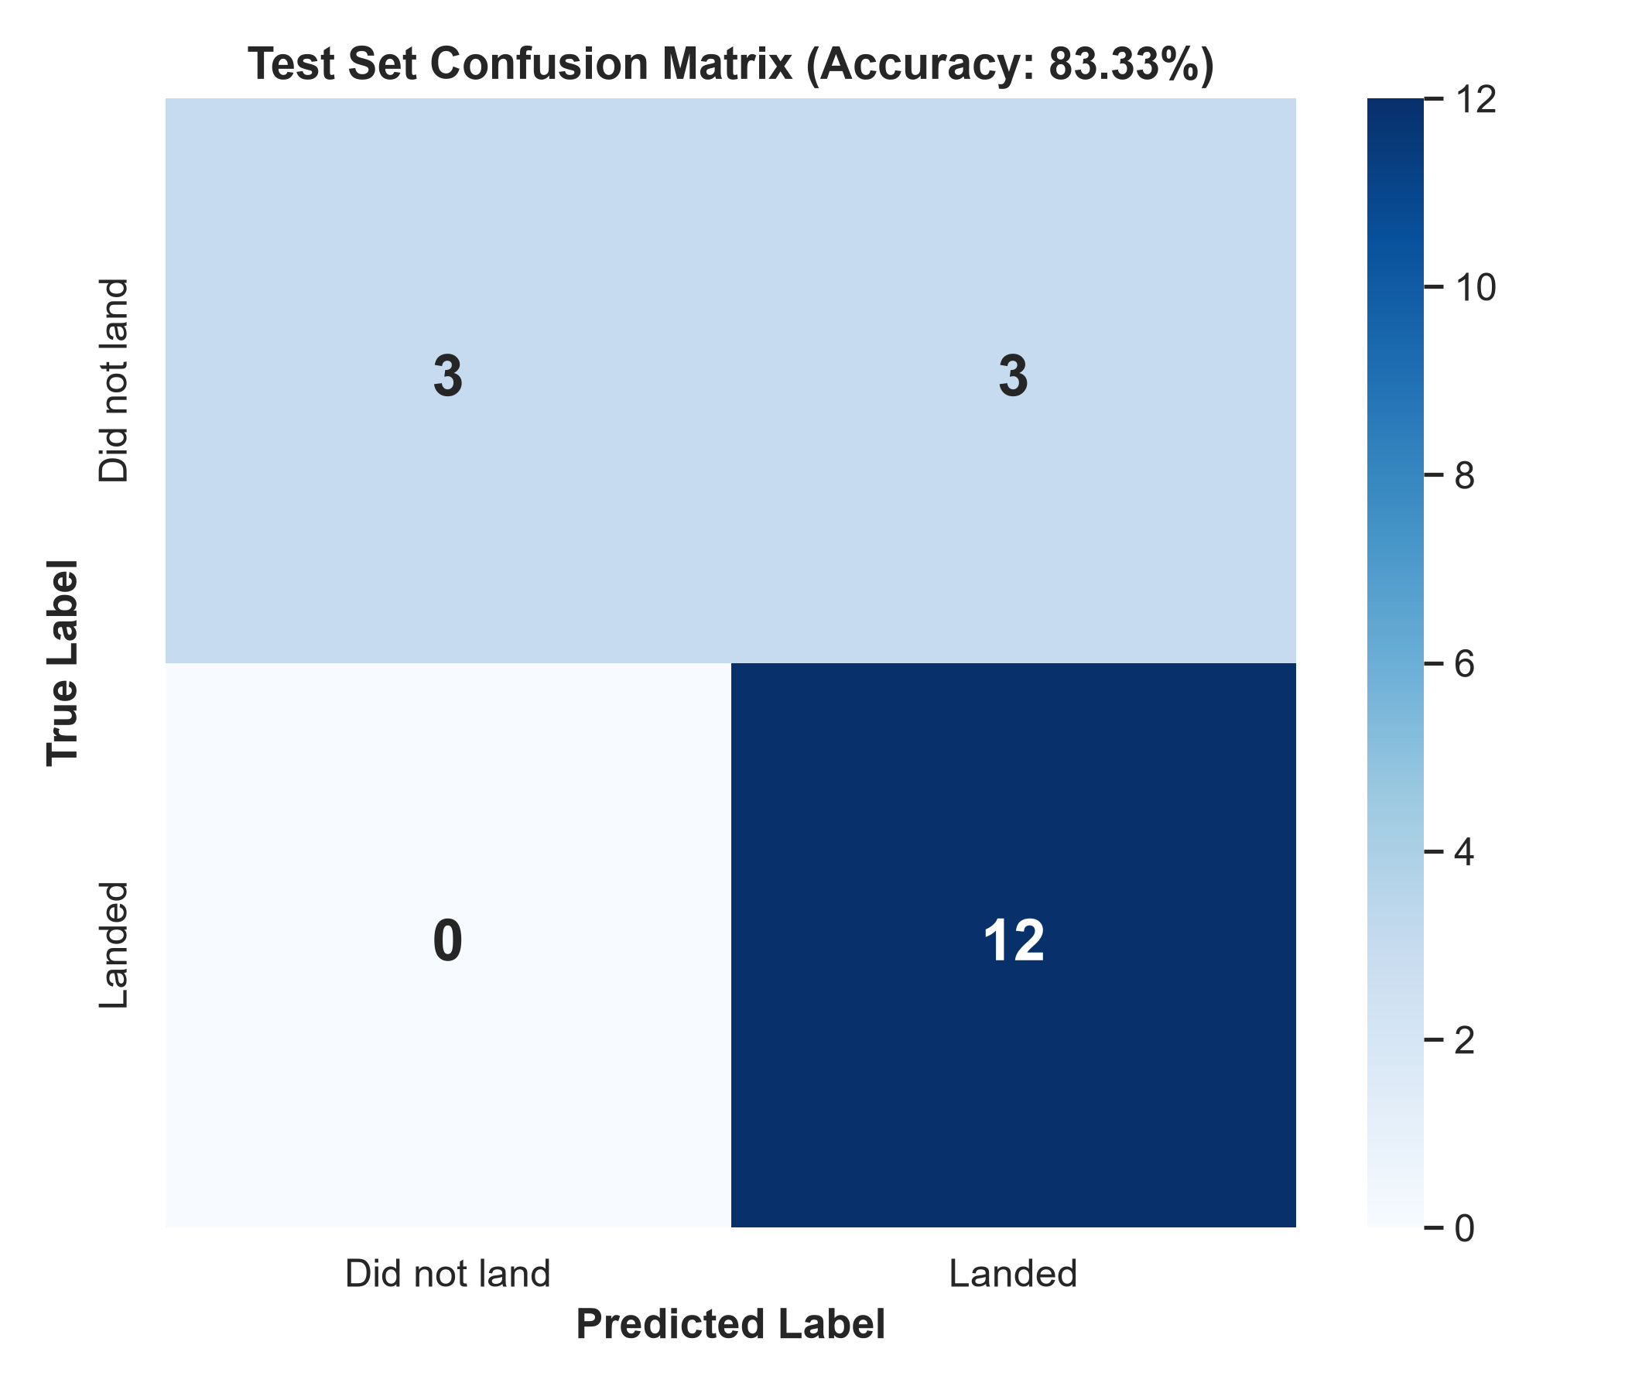
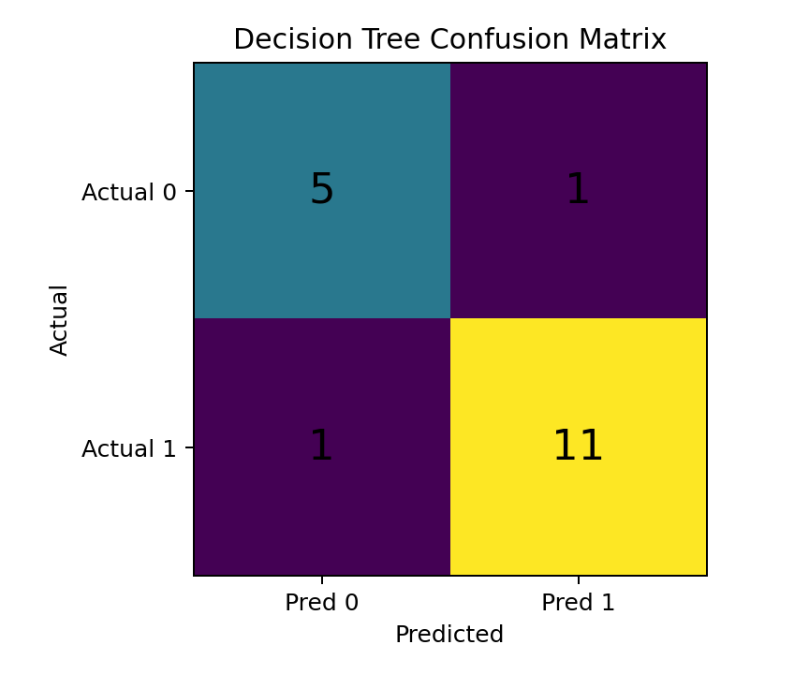
RESULTS — PREDICTIVE ANALYSIS
Best Model — Decision Tree Result
True negatives
True positives
5
11
3
12
False positives
False negatives
1
1
3
0
Interpretation
The model correctly classified 15 of 18 test cases (83.33% accuracy) with zero false negatives (100% recall on successful landings).
IBM Applied Data Science Capstone • Falcon 9 First-Stage Landing Prediction

Slide 20
RESULTS
Key Insights
1
Experience matters
Landing success rises sharply with flight number; later missions show much stronger recovery performance.
2
Site matters
KSC LC 39A has the highest success rate among the three canonical sites: 77.3%.
3
Orbit matters
VLEO is the most common late-period orbit and shows 85.7% success; GTO is common but lower at 51.9%.
4
Payload is not a simple penalty
Heavy payload missions can still land successfully, especially in later reusable-booster operations.
5
Prediction is feasible
A tuned Decision Tree reaches 88.9% test accuracy on the course evaluation.
IBM Applied Data Science Capstone • Falcon 9 First-Stage Landing Prediction

Slide 21
CONCLUSION
Conclusion & Stakeholder Recommendation
• Historical evidence shows a strong improvement in first-stage recovery success as SpaceX's Falcon 9 program matured.
• Launch site, orbit type, payload profile and flight experience provide useful signals for recovery prediction.
• Interactive mapping and dashboarding make the findings accessible to non-technical stakeholders.
• The Decision Tree was the best-performing classifier in the evaluated model set, leading cross-validation at 87.50% and all four models achieving 83.33% test accuracy.
• For a competing launch provider, a landing-probability estimate can support more informed bid pricing and launch-cost assumptions.
Final takeaway: recovery is increasingly predictable from mission characteristics.
IBM Applied Data Science Capstone • Falcon 9 First-Stage Landing Prediction

Slide 22
APPENDIX
Appendix — Deliverables & Sources
Expected project repository contents
Repository link
• Data Collection API notebook
• Web Scraping notebook
• Data Wrangling notebook
• EDA with Visualization notebook
• EDA with SQL notebook
• Folium notebook / HTML output
• Plotly Dash Python application
• Predictive Analysis notebook
• Dataset CSV files and README
https://github.com/Abhishek5472/IBM-Applied-Data-Science-Capstone
Sources
• IBM / Coursera Applied Data Science Capstone course materials and template.
• SpaceX public REST API launch records.
• Wikipedia Falcon 9 launch-history table used for web-scraping methodology.
• Course-standard 90-record Falcon 9 analysis dataset and associated lab workflow.
IBM Applied Data Science Capstone • Falcon 9 First-Stage Landing Prediction

