Slide 1

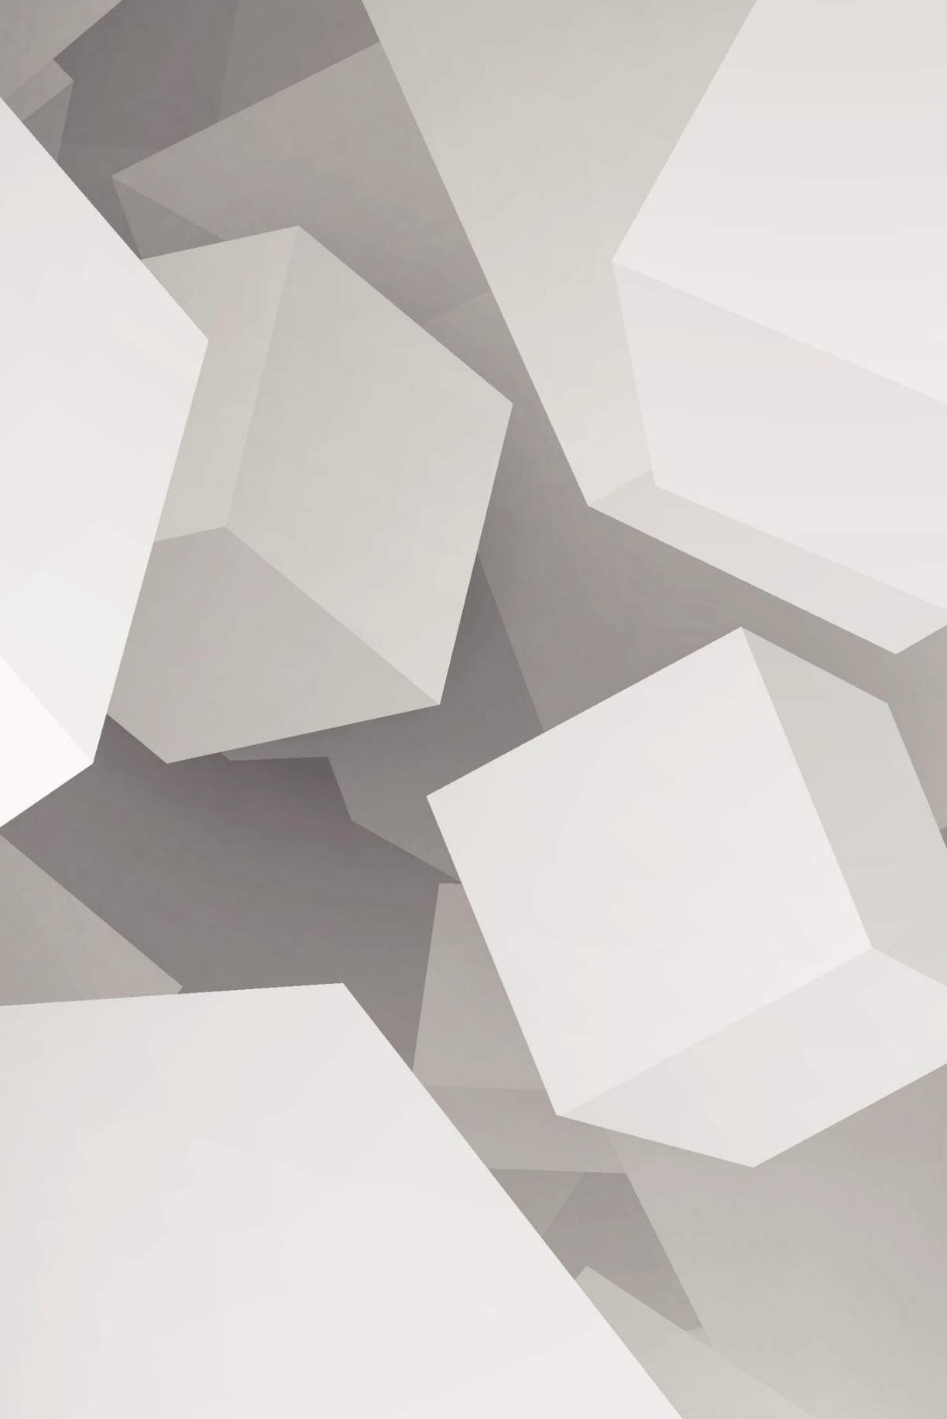
AI Virtual Mouse
Presented By-
Aastha Gupta
Abhishek Kumar
Mentored by-
Neelam Rawat Mam

Slide 2
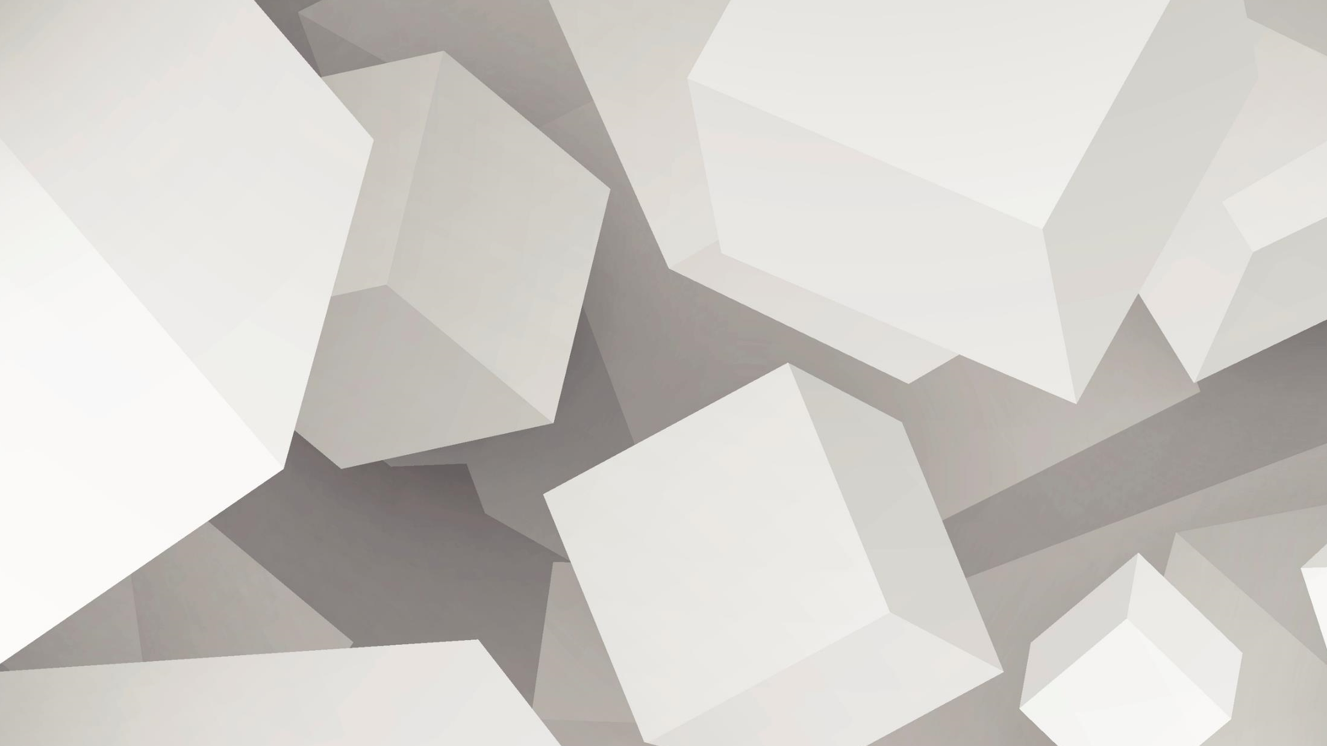
Introduction
This project is to develop an AI virtual Mouse using Hand Gesture Recognition.
The Hand Gesture are the effortless and natural way of communication.
The aim of perform various operation of the cursor.
It helps the user to interact with a computer without any physical and hardware device to control mouse operation.
In the proposed system, the web camera captures and then process the frames that have been captured then recognize the various hand gestures and hand tip gestures, and then performs the mouse function.

Slide 3
Technologies
Python
Python is a high-level, interpreted programming language. It is a robust, highly useful language focused on rapid application development (RAD). Python helps in the easy writing and execution of codes. Python can implement the same logic with as much as 1/5th code as compared to other OOPs languages. Python provides a huge list of benefits to all. The usage of Python is such that it cannot be limited to only one activity. Its growing popularity has allowed it to enter some of the most popular and complex processes like Artificial Intelligence (AI), Machine Learning (ML), natural language processing, Data science, etc. Python has a lot of libraries for every need of this project such as Pytube,Pyttsx3,mediapie for downloading videos, selenium for web automation, for accessing the camera and for the computations, etc. . Python is reasonably efficient. Efficiency is usually not a problem for small examples. If your Python code is not efficient enough, a general procedure to improve it is to find out what is taking most of the time and implement just that part more efficiently in some lower-level languages. This will result in much less programming and more efficient code (because you will have more time to optimize) than writing everything in a low-level language. Python allows the programmer to implement many major functionalities which can not be easily implemented by any other language without making the code or the program robust or redundant as it has included libraries which contain almost all the things that are needed while designing a major application.

Slide 4
Software and Hardware Requirements
Processor i5 and above
4 GB Ram and above
Processor i5 and above
Python

Slide 5

Proposed System
Start video Interface Using Webcam
Hand Landmark detection
Recognize Hand Gesture
Control Mouse Interaction
Perform Cursor Operation

Slide 6
Modules Description
1. Accessing Camera
The main function of the application will be done or achieved by the camera as it will act as the input source from where the application will take the command in the form of gestures and will perform the task.
2. Hand Gesture recognition
The application will try to recognize the hand movement from the functionality and the signs that are needed and will perform the task accordingly to that.
3. Performing Tasks
After the recognition of the gestures the app will perform the task by the task liking moving if the cursor selecting clicking on selected things selecting and the other tasks

Slide 7
METHODOLOGY
Operations of cursor:
Hand Landmark detection up(1) and down(0).
Move
Left Click
Double Click
Right click
Scroll Up
Scroll down
Brightness Control
Steps:
1. It will detect the camera, video interface will be start.
2. The camera can extract and recognize human hand gesture from and recognize.
3. Hand tracking functionality is done by media_pie.
4. After the recognition the cursor move accordingly, to perform various operation

Slide 8
FUNCTIONING
MOVE CURSOR
SCROLLING GESTURE

Slide 9
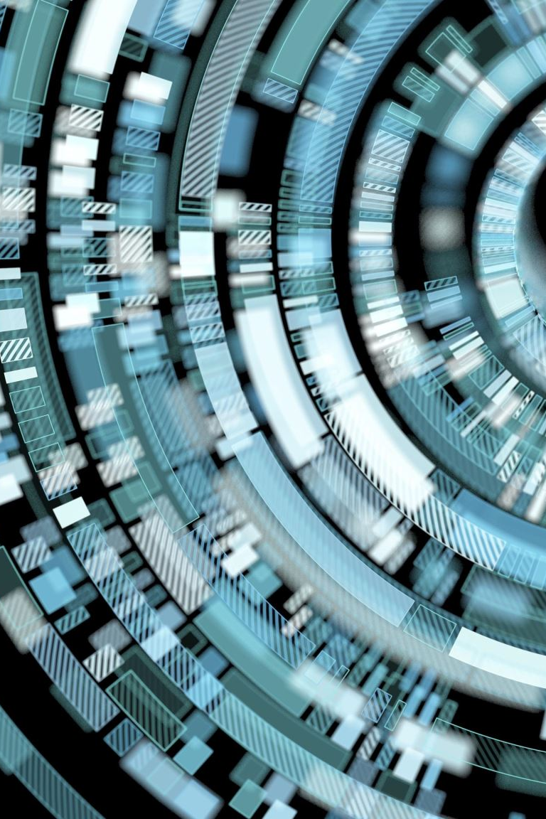
Conclusion
In conclusion, it is no surprise that the physical mouse will be replaced by a virtual non-physical mouse in the Human-Computer Interactions (HCI), where every mouse movement can be executed with a swift of your fingers everywhere and anytime without any environmental restrictions. This project had developed a colour recognition program with the purpose of replacing the generic physical mouse without sacrificing the accuracy and efficiency, it is able to recognize colour movements, and combinations, and translate them into actual mouse functions. Due to accuracy and efficiency playing a significant role in making the program as useful as an actual physical mouse, a few techniques had to be implemented.

Slide 10
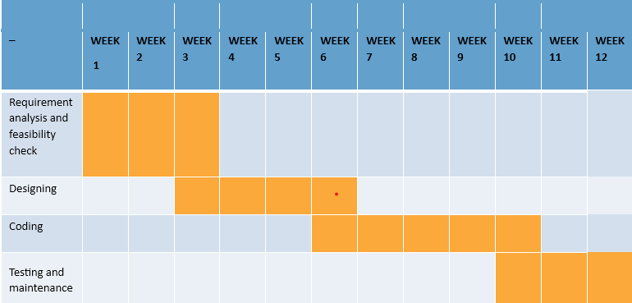
Gantt Chart

Slide 11

THANK YOU

