Slide 1

NYC Air Quality Analysis Using a Dimensional Data Warehouse
Module Title: Data Storage Solutions for Data Analytics
Module Code: B9DA111
Module Lecturer : Dr Luciana Nascimento
Programme: MSc in Data Analytics
Presented By:
Abhishek Shrivas(20035356) Kingsley Ogidi(20038983)
Fatih Husnu Basbagi(20046748)

Slide 2

Project Background
New York City experiences significant air quality challenges affecting millions of residents.
Pollutants like PM2.5, NO₂, and O₃ contribute to respiratory illnesses and environmental degradation.
The project aims to build a dimensional data warehouse to consolidate and analyze multi-source air quality data.
Deliver meaningful insights to support public health interventions and policy decision-making.

Slide 3
Project Objectives
Develop a dimensional data warehouse for structured air quality analytics.
1
Integrate diverse datasets from EPA and NYC Open Data into a unified system.
2
Analyze pollutant trends across time periods and geographic locations.
3
Enable interactive reporting and visualization using Tableau and SSRS.
4
Evaluate relational (SQL Server) and graph-based (Neo4j) database performance for complex data relationships.
5

Slide 4
Business Vision and Stakeholders
Business Vision
Deliver high-quality, actionable insights into New York City's air pollution trends.
Support evidence-based policymaking to improve public health outcomes and urban living conditions.
Empower stakeholders with dynamic, data-driven decision support tools.
Key Stakeholders
Government Agencies: NYC Department of Environmental Protection (DEP), Environmental Protection Agency (EPA).
Public Health Institutions: Hospitals, healthcare researchers, epidemiologists.
Urban Planners and Policy Makers: City developers, infrastructure authorities.
Non-Governmental Organizations (NGOs): Environmental advocacy groups.
General Public: Citizens, especially vulnerable groups like children and the elderly.

Slide 5
Data Sources and Challenges
Data Sources :-
Environmental Protection Agency (EPA):
Air quality measurements for key pollutants (PM2.5, NO₂, O₃).
NYC Open Data Portal:
Supplementary health and environmental datasets (hospitalizations, demographic statistics).
Key Challenges :-
Data Inconsistency:
Variations in formats, units, and structures across datasets.
Missing and Incomplete Data:
Gaps in historical records and real-time monitoring.
Large Data Volume:
Managing and transforming high-frequency, multi-source datasets.
Data Quality Assurance:
Need for strong ETL processes to ensure integrity, consistency, and reliability.

Slide 6
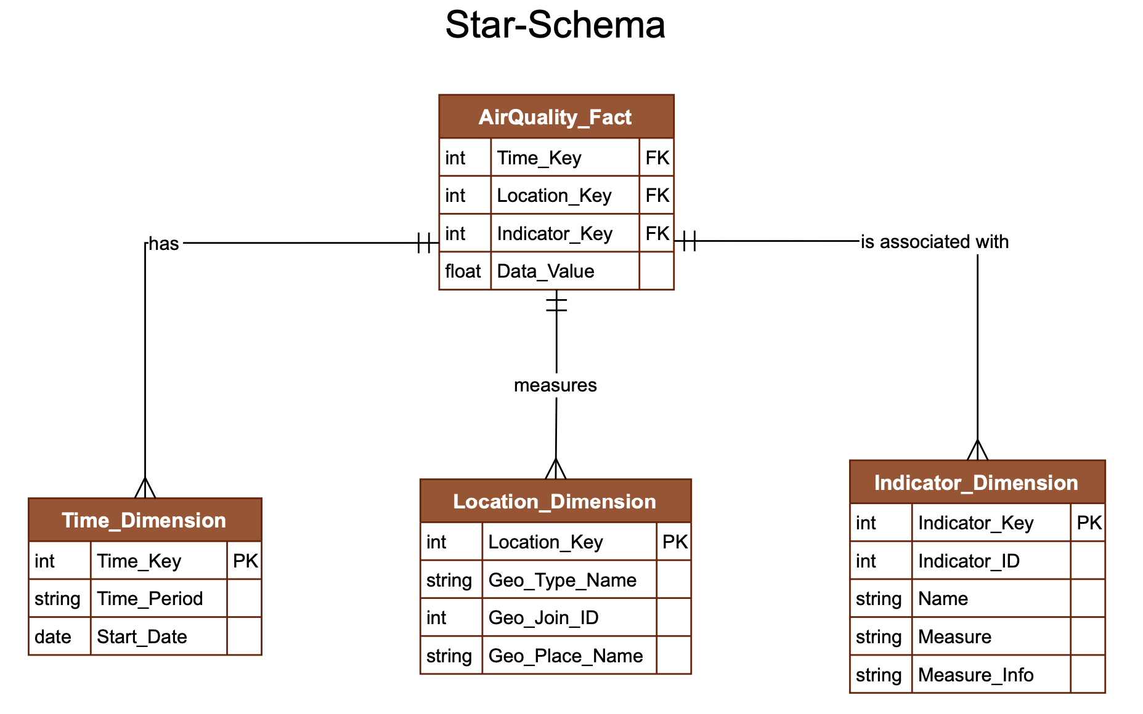
Dimensional Modeling
Schema Design Approach
Adopted a Star Schema for simplicity, fast querying, and intuitive analytics.
Fact Table
AirQuality_Fact:
Captures pollutant measurements and associated health indicators.
Linked to all dimensions via foreign keys.
Dimension Tables
Time_Dimension:
Tracks periods, seasons, and dates for temporal analysis.
Location_Dimension:
Stores geographic information: boroughs, districts, neighborhoods.
Indicator_Dimension:
Defines pollutant types (e.g., PM2.5, NO₂, O₃) and related health metrics.
Benefits
Simplified query structure.
Efficient aggregation across time, location, and pollutant types.
Scalable and extensible for future data sources.

Slide 7
ETL Process Overview
Extract
Gathered raw air quality and health-related data from EPA and NYC Open Data portals.
Imported structured (CSV, Excel) and semi-structured data formats.
Transform
Data cleansing: removal of nulls, duplicates, and inconsistencies.
Standardization of formats: pollutant units, date fields, geographic names.
Data enrichment: mapping to dimension keys (Time, Location, Indicator).
Load
Populated AirQuality_Fact and dimension tables in SQL Server.
Used SSIS (SQL Server Integration Services) for automating ETL workflows.
Built robust error-handling and data validation mechanisms.

Slide 8
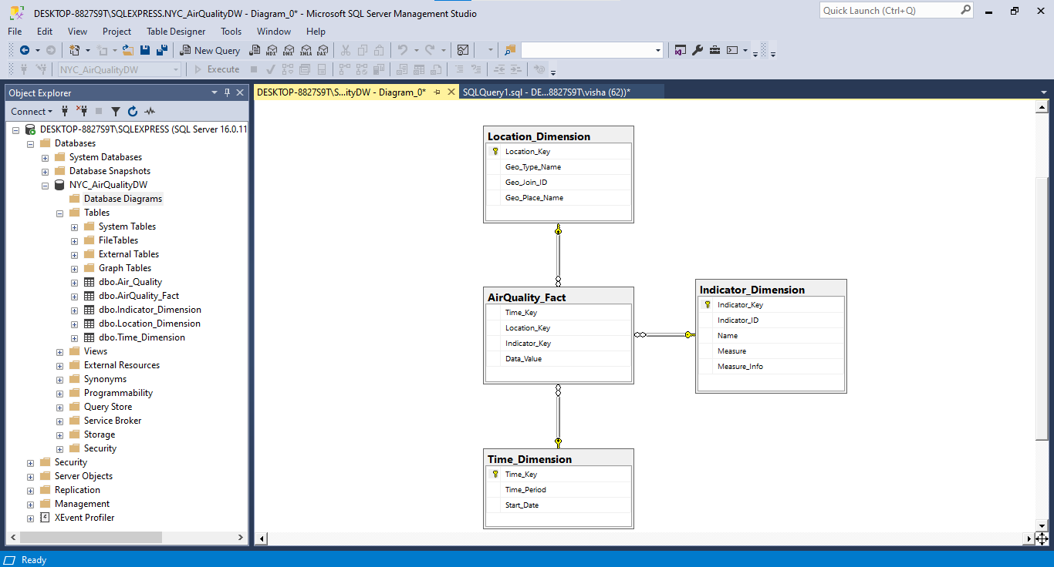
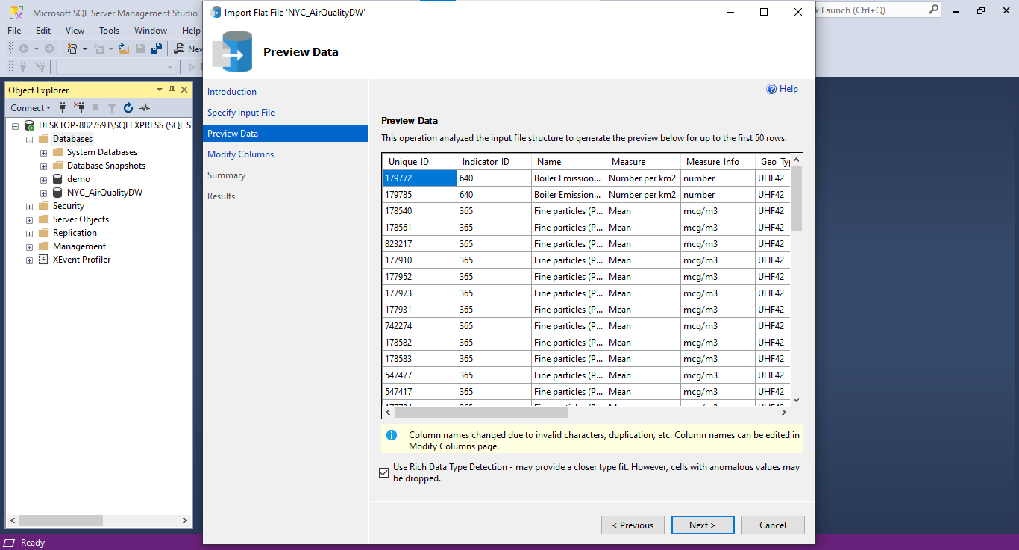
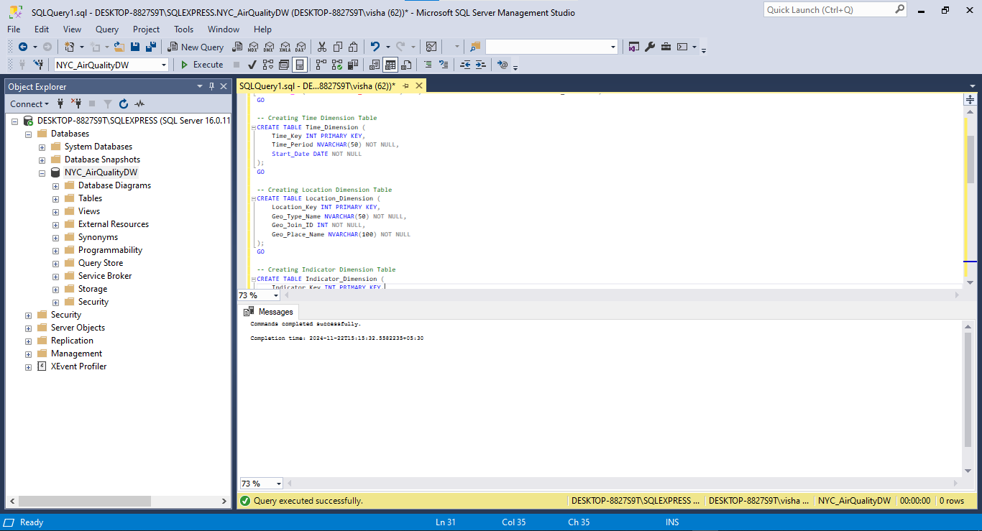
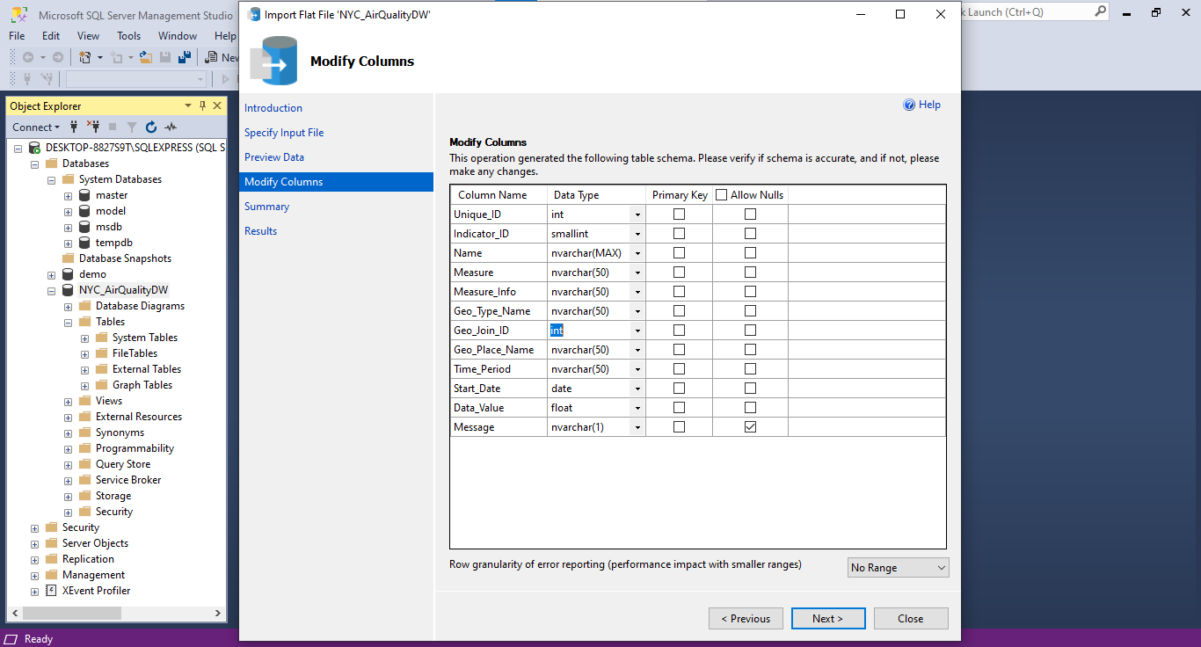

Slide 9
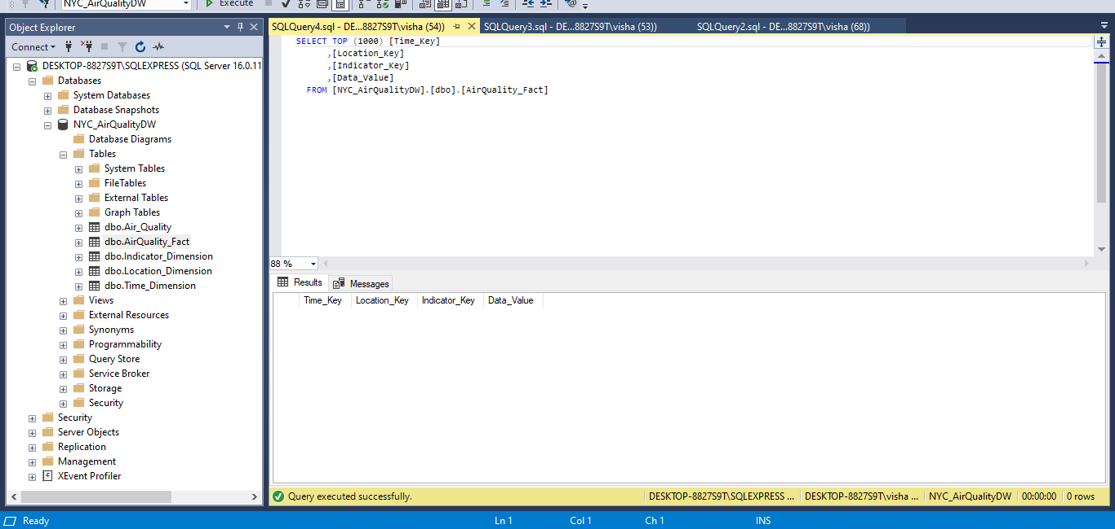
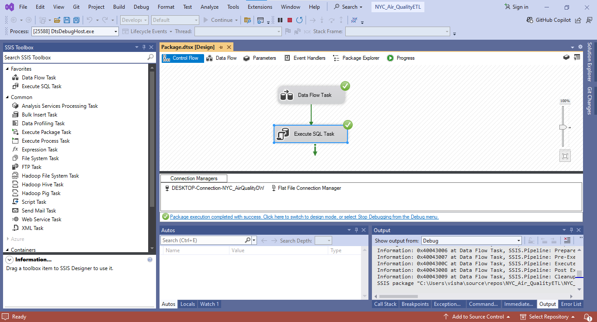
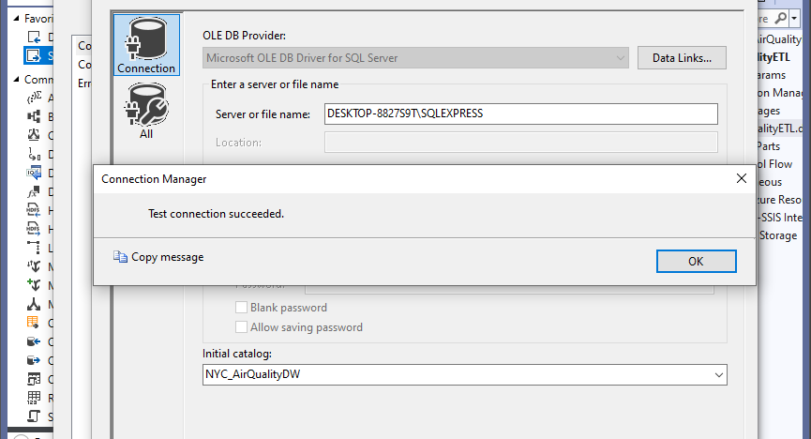
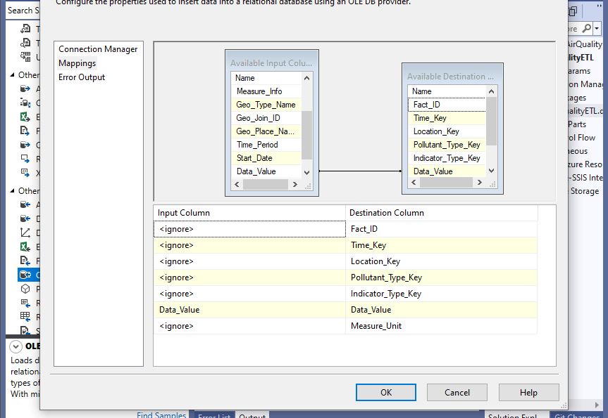
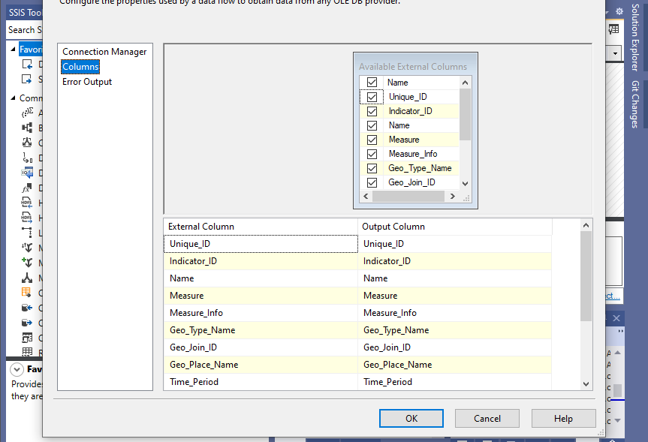
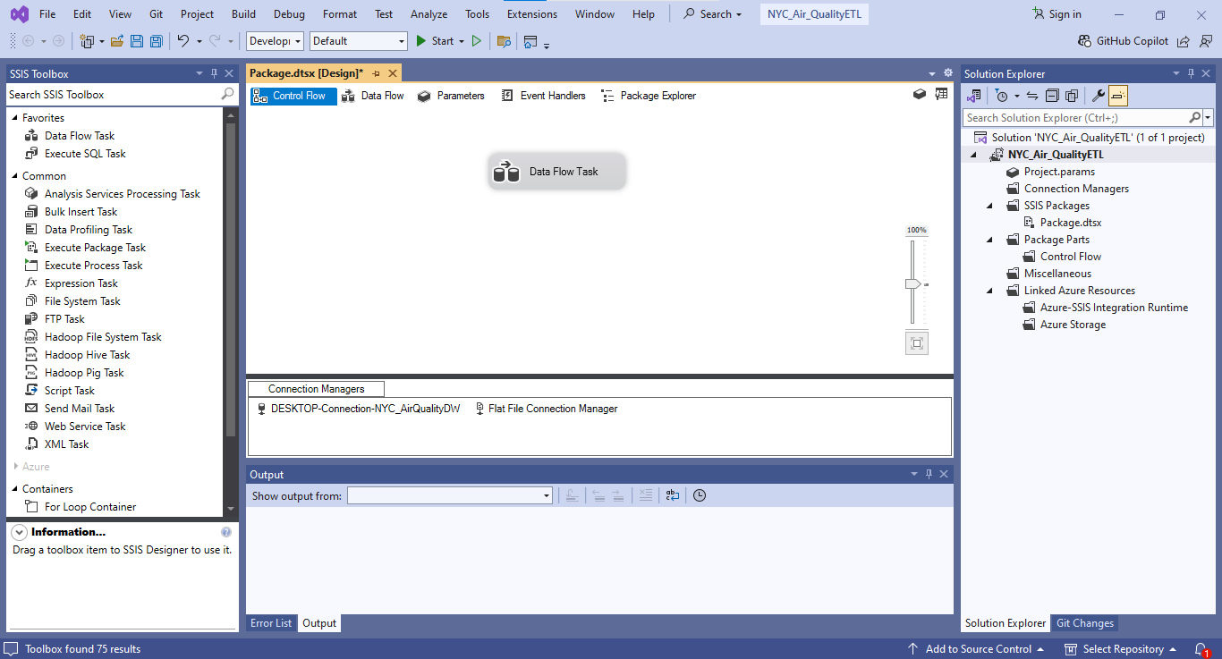

Slide 10

Data Validation and SQL Work
SQL Schema Implementation
Created tables using SQL Server Management Studio (SSMS).
Defined primary keys, foreign keys, and data types to enforce referential integrity.
Validation Procedures
Row count checks between source files and target tables after loading.
Data type validation: Ensured correct formats for dates, numeric pollutant values, and text fields.
Null checks and anomaly detection: Identified missing or outlier values post-load.
Key SQL Scripts
Integrity validation queries to verify fact and dimension table linkages.
Aggregation queries to cross-validate pollutant averages and health statistics.
Error logging scripts integrated into the ETL process for auditability.
Outcome
Achieved high data reliability, accuracy, and readiness for analytics and visualization.

Slide 11
Reporting Insights with SSRS
SSRS Report Development
Created professional, structured reports directly from the data warehouse.
Designed reports to meet the needs of public health officials and city planners.
Key Reports Produced
Daily Pollutant Trends Report:
Tracking daily changes in PM2.5, NO₂, and O₃ across boroughs.
Seasonal Variation Report:
Comparing pollutant levels between winter and summer seasons.
Borough Health Impact Report:
Linking borough-level pollution to asthma and respiratory hospitalization rates.
Annual Summary Report:
Providing year-over-year air quality comparisons for long-term planning.
Features and Benefits
Parameterized reports for borough, pollutant, and date filters.
Exportable to Excel, PDF, and web-based formats for easy distribution.
Drill-through capabilities for deeper analysis.
Outcome
Delivered highly detailed, customizable reporting to support data-driven environmental policy decisions.

Slide 12

Visual Analytics with Tableau
Dashboard Overview
Designed an interactive Tableau dashboard showcasing NYC air quality trends.
Connected Tableau directly to the SQL Server data warehouse for live updates.
Key Visualizations
Spatial Analytics:
Borough-level pollution heatmaps highlighting PM2.5, NO₂, and O₃ concentrations.
Time-Series Trends:
Seasonal and annual pollutant variation charts for trend analysis.
Borough Comparisons:
Visual comparisons of average pollutant levels across boroughs.
Health Impact Analysis:
Correlating pollution levels with asthma emergency visits and respiratory hospitalizations.
User Interactivity
Filters by borough, pollutant type, and time period.
Drill-down capabilities for exploring specific seasons or neighborhoods.
Outcome
Empowered stakeholders with intuitive, real-time exploration of complex air quality data.

Slide 13
Relational vs. Graph Database Comparison
Relational Database (SQL Server)
Data modeled in structured tables with primary and foreign keys.
SQL JOINs used to connect multiple tables for complex queries.
Strengths:
Well-suited for flat, structured data.
Strong support for standardized reporting and transactional systems.
Limitations:
Multi-level JOINs become complex and slow as relationships deepen.
Less intuitive for highly connected datasets (e.g., social networks, environmental systems).
Graph Database (Neo4j)
Data modeled as nodes (entities) and relationships (connections).
Cypher Query Language (CQL) simplifies complex relationship querying.
Strengths:
Fast relationship traversal even across multiple hops.
More natural for exploring connections, patterns, and influence chains.
Limitations:
Requires rethinking traditional relational structures.
Higher memory consumption for very large graphs if not optimized.

