Slide 1

Getting started with TypeScript
Anup Vasudeva

Slide 2
Agenda
Session 1
Setup walkthrough
What is TypeScript
Primitive and Object types
Type Annotations vs Type Inference
Modules
Type Alias
Union Types
Session 2
Enums
Rest and Spread Operators
Generics
Async Patterns

Slide 3
What is TypeScript
An optionally-typed superset of JavaScript
Free, Open-sourced and maintained by Microsoft
Compiles to JavaScript with no special runtime
Suitable to run on Node and browsers
Supports new ECMAScript features
Three constituents:
Language
Language Services
Compiler (tsc)

Slide 4
Why TypeScript
Improved code quality
Type Inference
Incremental Adoption
Latest and greatest ECMAScript features
Help peers to debug what values are expected in certain part of codebase.
Eliminate several class of bugs, for example:
cannot read property of undefined
undefined is not a function

Slide 5
Primitive and object types
PRIMITIVE
OBJECT
number
string
boolean
null
undefined
void
symbol (introduced in ES2015)
arrays
functions
objects
classes

Slide 6
Type Annotation and Type Inference
TYPE SYSTEM
Set of rules that a type-checker uses to assign types to your program.
Two kinds of type system:
Explicit Type System (where programmers annotates the type)
Implicit Type System (where TypeScript infers the type)
When inference happens:
When declaration and initialization happens on the same line
When to use annotations:
When a function returns any type
When variable declaration and initialization are done on different lines.
Always prefer type inference, keeping explicitly type code to a minimum.

Slide 7
Enums
A type that compiles down to JavaScript code and can be referenced by other parts of code
Constrain set of values and assign contextual names
Enables maintainability and readability of code
Reverse-mapping
String and const enums

Slide 8
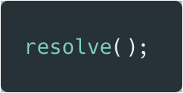
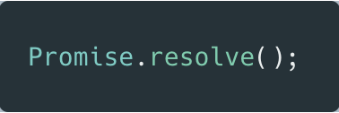
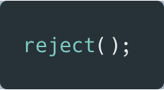
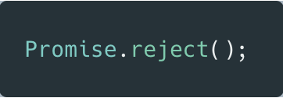
Promise
MDN: Represents eventual completion (or failure) of an async operation, and its resulting value.
Status:
Fulfilled: When promise succeeds
Rejected: When promise fails
Pending: Neither fulfilled nor rejected
Settled: Either fulfilled or rejected

Slide 9
async-await
Treats functions returning promises as if they were synchronous
Can be used in place of promises
Wide support in browsers

