Slide 1
Stock Market trend prediction model using LSTM
Group members - Shubham jain
Abhishek tiwari

Slide 2
WHAT IS LSTM ?
Long Short-Term Memory (LSTM) networks are a modified version of recurrent neural networks, which makes it easier to remember past data in memory. The vanishing gradient problem of RNN is resolved here. LSTM is well-suited to classify, process and predict time series given time lags of unknown duration. It trains the model by using back-propagation.

Slide 3
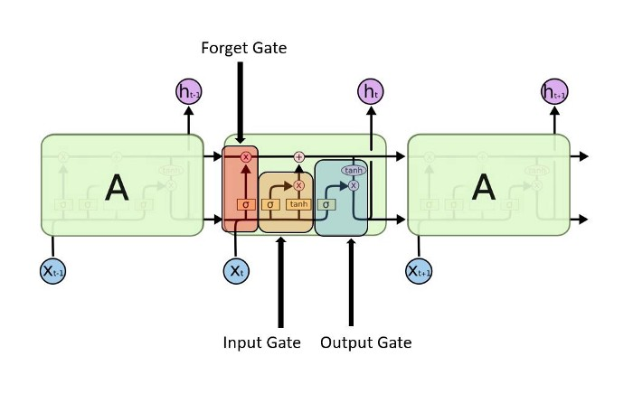

Slide 4
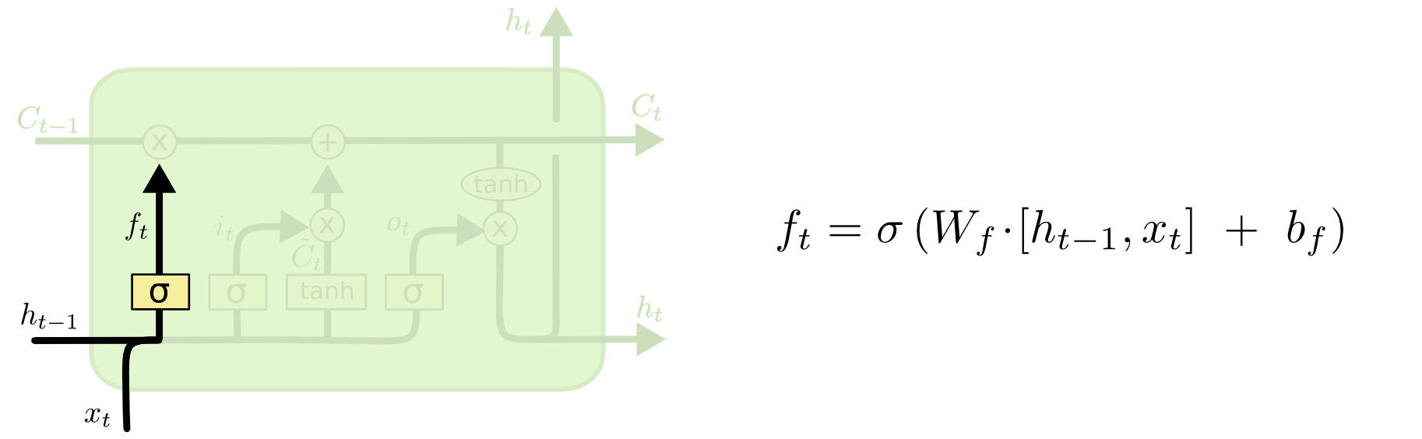
Forget gate — discover what details to be discarded from the block. It is decided by the sigmoid function. it looks at the previous state(ht-1) and the content input(Xt) and outputs a number between 0(omit this)and 1(keep this)for each number in the cell state Ct−1.

Slide 5
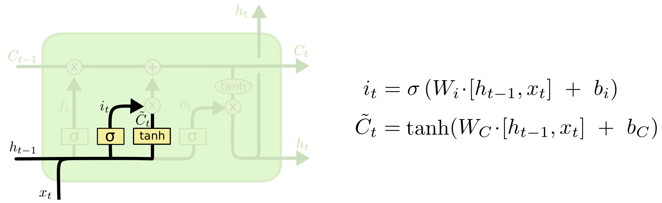
Input gate — discover which value from input should be used to modify the memory. Sigmoid function decides which values to let through 0,1. and tanh function gives weightage to the values which are passed deciding their level of importance ranging from-1 to 1.

Slide 6
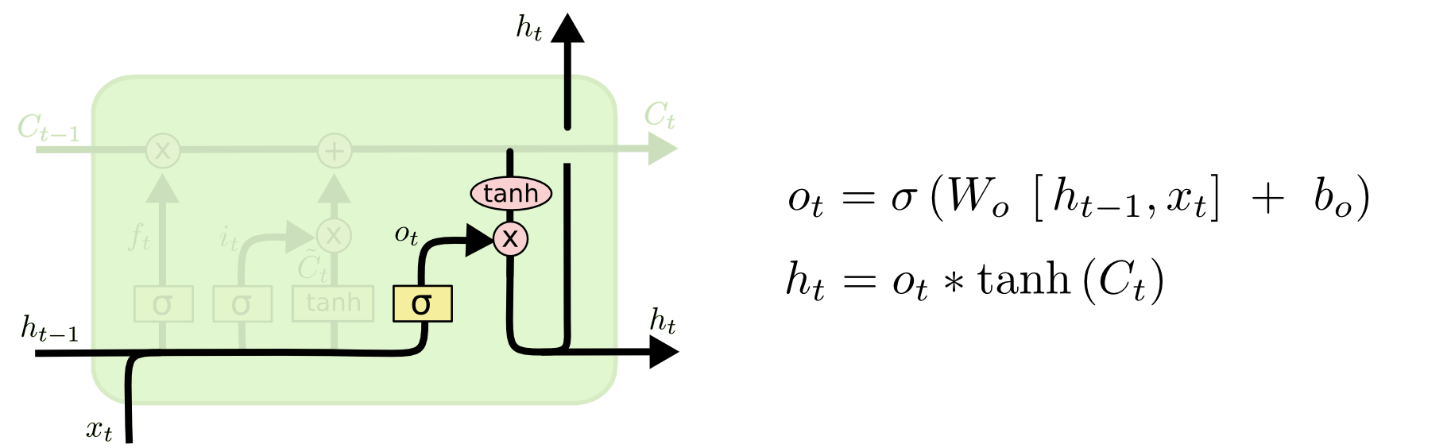
Output gate — the input and the memory of the block is used to decide the output. Sigmoid function decides which values to let through 0,1. and tanh function gives weightage to the values which are passed deciding their level of importance ranging from-1 to 1 and multiplied with output of Sigmoid.

Slide 7
WHY LSTM IN STOCK TREND PREDICTION
As stock price is the sequential time series data and we know that LSTM is best appreciated for time series data.
We have not used traditional RNN because two problems
Gradient vanishing and exploding problems.
Training an RNN is a very difficult task.
It cannot process very long sequences.

Slide 8
ABOUT DATA
Yahoo finance
Apple stock price data
Time duration 10 years (01/01/2010 – 31/12/2019)

Slide 9
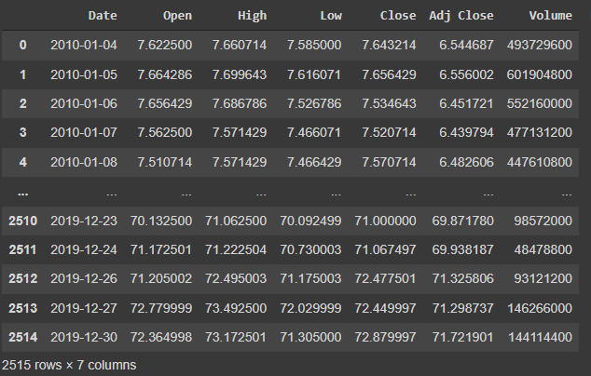
DATASET

Slide 10
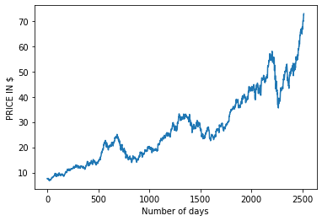
PLOTTING OF [Close] PRICE

Slide 11
INPUT DATASET
Suppose 60,62,61,65,66 …..69 close price of 99 days : x_train
Close price 70 of 100th day : y_train
Training data = 65%
Test data = 35%

Slide 12
ADAM OPTIMIZER
Adaptive Moment Estimation is an algorithm for optimization technique for gradient descent. The method is really efficient when working with large problem involving a lot of data or parameters. It requires less memory and is efficient. Intuitively, it is a combination of the ‘gradient descent with momentum’ algorithm and the ‘RMSP’ algorithm.
Momentum :
This algorithm is used to accelerate the gradient descent algorithm by taking into consideration the ‘exponentially weighted average’ of the gradients. Using averages makes the algorithm converge towards the minima in a faster pace.

Slide 13
Root Mean Square Propagation (RMSP):
Root mean square prop or RMSprop is an adaptive learning algorithm that tries to improve AdaGrad. Instead of taking the cumulative sum of squared gradients like in AdaGrad, it takes the ‘exponential moving average’.

Slide 14
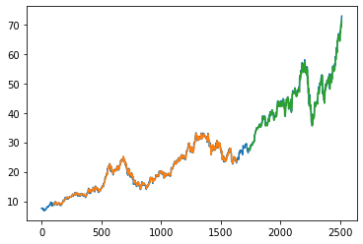
OUTPUT
Green indicates the Predicted Data
Blue indicates the Complete Data
Orange indicates the Train Data

