Slide 1

Navigation Route Planner
Walking & Wheelchair Path Planning
using Abraham et al. [2013]
Abhishek Kripal & Chra Jawhar
Institute of Geodesy and Geoinformation
University of Bonn
Under the Guidance of: Prof. Dr. Jan-Henrik Haunert
Supervisor: M.Sc. Dorian Baltzer
MSc GSD · LBS Exercise

Slide 2
Motivation
Why do we need alternative routes?
🔜
Shortest ≠ Best
♿
Accessibility Gaps
The mathematically shortest path may be congested, under construction, or simply disliked by the user. People have personal preferences algorithms can't know in advance.
Standard routing ignores steps, steep gradients, and broken kerbs. Wheelchair users need a completely different cost function, and alternative options when one accessible route fails.
🔀
User Autonomy
📍
Real-World Navigation
Presenting 2–3 meaningfully different routes lets users choose. One route for speed, another that avoids a busy junction, a third that stays on quieter streets.
Commercial systems (Google Maps, Here Maps) already offer alternatives via proprietary algorithms. This project implements a rigorous, peer-reviewed academic approach with formal quality guarantees.

Slide 3
Problem
Find paths that are substantially different from the shortest path, have small stretch, and are locally optimal.
✗
⚠
✓
Too Similar
Unreasonable Detours
Our Goal
k-shortest path algorithms return thousands of paths — nearly all are trivial detours that share 95%+ of their edges with the optimal.
A path can be 'different' while still containing obvious local wrong-turns. Users reject routes with unnecessary backtracking.
Routes that diverge meaningfully, stay within a sensible length budget, and feel natural to drive, with formal mathematical guarantees.

Slide 4
Project Goals & Overview
01
Graph setup
02
Shortest/ Alternative paths
Stack
Building & caching a wheelchair accessible street graph for Bonn
Fast, correct Dijkstra for both walking and wheelchair on OSM road graphs.
Up to 2 admissible alternatives per query using a double-Dijkstra via-node search.
OpenStreetMap data
GraphHolder
(Preprocess, filtering)
03
04
Utils
(Helper functions)
Quality guarantees
Performance
Three formal constraints ensure alternatives are different, reasonable, and not too long.
Cutoff-bounded search + optional fast_mode for real-time UX with ~2× speedup.
Navigation
(Algorithms)
Frontend
(Map display)

Slide 5
Graph Build
The GraphHolder class provides a single, ready-to-use street network for Bonn, where every path is physically usable by a wheelchair. It either loads a saved graph from disk, or builds one from scratch the first time it's needed.
⟳
Singleton cache
> 8% removed
It stores the graph on the class itself, so it's built or loaded only once per run.
⇄
Load-or-build
If Bonn_wheelchair.graphml already exists, it's read directly;
otherwise __prepareGraph() creates it.
≤ 8% passable
v
✓
Wheelchair-safe by design
u
Every remaining edge has already passed a highway-type filter and an 8% slope limit.
The 8% figure mirrors DIN 18040-3's practical field guidance for wheelchair-negotiable ramps and paths.

Slide 6
Graph Preprocessing Pipeline
Runs once, only when no cached .graphml file is found yet
Download
2. Filter highways
3. Sample elevation
4. Compute slope
5. Save
osmnx library pulls Bonn's walk network from OSM
Remove edges whose tag is in WHEELCHAIR_
BLOCKED,
or not in WHEELCHAIR_OK
Reproject node coords into the DEM's CRS and batch-sample elevation per node
slope =
(elev_v − elev_u) / length for every edge;
drop |slope| >8%
Serialize to GraphML sentinel

Slide 7
Algorithm: Shortest Path
_shortest_path() · used by both walking and wheelchair modes
1
Snap coordinates
Find source, target OSM node IDs
A
3
C
4
4
3
2
2
Validate nodes
S
1
T
Check: source ≠ target · both in graph · confirm connectivity
0
2
3
5
B
5
D
2
7
3
Run Dijkstra
Returns optimal node list
Shortest path S→B→C→T = 5
4
Return coordinates
From paths -> return [{lat, long}, …]
weight = "length" (walking) | weight = "weight" (wheelchair, after updateGraphWeights())

Slide 8
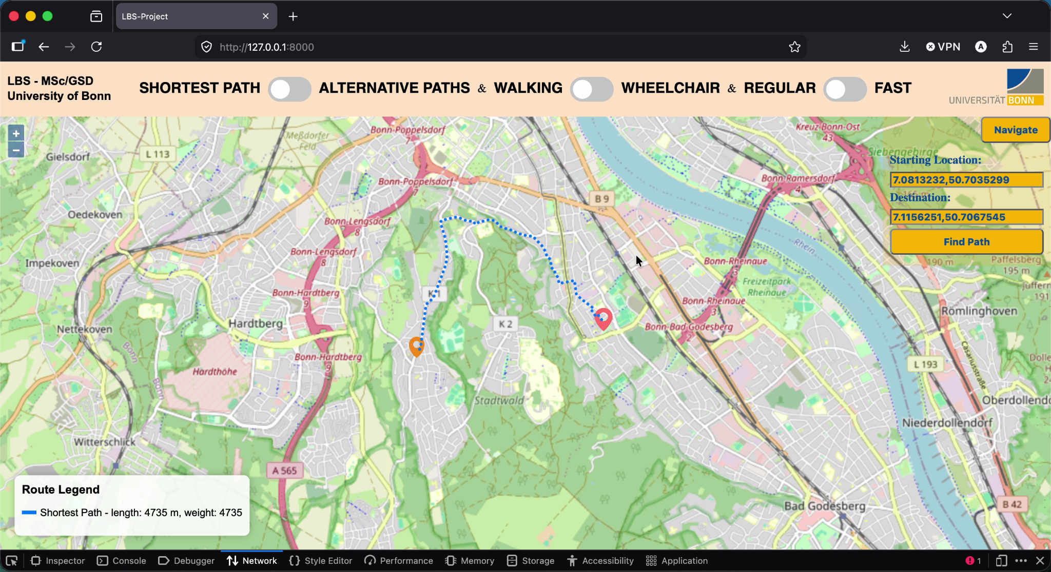
Live Results — Shortest Path
Bonn
Bad Godesberg
Test area
Constrained urban zone

Slide 9
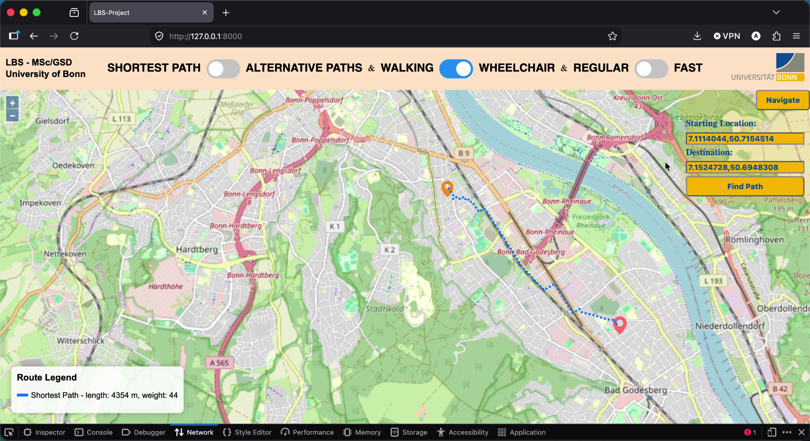
Live Results — Shortest Path
weight
44
Accessibility cost
Reflects slope + surface
Bonn
Bad Godesberg
Test area
Constrained urban zone

Slide 10
Algorithm: Alternative Paths
_alternative_paths() · 8-step pipeline · Abraham et al. [2013] simplified
1
Snap + validate
2
Compute Opt
Find closest node -> source, target.
Guard: same node, missing node, no path.
All constraints expressed as multiples of l_opt.
3
Forward Dijkstra
4
Backward Dijkstra
Returns dist_s, paths_s
Reverse graph. Returns dist_t, paths_t
5
UBS filter — constraint (c)
6
Constraints (a) + (b)
Keep via-node v
where d_s(v)+d_t(v) ≤ (1+ε)·l_opt.
Eliminate the rest before expensive checks.
(a) Sharing: shared_cost ≤ γ·l_opt
(b) T-test: sub-path must be a shortest path [skipped in fast_mode]
7
Score + de-duplicate
8
Return
Drop alternatives too similar to each other.
[opt_path] + up to 2 admissible alternatives

Slide 11
Walking vs. Wheelchair Mode
Same algorithm · different edge weight · different parameters
Walking weight = "length" (geographic metres) | Wheelchair weight = "weight" (accessibility cost)
Standard OSM edge distance — no pre-processing needed | updateGraphWeights() penalises steep slopes, poor surfaces, missing kerb cuts
Dense urban road network → alternatives easy to surface | Fewer navigable paths → relaxed parameters needed
ε = 0.25 — max 25% longer than optimal | ε = 0.35 — allows 35% longer routes to find accessible alternatives
γ = 0.65 — alternatives must use distinct corridors | γ = 0.70 — accessible corridors are sparse; some sharing is acceptable
α = 0.25 — every 25%-of-route sub-segment checked | α = 0.20 — looser: accessible sub-paths may be locally sub-optimal around obstacles
T-test at T = 0.25 × l_opt (Lemma 4.1) | Same T-test logic — different T value
🚶
♿
One _alternative_paths() function handles both modes — only the weight string and three parameter values change.

Slide 12
Quality Constraints
Every alternative must satisfy all three — Abraham et al. [2013] Section 3
Limited Sharing
(a)
l(Opt ∩ P) ≤ γ · l(Opt)
Ensures the alternative actually diverges and not just a trivial detour that rejoins immediately.
Too low: no alternatives found in sparse areas. γ = 0.65 (walking) / 0.70 (wheelchair)
T-local Optimality
(b)
P is T-locally optimal for T = α · l(Opt)
Prevents alternatives from containing obvious unnecessary detours that any driver would avoid
Skipped in fast_mode. α = 0.25 (walking) / 0.20 (wheelchair)
Uniformly Bounded Stretch (UBS)
(c)
l(P) ≤ (1 + ε) · l(Opt) for every sub-path
Ensures alternatives don't feel absurdly long — a path 3× longer than optimal is never useful.
Applied early as cheap pre-filter. ε = 0.25 (walking) / 0.35 (wheelchair)

Slide 13
Parameter Choice: α · γ · ε
Set in main.py via the request object
Parameter | Walking | Wheelchair | Range | Effect of higher value | Effect of lower value
ε (epsilon) | 0.25 | 0.35 | 0.10–0.40 | More candidates; alternatives may feel circuitous | Fewer candidates; often no alternatives in sparse graphs
γ (gamma) | 0.65 | 0.70 | 0.50–0.80 | Alternatives can look very similar to Opt | Very distinct routes; may fail in areas with few roads
α (alpha) | 0.25 | 0.20 | 0.10–0.40 | Stricter local-optimality; longer sub-paths verified | Looser; paths with short detour segments admitted
Why ε = 0.35 for wheelchair?
Why γ = 0.65 for walking?
Why α = 0.20 for wheelchair?
Accessible routes are fewer and inherently longer. A 25% stretch budget frequently returns zero alternatives. 35% surfaces meaningful alternatives without feeling absurd.
Urban areas have many parallel roads. Requiring ≤65% sharing forces genuinely different corridors, not just a parallel street one block away.
Accessible paths are sometimes forced to detour around obstacles (stairs, steep ramps). A looser T avoids rejecting valid but locally sub-optimal accessible routes.
ε also controls via_path_cutoff — callers set cutoff = 1+ε, keeping UBS and Dijkstra radius perfectly consistent.

Slide 14
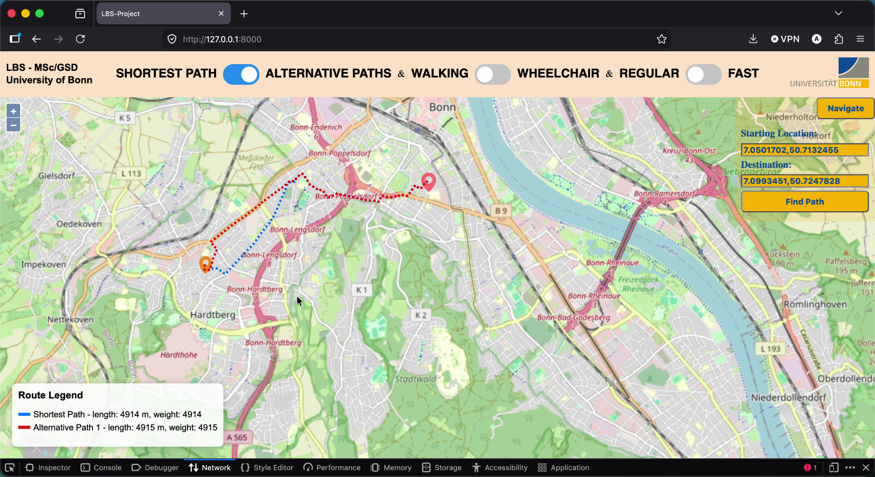
Live Results — Alternative Paths
2 paths
Distinct alternatives
Different accessible pathways
Bonn
Bad Godesberg
Test area
Constrained urban zone
ε=0.25 γ=0.65 α=0.25 (walking)

Slide 15
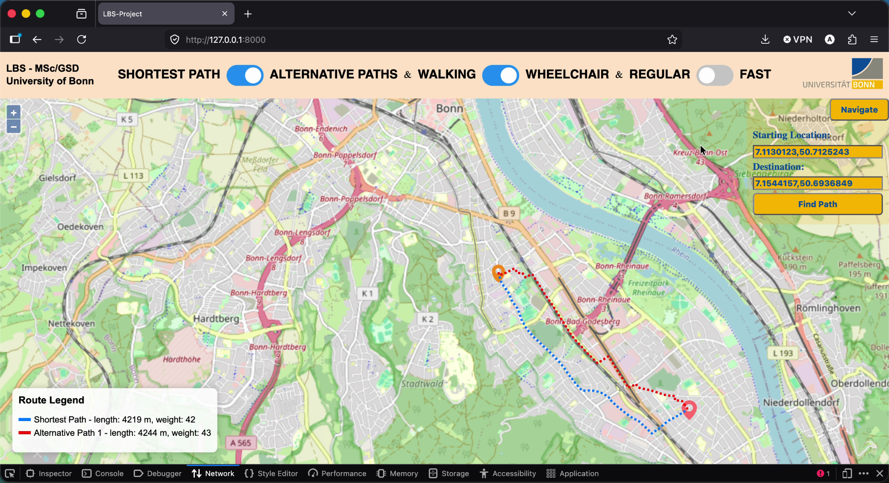
Live Results — Alternative Paths
weight
42-43
Accessibility cost
Reflects slope + surface
2 paths
Distinct alternatives
Different accessible pathways
Bonn
Bad Godesberg
Test area
Constrained urban zone
ε=0.35 γ=0.70 α=0.20 (wheelchair)

Slide 16
Optimization: fast_mode
Optional speedup add-on — fast_mode=False preserves the full algorithm
Speedup 1
~2×
Spatial Grid Clustering
Groups via-node candidates into ~200 m grid cells (OSM x/y node attributes). Only the cheapest candidate per cell enters the inner loop. Via-nodes in the same cell produce near-identical paths, discarding the more expensive one is safe.
average speedup
(12×12 grid,
30 queries)
Speedup 2
T-test Bypass (Constraint b skipped in fast_mode)
In fast_mode, skipped entirely. UBS + sharing constraints still run. Lemma 4.2 guarantees admitted paths are at most 2T-suboptimal.
Quality trade-off:
fast_mode may admit paths that are not strictly T-locally-optimal, but empirically shows equal or higher success rate because the T-test was rejecting some valid alternatives. UBS and sharing guarantees are never relaxed.

Slide 17
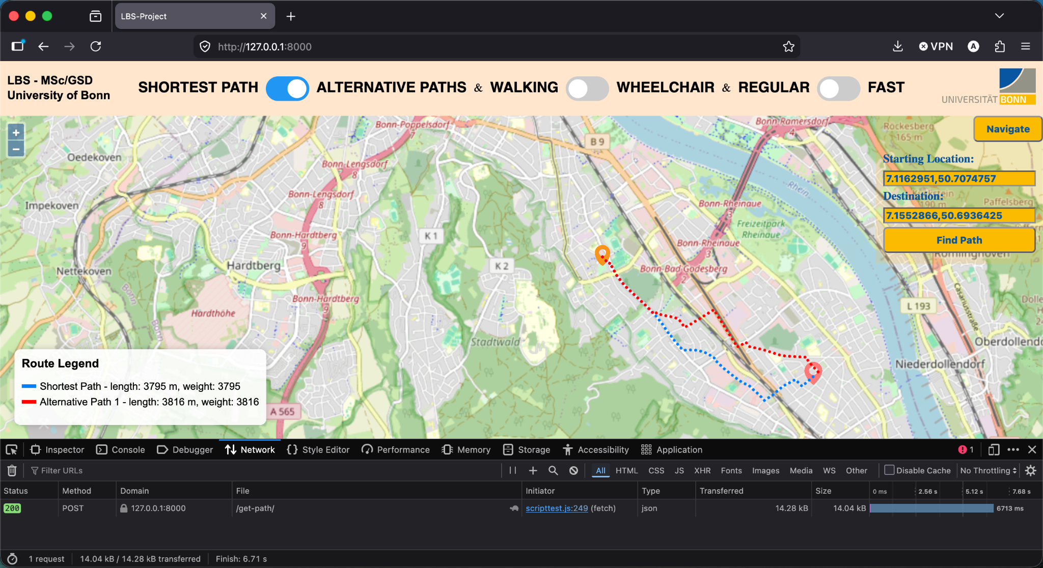
Live Results — Regular Mode
6713 ms
Optimization
Not optimized, better quality
False
fast_mode
Regular Abraham et al. [2013] algorithm
2 paths
Distinct alternatives
Different accessible pathways
Bonn
Bad Godesberg
Test area
Constrained urban zone
ε=0.25 γ=0.65 α=0.25 (walking)

Slide 18
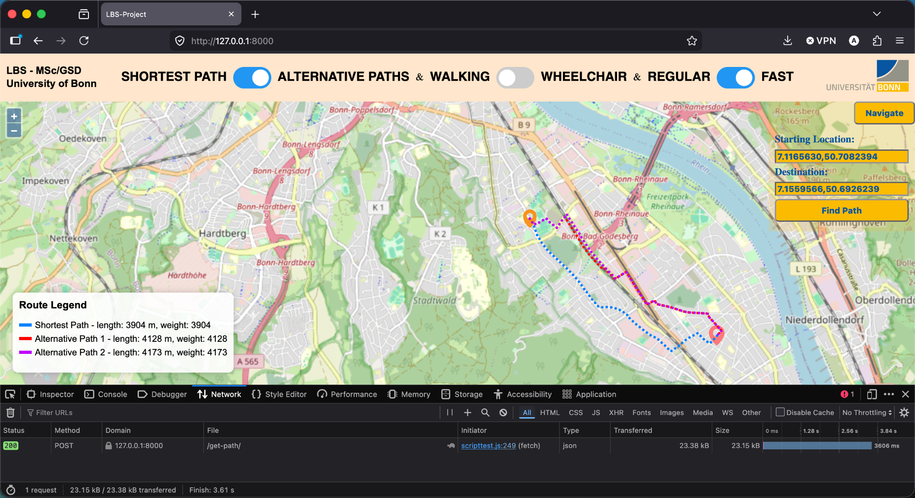
Live Results — Fast Mode
3606 ms
Optimization
Optimized for speed
True
fast_mode
Optimized Abraham et al. [2013] algorithm
3 paths
Distinct alternatives
Different accessible pathways
Bonn
Bad Godesberg
Test area
Constrained urban zone
ε=0.25 γ=0.65 α=0.25 (walking)

Slide 19
Room for Improvement
Proposed
Route metadata in return value
Return {type, cost, coords} per path so the frontend can colour-code routes, the UI cannot distinguish optimal from alternatives.
Proposed
Cache the reversed graph
On every alternative paths call, a large memory allocation happens for city-scale OSM graphs. A function that caches this at load time would eliminate the per-query cost entirely.

Slide 20
Summary
Graph: | One graph (built once), Two accessibility filters, Direction-aware, Round-trip safe
Algorithm: | Double-Dijkstra with (1+ε)-UBS cut off — simplified Abraham et al. [2013]
Constraints: | All three implemented: sharing (γ), T-local optimality (α), uniformly bounded stretch (ε)
Dual mode: | Single _alternative_paths() handles walking and wheelchair — only edge weight attribute changes
Parameters: | Externalised via request object: walking ε=0.25/γ=0.65/α=0.25 · wheelchair ε=0.35/γ=0.70/α=0.20
Speedup: | fast_mode: spatial grid clustering (~80% fewer candidates) + optional T-test skip → ~2× faster
Next steps: | Route metadata for frontend · cache reversed graph
University of Bonn · MSc GSD · LBS Exercise · Abraham et al. [2013]

Slide 21
Thanks for listening!

