Slide 1


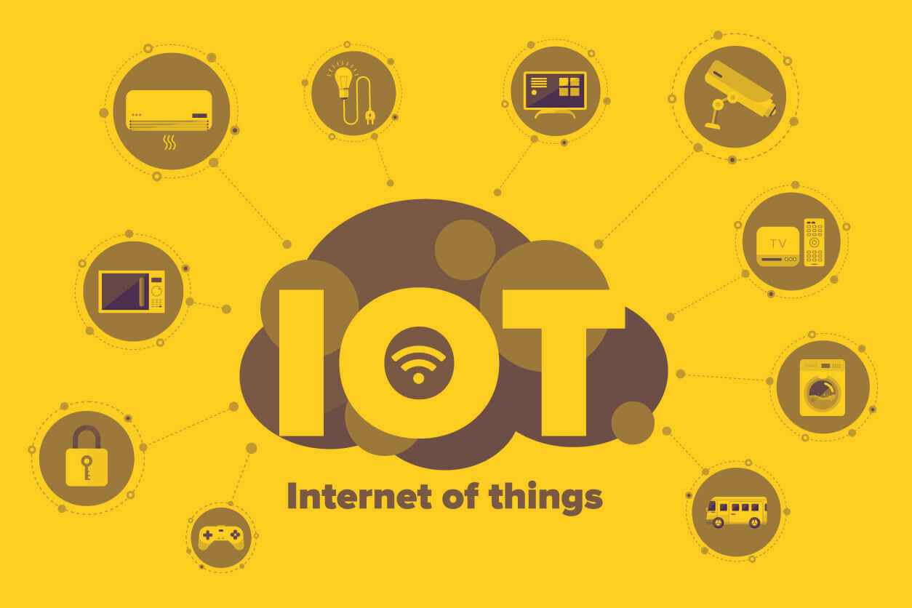

19ECE311 - COMPUTER NETWORKS
Iot Based Home Automation with Network Segmentation
01

Slide 2

TEAM MEMBERS
.
A.M.NAKUL - (AM.EN.U4ECE22001)
ABHIJITH K - (AM.EN.U4ECE22004)
ABHINAV NAMBIAR - (AM.EN.U4ECE22005)
ADITH SH - (AM.EN.U4ECE22006)
K.V.ABHISHEK - (AM.EN.U4ECE22018)
01

Slide 3
INTRODUCTION
.
With the rapid growth of smart technologies, IoT-based home automation has become a crucial application in modern networking. This project aims to simulate a smart home environment using Cisco Packet Tracer, integrating wireless connectivity, IoT devices, and centralized control through a web server. The network is designed with multiple clusters representing the home, internet, and core network infrastructure. Devices like smart ACs, thermostats, and fire sensors are connected via a Wi-Fi router, enabling real-time interaction and control. The project also demonstrates key networking concepts such as DHCP, static IP configuration, device grouping, and server-client interaction, offering a practical and scalable model of a smart, connected home.
02

Slide 4
OBJECTIVES
1
2
3
4
Simulate a unified smart home network using wireless routers for IoT, personal, and guest connectivity.
Assign static and dynamic IPs to logically segment devices by role.
Set up a central server to enable web-based automation and device management.
Apply basic access control through IP grouping to improve security without VLANs.
03

Slide 5
Network Initialization
The wireless router is powered on and configured with an SSID and WPA2 security.
A server is connected through a switch to the main router, enabling services such as registration and control.Device Configuration
IoT and user devices (including smart AC units, fire sensors, thermostats, PCs, and phones) connect wirelessly to the router.
Devices acquire IP addresses through DHCP or are assigned static IPs manually.
Server Setup
A central web/registration server is configured with a static IP (e.g., 10.1.2.2) and equipped with essential services (HTTP/IoT).
Devices access the server’s web-based dashboard using a browser.
Device Registration and Control
Devices either register with the server or are configured manually through the server dashboard.
Users can simulate turning devices on or off and adjusting settings (such as thermostat values) from a PC or mobile browser.
Data Communication
The router manages wireless communication, while routing and switching facilitate accurate packet delivery.
IP-based grouping provides logical segmentation among personal, guest, and IoT devices.
Monitoring and Response
Inputs from sensors (such as fire and temperature) can trigger changes in other devices (like the AC or windows) based on predefined automation logic.
The server logs or displays real-time control changes, creating an interactive automation experience.
04

Slide 6








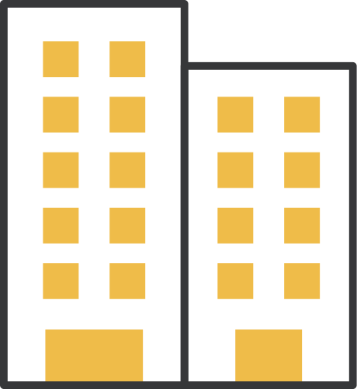














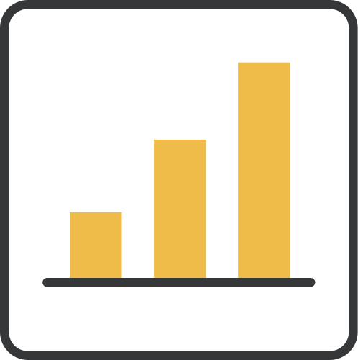

TOOLS USED
Cisco Packet Tracer
Wireless Router
Switches
End Devices: (IOT and User)
Server
DHCP Service
Web Browser (in simulation)

Slide 7
IP ADDRESSING
CLIENT-SERVER MODEL
ACCESS CONTROL LISTS (ACLS)
PACKET FLOW AND ROUTING
Use of both static IPs (for servers) and DHCP (for dynamic device assignment) to manage network identity.
A central server handles device registration and control, accessed via web browsers.
Understanding of how data moves through the network, from devices to server and across different segments.
Used to restrict communication between device groups (IoT, personal, guest).
WIRELESS COMMUNICATION
NETWORK TOPOLOGIES
DEVICE SEGMENTATION:
BASIC TROUBLESHOOTING
Devices connected via Wi-Fi routers, simulating real-world smart home setups.
Understanding of hierarchical design, including router-switch-device layouts.
Logical grouping of devices to simulate secure zones without VLANs.
identifying and resolving issues related to IP conflicts, DHCP failures, and Wi-Fi connectivity.
06

Slide 8
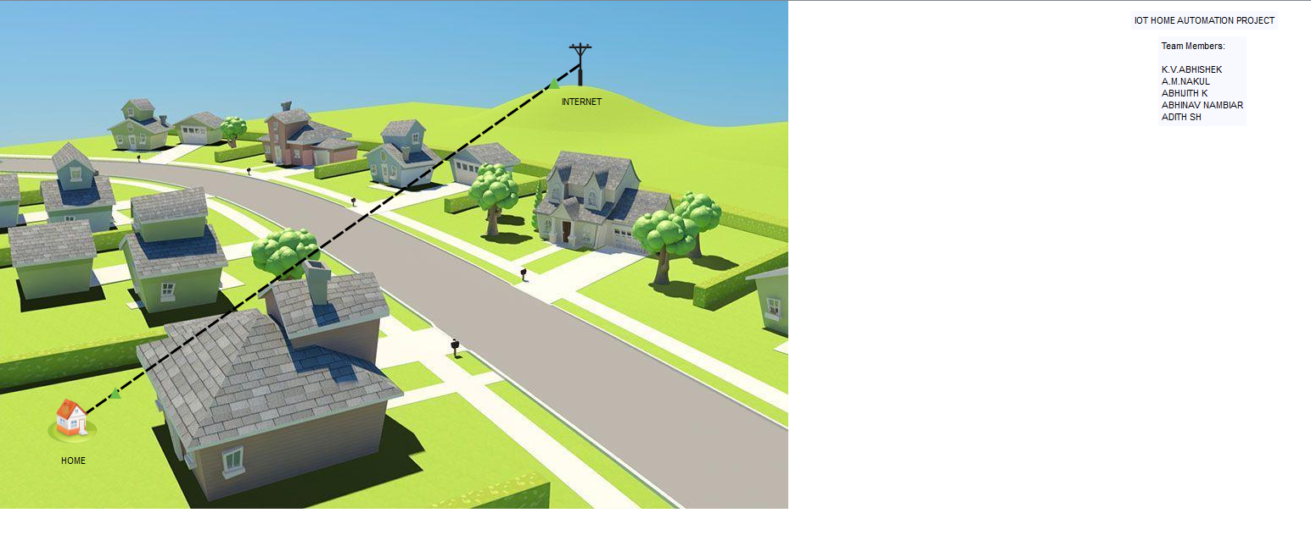
Project Output
07

Slide 9
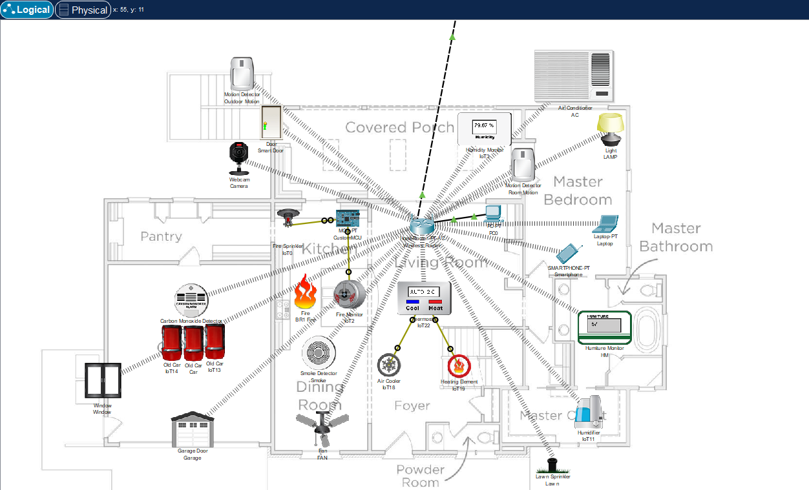
08

Slide 10
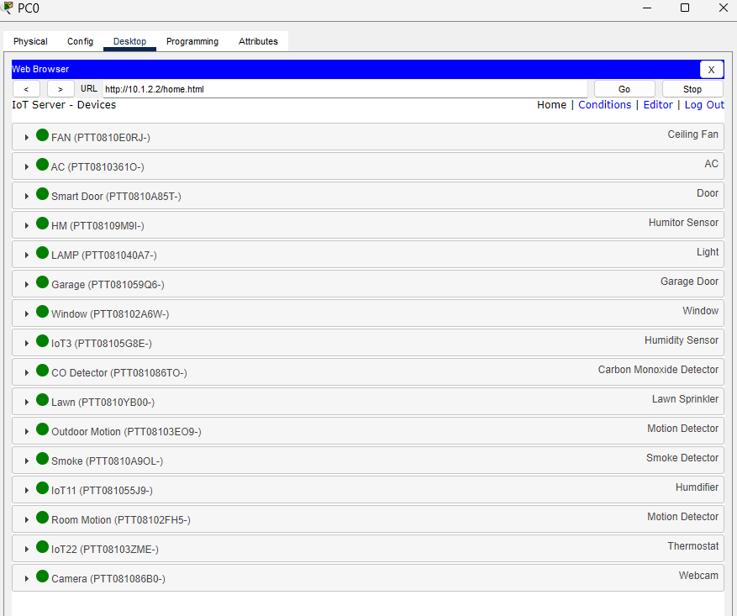
09

Slide 11
ADVANTAGES
Improved Security
Network Segmentation
Security Foundation
Easy Management
User Accessibility
Hands-On Networking
Devices can be controlled wirelessly, reflecting modern home automation convenience.
Keeps personal and guest devices safe even if an IoT device is hacked
Introduces basic access restrictions and isolation without requiring advanced VLANs or firewalls.
Introduces basic access restrictions and isolation without requiring advanced VLANs or firewalls.
Makes the network easier to monitor, manage, and troubleshoot
Reinforces core networking concepts such as IP addressing, DHCP, static routing, and ACLs.
10

Slide 12


CONCLUSION
This project successfully demonstrates the design and simulation of a smart home automation system using Cisco Packet Tracer. By integrating wireless routers, IoT devices, personal systems, and a central server, it creates a realistic representation of a modern home network. The use of IP-based segmentation, DHCP, and basic access control enhances the functionality and security of the system without relying on complex VLAN configurations. Overall, the project reinforces key networking concepts while showcasing the practical implementation of home automation in a simulated environment.
11

Slide 13


Thank you!
12

