Slide 1
EDA on Credit Risk Analyser

Slide 2
Problem statement
This assignment aims to give you an idea of applying EDA in a real business scenario. In this assignment, apart from applying the techniques that you have learnt in the EDA module, you will also develop a basic understanding of risk analytics in banking and financial services and understand how data is used to minimize the risk of losing money while lending to customers.
It contains two types of data sets :-
Application_data set
Previous_application dataset
Application_dataset:-contains all the information of the client at the time of application. The data is about whether a client has payment difficulties.
Previous_dataset:-contains information about the client’s previous loan data. It contains the data on whether the previous application had been Approved, Cancelled, Refused or Unused offer.

Slide 3
Approch to do EDA on this dataset
EDA involves :-
Data analyzing
Data Cleaning(i.e removing the unnecessary columns)
Data filling or filling the missing values
Data Visualization:-
This includes
Univeirate Analysis
Biverate Analysis
Multivariate Analysis

Slide 4
DATA ANALYZING
Data analyzing is one of important part of the EDA which includes:-
Loading the dataset in the dataframe.
The syntax for it is df= pd.read_csv(“csv_name”)
Then check the size of dataset so, that we can get to know how much data is peresnt. Synntax for it is df.size
After checking the how many null values are present in side the dataset.
Syntax for it is : df.isnull().sum()

Slide 5
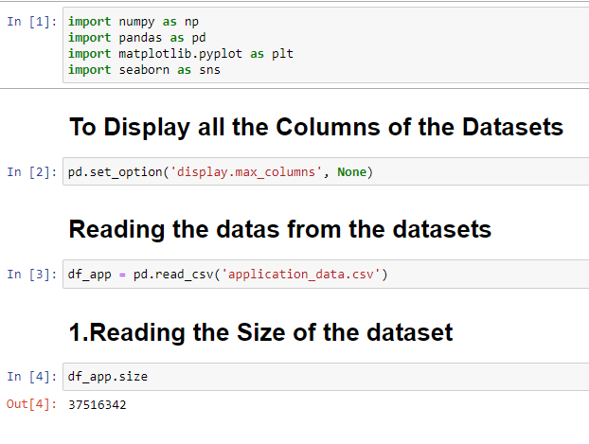
DATA ANALYZING in the DATASET

Slide 6
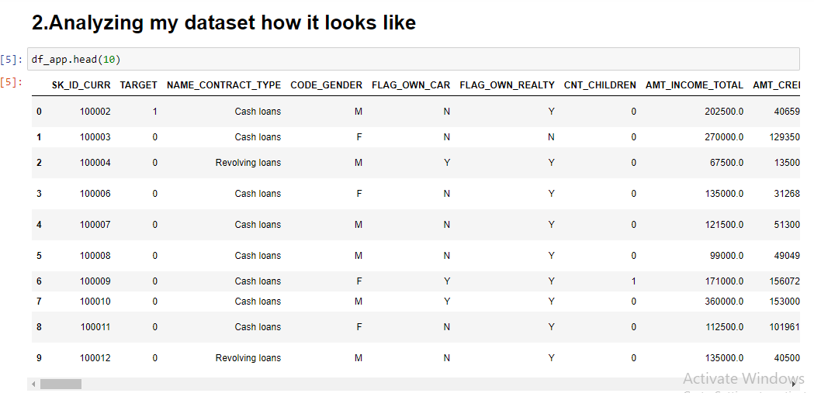
DATA ANALYZING in the DATASET

Slide 7
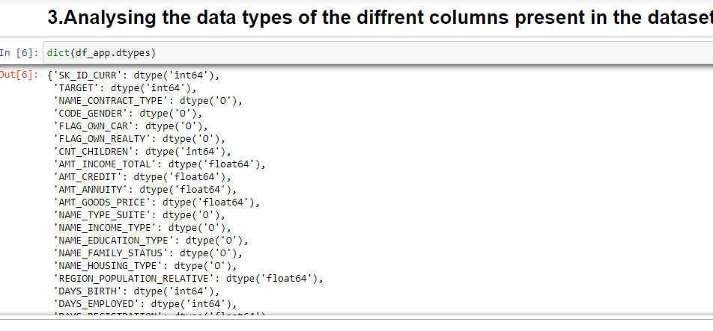
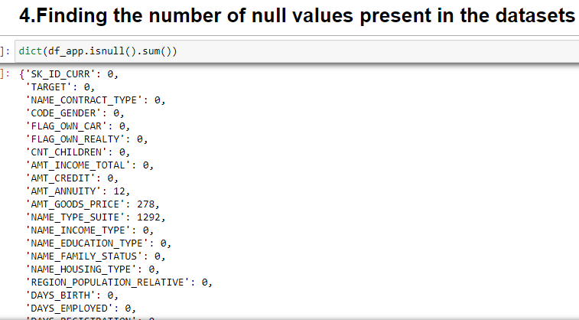
DATA ANALYZING in the DATASET

Slide 8
DATA CLEANING
It is method where we have to clean the columns which have null values more than 30% .
Also delete those columns according to our domain Knowledge
Syntax for the deleting the columns is
First make a list of the unncessary columns and use the command:
df.drop(List_of_coloums,axis=1,inplace=True)

Slide 9
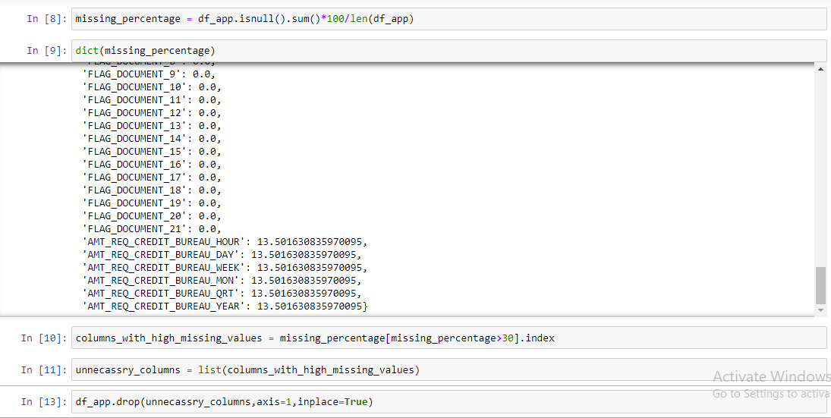
DATA CLEANING in the dataset
This cleaning is done on application data set

Slide 10
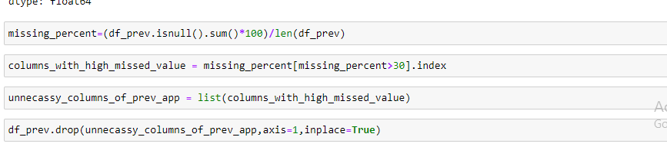
DATA CLEANING in the dataset
Same procedure I have followed for cleaning the previous_application data

Slide 11
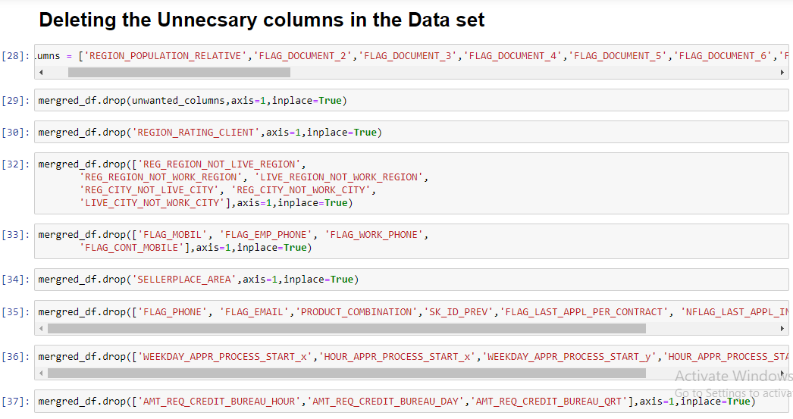
DATA CLEANING in the dataset
After merging both the files I have again done the cleaning according to domain Knowlwegde.

Slide 12
DATA Filling
Data filling is another process of filling the null values.
Here we fill our null values of data with either with mean ,median or mode value.
Syntax for it is
df.fillna(df.mean(),inplace=True)

Slide 13
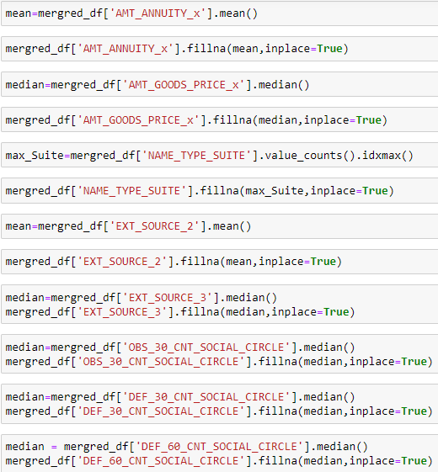
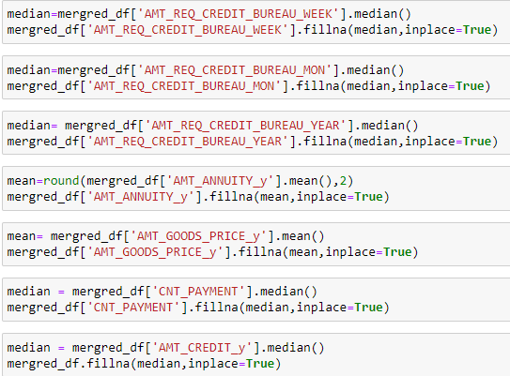
DATA FILLING in the dataset

Slide 14
DATA Visualization
The data visualization includes:
Unveriate analysis
Bi-Variate Analysis
Multi-Variate Analysis

Slide 15
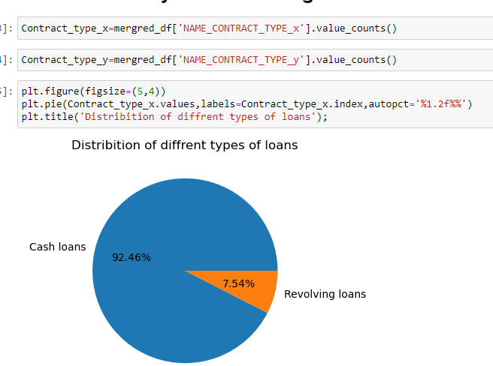
Univeriate ANALYSIS OF DATASET

Slide 16
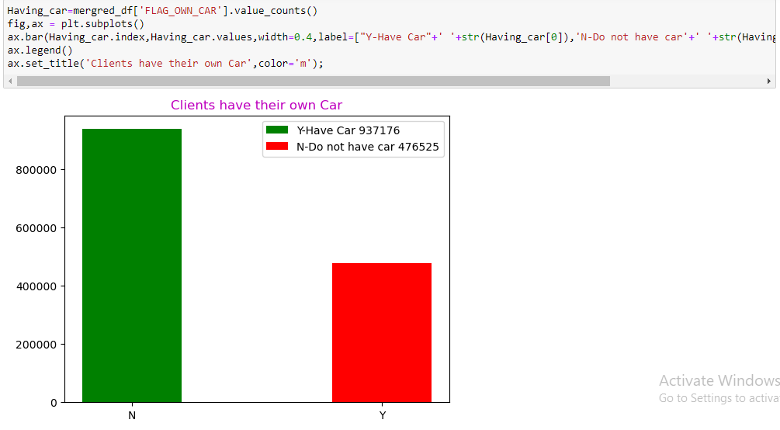
Univeriate ANALYSIS OF DATASET

Slide 17
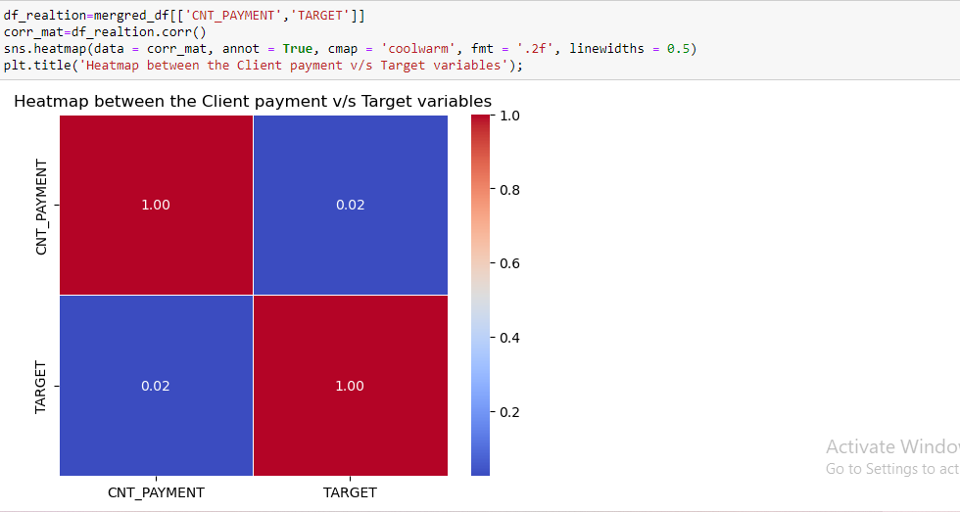
Bivariate Analysis

Slide 18
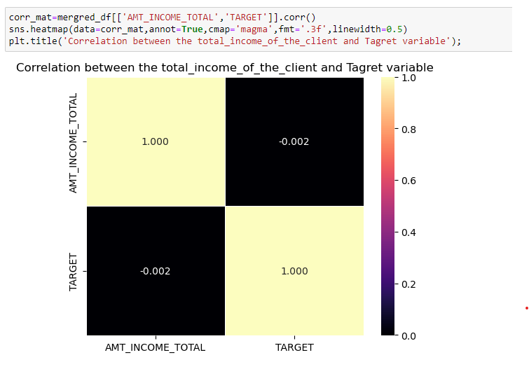
Bivariate Analysis

Slide 19
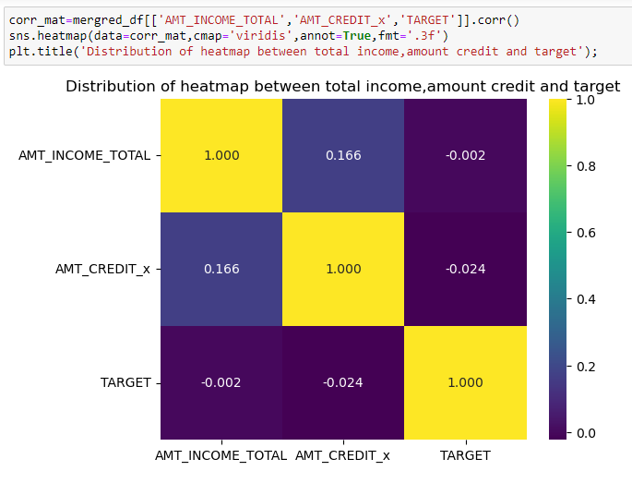
Multi-Variate Analysis

Slide 20
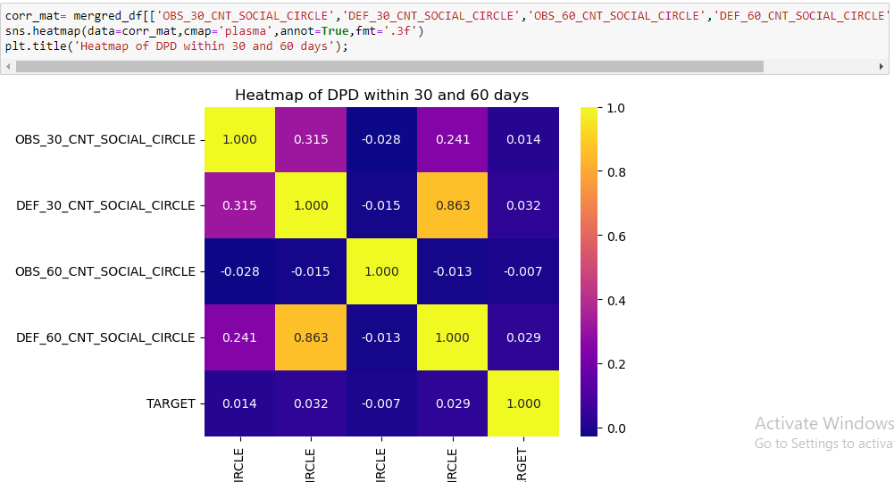
Multi-Variate Analysis

