Slide 1
Download
Visual Studio Code ( Preferred IDE )
NodeJS ( LTS version preferred)
Google Chrome ☺

Slide 2
Debugging
Why Debugging?
Find errors in codes
Test new features on the fly
Saves time
(See others code using Debugging tools as well)
How Debugging?
Tools used such as
Chrome Dev Tools,
VS Code Debugger Extensions (Debugger for Chrome),
POSTMAN,

Slide 3
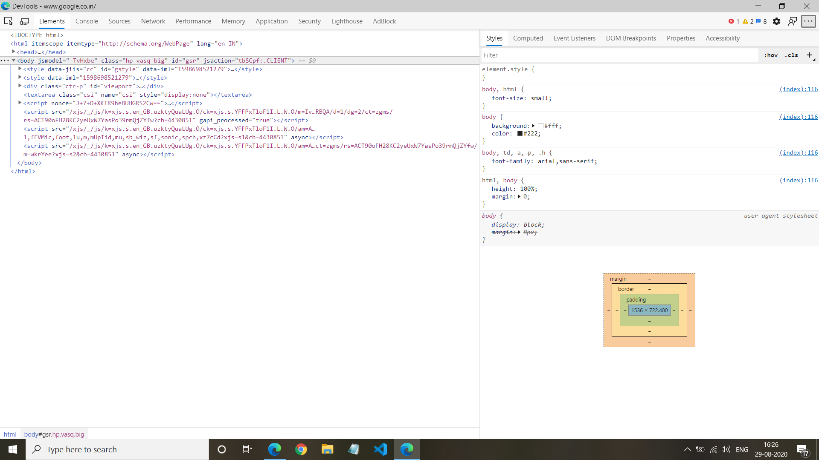
Chrome Dev Tools
Used for HTML debugging,
CSS debugging
JS debugging
(Press F12 on any page to open it up)

Slide 4
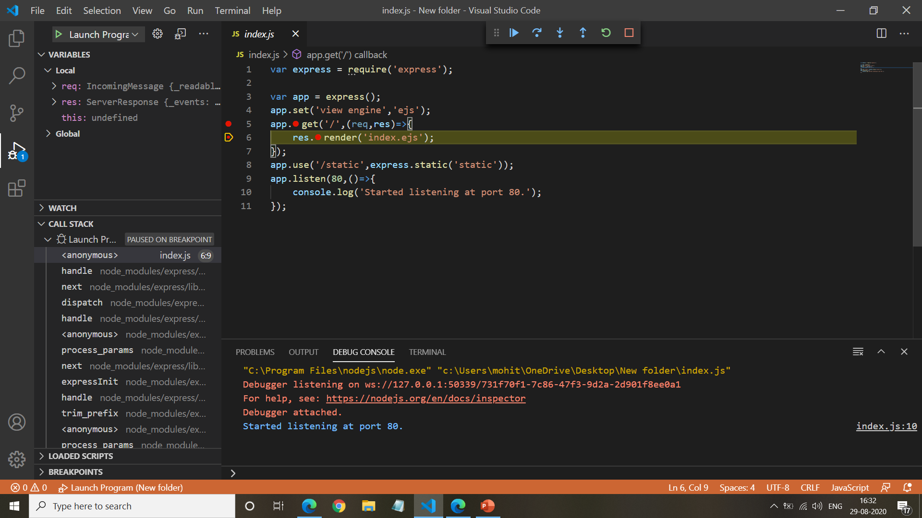
VS Code Debugging
(Debugger for Chrome Extension required)
Used for NodeJS Debugging

Slide 5
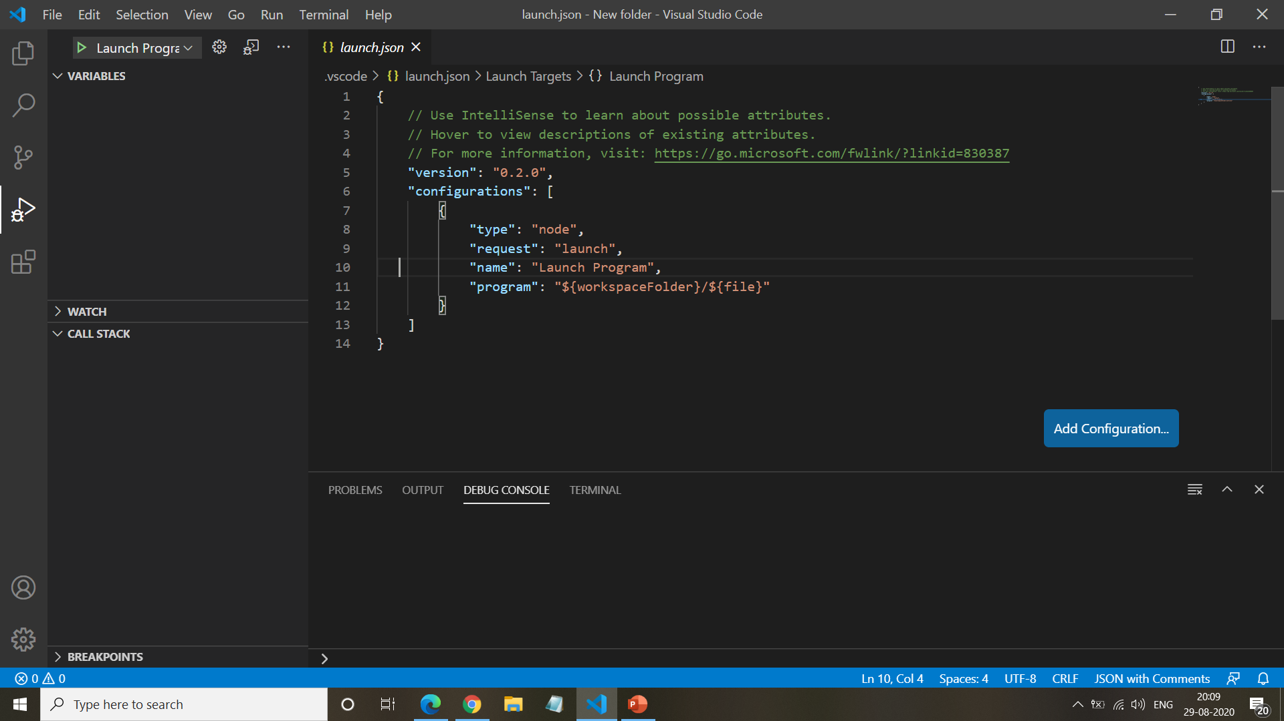
From the dropdown select Add configuration. And add the following code to start debugging

