Slide 1
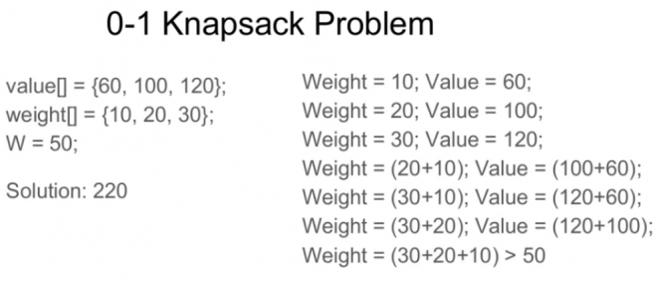
Knapsack DP
Problem Statement
Given weights and values of n items, put these items in a knapsack of capacity W to get the maximum total value in the knapsack.

Slide 2
Types of Knapsack
0-1 knapsack problem
Items are indivisible; you either take an item or not
Fractional knapsack problem
Items are divisible: you can take any fraction of an item

Slide 3
Fractional knapsack
Items as (value, weight) pairs arr[] = {{60, 10}, {100, 20}, {120, 30}} Knapsack Capacity, W = 50; Maximum possible value = 240 by taking items of weight 10 and 20 kg and 2/3 fraction of 30 kg. Hence total price will be 60+100+(2/3)(120) = 240

Slide 4
Fractional Knapsack Solution
An efficient solution is to use Greedy approach. The basic idea of the greedy approach is to calculate the ratio value/weight for each item and sort the item on basis of this ratio. Then take the item with the highest ratio and add them until we can’t add the next item as a whole and at the end add the next item as much as we can. Which will always be the optimal solution to this problem.
Complexity: ??

Slide 5
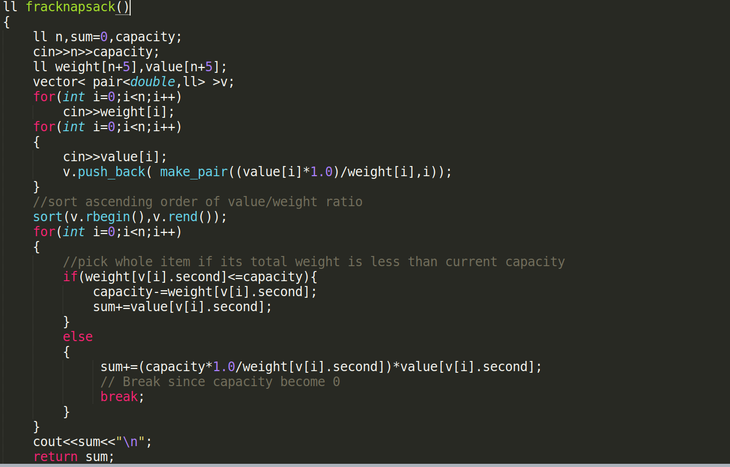
Code of Fractional Knapsack

Slide 6
0-1 Knapsack
Example 1:
val[] = {60, 100, 120};
wt[] = {10, 20, 30};
W = 50;
Output : 220 //maximum value that can be obtained 30 20 weights 20 and 30 are included.
Example 2:
val[] = {40, 100, 50, 60};
wt[] = {20, 10, 40, 30};
W = 60;
Output : 200
// Pick item with weights 30,20,10

Slide 7
0-1 Knapsack Solution
Recursion
A simple solution is to consider all subsets of items and calculate the total weight and value of all subsets.
Complexity : ???
Dynamic Programming
We will make 2 state DP . The state DP[i][j] will denote maximum value that can achieve using knapsack capacity ‘j-weight’ considering all values from ‘1 to ith’. So for every ith element we have two possibilities that can take place either
Choose the ith item
Or not choose the ith item
Complexity : ???

Slide 8
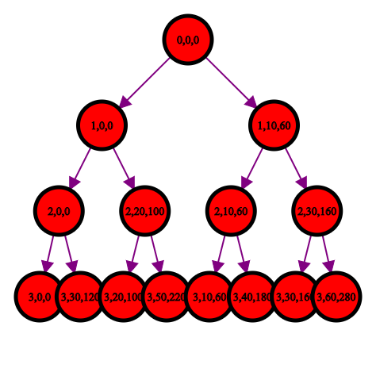

Slide 9
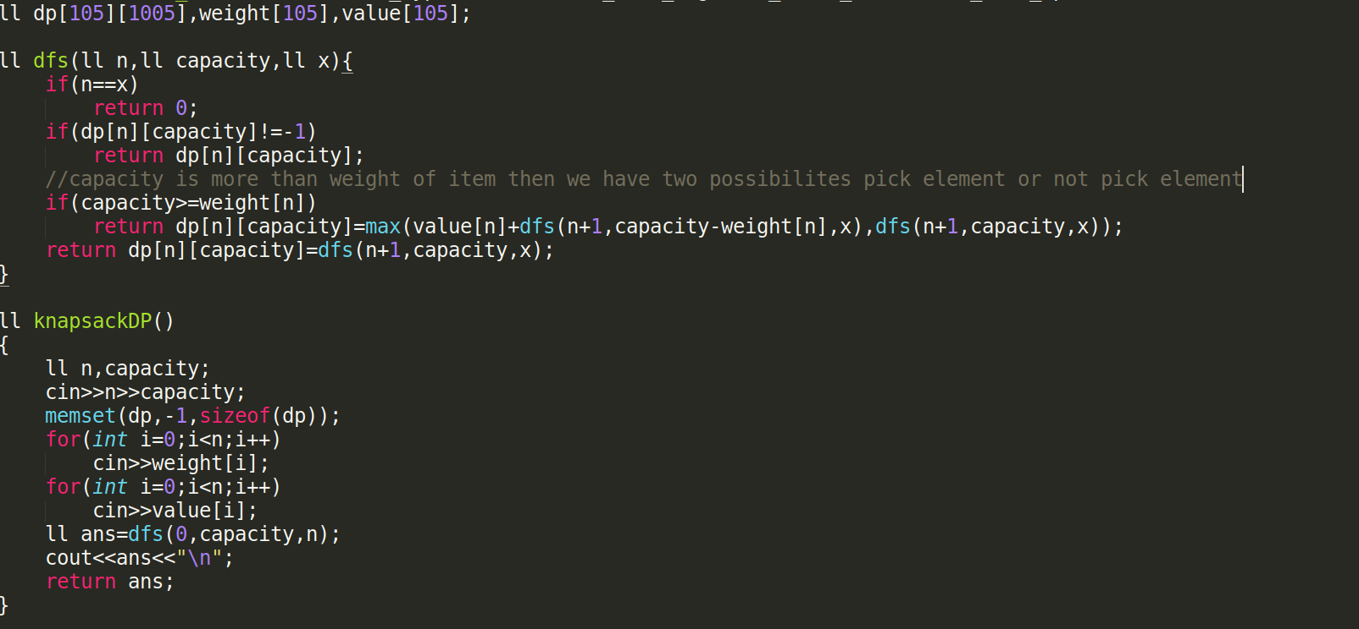
Code of 0-1 Knapsack

Slide 10
Thank You
Made by Gaurav Katare

