Slide 1
Dynamic Programming

Slide 2
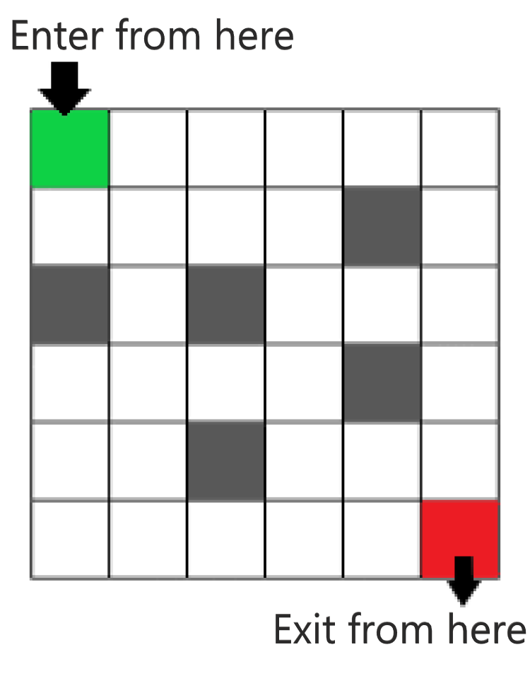
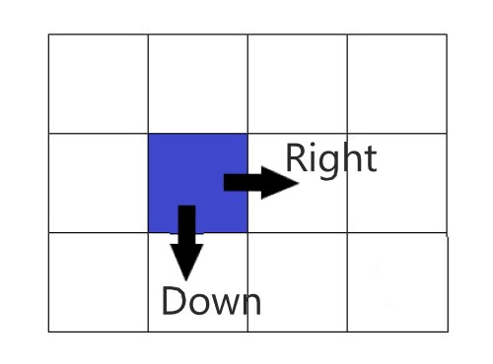
Q.NO. How many ways to go from start to end of maze with some boxes blocked and we can only move to right or down.
Left and down movements

Slide 3
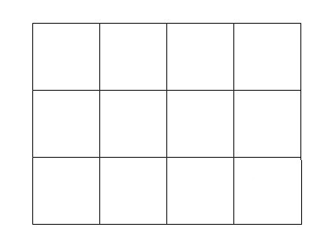
Let’s start with easy version
(without any box blocked)

Slide 4
Observation
One thing to observe was every figure had-
3 Arrows with this shape
And 2 Arrows with this shape
So we can calculate our answer via P&C….
Q. No. of ways to arrange 3 and 2 is
Ans. (3+2)!/(3!*2!)

Slide 5
So Basically for M x N Grid no. of ways is equal to
(M-1 + N-1)!
-------------------------
(M-1)! (N-1)!

Slide 6
DP Approach

Slide 7
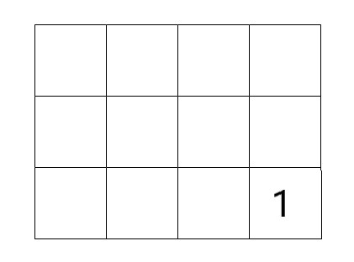
Lets Calculate for each cell the no. ways from there to exit
BASE CASE-
If I am in last cell then I have only one move that is exit this cell. So for last cell answer is 1

Slide 8
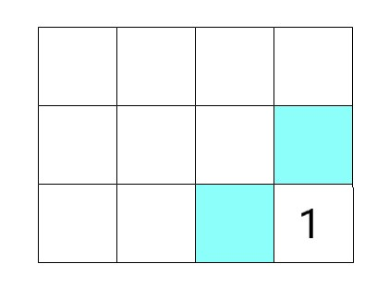
1
1

Slide 9
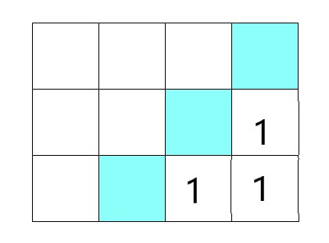
1
(1+1)
1

Slide 10
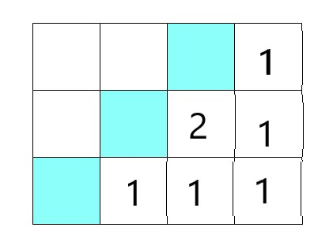
2+1
1+2
1

Slide 11
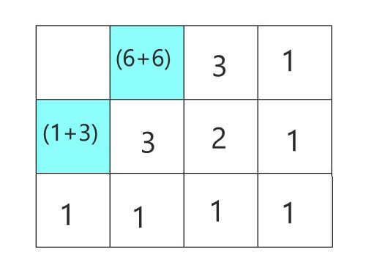

Slide 12
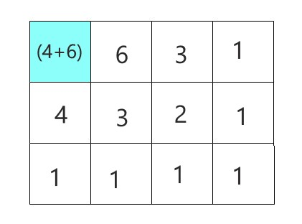

Slide 13
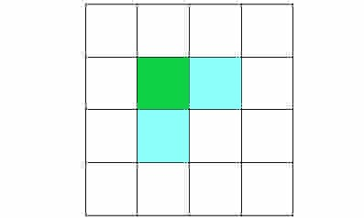
So for a general Case
ans(x,y) = ans(x+1,y) + ans(x,y+1)
Let’s say I want to calculate answer for (X,Y) .
Then I will first Calculate for them -
(X+1,Y) and (X,Y+1)
x,y
x,y+1
x+1,y

Slide 14
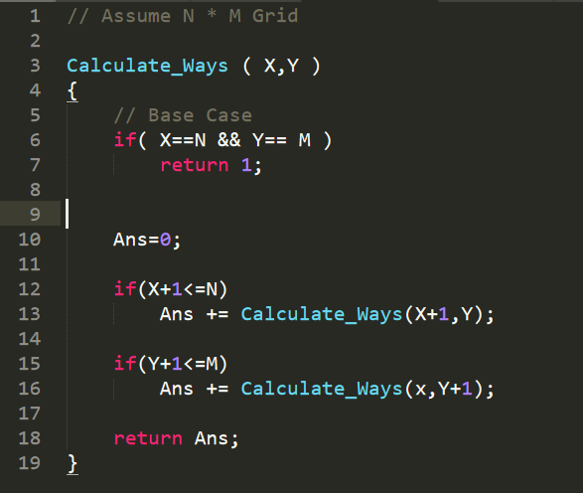
Recurrence relation
(Pseudo Code)

Slide 15
What happens
We are in block (1,1).. So to find answer for it we need to calculate answer for (1,2) and (2,1).
Now similarly (1,2) calls (1,3) and (2,2)... and (2,1) calls (1,2) and (1,3) and this goes on….
Sometime we reach base Case and then we actually have answers.

Slide 16
In actual this happens…
1
This Goes on….
In some time, we reach end.
2
1
So, now I will soon have answers
1
1
1
So.. soon I will have answer for every box.

Slide 17
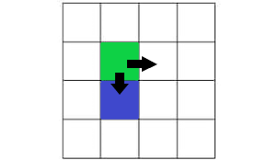
Now Let's move on to block cells.
This cell is blocked. So we shouldn’t go here.

Slide 18
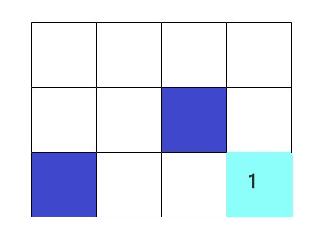
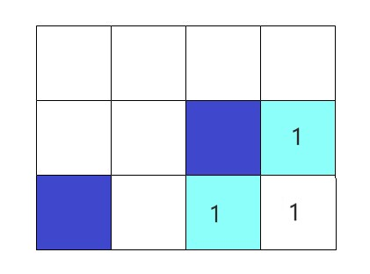

Slide 19
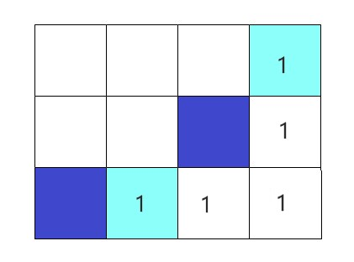
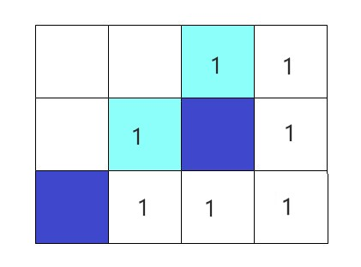

Slide 20
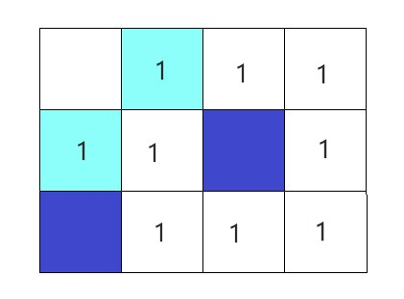
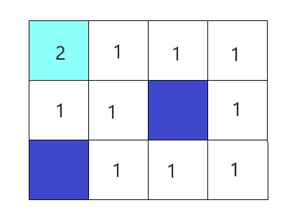

Slide 21
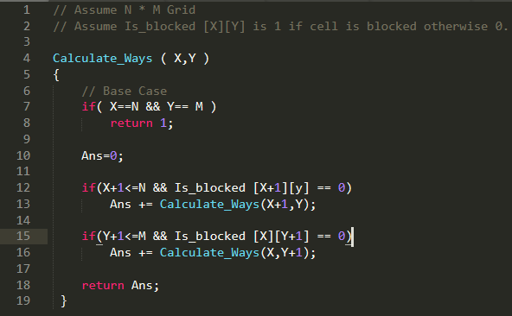
Like we are checking for boundary condition, Similarly check for if the cell is blocked

Slide 22
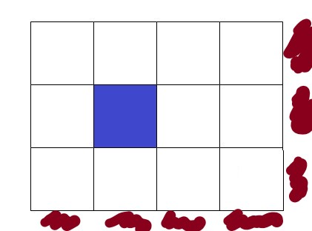
More better way to write code….
Invalid Blocks have following property
X>N
Y>M
Is_blocked [X] [Y] == 1
I have 0 way to reach to the end from these places.

Slide 23
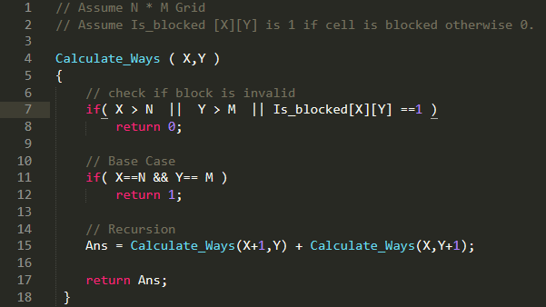
More better way to write code….

Slide 24
Relation to PMI (just for understanding)
Dynamic Programming
Base Case- Like Ans[M][N] =1
Or Our invalid Cases X>N ,Y>M or if the cell is blocked Ans is 0.
Recursion Step - We want answer for (X,Y), so we first find for (X+1,Y) and (X,Y+1)
PMI
Base Case- Like we had for k=0, or k=1, we had proof.
Recursion Step - If we want to prove for K+1, then we need to have proof for K.

Slide 25
Memoization…
Problem is we might be reaching the same Box again… like…
So why calculate again and again...
Lets store the answer…
If ans[X][Y] == -1 ….then we have not calculated for it yet otherwise we had.

Slide 26
