Slide 1
PANCREATIC CANCER
Survival analysis
with clinical data
Reference workflow adaptation + five-classifier comparison
Public MSK 2024 cohort · 2,260 patients · 5-fold evaluation
Team members:
Abhishek Aithal (PES1UG24CS651)
Shreeranganath Manjunath Saravade (PES1UG24CS622)
UE24CS352A · Machine Learning Mini-Project
Notes:
This presentation uses only the public cBioPortal PDAC MSK 2024 cohort. The Stanford cohort in the reference report is restricted, so these results are a public-cohort adaptation, not a numerical replication.

Slide 2
Study question and public cohort
Can clinical variables help order survival risk?
We use the public MSK 2024 pancreatic cancer cohort to study survival risk with clinical and demographic data. The reference report’s restricted Stanford cohort and radiomic features are unavailable.
2,260
1,521
739
MSK patients retained
observed deaths
right-censored
Predictors
Classification: age · sex · stage · genomic group · tumor location · exposure/history
Cox survival model: age · sex · stage
No radiomic features in this public extract
UE24CS352A · ML MINI-PROJECT 02 / 07
Notes:
Source: cBioPortal PDAC MSK 2024 study, pdac_msk_2024. The original Jamalian report describes a restricted Stanford cohort with radiomic features. The current cohort and predictors differ, so numerical scores are not direct replications.

Slide 3
Analysis workflow
01
Prepare survival outcome
Duration in days; event=death, censored=0
02
Fit survival model
Penalized Cox model; 5-fold C-index
03
Build early-risk label
Death by 270 days; exclude early-censored unknowns
04
Compare classifiers
NB · Logistic Regression · RBF SVM · Random Forest · Gradient Boosting
Preprocessing is fitted inside training folds. SMOTE is omitted because synthetic interpolation can create invalid records from censored survival data.
UE24CS352A · ML MINI-PROJECT 03 / 07
Notes:
Classification outcome known at horizon: observed death before threshold versus known alive at threshold. Patients censored before the threshold cannot be labeled and are excluded only from this binary task.

Slide 4
Classifier results at 270 days
Logistic Regression led fixed balanced accuracy; tuned SVM led nested balanced accuracy.
Classifier | Balanced acc. | Precision | Recall | F1 | ROC-AUC
Logistic Regression | 0.653 | 0.389 | 0.696 | 0.499 | 0.692
SVM (RBF) | 0.652 | 0.390 | 0.685 | 0.497 | 0.666
Random Forest | 0.590 | 0.346 | 0.552 | 0.425 | 0.636
Naive Bayes | 0.650 | 0.388 | 0.685 | 0.495 | 0.684
Gradient Boosting | 0.540 | 0.374 | 0.201 | 0.261 | 0.631
Known labels: 2,027 · early-censored excluded: 233 · high-risk events: 533
Cox clinical C-index: 0.657 ± 0.016 (5 folds)
UE24CS352A · ML MINI-PROJECT 04 / 07
Notes:
MSK 2024 fixed-parameter results at 270 days. Stratified five-fold CV, seed 229. Nested tuning used five outer folds with three-fold inner search. Results are exploratory and are not clinical decision support.

Slide 5
Threshold sensitivity and interpretation
Naive Bayes balanced accuracy across MSK survival horizons
0.664
0.650
0.658
0.653
0.653
240 d
270 d
300 d
330 d
360 d
Highest exploratory NB score: 240 days (0.664). Primary comparison stays at 270 days.
The horizon sweep is exploratory and not nested selection. Results depend on the cohort and censoring pattern.
UE24CS352A · ML MINI-PROJECT 05 / 07
Notes:
MSK 2024 Naive Bayes exploratory horizon sensitivity values: 240d 0.664 (n=2044, high-risk=482); 270d 0.650 (n=2027, high-risk=533); 300d 0.658 (n=2014, high-risk=602); 330d 0.653 (n=1997, high-risk=658); 360d 0.653 (n=1989, high-risk=712). The primary classifier comparison remains at 270 days.

Slide 6
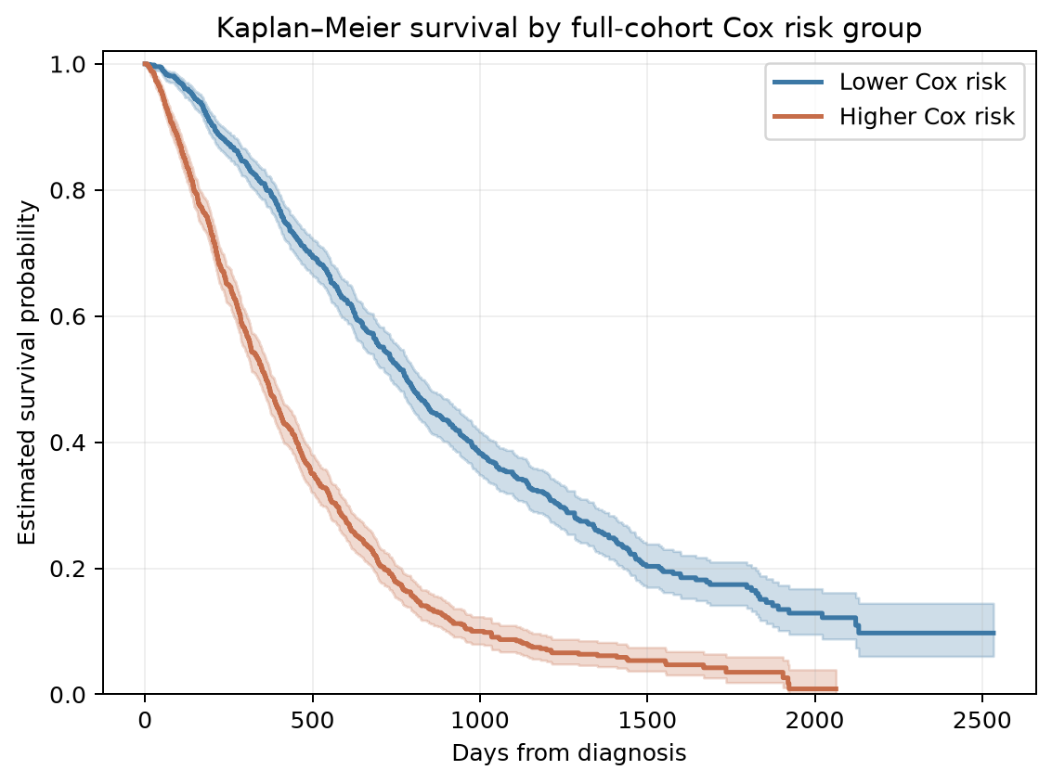
Kaplan–Meier curves by Cox risk group
Median risk split
Higher Cox risk
n = 1,130
Lower Cox risk
n = 1,130
Log-rank p = 1.73e-72
Full-cohort descriptive split; curves are not out-of-fold validation.
UE24CS352A · ML MINI-PROJECT 06 / 07
Notes:
MSK 2024 Kaplan-Meier plot uses a full-cohort Cox fit to split patients by median partial hazard. The log-rank p-value is descriptive and not an independent validation result.

Slide 7
Conclusion and nested tuning results
•
MSK 2024 is the only cohort in this analysis; the reference Stanford cohort and radiomic features are unavailable.
•
Nested tuning: SVM 0.661 (fixed 0.652); Random Forest 0.658 (fixed 0.590).
•
The Cox model reached C-index 0.657 ± 0.016. Results are exploratory and the KM split is descriptive.
Demo command
python src/analysis.py --data data/private/msk_paad_2024.csv --threshold 270 --folds 5 --seed 229 --output outputs/msk_paad_2024 --tune
Outputs: MSK classifier metrics · nested tuning · survival C-index · plots · two-page summary
UE24CS352A · ML MINI-PROJECT 07 / 07
Notes:
Data source: cBioPortal PDAC MSK 2024 study, pdac_msk_2024. The assignment requires a private GitHub repository, a two-page write-up, a presentation, and a live demonstration. Team member names and SRNs appear on the title slide. Add the team-specific assigned problem statement and individual contribution details when provided.
Nested tuning: five-fold outer CV with three-fold inner parameter search by balanced accuracy. MSK tuned results: SVM bAcc 0.661 / AUC 0.675; RF 0.658 / 0.689; NB 0.652 / 0.682; LR 0.650 / 0.692; Gradient Boosting 0.537 / 0.664.

