Slide 1
PANCREATIC CANCER
Survival analysis
with clinical data
Reference workflow replication + five-classifier comparison
Public TCGA PAAD cohort · 184 patients · 5-fold evaluation
Team members: __________________________________
UE24CS352A · Machine Learning Mini-Project
Notes:
The Stanford cohort used in the reference report is restricted. This presentation reports a public TCGA substitute analysis and does not claim to reproduce the paper’s numerical results.

Slide 2
Study question and public cohort
Can clinical variables help order survival risk?
The reference report uses pancreatic cancer survival, clinical/radiomic features, Naive Bayes risk groups, and Cox proportional hazards.
184
100
84
PAAD records
observed deaths
right-censored
Predictors
Classification: age · gender · stage · histology · race
Cox survival model: age · gender · stage
No radiomic features in TCGA-CDR extract
UE24CS352A · ML MINI-PROJECT 02 / 07
Notes:
Source: NCI Genomic Data Commons TCGA-CDR. https://gdc.cancer.gov/about-data/publications/PanCan-Clinical-2018. The original Jamalian report describes a restricted Stanford cohort of 80 patients with 900 radiomic features. The current cohort and predictors differ.

Slide 3
Analysis workflow
01
Prepare survival outcome
Duration in days; event=death, censored=0
02
Fit survival model
Penalized Cox model; 5-fold C-index
03
Build early-risk label
Death by 270 days; exclude early-censored unknowns
04
Compare classifiers
NB · Logistic Regression · RBF SVM · Random Forest · Gradient Boosting
Preprocessing and resampling stay inside the training folds. SMOTE is omitted because interpolating censored survival times can create invalid records.
UE24CS352A · ML MINI-PROJECT 03 / 07
Notes:
Classification outcome known at horizon: observed death before threshold versus known alive at threshold. Patients censored before the threshold cannot be labeled and are excluded only from this binary task.

Slide 4
Classifier results at 270 days
Logistic Regression led balanced accuracy; recall remains higher than precision.
Classifier | Balanced acc. | Precision | Recall | F1 | ROC-AUC
Logistic Regression | 0.642 | 0.282 | 0.688 | 0.400 | 0.620
SVM (RBF) | 0.640 | 0.274 | 0.719 | 0.397 | 0.417
Random Forest | 0.608 | 0.300 | 0.469 | 0.366 | 0.574
Naive Bayes | 0.574 | 0.235 | 0.594 | 0.336 | 0.602
Gradient Boosting | 0.518 | 0.273 | 0.094 | 0.140 | 0.583
Known labels: 171 · early-censored excluded: 13 · high-risk events: 32
Cox clinical C-index: 0.522 ± 0.035 (5 folds)
UE24CS352A · ML MINI-PROJECT 04 / 07
Notes:
Results from outputs/classifier_results.csv and outputs/survival_results.csv. Five-fold shuffled CV, seed 229. Results are exploratory and should not be interpreted as clinical decision support.

Slide 5
Threshold sensitivity and interpretation
Naive Bayes balanced accuracy across the paper’s tested horizons
0.543
0.574
0.493
0.515
0.512
240 d
270 d
300 d
330 d
360 d
Best Naive Bayes threshold in this sweep: 270 days (0.574). Threshold performance is cohort-specific.
C-index near 0.5 indicates weak risk ordering here. Small cohort, missing values, sparse stage categories, and five-fold variability limit conclusions.
UE24CS352A · ML MINI-PROJECT 05 / 07

Slide 6
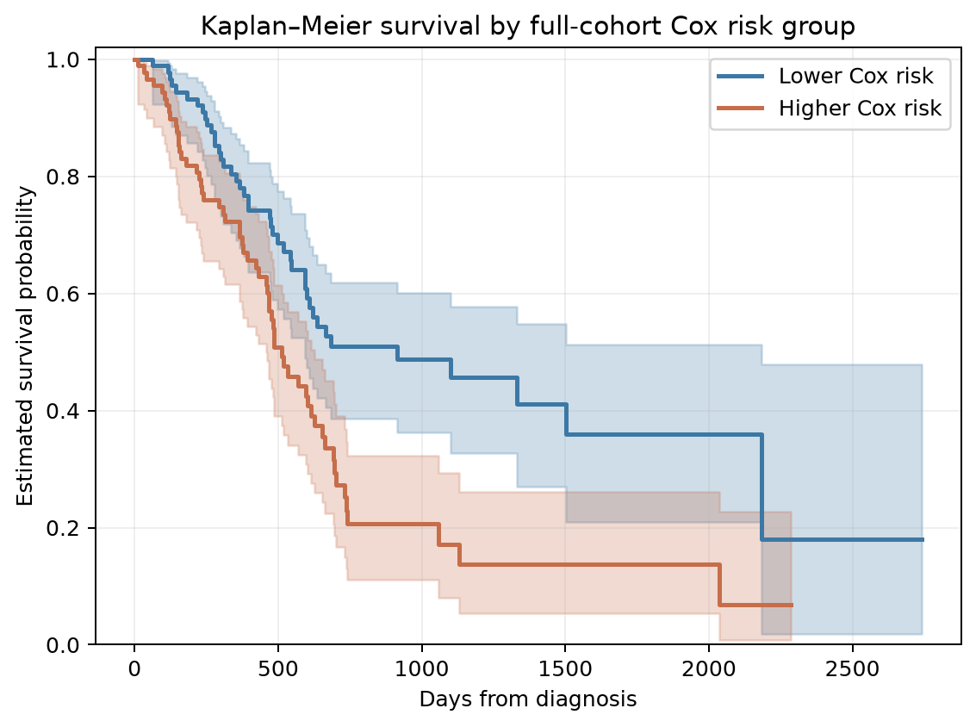
Kaplan–Meier curves by Cox risk group
Median risk split
Higher Cox risk
n = 92
Lower Cox risk
n = 92
Log-rank p = 0.0012
Full-cohort descriptive split; curves are not out-of-fold validation.
UE24CS352A · ML MINI-PROJECT 06 / 07
Notes:
Exploratory Kaplan–Meier plots use a full-cohort Cox fit to split by median partial hazard. The log-rank p-value is descriptive and not an independent validation result.

Slide 7
Conclusion and live demonstration
•
Public TCGA PAAD data let us implement the workflow; the original restricted Stanford cohort is unavailable.
•
Logistic Regression reached 0.642 balanced accuracy at 270 days; clinical Cox C-index was 0.522.
•
Scores are modest and cohort-specific. This is a methods exercise, not a clinical prediction tool.
Demo command
python src/analysis.py --data data/private/tcga_paad.csv --threshold 270 --folds 5 --seed 229
Outputs: classifier metrics · threshold sweep · survival C-index · two-page summary
UE24CS352A · ML MINI-PROJECT 07 / 07
Notes:
Data source: TCGA Pan-Cancer Clinical Data Resource, NCI GDC, https://gdc.cancer.gov/about-data/publications/PanCan-Clinical-2018. The assignment guidelines require a private GitHub repository, two-page PDF write-up, presentation and live demonstration. Add team member names and the assigned serial-number problem before submission.

