Slide 1

PES’s
Modern College of Engineering
Department of Electrical Engineering
“DESIGN & SIMULATION OF SOLAR POWERED BLDC Motor”
Name of Students :
Ramkrishna Kadam
Krushna Padile
Abhishek Patil
Name of Guide :
Prof. R. V. Borkar

Slide 2
CONTENT:-
Introduction
Aim & Objective
Methodology
Block Diagram
Software Simulink Model
Results
Conclusion
References

Slide 3
AIM:-
To Develop Simulink Model Of Solar Powered BLDC Motor

Slide 4
OBJECTIVES:-
To Develop Solar PV Array
To Develop Converter
To Develop VSI
To Simulate the Solar Powered BLDC Motor
Comparison of software results with IEEE paper results.

Slide 5
METHODOLOGY:-
SOFTWARE BASED SIMULATION
SOFTWARE USED:- MATLAB R2014a , MATLAB R2017a

Slide 6
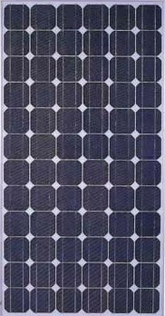
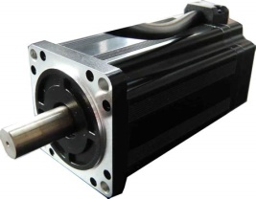
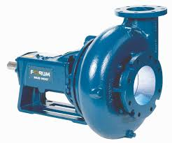


BLOCK DIAGRAM:-
THREE PHASE VSI
ZETA CONVERTOR
BLDC MOTOR
PUMP
SPV ARRAY
CONTROL CIRCUIT
INC MPPT

Slide 7
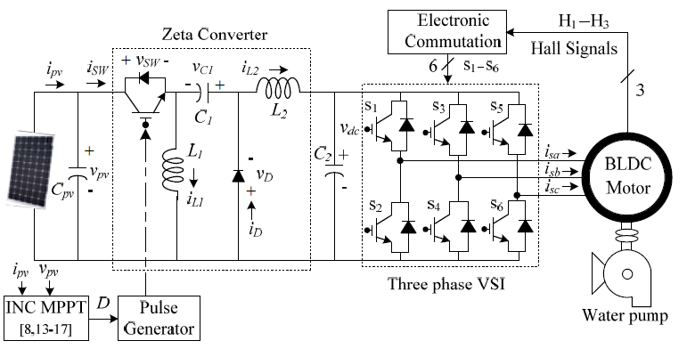
Figure 2: Proposed SPV zeta Convertor fed BLDC Motor

Slide 8
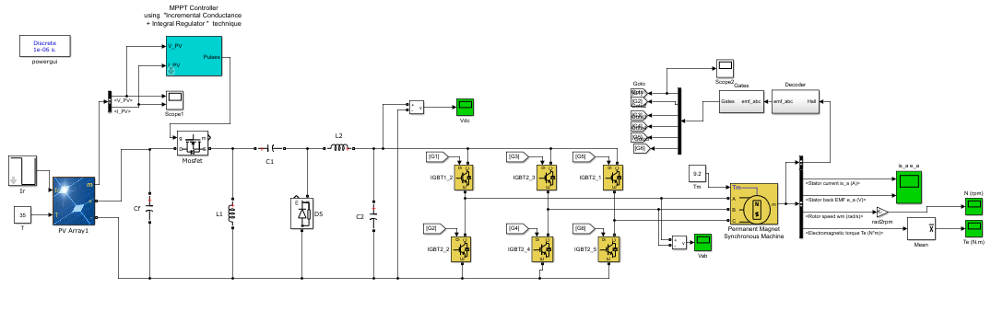
Software Simulink Model:-
Figure 3: MATLAB model of proposed system

Slide 9
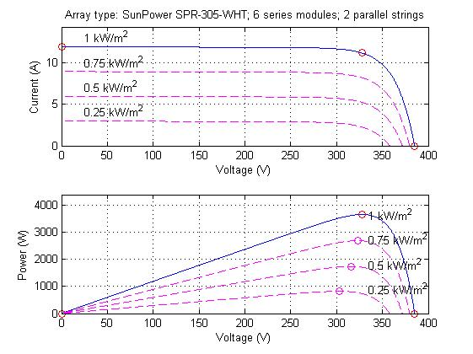
Results:-
Figure 4 : P-V, I-V Characteristics of Solar

Slide 10
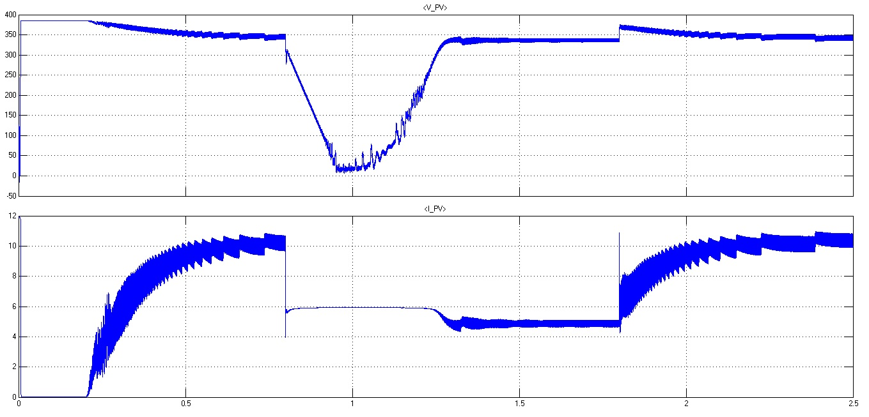
Result:-
Figure 5 : Solar PV array output Vpv and Ipv

Slide 11
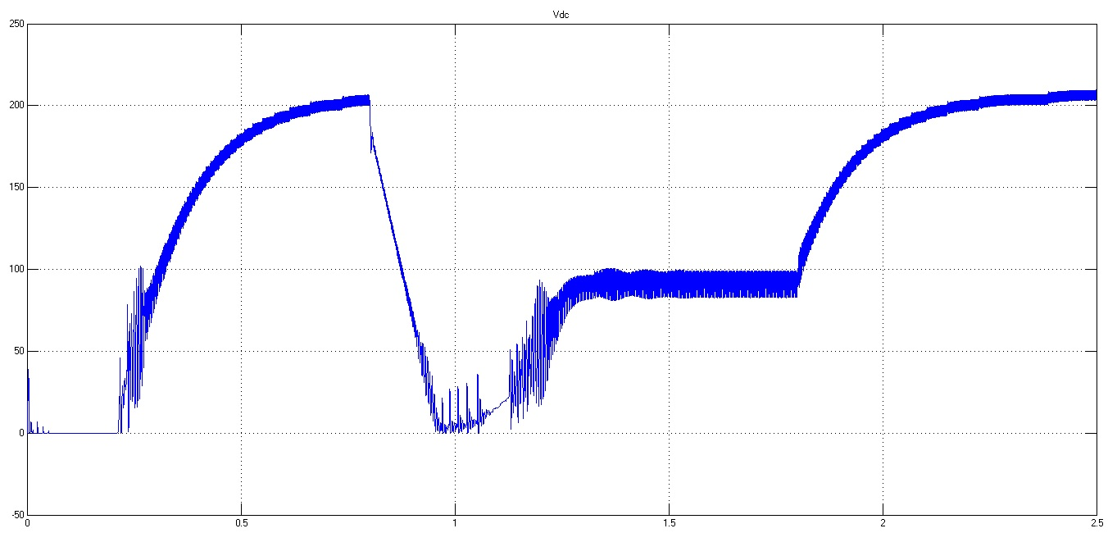
Result:-
Figure 6 : Zeta Convertor Output

Slide 12
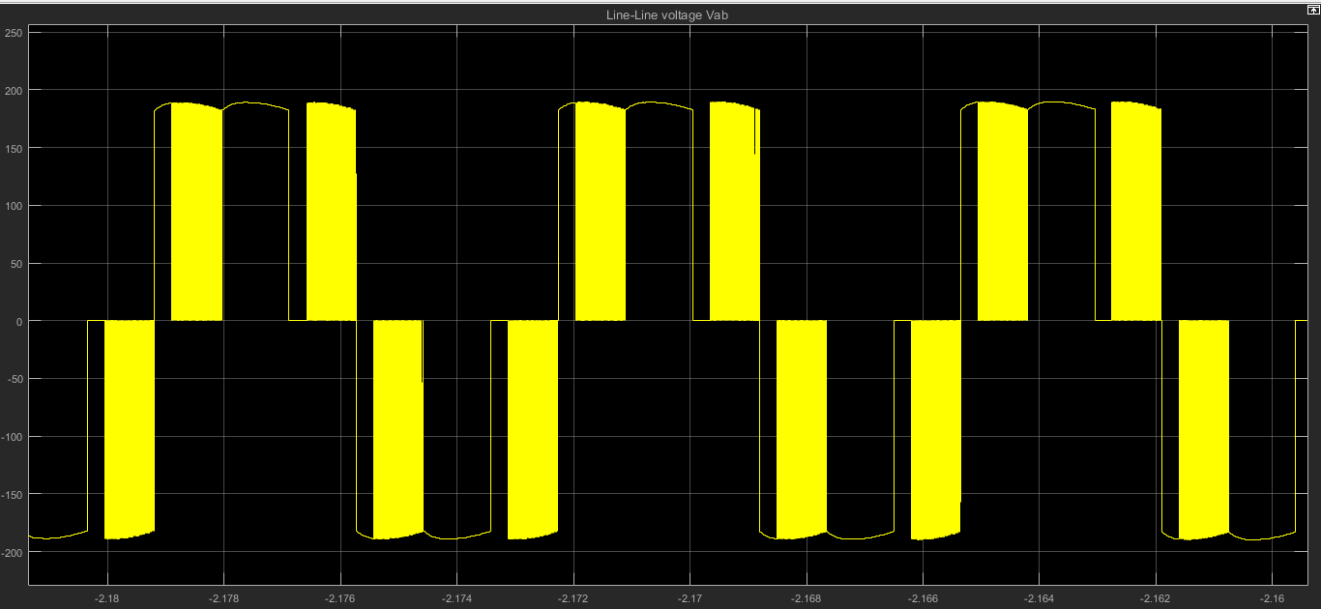
Result:-
Figure 7 : VSI Line-Line Voltage

Slide 13
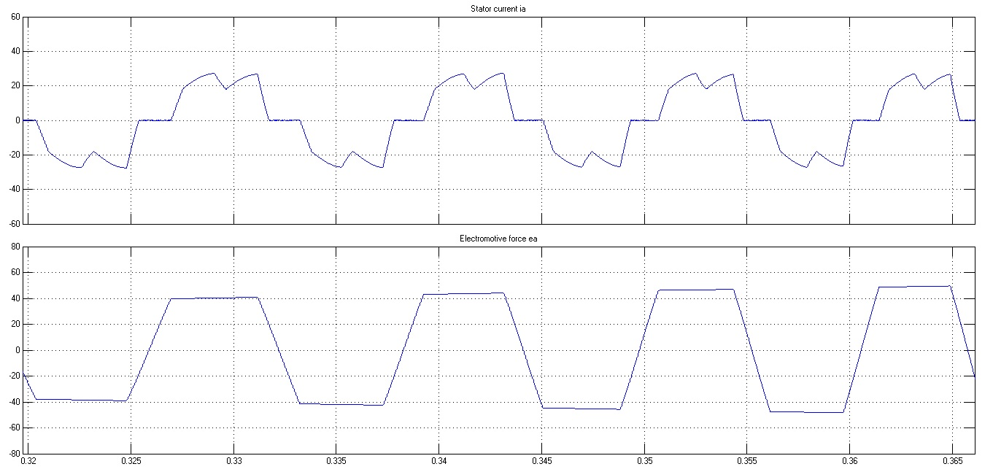
Result:-
Figure 8 : Stator Current and Electromotive Force Developed in BLDC Motor

Slide 14
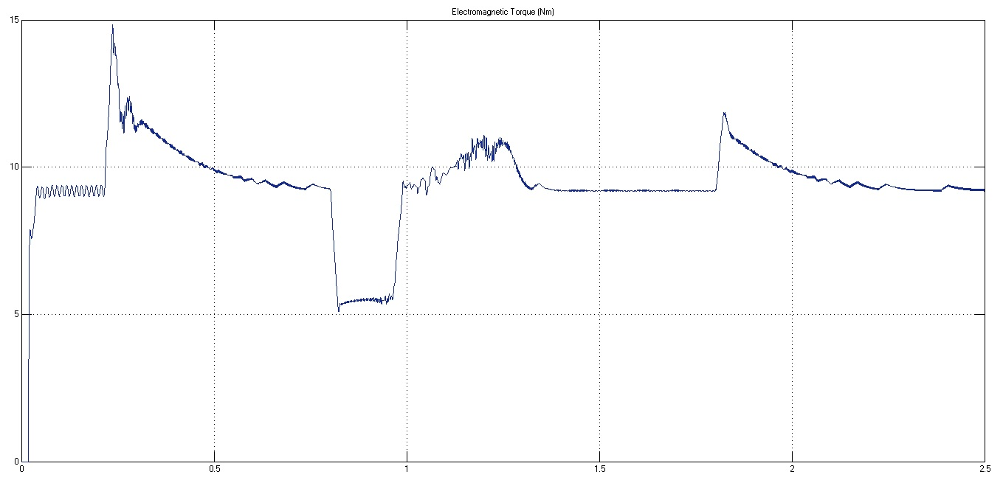
Result:-
Figure 9 : Electromagnetic Torque of BLDC Motor

Slide 15
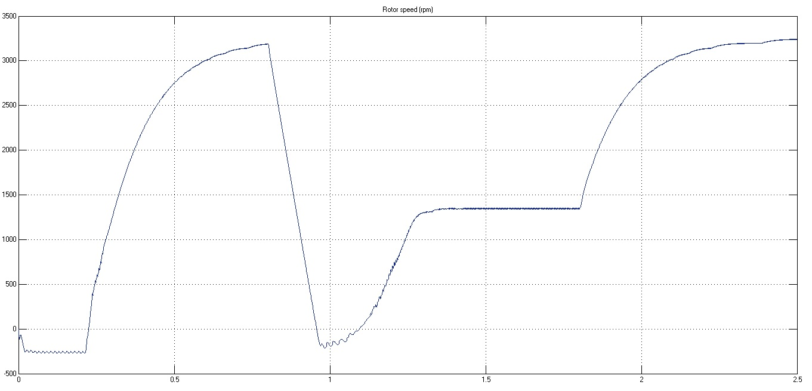
Result:-
Figure 10: Rotor Speed of BLDC Motor

Slide 16
Conclusion:-
The proposed system has been designed and modelled appropriately to accomplish the desired objectives and validated to examine various performances. The performance evaluation has justified the combination of zeta converter and BLDC motor for SPV array based water pumping. The system under study has shown various desired functions such as MPP extraction of the SPV array, soft starting of BLDC motor, fundamental frequency switching of VSI resulting in a reduced switching losses, speed control of BLDC motor without any additional control and an elimination of phase current and DC link voltage sensing, resulting in the reduced cost and complexity. The proposed system has operated successfully even under minimum solar irradiance.

Slide 17
References:-
Rajan Kumar, Bhim Singh “BLDC Motor Driven Solar PV Array Fed Water Pumping System Employing Zeta Converter” IEEE Transactions on Industry Applications 0093-9994 (c) 2015 IEEE DOI 10.1109/TIA.2016.2522943
S. Iyappan, R. Ramaprabha “Design and Implementation of Brushless DC Motor based Solar Water Pumping System for Agriculture using Arduino UNO” Article in International Journal of Engineering and Technology · February 2017
Ashish Kumar Singhal “Journal of Electronic Design Technology Solar Electric Powered Hybrid Vehicle” https://www.researchgate.net/publication/282356190 Article · September 2015
Trishan Esram and Patrick L. Chapman “Comparison of Photovoltaic Array Maximum Power Point Tracking Techniques” IEEE Transactions On Energy Conversion, Vol. 22, No. 2, June 2007 439
Arjav Harjai Abhishek, Bhardwaj Mrutyunjaya, Sandhibigraha “Study Of Maximum Power Point
Tracking (Mppt) Techniques In A Solar Photovoltaic Array” B-Tech Project NIT Rourkela-2014
Dr. R. Anand and M. Chella Deepika “Solar PV Array Employing Zeta Converter Based MPPT Controller Supplying BLDC Motor Drive” Published BYAENSI Publication EISSN: 1998-1090 http://www.aensiweb.com/ANAS 2017 May 11(7): pages 15-25 Open Access Journal

Slide 18
THANK YOU!!!
Save Electricity for your future generations.

