Slide 1
Seismology, geology and environment
Group 3 Final Project Report

Slide 2
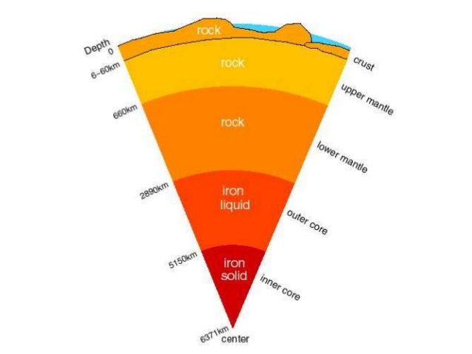
Earth’s cross section

Slide 3
Seismology
Aristotle was one of the first to attempt an explanation of earthquakes based on natural phenomena. He postulated that winds within the earth whipped up the occasional shaking of the earth's surface.
However, these old explanations came to an end when the reign of science took over.
Now we know earthquakes are generated by seismic waves.
Seismic waves are the waves of energy caused by the sudden breaking of rock within the earth or an explosion. They are the energy that travels through the earth and is recorded on seismographs.
There are several different kinds of seismic waves, and they all move in different ways
Two of the most common types of waves are:-

Slide 4
P waves

Slide 5
The first kind of body wave is the P wave or primary wave. This is the fastest kind of seismic wave, and, consequently, the first to 'arrive' at a seismic station. The P wave can move through solid rock and fluids, like water or the liquid layers of the earth. It pushes and pulls the rock it moves through just like sound waves push and pull the air.
The windows rattle because the sound waves were pushing and pulling on the window glass much like P waves push and pull on rock.
Sometimes animals can hear the P waves of an earthquake. Dogs, for instance, commonly begin barking hysterically just before an earthquake 'hits' (or more specifically, before the surface waves arrive). Usually people can only feel the bump and rattle of these waves.

Slide 6
S waves

Slide 7
The second type of body wave is the S wave or secondary wave, which is the second wave you feel in an earthquake.
An S wave is slower than a P wave and can only move through solid rock, not through any liquid medium.
It is this property of S waves that led seismologists to conclude that the Earth's outer core is a liquid.

Slide 8
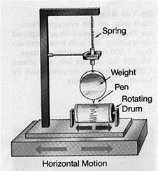
Seismograph
A seismograph, or seismometer, is an instrument used to detect and record earthquakes.

Slide 9
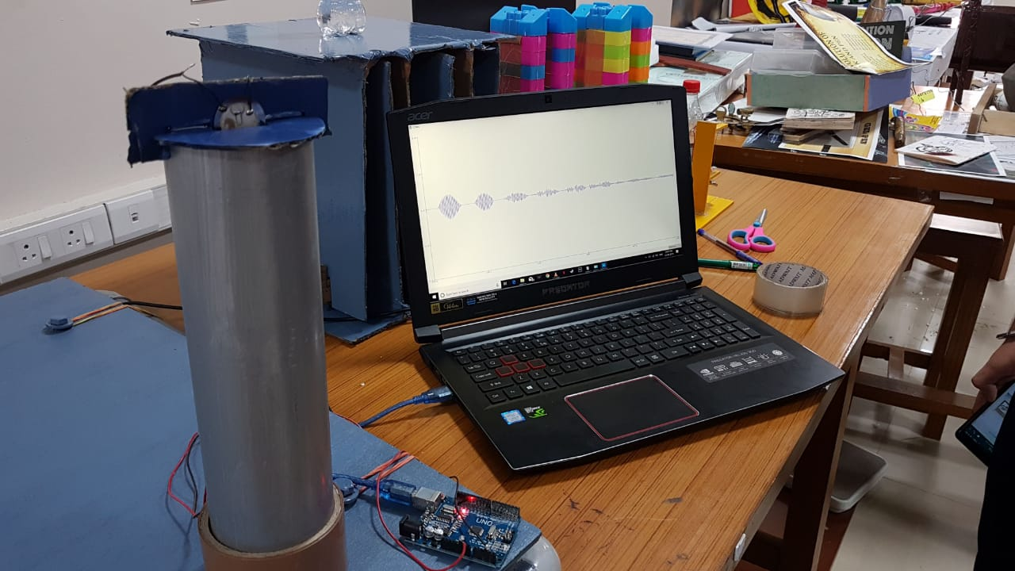
Project overview - seismograph

Slide 10
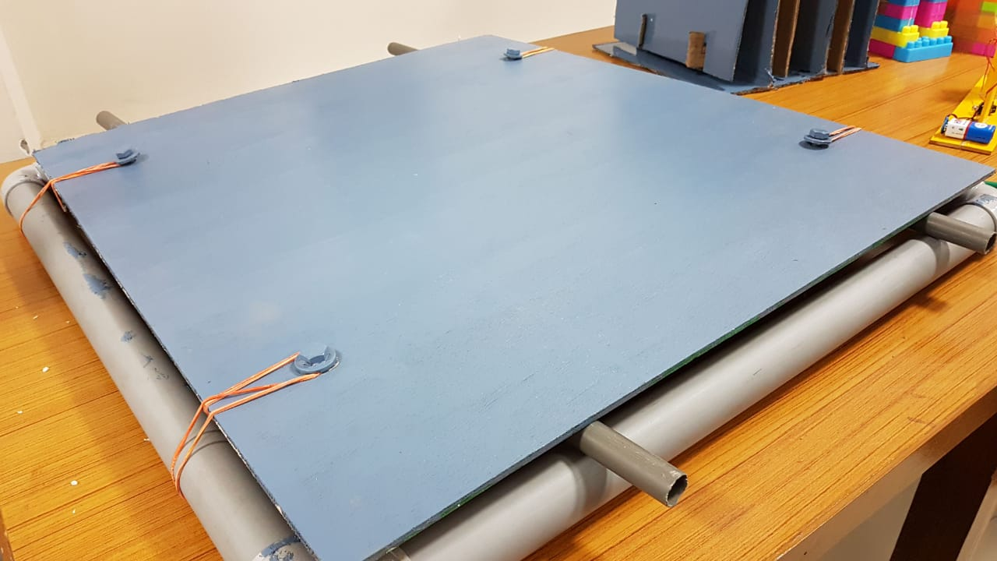
Shake table

Slide 11
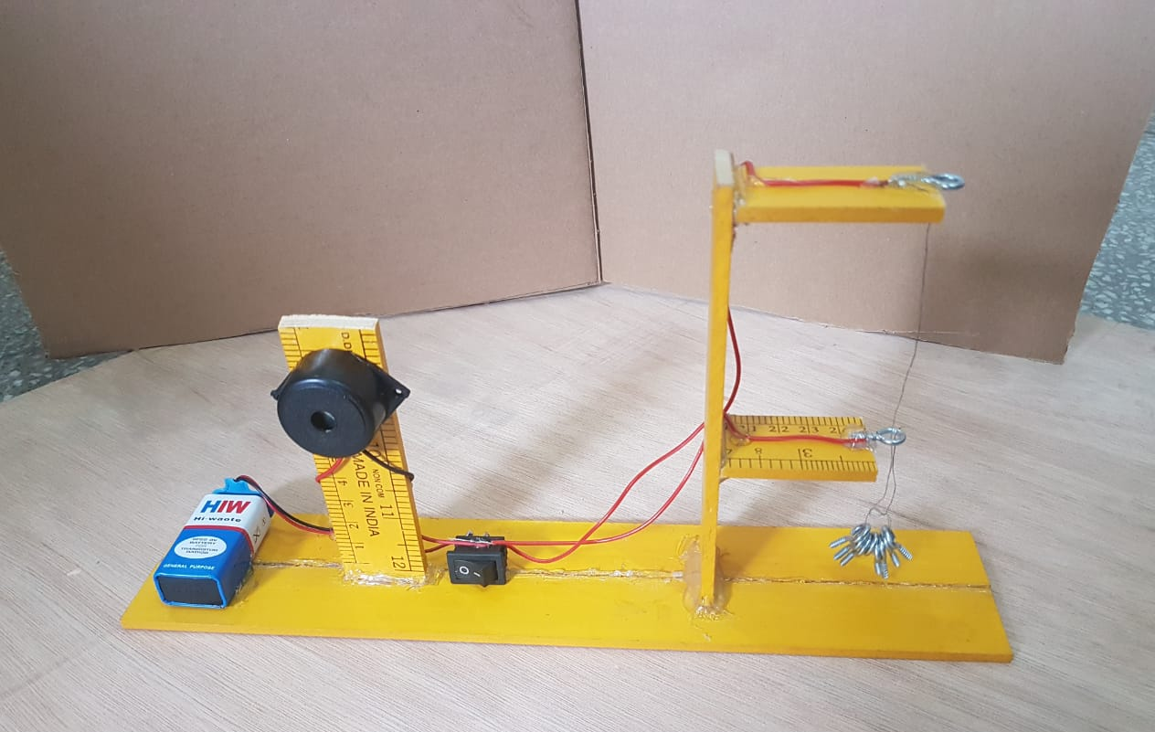
Earthquake alarm

Slide 12
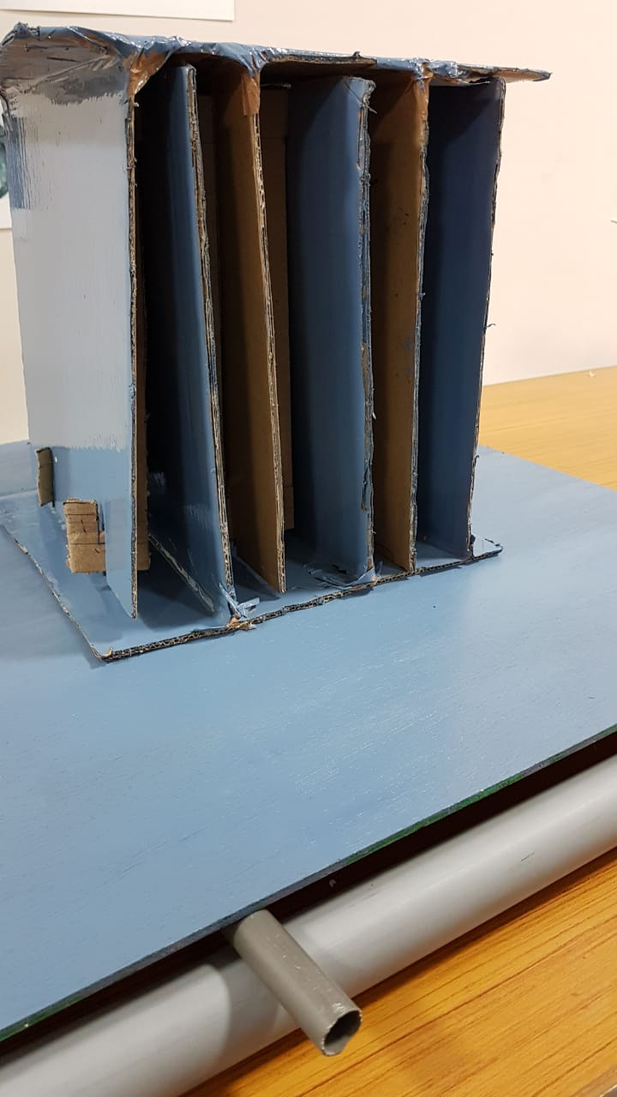
Base Isolation technique:

Slide 13
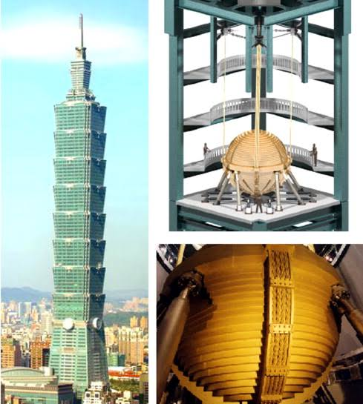
TUNED MASS DAMPER
The impact is reduced on the building by sharing the impulse with the heavy mass.
The dampers eventually reduce the kinetic energy of the structure

