Slide 1
Tech. museum project
Seismology, geology and environment

Slide 2
In the first week we were introduced with the course and its policies.
In the next week we made our group and chose the theme based on the interest and availability.

Slide 3
Week 3
Decided the theme.
Searched for working model and something interesting based on our theme to work on.

Slide 4
Week 4
Finalized our project on seismograph and plate tectonics.
Procured more information of seismology and the working and use of seismograph.

Slide 5
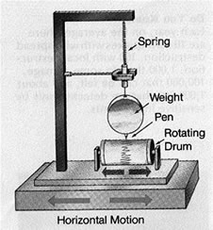
Basic seismograph

Slide 6
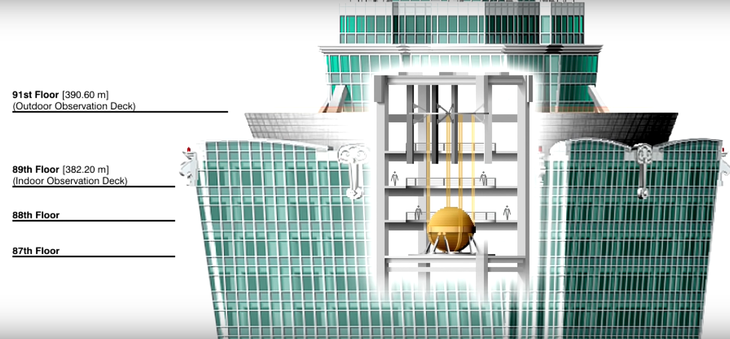
Tuned mass damper
Appropriate heavy weight is attached to the top of the building to reduce the direct impact of the earthquake to the building.

Slide 7
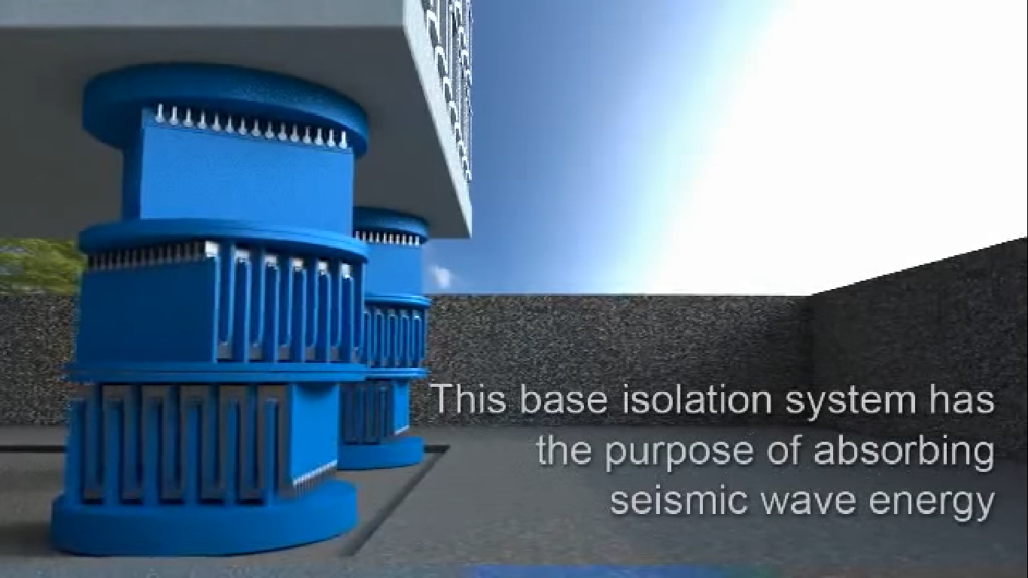
Base Isolation

Slide 8
Week 5
Included one more working model of the earthquake table including earthquake alarm to show the impact of earthquake on buildings of different heights.
Seismograph, the second working model, to read the intensity of the fake earthquake.
Searched more for plate tectonics and the seismic activities below Indian subcontinent .
Decided to make posters on the plate tectonics and the evolution of the earthquake engineering in India.
Made a rough list of the items required for our project.
So in total we will be making two working models of seismograph and an earthquake table and some poster as specified above.

Slide 9
Rough Estimate of price our project items * In case if there is need of some items we will update it to you.
 | Item | Rough price
1. | Plyboard base for the seismograph and shake shake table
2. | Pvc pipes to make shake table
3. | Lego blocks to make the building on the shake table
4. | cardboard
5. | Spring, motor, cardboard roll, paper sheet, battery, wires, marker
6. | 3-4 30cms Wooden scales for earthquake alarm, copper wire, screw eyes, Buzzer
7. | Posters

