Slide 1
Tech Talks: Consul
CSC 519 DevOps
Abhishek Bandarupalle (abandar)
Meghav Desai (mpdesai)

Slide 2
Definition
A Distributed service discovery tool and key value store
Service Discovery
Discover services dynamically
Health Checking
Only healthy services should handle traffic
Multi Datacenter
Networking is abstracted for consul clients

Slide 3
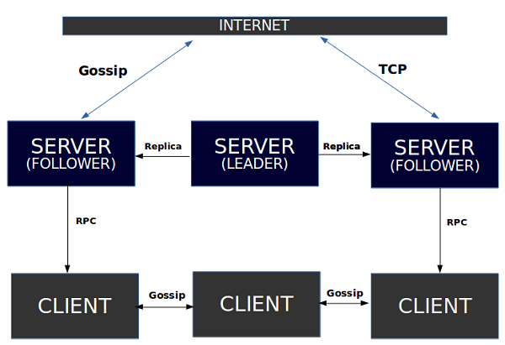
Architecture
Reference: https://www.tutorialspoint.com/consul/consul_architecture.htm

Slide 4
Working
Consul agents running on each node
Elect server leader
Add services for each host
Expose API to Run health checks using agents
Send this data to the server leader which further sends this to all the servers

Slide 5
DEMO: https://youtu.be/EZkIurOw370

Slide 6
Advantages
Properties | Consul | Etcd | Zoo Keeper
User Interface | Available | NO | NO
RPC | Available | Available | NO
Health Check | HTTP API | HTTP API | TCP
Key Value | 3 Consistency modes | Good Consistency | Strong Consistency
Token System | Available | NO | NO
Language | Golang | Golang | Java

Slide 7
Drawbacks
Messages can be lost in the network system
Bandwidth is another problem
Overloading is another problem in distributed operating systems
Poor performance when multiple clients are using the database
The databases in network operating is difficult to administrate then single user system

Slide 8

Thank You

