Slide 1



Srishyla Educational Trust (R), Bheemasamudra GM INSTITUTE OF TECHNOLOGY, DAVANAGERE (Affiliated to VTU, Belagavi, Approved by AICTE -New Delhi & Govt. of Karnataka)
Department Of Information Science and Engineering
Synopsis Presentation on
“Detecting Criminal Activities From CCTV by using Object Detection and machine Learning Algorithms”
Project Co-Ordinator:
Dr.Neelambike S
B.E, M.Tech.,(Ph.D)., M.I.S.T.E
Project Guide:
Nasreen Taj M B
B.E, M.Tech.,(Ph.D)., M.I.S.T.E
Head of the Department:
Dr. Sunil Kumar B S
B.E., M.Tech., Ph.D., M.I.S.T.E
Project Associates:
Bhoomika G B - 4GM20IS008
Bhuvana B G -4GM20IS009
Kavana M -4GM20IS026
Shreya -4GM20IS046

Slide 2
Vision: To evolve as an Excellent Technological Education Centre of Information Science and Engineering to create competitive professional engineers for the advancement of society.
Mission:
M1: To provide Application Specific Training & Practical Experience for developing Quality engineers in Information Science & Engineering.
M2: To Inculcate Creative Skills in students to become Competent in the field of Information Science & Engineering.
M3: To Inculcate Professional, Social and Ethical values in students to perform better in diverse environment.

Slide 3
Program Educational Objectives - PEO's PEO1: To develop graduates who are proficient to solve wide range of computing related problems. PEO2: To prepare graduates who have the necessary skills required for Higher Education & Entrepreneurship. PEO3:To prepare graduates who have the ability to engage in Lifelong Learning.
Program Specific Outcomes - PSO's
Graduates of Information Science & Engineering are:
1. Capable to design, develop & test the IT Solutions in real time.
2. Competent to apply knowledge to manage & monitor IT resources.

Slide 4
Content
Introduction
Existing Technology
Problem Statement
Literature Survey
Objectives
Scope
Methodology
Software and hardware Requirement
Project Schedule
References

Slide 5
Introduction
Using object detection and machine learning for detecting criminal activities from CCTV footage is a powerful approach to enhance security. It involves training systems to automatically identify suspicious behaviors and has wide applications in reducing crime and improving public safety

Slide 6
Existing Technology
Real-world anomaly detection in surveillance videos is a challenging and important task in various fields, including security, safety, and industrial monitoring .
There are several existing technologies and approaches that are commonly used for anomaly detection in surveillance videos.

Slide 7
Problem Statement
"In earlier times there is no method to detect Crime. After That the CCTV cameras were used to detect Crimes. But Watching these Videos manually by humans for detecting crimes is a very time Consuming process especially in today's world of Artificial Intelligence and Machine learning .So this crime detection in CCTV surveillance becomes an important area of research in the field of machine learning."

Slide 8
Literature Survey
Papers | Title | Authors | Year of Publication | Proposed System
[1] | Object Identification and Localization of Visual Explanation for Weapon Detection | N. Hnoohom, P. Chotivatunyu, S. Yuenyong, K. Wongpatikaseree, S. Mekruksavanich and A. Jitpattanakul | 2022 | object identification and localization techniques to provide visual explanations for weapon detection. It likely involves advanced computer vision algorithms to recognize objects, particularly weapons, in images or videos. The localization aspect ensures pinpointing the exact location of the identified objects within the visual content. This combination allows for a more comprehensive understanding and explanation of the detected weapons in the given context.
[2] | Understanding Transit Scenes: A Survey on Human BehaviorRecognition Algorithms | J. Candamo, M. Shreve, D. B. Goldgof, D. B. Sapper and R. Kasturi | 2010 | Survey on existing human behavior recognition algorithms, focusing on their application in transit scenes. The goal is to enhance understanding of how these algorithms operate in the context of transportation environments. This could lead to the development of improved algorithms tailored specifically for recognizing and interpreting human behavior in transit scenarios, potentially contributing to advancements in public safety, transportation efficiency, or related fields.
[3] | Detection and Tracking the Criminal Activity using Network of CCTV cameras | N. Y. Katkar and V. K. Garg | 2022 | Network of CCTV cameras for the detection and tracking of criminal activities. It may employ advanced computer vision and machine learning techniques to analyze video feeds in real-time, identifying suspicious behavior or incidents. The system could include algorithms for activity recognition, object detection, and tracking to provide accurate and timely information to security personnel. Integration with a central monitoring system may enhance overall surveillance capabilities for crime prevention and response.

Slide 9
Objectives
To detect criminal activities from CCTV footage is to enhance security and safety .
To systems automatically identify suspicious or potentially criminal behaviour captured by cameras .
To notifying system that generates alerts or alarms when potentially criminal activities are detected.

Slide 10
Scope
Camera Installation and Configuration
Video Feed Acquisition
Anomaly Detection
Real-Time Processing

Slide 11
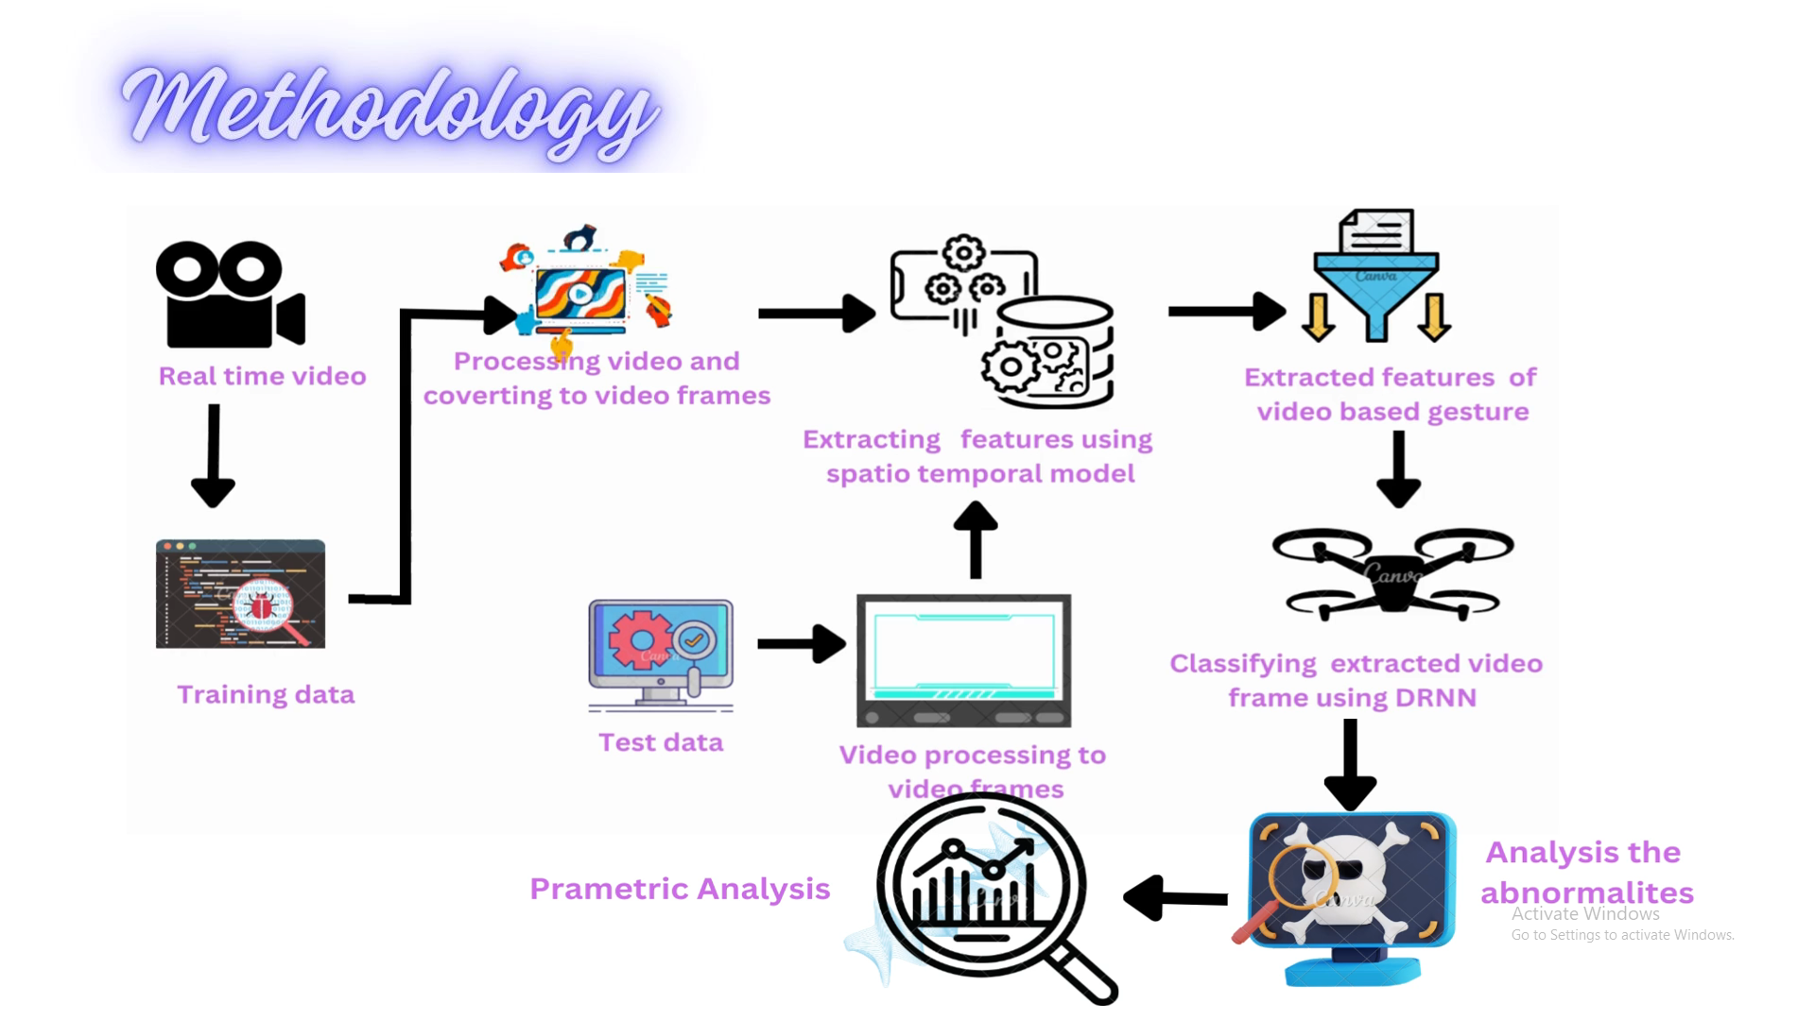
Methodology

Slide 12
Real-time Video Input: The process starts with receiving real-time video input, which is the raw data in the form of a video stream.
Training Data Collection: This step involves collecting and curating a dataset that will be used to train the models in the subsequent steps.
Video Processing: The raw video is processed, and the frames of the video are extracted. This step involves breaking down the video into individual frames for further analysis.

Slide 13
Feature Extraction Using Spatio-Temporal Model: The extracted frames are then fed into a spatio-temporal model that captures both spatial and temporal information from the video. This model extracts meaningful features that represent the gestures or actions in the video.
Testing Data Processing : Similar to the training data, the testing data (which is used to evaluate the performance of the model) is also processed. The video is converted into frames, and the spatio-temporal model is applied to extract features.

Slide 14
Feature Classification Using DRNN: The extracted features from both the training and testing data are fed into a Deep Recurrent Neural Network (DRNN). This neural network is designed to handle sequential data and is used to classify the extracted video frames based on the learned features.
Abnormality Analysis: After classification, the system undergoes an analysis phase where it examines the classified data for any anomalies or abnormalities. This step helps in identifying any deviations from the expected patterns or gestures.

Slide 15
Hardware Requirements
RAM | 8 GB
PROCESSOR SPEED | 2 GHz
HARD DISK | 120 GB
PROCESSOR | Intel Core i5
CCTV Surveillance

Slide 16
Software Requirements
Operating system | Windows 11
Technology | Computer vision
Programming Language | Python
Web Browser | Google Chrome
IDE | Jupyter Notebook

Slide 17
Project Schedule
PROBLEM STATEMENT | SEPTEMBER
SYNOPSIS & REQUIREMENTS | OCTOBER & NOVEMBER
ANALYSIS | DECEMBER & JANUARY
PROJECT DESIGN | FEBRUARY
IMPLIMENTATION & TESTING | MARCH
DOCUMENTATION SUBMISSION | APRIL

Slide 18
References
[1] N. Y. Katkar and V. K . Garg Detection and Tracking the Criminal Activity using Network of CCTV cameras," 2022 3rd International Conference on Smart Electronics and Communication (ICOSEC), 2022, pp. 664-668, doi: 10.1109/ICOSEC54921.2022.9952104.
[2]N. Hoohony P Chotivatunyu, S. Yuenyong, K. Wongpatikaseree, S. Mekruksavanich and A. Jitpattanakuk, "Object Identification and Localization of Visual Explanation for Weapon Detection," 2022 Research, Invention, and Innovation Congress: Innovative Electricals and Electronics (RI2C), 2022, pp 144-147
[3] J. Candamo, M. Shreve B Goldgof, D. B. Sapper and R. Kasturi, "Understanding Transit Scenes: A Survey on luu Behavior Recognition Algorithms," in IEEE Transactions on Intelligent Transportation Systems, vol. 11, no. 1, pp. 206-224, March 2010

Slide 19
THANK YOU

