Slide 1

TravelEase — Travel & Tourism
Project Presentation by Abhishek Chaurasiya
Technology Stack
Goal
HTML5 • CSS3 • JavaScript
Create a simple, responsive, and visually appealing travel portal

Slide 2


Problem Statement
Trip planning today is scattered: users jump between sites for destinations, pricing, booking, and reviews — creating friction, confusion, and lost bookings.
Information dispersed across many sites
Poor navigation and complex booking flows
Weak mobile responsiveness and unfriendly UI
Limited side-by-side package comparison
Objective: Build a centralized, mobile-first site to discover destinations, compare packages, and contact the agency quickly.

Slide 3
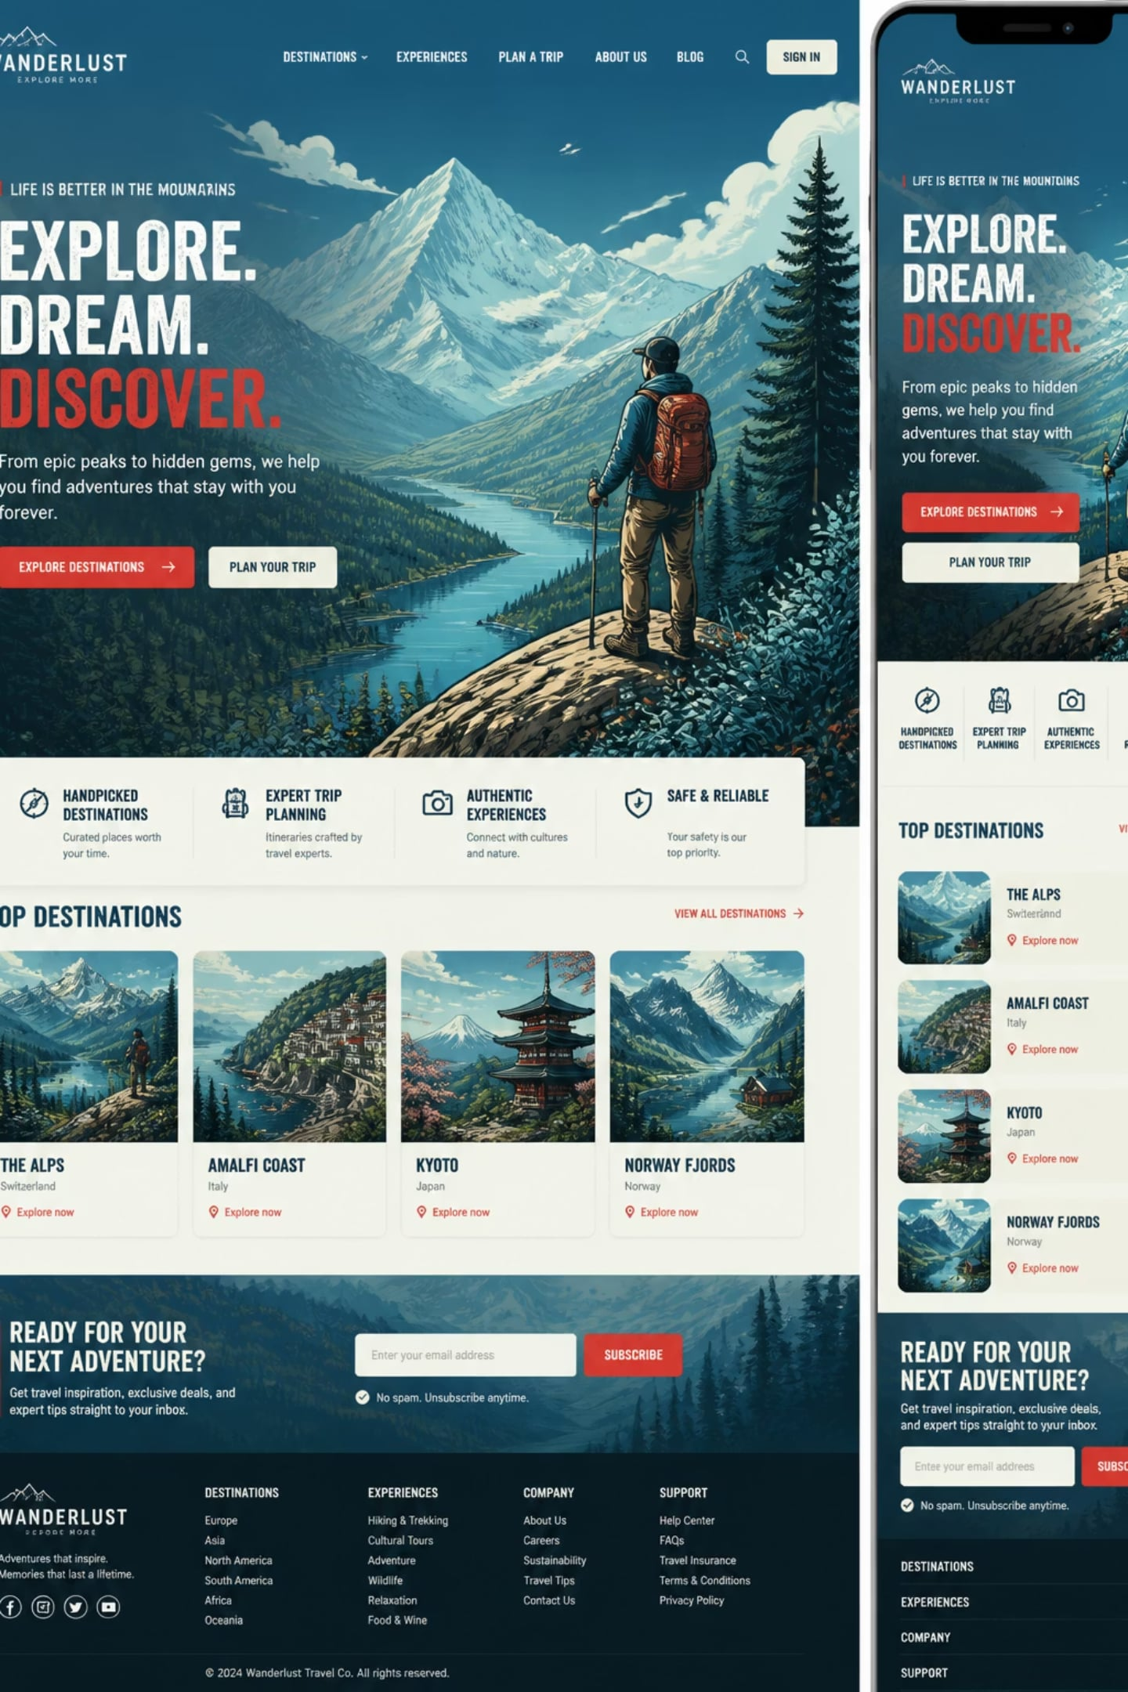




Proposed Solution — TravelEase
TravelEase centralizes planning into a single, elegant interface that guides users from discovery to contact in a few taps.
Responsive Homepage
Engaging hero, featured destinations, and clear CTAs for bookings and enquiries.
Destination Browsing
High-quality cards with images, short descriptions, and pricing highlights.
Packages & Gallery
Organized package listings and an easy-to-browse photo gallery.
Contact & Support
Simple enquiry form with validation and success confirmations.
Working flow: Home → Browse Destinations → Explore Packages → View Gallery → Contact Agency

Slide 4
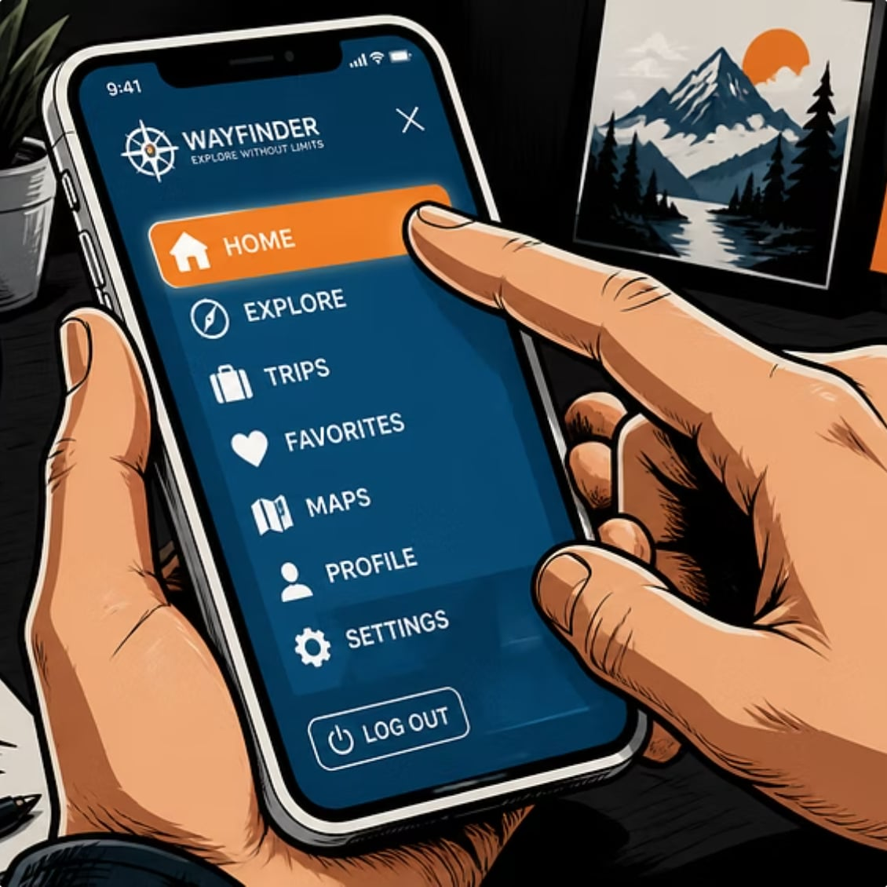
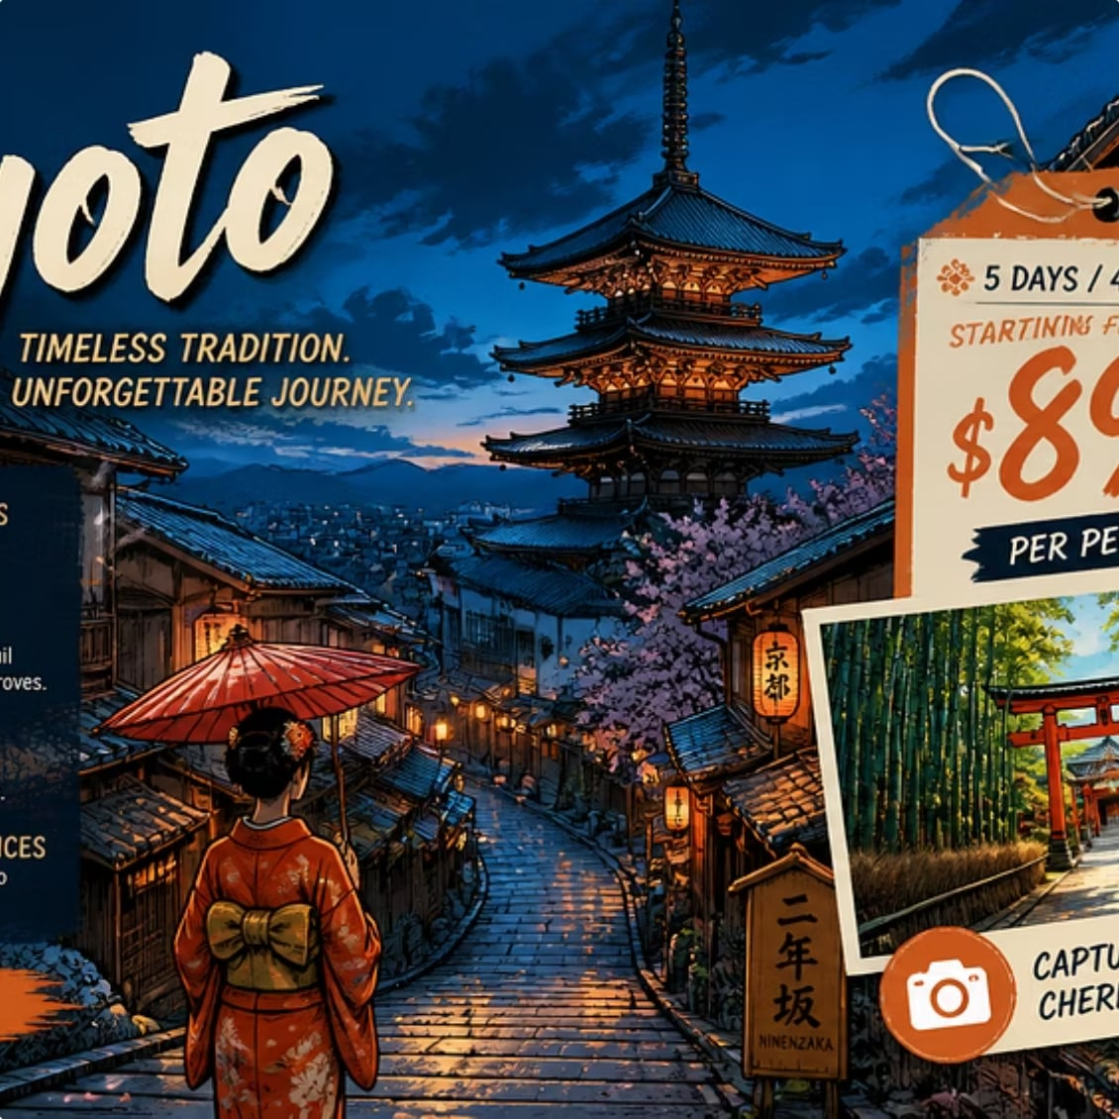

Key Features
Responsive Navigation
Destination Showcase
Customer Testimonials
JavaScript-powered mobile menu and clear page structure for easy movement across the site.
Visually rich cards with images, short blurbs, and price
previews to entice users.
Real user feedback to build trust and increase
conversions.

Slide 5
Technologies Used
Front End
Feature
Purpose
HTML5 • CSS3 • JavaScript
HTML5
Website structure and semantic markup
Layout Tools
CSS3
Styling, responsive layouts, and animations
Flexbox & CSS Grid • Media Queries
JavaScript
Interactivity: menu, filters, form validation
Developer Tools
VS Code • Web Browser testing

Slide 6
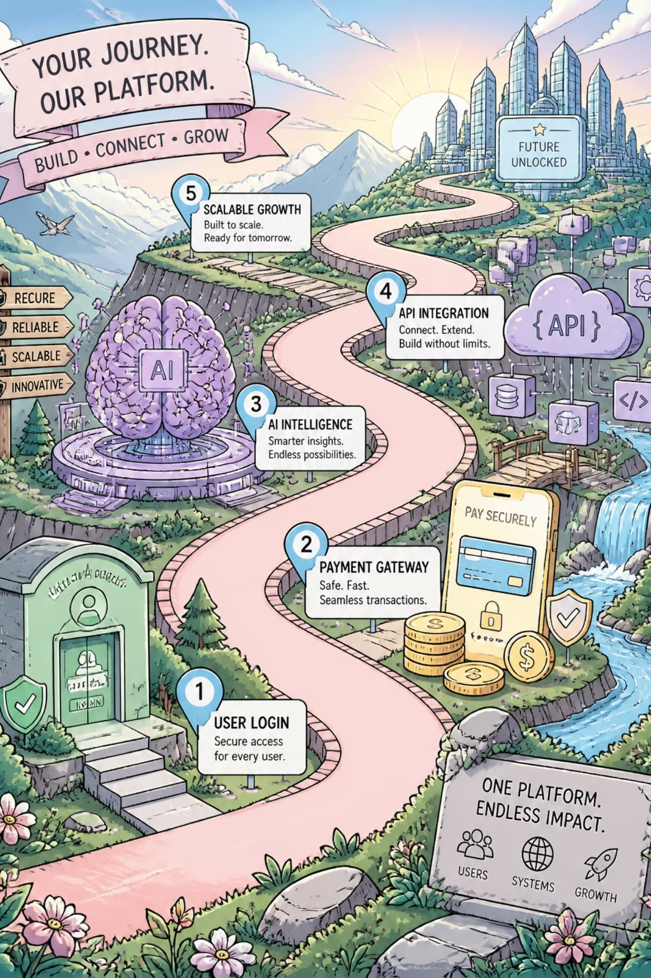


Future Scope
Current site is a static front-end prototype. Planned enhancements will expand functionality and user value.
1
2
3
Authentication & Profiles
Booking & Payments
Backend & Database
User login, registration, and profile management
Online booking workflow with secure payment gateway integration
Server-side integration (Node.js/PHP) and MySQL/MongoDB for package management
4
Smart Features
AI-based recommendations, live weather, multi-language support, and admin dashboard

Slide 7

Conclusion & Outcomes
TravelEase demonstrates front-end web development concepts through a polished, responsive travel portal that simplifies discovery and contact.
Achievements
Attractive UI • Mobile responsiveness • Interactive filtering • Functional contact form
Learning Outcomes
Practical HTML/CSS/JS implementation, responsive layout strategies, and user-centered UI design.
Thank you! Any questions?

