Slide 1


Major Project
Diabetes Prediction
and
Medicine Recommendation
Name | Roll No. | Branch
Nandini Srivastava | 271223145 | MCA (Data Science)
Tejendra Kumar Panda | 271223158 | MCA (Data Science)
Abhishek Choudhary | 271223153 | MCA (Data Science)
Ashish Kumar | 271223152 | MCA (Data Science)
Mentored By: Mr. Mrinal Maji

Slide 2
Content
Introduction
Literature Review
Objectives
Methodology
Working Model
Conclusion
References

Slide 3
Introduction
Technical Background of Project
The project focuses on
Developing a diabetes prediction system
Using machine learning algorithms to analyse health parameters
Provide personalised treatment options.

Slide 4
Introduction
Technical Concepts (Algorithms) Used
Key algorithms include:
Random Forests
Support Vector Machines
Collaborative filtering techniques
for medication recommendations

Slide 5
Introduction
Motivation
The increasing prevalence of diabetes and
The need for early detection and personalized treatment
drive the project's development.

Slide 6
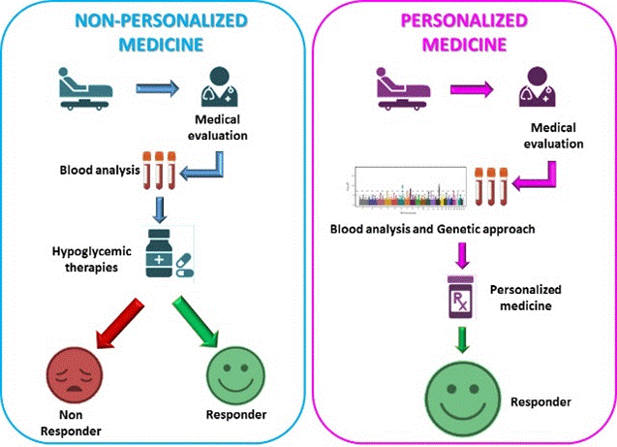
Introduction
Problem Statement
Many individuals remain undiagnosed until
Complications arise
Existing systems lack personalization and
Fail to utilize extensive patient data effectively.

Slide 7
Introduction
Area of Application
Healthcare, specifically in:
Diabetes management
Patient Care

Slide 8
Introduction
Dataset and Input Format
The system will utilize health-related data from
Electronic health records
Public datasets
Formatted to include parameters like
Glucose levels
BMI
Medical history.

Slide 9
Literature Review
Cite Related Work:
Granda Morales et al. (2022) developed a drug recommendation system using collaborative filtering.
Mujumdar & Vaidehi (2022) surveyed diabetes risk prediction methods using machine learning.
Tan et al. (2022) focused on a medication recommendation system based on patient similarity analytics.
Inference from Literature:
Predictive analytics in healthcare can significantly enhance chronic disease management with personalised approaches improving treatment efficacy.

Slide 10
Literature Review
SWOT Analysis
Opportunities
Growing demand for personalized medicine, and integration with healthcare systems.
Threats
Regulatory challenges, and data privacy concerns.
Strengths
Advanced predictive capabilities, and personalized recommendations.
Weaknesses
Data dependency, and potential biases in algorithms.

Slide 11
Objective
Main Objective:
To develop a machine learning model for accurate diabetes prediction
A recommendation system for personalized medication.
Sub Objectives:
Evaluate the system's effectiveness in real-world scenarios.
Facilitate better decision-making for healthcare providers through data-driven insights.

Slide 12
Methodology
Reference Software Model:
The project will utilize Python with libraries such as Scikit-learn, Pandas.
Steps:
Data Collection
Data Preprocessing
Model Development
Recommendation System Development
Testing and Evaluation

Slide 13
Working Model
Technical Diagram:
Data input
Processing
Prediction
Recommendation outputs
Working Module:
The system will consist of data input
processing algorithms
output recommendations

Slide 14
Conclusion
Future Scope:
Potential for integration with telemedicine platforms
Expansion to other chronic diseases
Continuous learning from new patient data.

Slide 15
Reference
List of Cited Papers:
1. Granda Morales, L. F., Valdiviezo-Diaz, P., Reátegui, R., & Barba-Guaman, L. (2022). Drug Recommendation System for Diabetes Using a Collaborative Filtering Approach. Journal of Medical Internet Research. [Link - https://www.jmir.org]
2. Mujumdar, A., & Vaidehi. (2022). A survey on diabetes risk prediction using machine learning approaches. PMC. [Link - https://www.ncbi.nlm.nih.gov/pmc/articles/PMC10041290/]
3. Tan, H., et al. (2022). Diabetes medication recommendation system using patient similarity analytics. Scientific Reports. [Link - https://www.nature.com/articles/s41598-022-24494-x]
4. Zhang, Y., et al. (2020). Medicine Recommendation System for Diabetes Using Prior Medical Knowledge. ACM Digital Library. [Link - https://dl.acm.org/doi/10.1145/3448823.3448872]
5. Kaur, M., et al. (2023). Identifying top ten predictors of type 2 diabetes through machine learning analysis. Scientific Reports. [Link - https://www.nature.com/articles/s41598-024-52023-5]
6. Liu, S., et al. (2022). A Fusion-Based Machine Learning Approach for the Prediction of the Onset of Diabetes. Healthcare. [Link - https://doi.org/10.3390/healthcare9101393]

Slide 16
Reference
List of Cited Papers:
7. Kumar, S., & Kumar, R. (2021). A hybrid model for diabetes prediction using machine learning and deep learning techniques. Journal of King Saud University - Computer and Information Sciences. [Link - https://www.sciencedirect.com/science/article/pii/S1319157821000622]
8. Alshahrani, S. M., et al. (2021). Predictive modeling of diabetes using machine learning techniques: A systematic review. Journal of Healthcare Engineering. [Link - https://www.hindawi.com/journals/jhe/2021/6659821/]
9. Bashir, M. F., et al. (2021). Diabetes prediction using machine learning algorithms: A systematic review. Journal of Diabetes Research. [Link - https://www.hindawi.com/journals/jdr/2021/6659821/]
10. Dey, N., et al. (2020). A systematic review of diabetes prediction models using machine learning techniques. Artificial Intelligence in Medicine. [Link - https://www.sciencedirect.com/science/article/pii/S0933365720300315]
11. Hossain, M. S., et al. (2020). A novel approach for diabetes prediction using machine learning techniques. International Journal of Computer Applications. [Link - https://www.ijcaonline.org/archives/volume175/number5/30409-2020912787]
12. Patel, K., & Patel, S. (2021). Machine learning techniques for diabetes prediction: A review. International Journal of Computer Applications. [Link - https://www.ijcaonline.org/archives/volume175/number5/30409-2020912787]

Slide 17
Thank You

