Slide 1

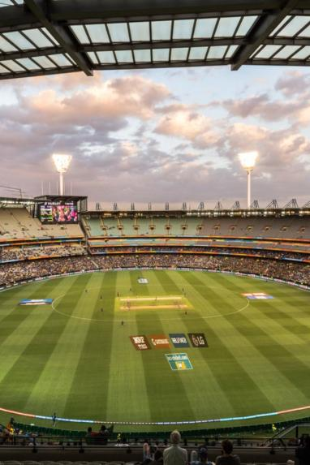
IPL Best 11 Players & Win Prediction
A Data Science Approach Comprehensive analysis of IPL data from 2008-2023. Machine learning models for player selection and match prediction. Innovative approach combining data science and sports analytics.
612203039 ABHISHEK DHAIGUDE
612203040 YASH DHIVAR
612203049 PRAMOD DUDHAL
Notes:
1

Slide 2


Project Overview
Objective: Optimize team composition and match win probability. Data source: Complete IPL match and player performance records. Methodology integrates machine learning and linear programming. Advanced predictive modeling techniques used.
Notes:
2

Slide 3
Objective
Predict IPL match winner
Predict best-performing XI for Dream11
Use machine learning for accurate insights
Optimize team selection using budget and rule constraints
Notes:
3

Slide 4

Dataset Overview
🏏 1. Deliveries Dataset (Ball-by-ball data)
Granularity: Per delivery
Key Columns: match_id, batsman, bowler, runs, dismissal_kind
Used For: Player-level stats and form tracking
Notes:
4

Slide 5
Dataset Overview
📋 2. Match Summary Dataset (Team performance)
Granularity: Match summary
Key Columns: match_id, team_1, team_2, venue, total_runs, wickets
Used For: Team-level feature extraction
Notes:
5

Slide 6
Dataset Overview
🗂️ 3. Metadata Dataset (Contextual info)
Granularity: Match-level metadata
Key Columns: match_id, date, toss_winner, winner, player_of_match
Used For: Model labels, toss analysis, match outcome
Notes:
6

Slide 7

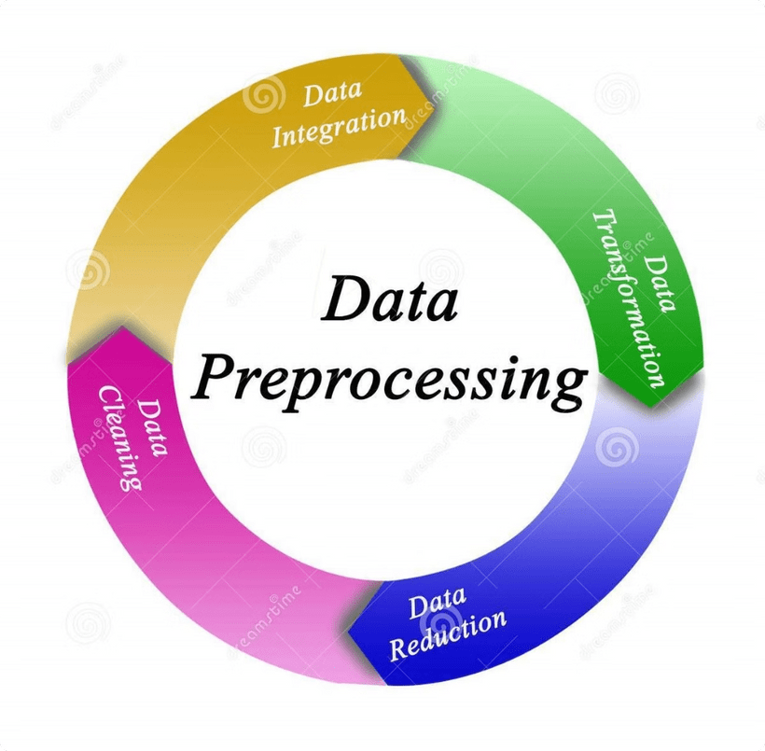
Data Preprocessing
Data Reduction
Data cleaning
Data Integration
Data Transformation
Notes:
7

Slide 8

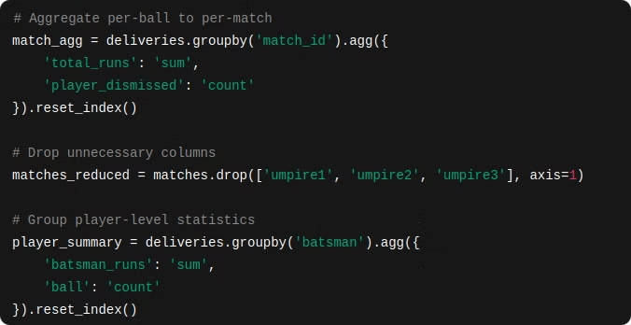
1. Data Reduction
Aggregation:
Aggregated per-ball data into match-level and player-level statistics.
Column Selection:
Dropped irrelevant columns (e.g., umpire1, umpire2) to reduce dimensionality.
Grouping:
Grouped data by match ID, player name, and team to simplify processing.
Notes:
8

Slide 9

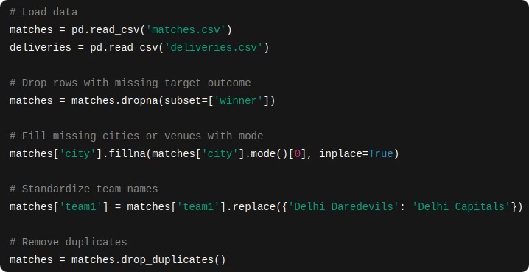
2. Data Cleaning
Handling Missing Values:
Dropped rows with missing match outcomes (e.g., no result matches).
Filled missing city or venue names using available metadata.
Standardizing Formats:
Uniformed player and team names (e.g., 'Delhi Daredevils' → 'Delhi Capitals').
Removing Duplicates:
Ensured unique match IDs and filtered overlapping data.
Notes:
9

Slide 10

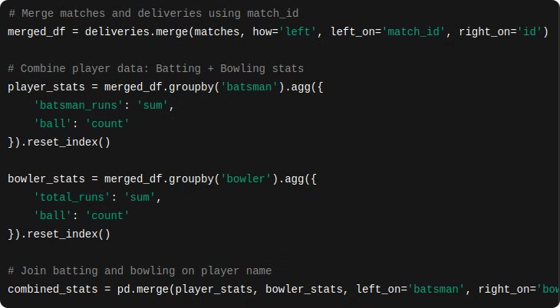
3. Data Integration
Merging Datasets:
Merged matches.csv, deliveries.csv, and ball_by_ball.csv using match_id as the key.
Integrated player performance data from multiple matches into unified statistics.
Combining Player Data:
Combined batting and bowling stats to assign player roles.
Notes:
10

Slide 11

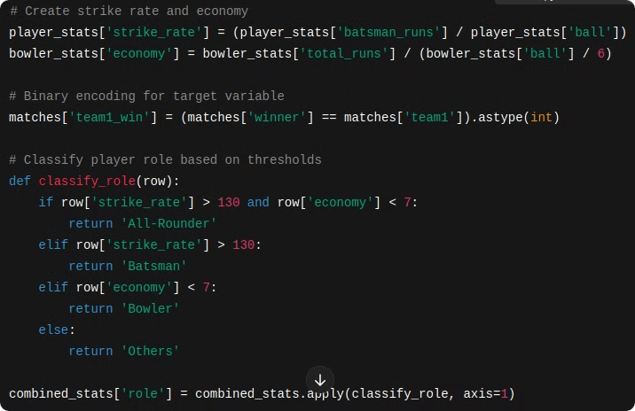
4. Data Transformation
Feature Engineering:
Created new features like:
Strike Rate = (Runs / Balls) × 100
Economy Rate = (Runs Conceded / Overs Bowled)
Categorical to Numerical (Label Encoder):
Converted Categorical Data to Unique numerical values for model use.
Normalize The Numerical Data:
Min-Max Scaler is used to normalized the data.
Notes:
11

Slide 12
Machine Learning Models
We trained and compared three powerful machine learning models to predict match outcomes:
XGBoost
Gradient Boosting algorithm known for high accuracy and performance.
⚡️ Used for predicting win probabilities and player performances.
CatBoost
Designed to handle categorical features efficiently without extra preprocessing.
🧠 Ideal for cricket data with team names, player roles, etc.
Random Forest
An ensemble of decision trees, great for reducing overfitting and improving generalization.
🌲 Used as an alternative prediction model to compare results with XGBoost.
Notes:
12

Slide 13
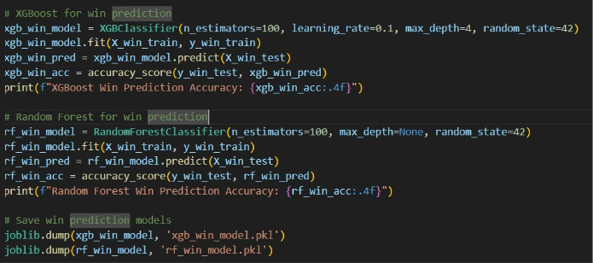
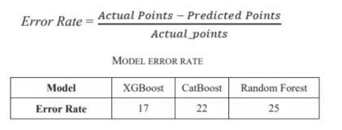
Model Training & Prediction Workflow
Player Performance Prediction
Trained XGBoost, CatBoost, Random Forest on player stats to predict fantasy points.
Evaluated using Root Mean Squared Error (RMSE) for accuracy.
Combined predictions using a weighted ensemble model for improved reliability.
Saved models using joblib for later use in team selection.
Trained XGBoost and Random Forest classifiers to predict winning team.
Evaluated on IPL 2023 data using accuracy score.
Player Credit Assignment
Credits dynamically calculated using:
Predicted performance
Player role (Batsman, Bowler, etc.)
Ensures realistic credit range (8.0 to 10.5) like fantasy platforms.
Notes:
13

Slide 14
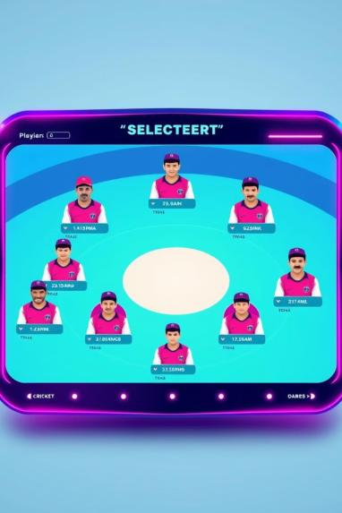
Team Selection with Linear Programming
Objective:
Maximize total predicted points using player selection and captaincy roles.
We use PuLP, a Python library for solving optimization problems.
Our goal: Maximize total predicted points while respecting Dream11 rules.
Constraints include: player count, credits, roles, and team limits.
PuLP selects the best 11 players, along with a Captain and Vice-Captain.
Notes:
14

Slide 15

Key insights lead to better team strategy.
Using PuLP Linear Programming, we optimize player selection by evaluating performance, roles, and credit scores within strict constraints (like max 11 players and 100 total credits).
This ensures a strategically balanced team that maximizes winning potential—just like real-world Dream11 strategies.
Notes:
15

Slide 16
IPL Best 11 Player & Win Prediction Logic
🎯 Objective
Maximize total predicted points scored by the selected 11 players.
This includes weighted points if a player is chosen as captain (×2) or vice-captain (×1.5).
✅ Constraints
To make it realistic (as per Dream11 rules), we enforce these constraints:
Exactly 11 players must be selected.
Credit Limit:
The total credits used by all 11 players must be ≤ 100.
Team Composition:
From Team 1: ≤ 7 players
From Team 2: ≤ 7 players
(So you can't just pick 10 players from one team.)
Notes:
16

Slide 17
IPL Best 11 Player & Win Prediction Logic
✅ Constraints
To make it realistic (as per Dream11 rules), we enforce these constraints:
4. Roles (Player Types):
Batsmen: Minimum 3, Maximum 5
Bowlers: Minimum 3, Maximum 5
All-Rounders: Minimum 1, Maximum 3
Wicket-Keepers: Minimum 1, Maximum 2
5. Captain & Vice-Captain:
Choose exactly 1 captain and 1 vice-captain from the selected 11 players.
Their contribution to predicted points is multiplied:
Captain → ×2
Vice-captain → ×1.5
Notes:
17

Slide 18
IPL Best 11 Player & Win Prediction Logic
🧮 How It Works
We represent each player as a variable: 1 if selected, 0 if not.
Use an optimization solver to maximize total fantasy points.
Apply all the above constraints so the selected team is valid under Dream11 rules.
The solver picks the best 11 players + the best captain and vice-captain to achieve the highest total predicted points.
Notes:
18

Slide 19
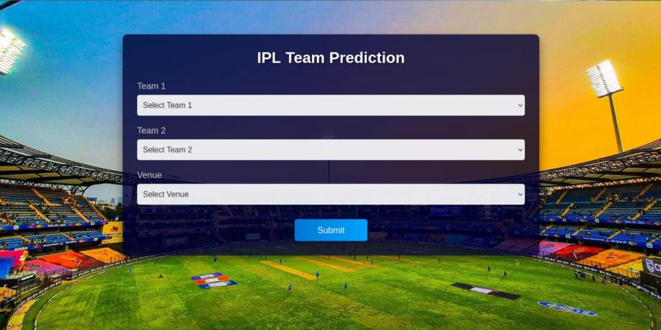
Flask Web App
Notes:
19

Slide 20
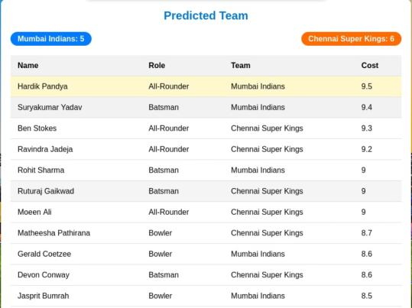
Flask Web App
Notes:
20

Slide 21
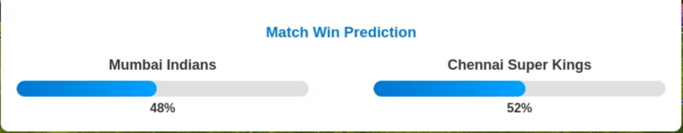
Flask Web App
Notes:
21

Slide 22


Challenges
Data inconsistencies
Player name mismatches
Handling new players
Balancing model accuracy vs interpretability
Notes:
22

Slide 23

Conclusion and Future Directions
Impact of data-driven approach in sports analytics. Potential applications beyond IPL. Recommendations for team management. Future research and model improvement strategies.
Data science is changing the game!
Notes:
23

