Slide 1

Decision support system for retinal diseases
Research Presentation
by
Abhishek G Sheelvant
(Reg no: 230913007)
Department of Computer Science & Engineering
Manipal Institute of Technology, Manipal
Under the supervision of
Prof. P C Siddalingaswamy
Professor, Dept. of Computer Science and Engineering
Manipal Institute of Technology, Manipal
Year 2024

Slide 2
Contents
Introduction
Literature Review
Research Gaps Identified
Objectives
Methodology
Expected Outcomes
Importance of the Proposed Research
References

Slide 3
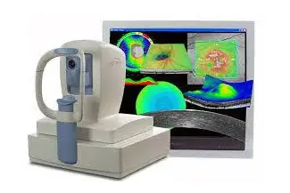
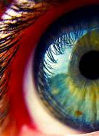
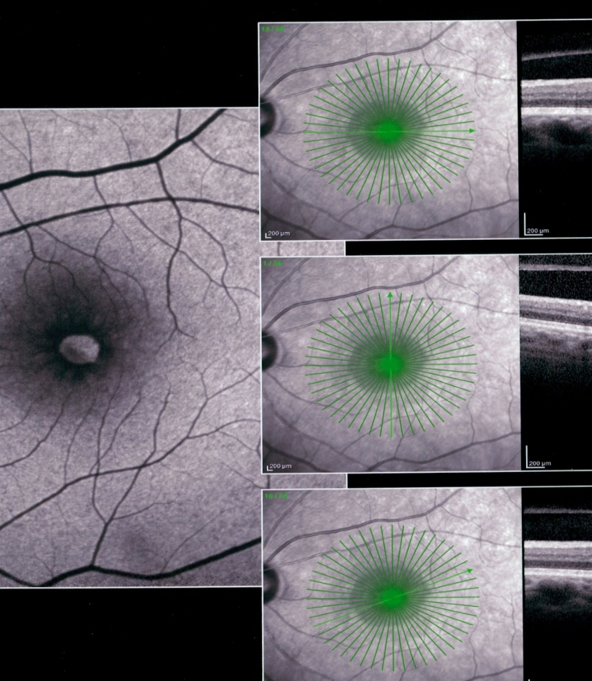
Introduction
The human eye relies on the retina for vision.
OCT provides detailed images of the retina in ophthalmology.
OCT assists in detecting and evaluating CME, aiding in disease management.
Improved diagnosis and treatment with OCT enhance patient care in ophthalmology.

Slide 4
Importance of proposed research
According to WHO globally, at least 2.2 billion people have a near or distance vision impairment. In at least 1 billion – or almost half – of these cases, vision impairment could have been prevented or has yet to be addressed.
Manual process of identifying and measuring cysts or fluid in OCT images, which relies on the expertise of retinal specialists, is susceptible to inconsistencies due to subjective interpretation and lacks repeatability.
Furthermore, the substantial volume of imaging data per patient makes the manual assessment a highly time-consuming task.
These challenges have motivated numerous researchers to introduce automated algorithms for the segmentation and measurement of cysts. These algorithms aim to expedite the process and decrease the need for human labor. Thus, it is beneficial to develop an automatic diagnosis system to support physicians in their diagnosis work.

Slide 5
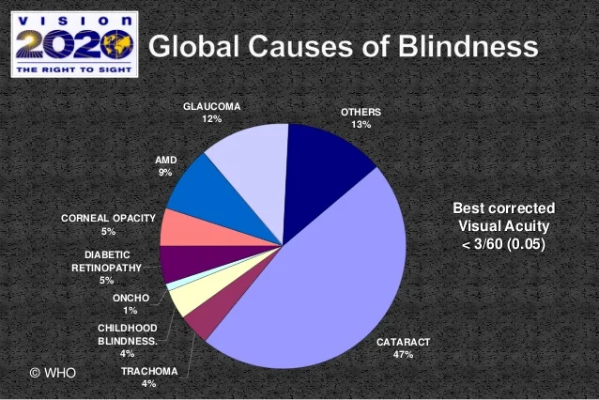

Slide 6
Literature Review
Author | Title | Work done | Observations
Chetoui, M., Akhloufi, M.A. (2020). | Deep Retinal Diseases Detection and Explainability Using OCT Images | Retinal disorders are identified and diagnosed through retinal layer segmentation and thickness measurement in OCT images. | Changes in retinal layers due to disorders are uncommon, making it challenging to establish a specific benchmark process for data analysis. Generalizing the process for automatic processing is also challenging.
Zeng X., Chen H., Luo Y., and Ye W | Automated diabetic retinopathy detection based on binocular siamese-like convolutional neural net- work | A transfer learning-based Convolutional Neural Network (CNN) was proposed on binocular retinal fundus images. | CNN algorithm for DR grading exhibited decreased performance during testing when confronted with a smaller dataset

Slide 7
Literature Review
Author | Title | Work done | Observations
Gulshan V. et al., | Development and validation of a deep learning algorithm for detection of diabetic retinopathy in retinal fundus photographs | Deep convolutional neural network (CNN) optimized for image classification trained on a dataset of 128,175 retinal images. Images graded 3 to 7 times for diabetic retinopathy, diabetic macular edema, and image gradability by 54 US licensed ophthalmologists and ophthalmology senior residents between May and December 2015. | Training and validation aimed to assess algorithm effectiveness in accurately classifying retinal images for diabetic retinopathy and diabetic macular edema detection.
Kermany, D.S., Goldbaum, M., Cai, W., Valentim, C.C., Liang, H., Baxter, S.L., McKeown, A., Yang, G., Wu, X., Yan, F. and Dong, J. | Identifying medical diagnoses and treatable diseases by image- based deep learning | A diagnostic tool based on a deep-learning framework is established for screening patients with common treatable blinding retinal diseases. The tool provides a more transparent and interpretable diagnosis by highlighting the regions recognized by the neural network. This tool has the potential to expedite the diagnosis and referral of treatable conditions, facilitating earlier treatment and leading to improved clinical outcomes. | When applied to a dataset of optical coherence tomography images, the framework achieves performance comparable to human experts in classifying age-related macular degeneration and diabetic macular edema.

Slide 8


Research Gap
Limited Model Interpretability
Contextual Information Integration
Small and Imbalanced Datasets
Generalization Across Different Populations

Slide 9

Objectives
Achieve higher accuracy than existing models.
To categorize OCT images into Diabetic Macular Edema, Drusen Macular Degeneration, Choroidal Neovascularization, and Normal.
Increase Model Interpretability
Ethical and Fair AI: Addressing ethical considerations and biases in deep learning systems

Slide 10
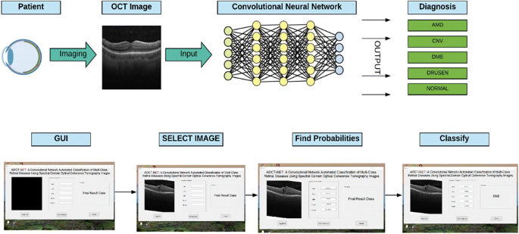
Proposed Methodology
The use of convolutional neural network architecture will be explored and fine-tuned to detect choroidal neovascularization (CNV), diabetic macular edema (DME), drusen, and normal using Optical Coherence Tomography (OCT) images.
An explainability algorithm will be developed to visually show the pathology regions identified by the network.
Currently exploring other Models.

Slide 11
Cont. Methodology
Data Collection: Gather a large dataset of retinal images. These images can be collected from various sources such as hospitals, clinics, research institutions, or public datasets.
Data Preprocessing: Prepare the dataset for training by performing preprocessing steps such as resizing, normalization, and augmentation. Preprocessing may also involve labeling the images with the corresponding disease or condition.
Model Selection: Choose a deep learning architecture suitable for image classification tasks. Convolutional Neural Networks (CNNs) are commonly used for this purpose due to their effectiveness in capturing spatial hierarchies in images.
Model Training: Train the selected model on the preprocessed dataset. This involves feeding the images through the network, computing the loss (error), and updating the model parameters using optimization algorithms like Stochastic Gradient Descent (SGD) or Adam.
Model Evaluation: Evaluate the trained model's performance using a separate validation dataset. Common evaluation metrics for classification tasks include accuracy, precision, recall, F1-score, and area under the Receiver Operating Characteristic (ROC) curve.
Hyperparameter Tuning: Fine-tune the model's hyperparameters, such as learning rate, batch size, and network architecture, to improve performance further.
Deployment and Testing: Deploy the trained model to real-world applications such as clinics or hospitals. Test the model's performance on unseen data to ensure its generalization ability.
Monitoring and Maintenance: Continuously monitor the model's performance in production and update it periodically with new data or retraining to maintain its accuracy and effectiveness.

Slide 12
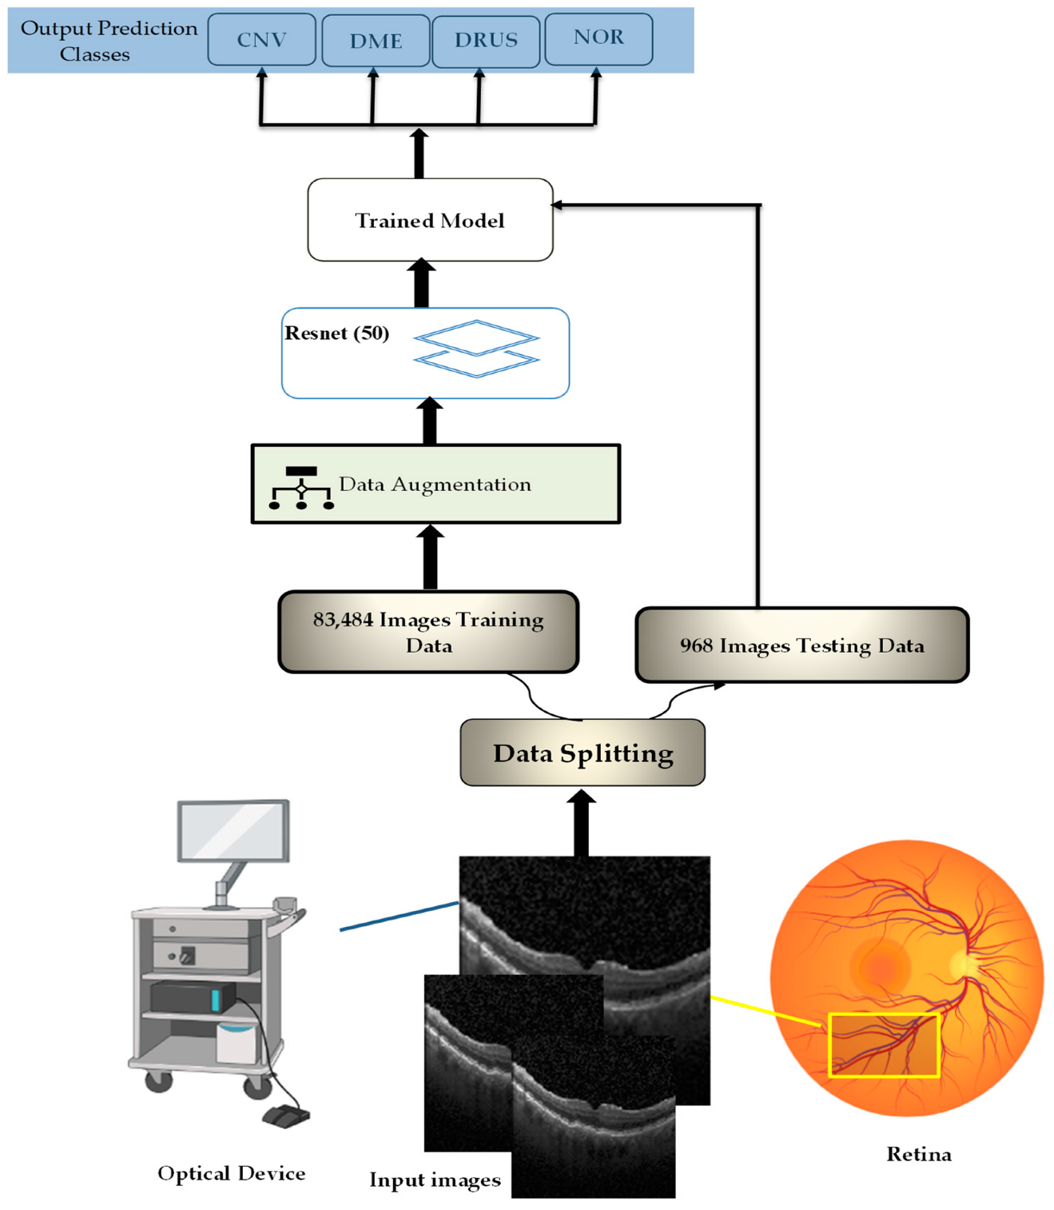
Flow Diagram

Slide 13
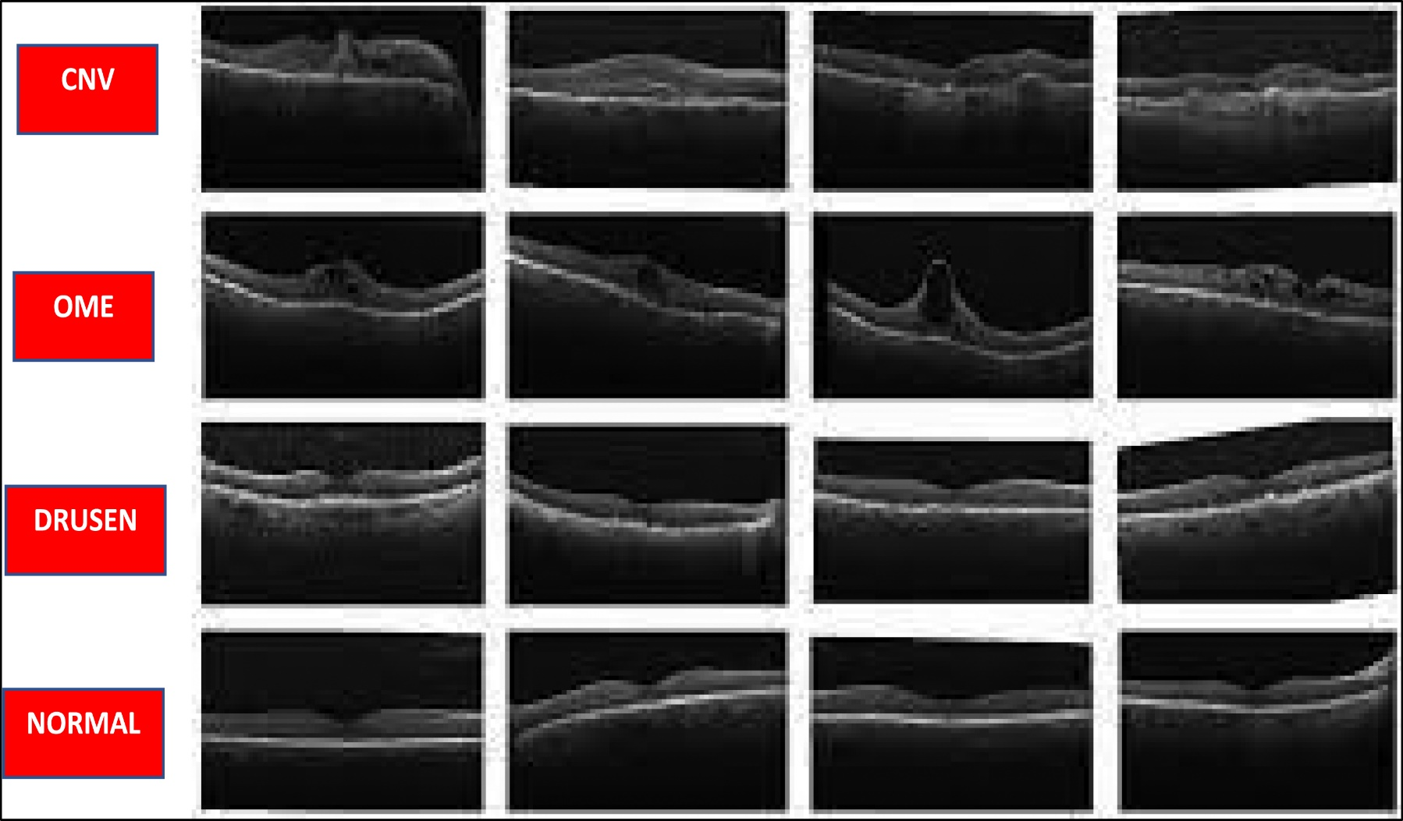
Data set
Data label | Data count
CNV | 37,203
DME | 11,348
Drusen | 8,616
Normal | 26,315

Slide 14
Expected Outcomes
The explored model will be effectively identifying the key disease symptoms. This represents a valuable contribution to the advancement of a diagnostic system capable of detecting various eye diseases in OCT images.
The examined model has the potential to assist clinicians in the diagnostic process and support them in making more informed decisions.

Slide 15
References
Chetoui, M., Akhloufi, M.A. (2020). Deep Retinal Diseases Detection and Explainability Using OCT Images. In: Campilho, A., Karray, F., Wang, Z. (eds) Image Analysis and Recognition. ICIAR 2020. Lecture Notes in Computer Science(), vol 12132. Springer, Cham. https://doi.org/10.1007/978-3-030-50516-5_31
Rahil, M., Anoop, B.N., Girish, G.N., Kothari, A.R., Koolagudi, S.G. and Rajan, J., 2023. A Deep Ensemble Learning-Based CNN Architecture for Multiclass Retinal Fluid Segmentation in OCT Images. IEEE Access, 11, pp.17241-17251.
Wei, X. and Sui, R., 2023. A Review of Machine Learning Algorithms for Retinal Cyst Segmentation on Optical Coherence Tomography. Sensors, 23(6), p.3144.
Seth S. and Agarwal B., “A hybrid deep learning model for detecting diabetic retinopathy,” J. Stat. Manag. Syst., vol. 21, no. 4, pp. 569–574, Jul. 2018, https://doi.org/10.1080/09720510.2018.1466965
Geetharamani R. and Balasubramanian L., “Retinal blood vessel seg- mentation employing image pro cessing and data mining techniques for computerized retinal image analysis,” Integr. Med. Res., vol. 36, pp. 102–118, 2016, https://doi.org/10.1016/j.bbe.2015.06.004
Zeng X., Chen H., Luo Y., and Ye W., “Automated diabetic retinopathy detection based on binocular siamese-like convolutional neural net- work,” IEEE Access, vol. 7, pp. 30744–30753, 2019, https://doi.org/ 10.1109/ACCESS.2019.2903171
Abramoff M. D. et al., “Improved automated detection of diabetic ` retinopathy on a publicly available dataset through integration of deep learning,” Investig. Ophthalmol. Vis. Sci., vol. 57, no. 13, pp. 5200– 5206, Oct. 2016, https://doi.org/10.1167/iovs.16-19964 PMID: 27701631
Gulshan V. et al., “Development and validation of a deep learning algorithm for detection of diabetic retinopathy in retinal fundus pho- tographs,” JAMA—J. Am. Med. Assoc., vol. 316, no. 22, pp. 2402–2410, Dec. 2016, https://doi.org/10.1001/jama.2016.17216 PMID: 27898976
Chetoui, M. and Akhloufi, M.A., 2020, June. Deep retinal diseases detection and explainability using oct images. In International Confer- ence on Image Analysis and Recognition (pp. 358-366). Cham: Springer International Publishing.
Rahil, M., Anoop, B.N., Girish, G.N., Kothari, A.R., Koolagudi, S.G. and Rajan, J., 2023. A Deep Ensemble Learning-Based CNN Architec- ture for Multiclass Retinal Fluid Segmentation in OCT Images. IEEE Access, 11, pp.17241-17251
Wei, X. and Sui, R., 2023. A Review of Machine Learning Algorithms for Retinal Cyst Segmentation on Optical Coherence Tomography. Sensors, 23(6), p.3144.
Awais, M., Muller, H., Tang, T.B. and Meriaudeau, F., 2017, September. ¨ Classification of sd-oct images using a deep learning approach. In 2017 IEEE International Conference on Signal and Image Processing Applications (ICSIPA) (pp. 489-492). IEEE.

Slide 16
THANK YOU

