Slide 1

CAPSTONE PROJECT
Text, Social Media & Web Analytics
Title:”Advanced Sales Forecasting: A Machine Learning Approach to Market-Integrated Predictions”
ANALYZING PUBLIC SENTIMENTANDENGAGEMENT TRENDS
Abhishek Gantana
Reg no: 24MBMB03
MBA Business Analytics

Slide 2

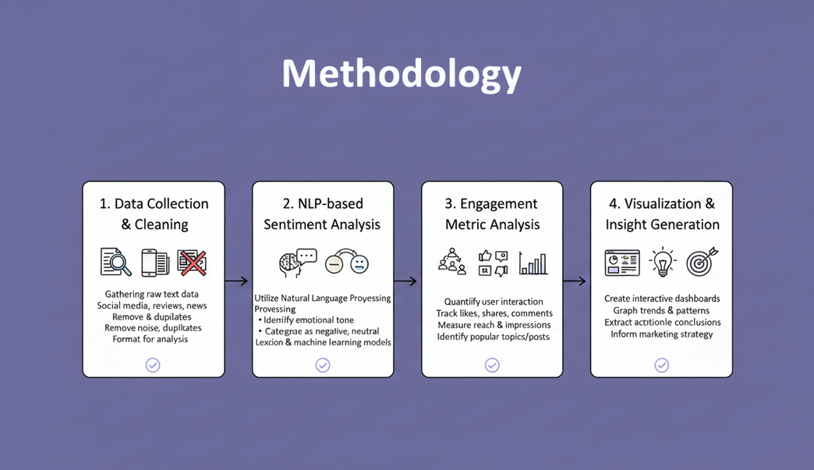
Problem statement & objectives
Problem statement & Methodology
Key Objectives
• Extract sentiment from social, review, and news data
• Visualize trends and engagement patterns
• Derive actionable insights for marketing and business strategy
Methodology
• Data Collection & Cleaning
• NLP-based Sentiment Analysis
• Engagement Metric Analysis
•Visualization & Insight Generation
Brands need real-time sentiment and engagement intelligence from digital text sources.
Rapidly evolving online
narratives demand
instant understanding.

Slide 3

Data & Implementation
Datasets Used:
• tweets_sample.csv
• reviews_data.csv
• news_headlines.csv
Preprocessing Steps:
• Tokenization, stopword removal,
normalization
Techniques:
• Sentiment Analysis: VADER, TextBlob
• Keyword Extraction: Frequency & Word
Cloud
• Engagement Analysis: Correlation between
sentiment & likes/retweets

Slide 4


Data & Implementation
DATA
  Tweets_sample.csv
  Reviews_data.csv
  News_headlines.csv
  Tokenization
  stopword removal
  normalization
Techniques
Techniques
  Sentiment Analysis: VADER, TextBlob
  Keyword Extraction: Frequency & Word Cloud
  Engagement Analysis: Correlation between sentiment & likes/retweets

Slide 5
Results & visual insights
Key Insights:
•Tweets show high polarity variance (~0.65 correlation between sentiment & engagement)
• Reviews are mostly positive (avg sentiment > 0.3)
• News headlines remain neutral, useful for event trend tracking
results & visual insights
Visuals:
• Sentiment Distribution
• Tweets Word Cloud
• Final Dashboard Snapshot

Slide 6
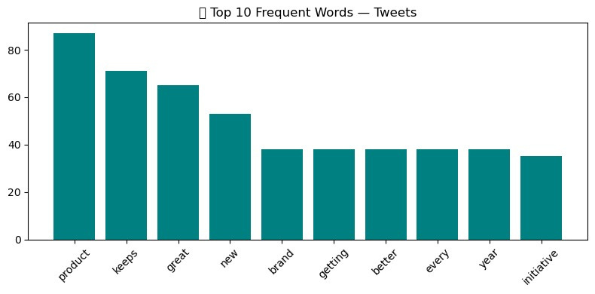
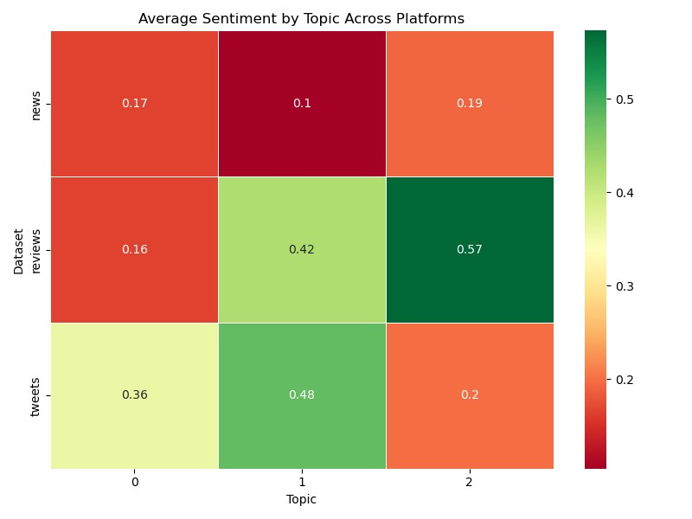
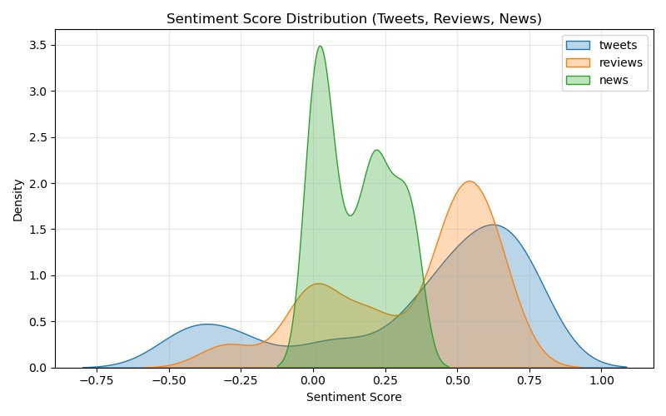
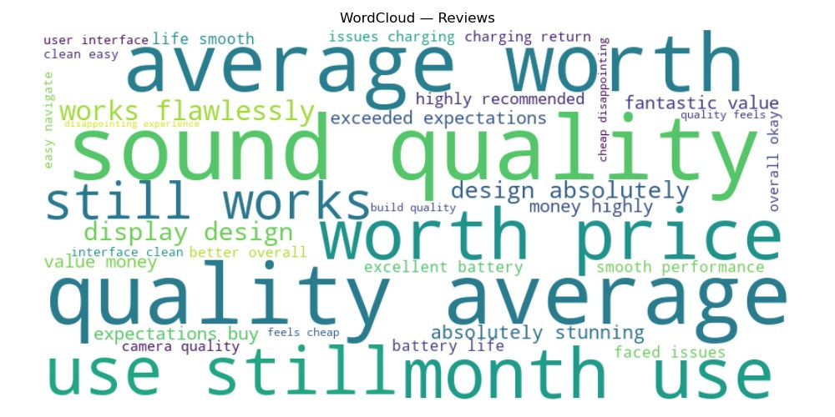

Slide 7
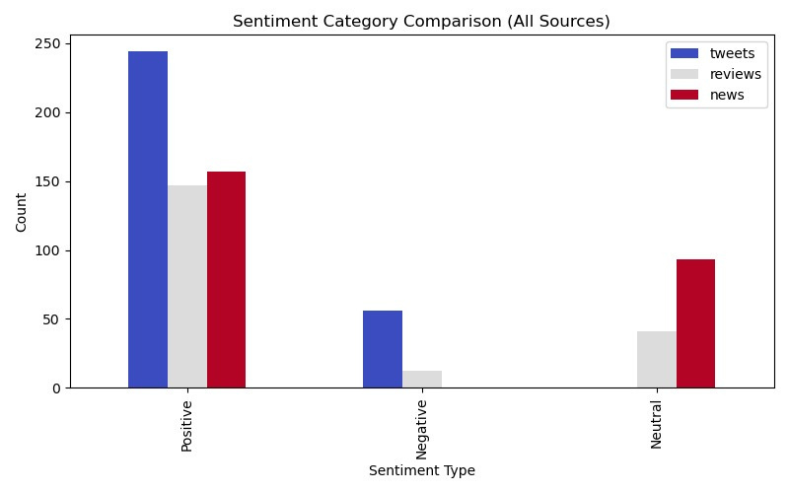
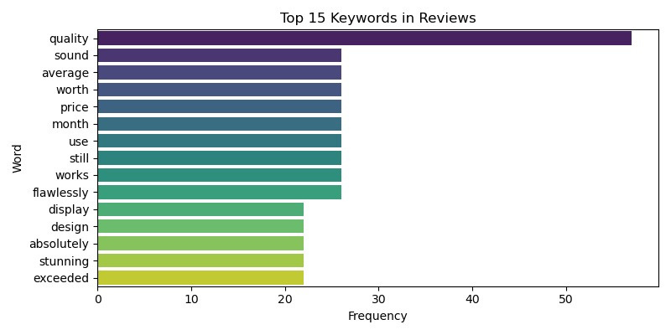
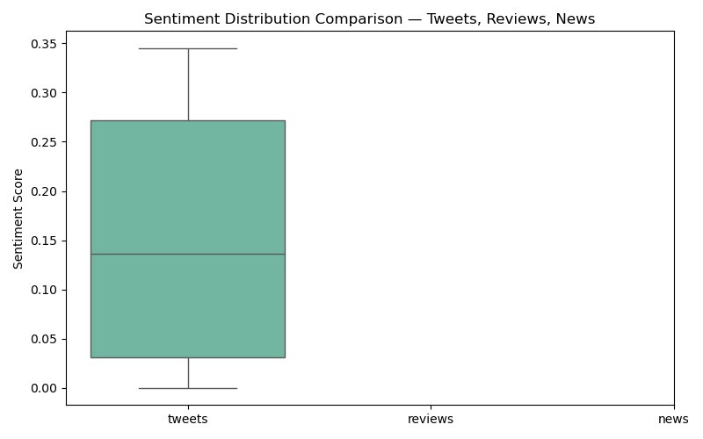
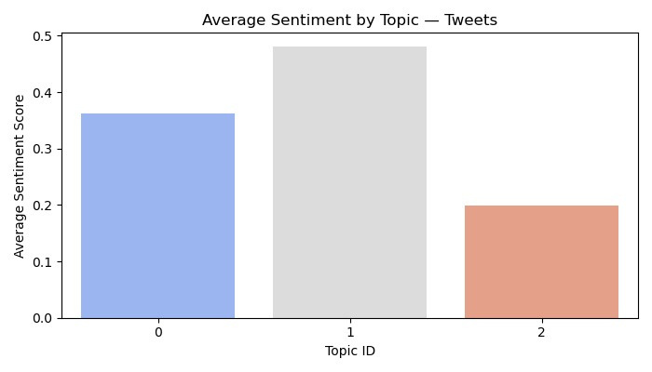

Slide 8
Conclusion:
• Demonstrated NLP-based multi-
source sentiment analytics
• Unified dashboard for public
sentiment & engagement
visualization
Future Enhancements:
• Live Twitter API integration
• Topic modeling (LDA/BERT)
• Streamlit-based interactive
dashboards
our solutions
Conclusion & Future Scope

Slide 9
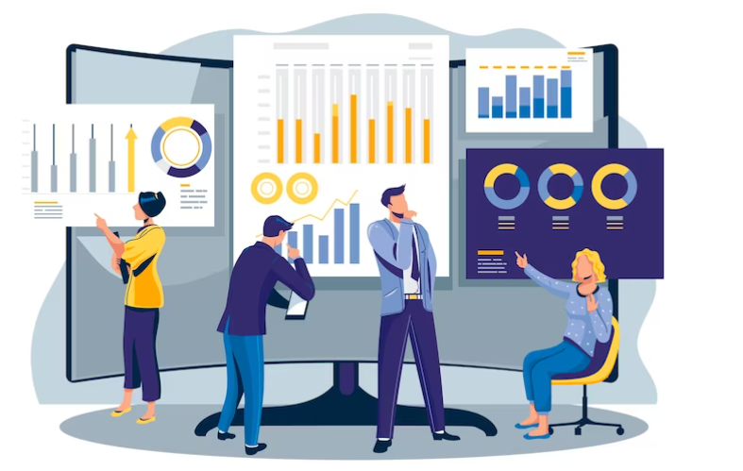


Thank you
thank you

