Slide 1
E-COMMERCE PRODUCT SHOWCASE
CAPSTONE PROJECT
Presented By:
Abhishek Ganvir
Ballarpur Institute of Technology
B.Tech in CSE
AICTE ID: STU681c3ee6f1a521746681574

Slide 2
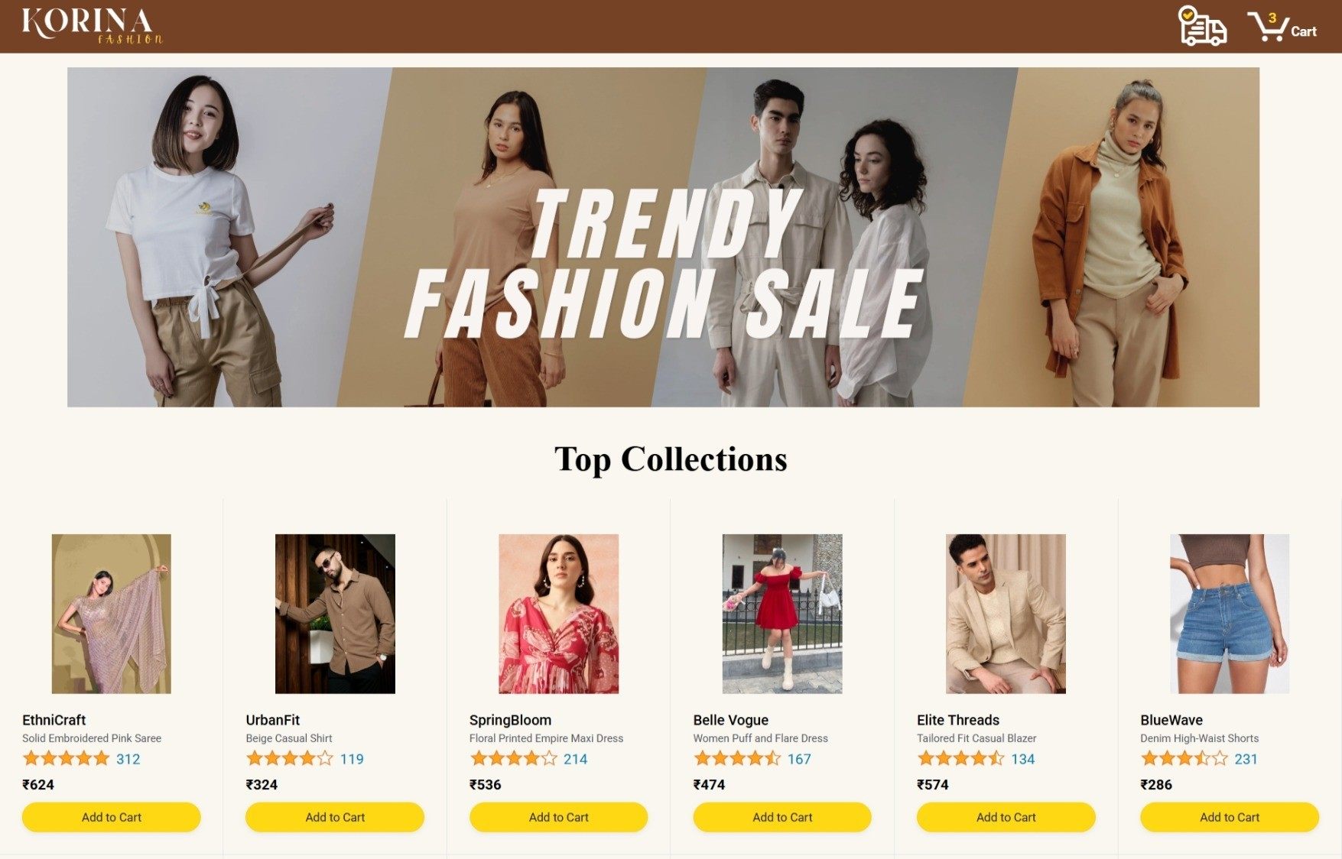
E-Commerce Product Showcase
A lightweight platform for small businesses

Slide 3
OUTLINE
Problem Statement
System Development Approach
Application Flow Pages
Testing & Deployment
Result
Conclusion
Future Scope
References

Slide 4
Problem Statement
Small businesses lack an easy-to-use online platform to display their products.
Existing e-commerce solutions are often too complex and expensive.
There is a need for a lightweight, visually appealing, and easy-to-manage product gallery.
Must allow customers to browse, filter, and view details of products interactively.

Slide 5
System Approach
Frontend Technologies: HTML5, CSS3, JavaScript.
Design Approach:
Clean and user-friendly interface
Mobile-responsive design
Dynamic interactivity (cart, filtering, total calculation)
Modular separation of HTML, CSS, and JS files

Slide 6
Application flow pages
Home Page: Displays products with banner & Add-to-Cart.
Product View Page: Shows details, images, and filters.
Checkout Page: Manage cart, delivery, and confirm order.
Tracking Page: Live order status updates.
Delivery Page: Real-time delivery progress.

Slide 7
Home page
The entry point of the platform where customers are greeted with a banner and featured products. Multiple items are displayed with “Add to Cart” buttons, making it simple to start shopping.

Slide 8
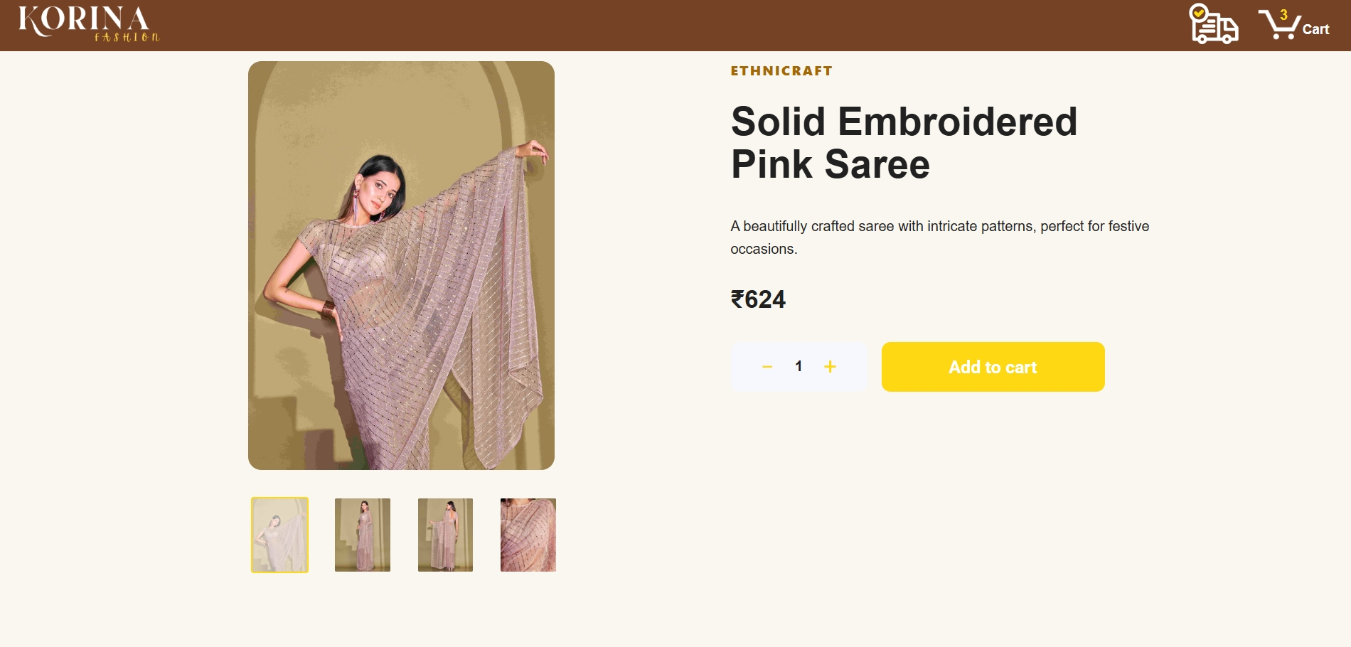
Product view page
After clicking on a product, users can view detailed descriptions, images, and variants. Options like filtering quantity, viewing models, and checking price are included, along with an “Add to Cart” button.

Slide 9
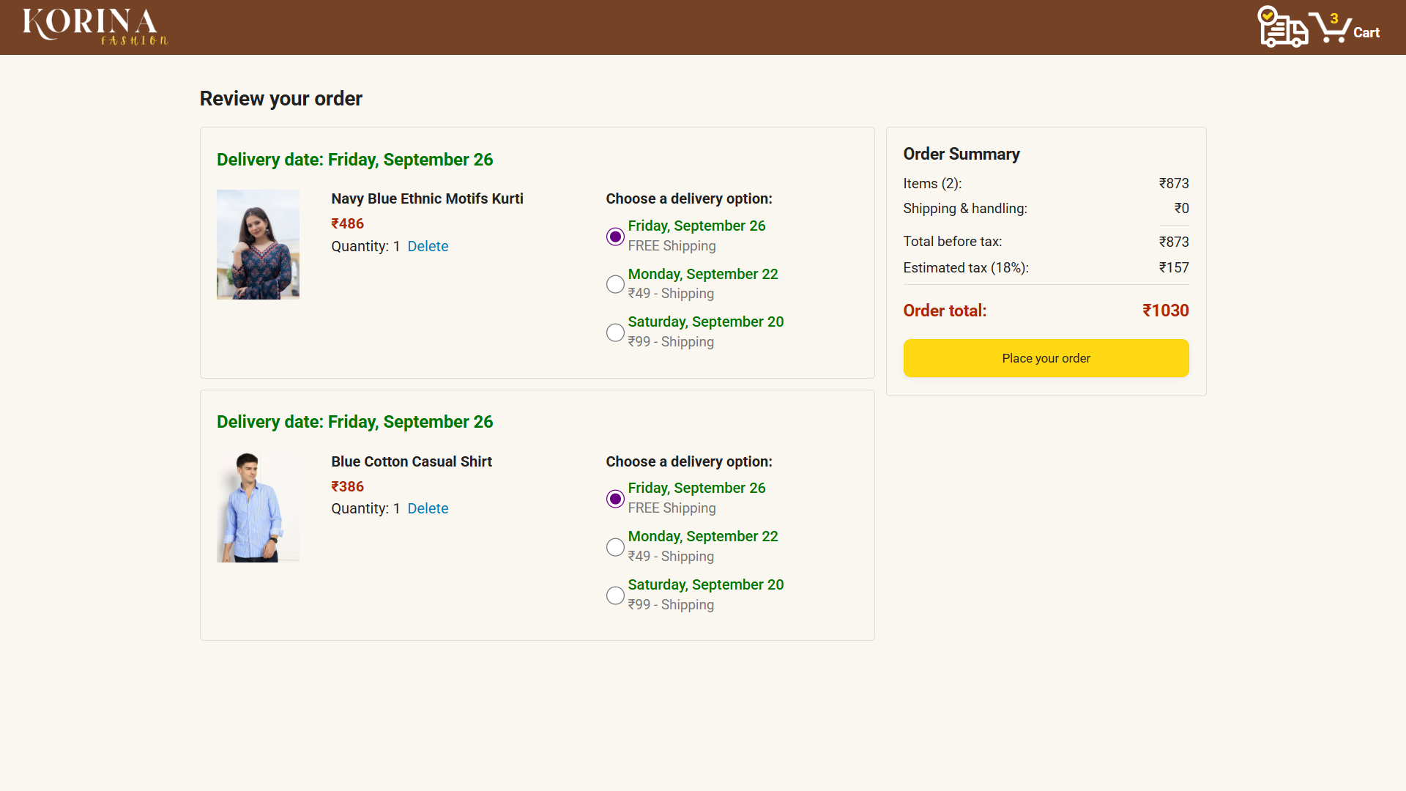
Checkout page
This page summarizes the products added to the cart. Customers can choose delivery options, remove items, and finally confirm their order with the “Place your order” button.

Slide 10
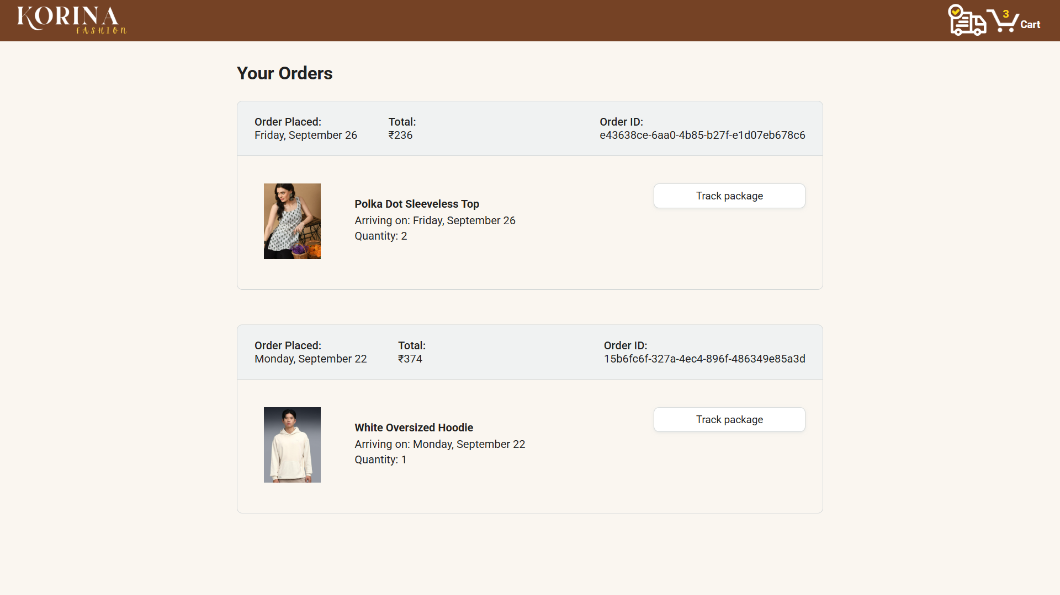
tracking page
Once an order is placed, this page allows users to track each purchased item. It provides order status updates with a “Track package” button that leads to detailed delivery progress.

Slide 11
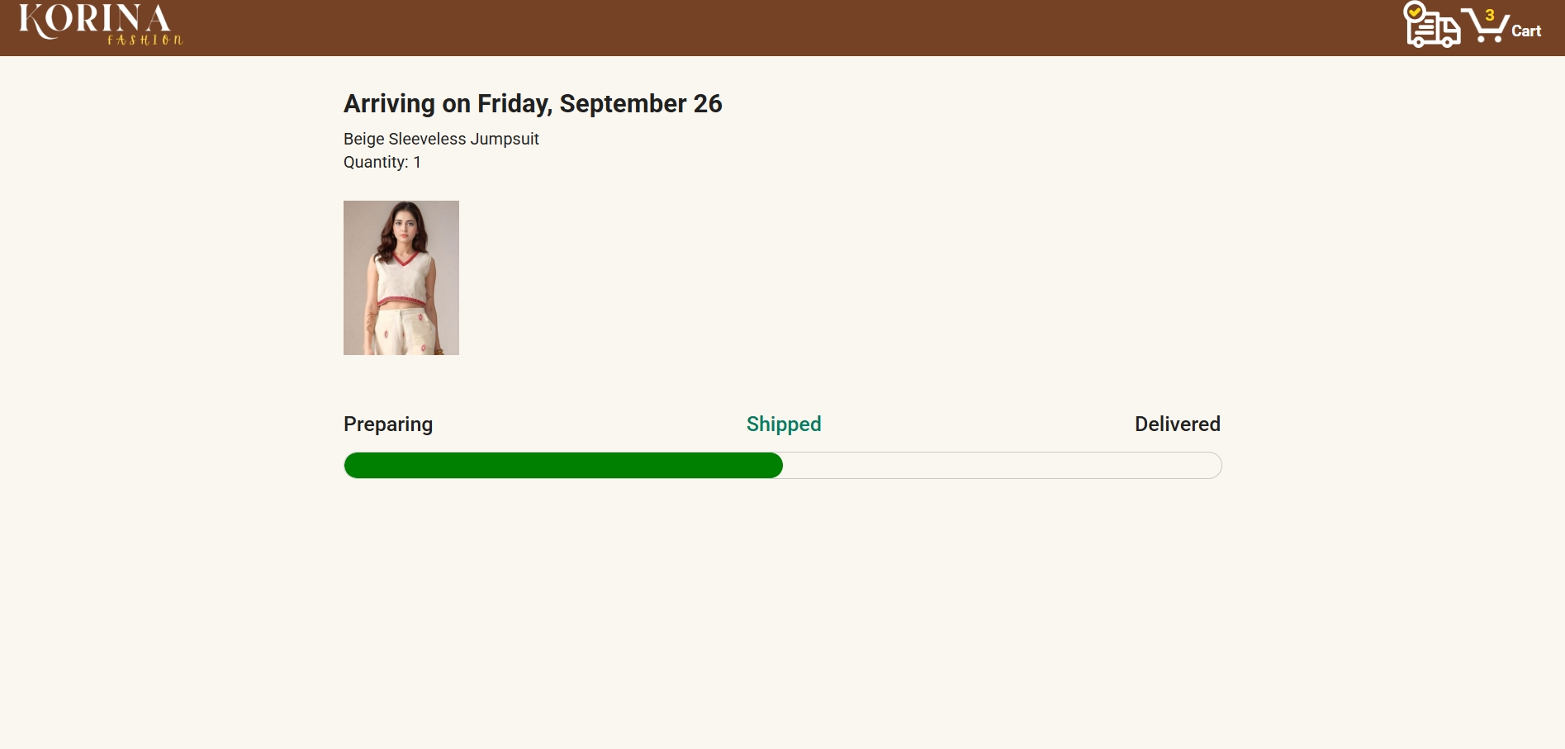
Delivery page
The delivery status page shows the real-time journey of the ordered product. Customers can see the location updates and estimated delivery time until the order is successfully delivered.

Slide 12
Testing & Deployment
Testing: Cross-browser compatibility is ensured so the platform works seamlessly on Chrome, Firefox, Edge, and Safari. Mobile responsiveness is tested thoroughly to provide a smooth experience on phones and tablets.
Deployement: The solution is hosted on GitHub Pages, providing free, reliable, and hassle-free access for small businesses, while eliminating the need for expensive hosting services

Slide 13
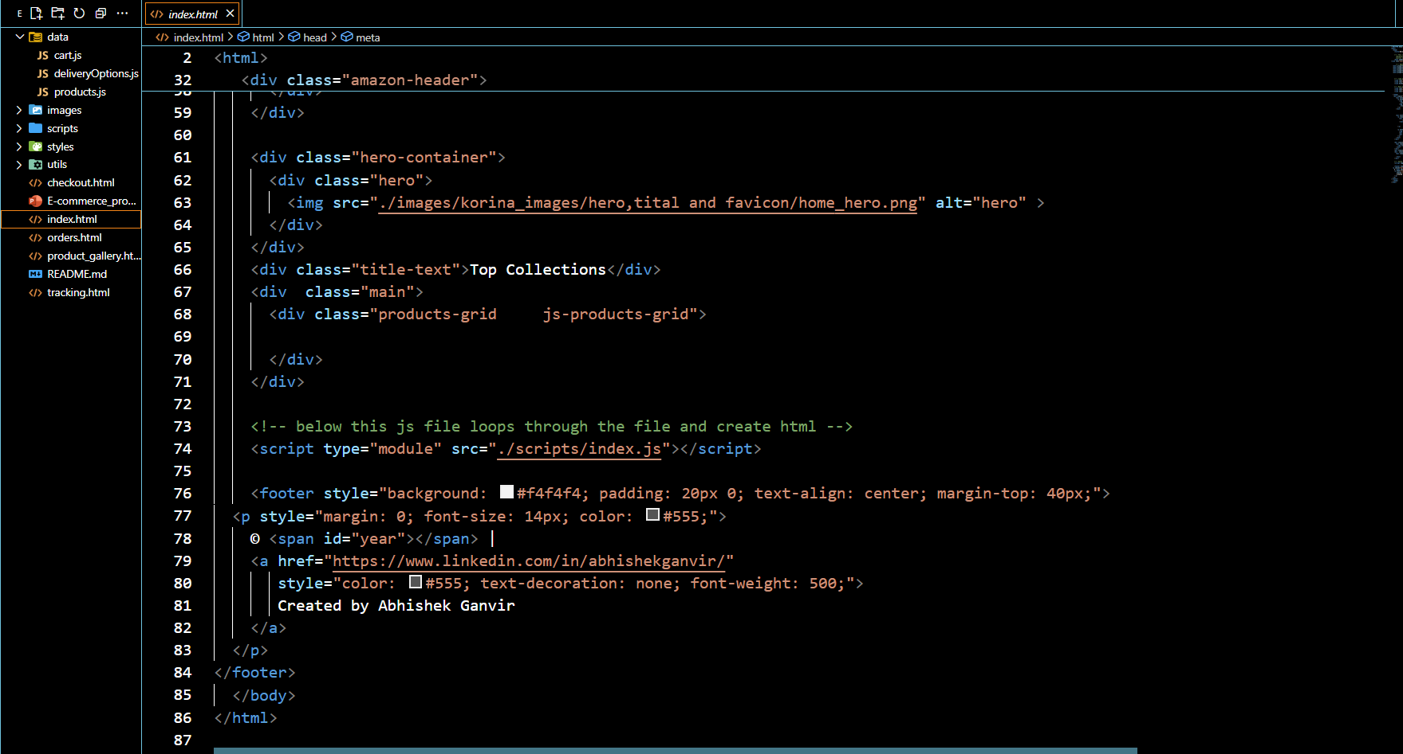
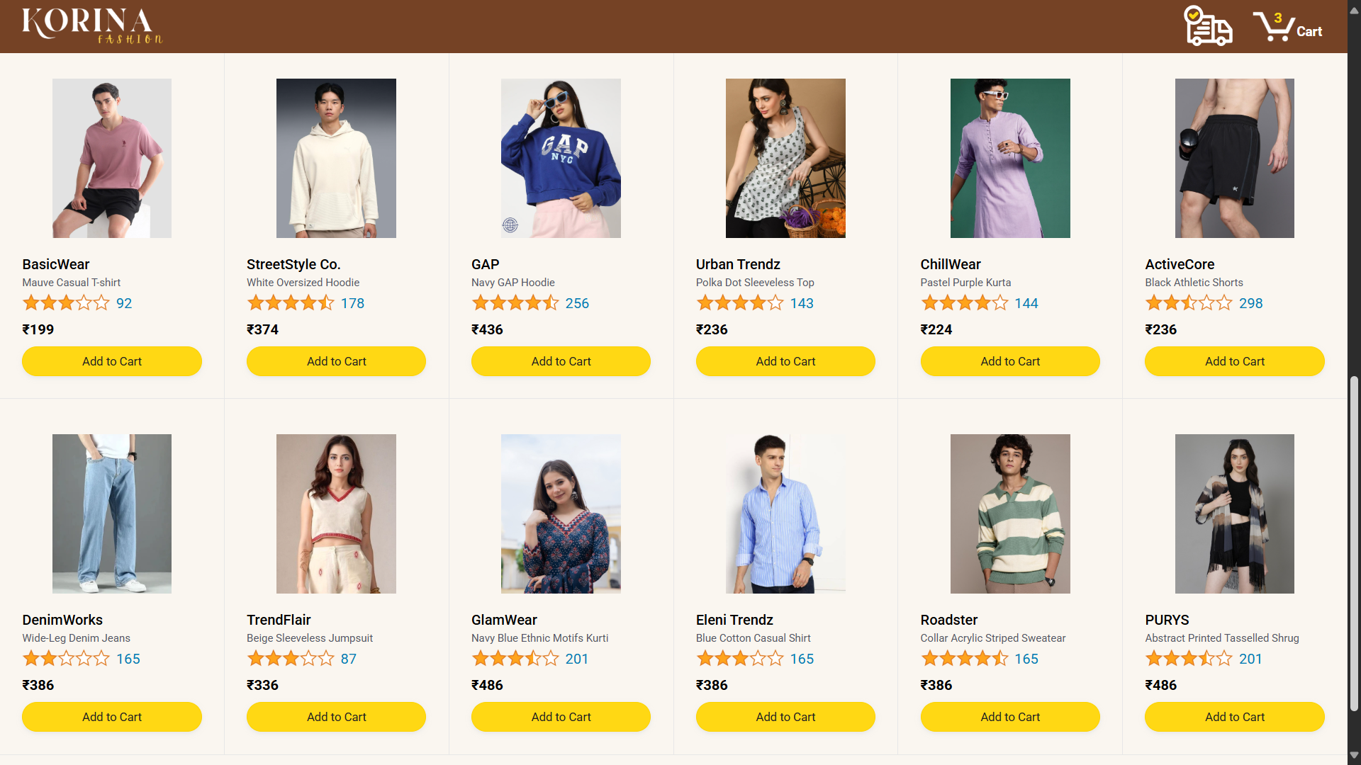
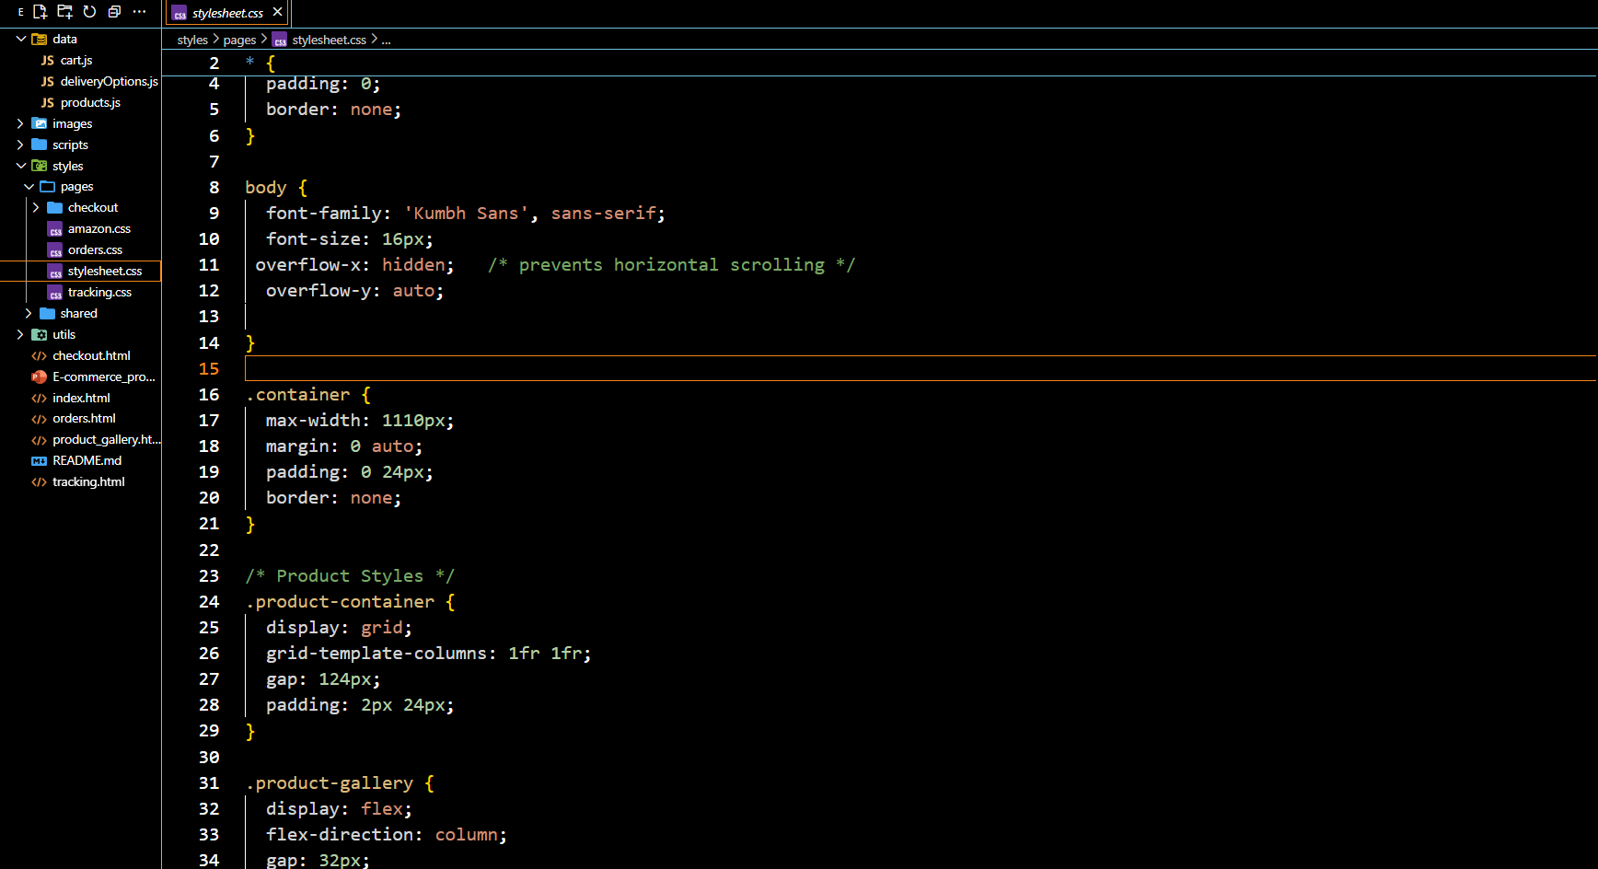
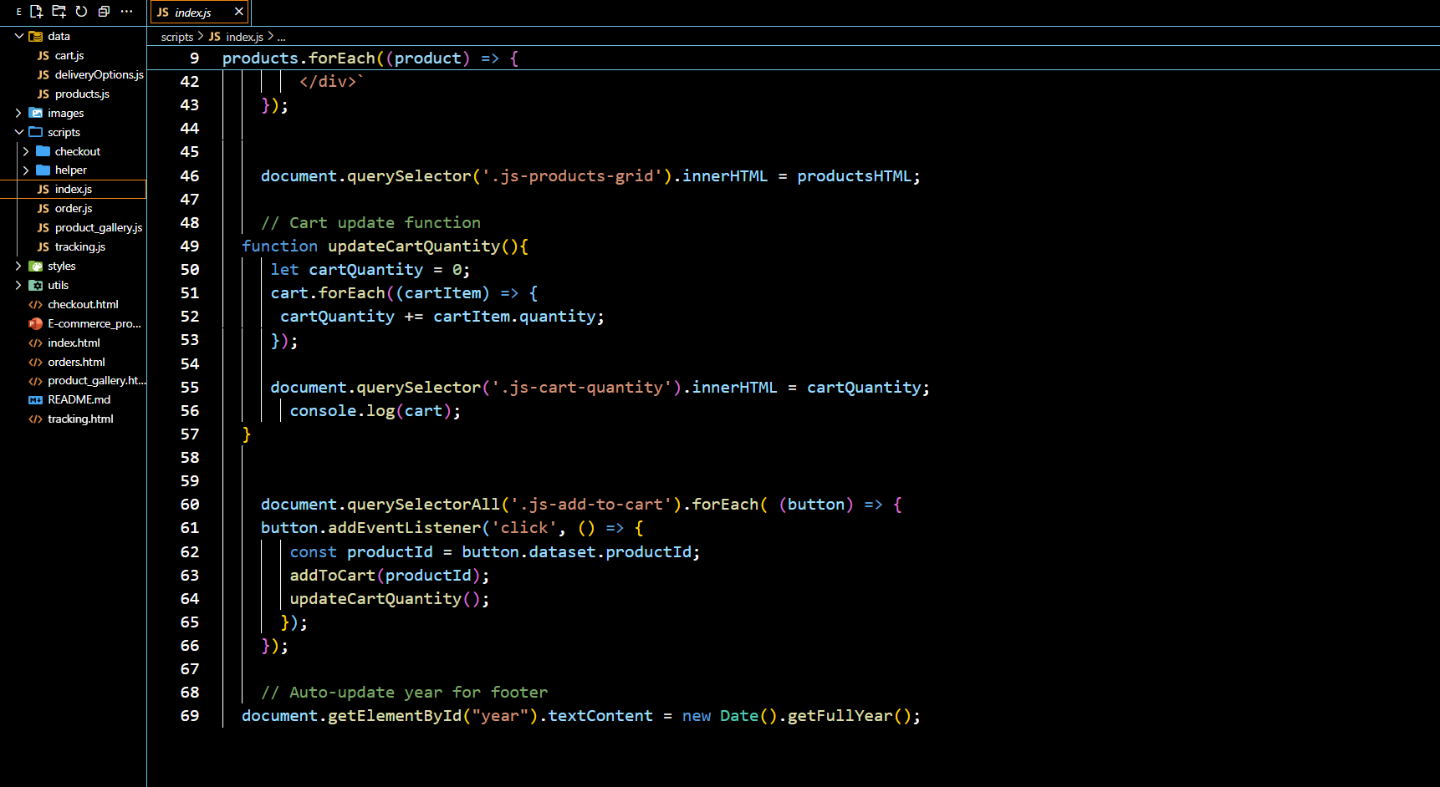
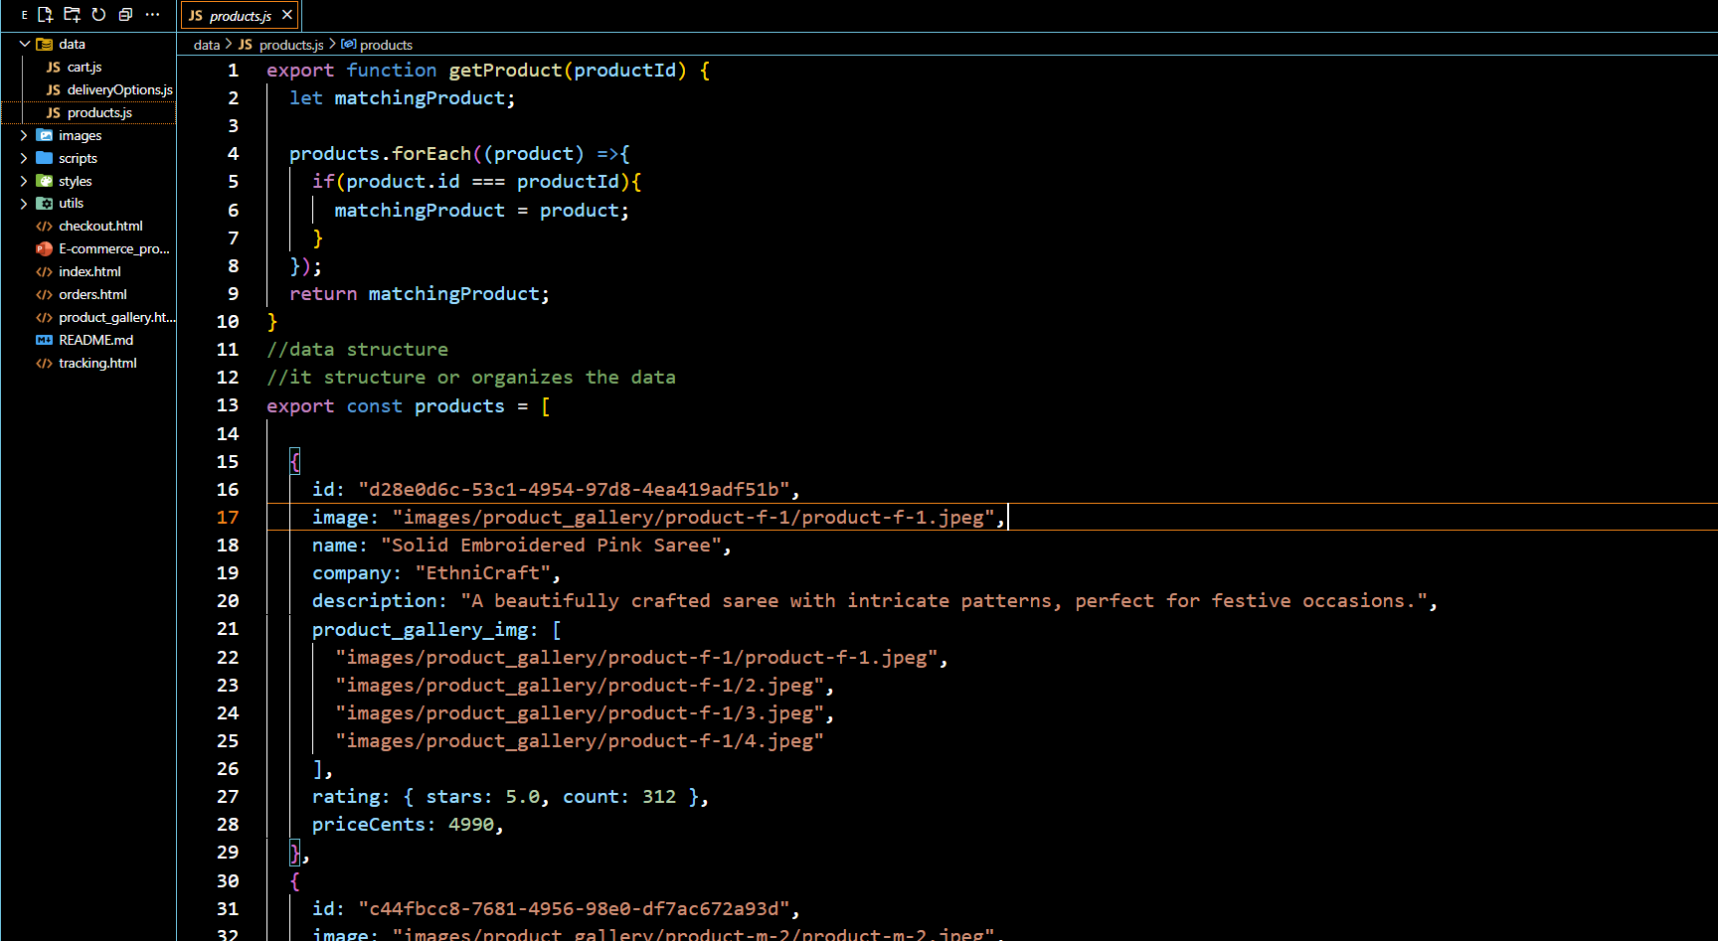
Result
Screenshots of the project have been attached, including the file structure, HTML, CSS, JavaScript, and product.js files, along with sample outputs. These demonstrate the implementation and working of the e-commerce product showcase.
The complete project is available on GitHub:
https://github.com/AbhishekGanvir/fwd-ecommerce-product-showcase/
The Deployment Link:
https://abhishekganvir.github.io/fwd-ecommerce-product-showcase/

Slide 14
Conclusion
Provides a cost-effective online presence for small businesses, removing the need for heavy investment and complex e-commerce setups.
Ensures an interactive and user-friendly shopping experience, with features like product filtering, add-to-cart, checkout, and tracking.
Offers a scalable and responsive solution, accessible on multiple devices and easily deployed through free hosting platforms.

Slide 15
Future scope
Implementing a Node.js backend enables efficient management of customer orders, product inventory, and scalable.
Integrating secure payment gateways like Stripe, Razorpay, or PayPal ensures smooth, encrypted transactions and builds customer trust.
A dedicated admin dashboard allows business owners to add, remove, or update products in real time.
AI-based product recommendations enhance personalization by analyzing customer preferences and offering smart suggestions.

Slide 16
References
The following URLs were used as references for developing the solution:
https://getbootstrap.com/
https://www.w3schools.com/
https://www.geeksforgeeks.org/
https://www.browserstack.com/guide/mobile-responsive
https://www.tutorialrepublic.com/

Slide 17
THANK YOU

