Slide 1




Department of Computer Science & Engineering • BIT Ballarpur
SMART INDIA HACKATHON 2026
SCHEME SAHAYAK
AI Assistant for Government Schemes
PS07: AI assistant for government schemes that recommends benefits
based on a citizen’s profile.
Presented by: Team JanSetu

Slide 2
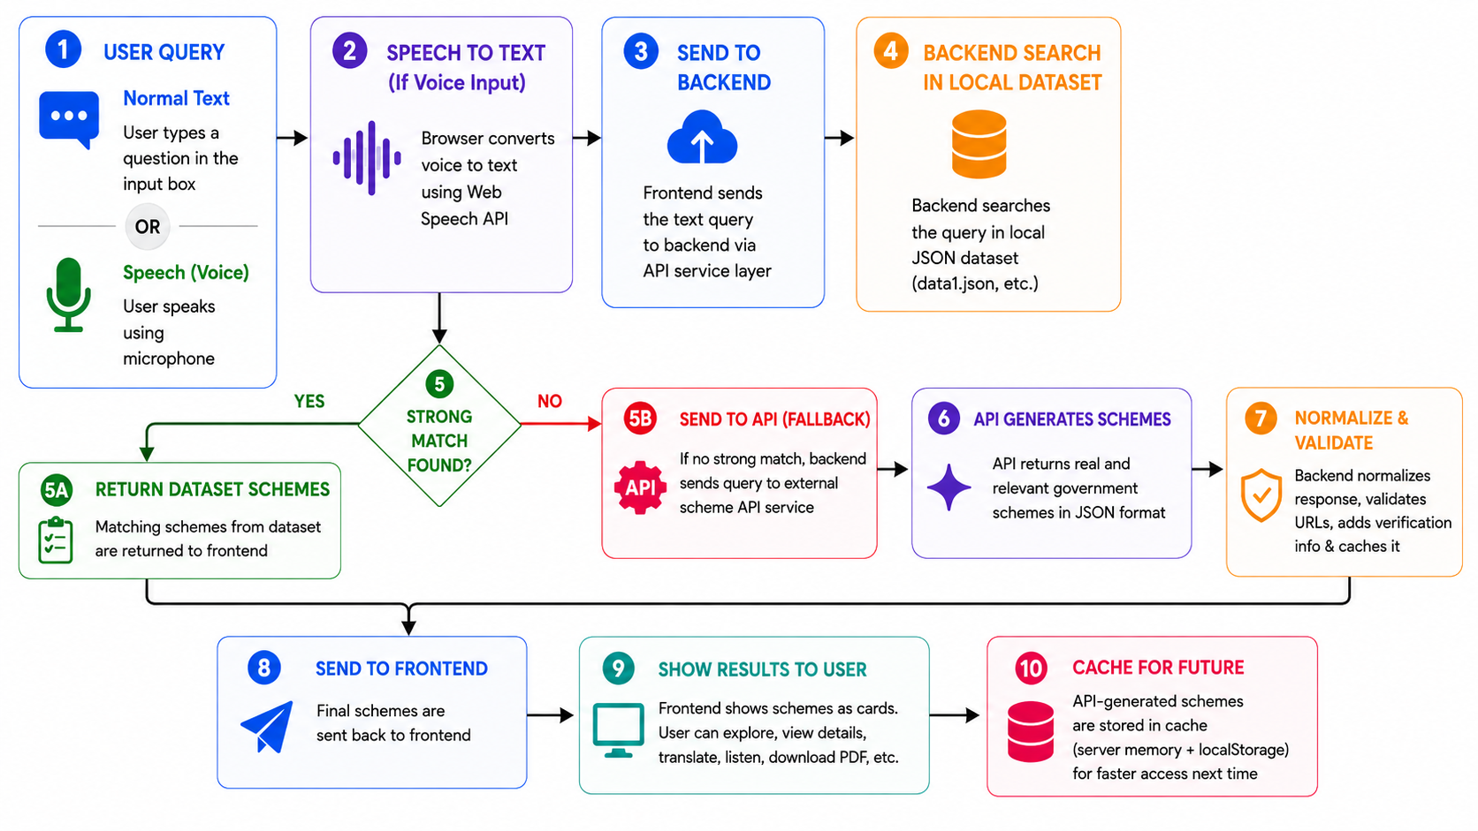
Proposed Solution
A profile-assisted scheme discovery layer built around the existing Scheme Sahayak workflow.
Major Workflow
1. Citizen Profile
The application exposes selectable profiles that can prepare a focused scheme search.
2. Ask Naturally
The user can type a query or speak it through the voice interface.
3. Match Benefits
The backend searches the local scheme dataset first and uses Gemini API as a fallback when needed.

Slide 3
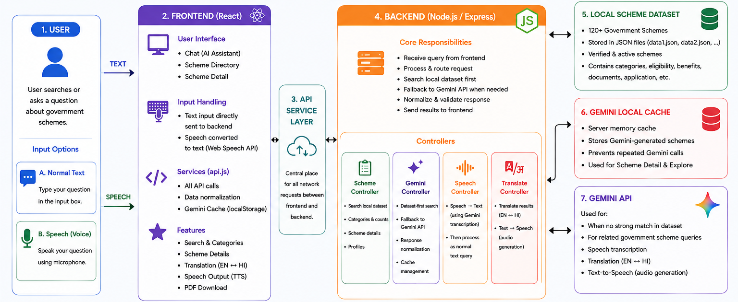
Technology Stack
Technologies used in the current Scheme Sahayak application.
Backend
System Architecture
JavaScript
Node.js
Express.js
Gemini API
Frontend
React
Vite
Tailwind CSS

Slide 4
Citizen-Facing Features
Features that turn scheme discovery into an actionable experience.
Profile Selection
Natural Language Search
Voice Input
Select a profile to prepare a focused scheme search.
Ask about a need instead of knowing the exact scheme name.
Speak the query; browser speech recognition converts it to text.
Scheme Directory
Detailed Scheme View
Hindi Translation
Search and browse schemes through categories.
Benefits, eligibility, documents, application, payment, FAQs and sources.
Translate AI responses for easier understanding.
Audio Readout
PDF Download
Backend TTS with browser speech fallback.
Generate a shareable scheme detail PDF.

Slide 5
Reliability, Validation & Trust
Government scheme assistance is useful without confusing AI output with official verification
AI Normalization
Verification Distinction
Government Data
The application maintains a local scheme dataset with structured fields such as eligibility, benefits, application and source information.
Gemini responses are mapped into a canonical scheme structure, URLs are normalized and unusable records are filtered before UI use.
A government source / verification field should not be confused with an AI-generated response. Users should confirm official details before applying.

Slide 6
Research & References
Comparison with Existing Systems
References
myscheme.gov.in
india.gov.in/my-government/schemes
ai.google.dev/api
ai.google.dev/gemini-api/docs/libraries
Feature | Scheme Sahayak | Yojana Mitra | Sarkar Sahayak | Scheme Sathi
AI Chat Assistant | ✓ | ✓ | ✓ | ✓
Personalized Recommendations | ✓ | ✓ | × | ✓
Scheme Search / Directory | ✓ | ✓ | × | ×
Voice Input | ✓ | × | ✓ | ×
Detailed Scheme Information | ✓ | ✓ | ✓ | ✓
PDF Export | ✓ | × | × | ×

Slide 7
Thank you
Does anyone have any questions?
https://schemesahayak.onrender.com/

