Slide 1

Game-Theory-Based Balance: Formalizing the Machine Unlearning Problem as a Game Between Model Provider and Data Provider
Machine Unlearning : Addressing the Challenge of Incorrectly Learned Information
Ph.D Proposal Presentation by
Abhishek Hupele
Reg. No.: 240900465
Computer Scientist (PE), Research and Development - EV
EdgeVerve Systems Limited, An Infosys Company
Under the supervision of
Dr. Sanjay Singh
Professor (Guide)
School of Computer Engineering,
Manipal Institute of Technology, Manipal
Dr. P.C. Siddalingaswamy
Professor (Co-Guide)
School of Computer Engineering,
Manipal Institute of Technology, Manipal
Dr. Naveen Kulkarni (Co-Guide)
Director – Product Engineering - AI
EdgeVerve Systems Limited
Mar 17, 2026

Slide 2
Presentation Overview
Introduction
Literature Review
Research Gaps
Objectives
Methodology
Expected Outcomes
Importance of Proposed Research Investigation
Research Time Plan
Pilot Study/Preliminary Work Done
Course Work Details
References

Slide 3
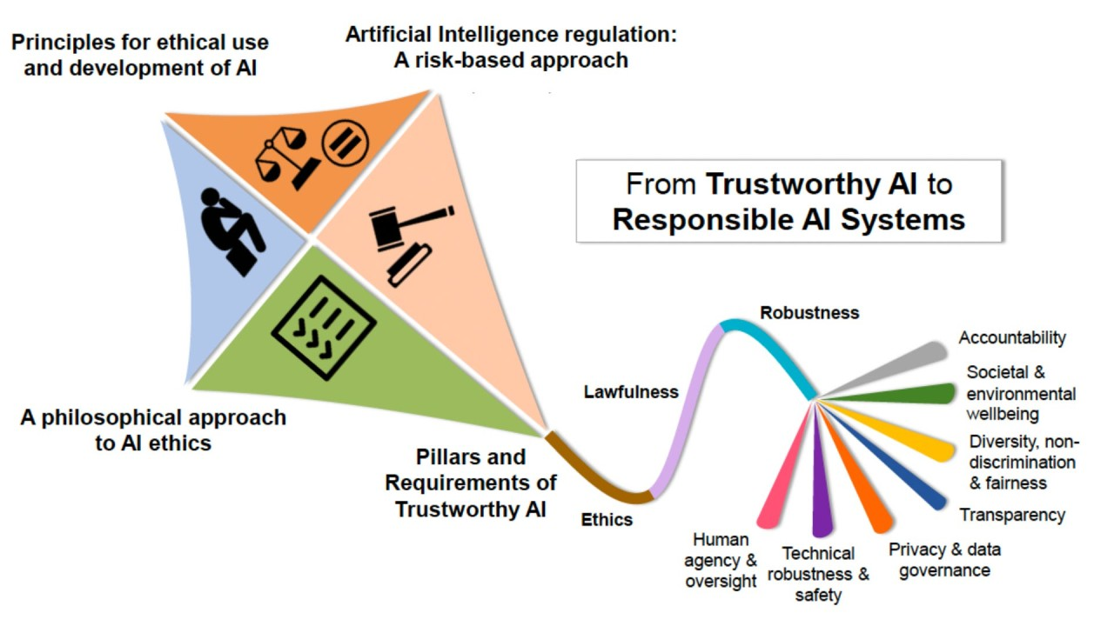
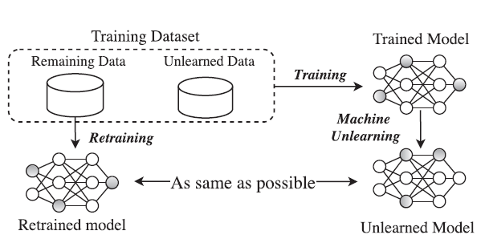
Introduction-I
Responsible AI: The Foundation
Responsible AI (RAI) is about building AI systems that are:
Fair and unbiased
Transparent and explainable
Accountable and auditable
Privacy-preserving and secure
It emphasizes user rights, ethical data use, and compliance with legal frameworks.
Machine Unlearning: A Pillar of Responsible AI
Process of removing the influence of specific data from a trained model.
The “Right to be Forgotten” (GDPR, CCPA), DPDP Act (India)
Ethical data revocation
Mitigation of bias and adversarial data
It ensures that AI systems remain compliant, fair, and adaptable.
Figure 1: Responsible AI (RAI):
(Source:https://www.linkedin.com/pulse/responsible-ai-rai-imperative-artificial-intelligence-mark-kovarski-iwsxc/)
Figure 2: Illustration of machine unlearning. (Source:https://doi.org/10.48550/arXiv.2306.03558)

Slide 4
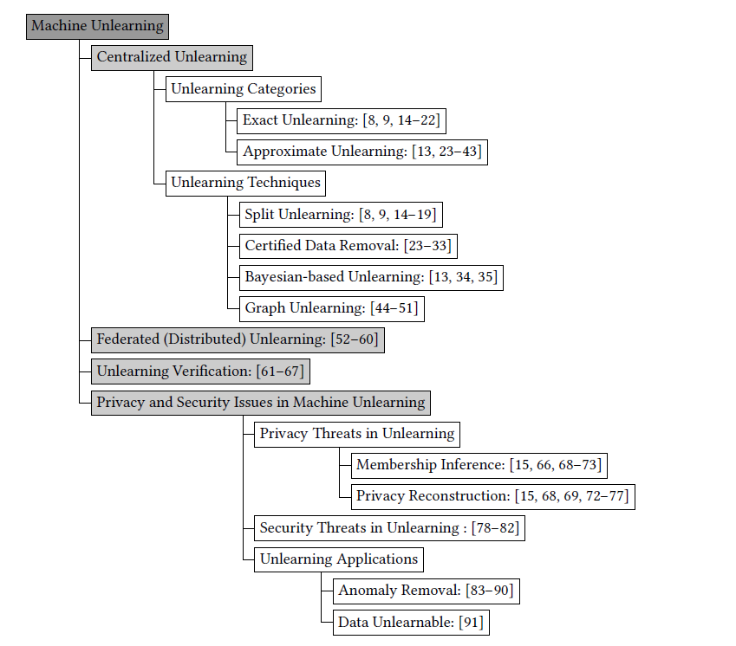
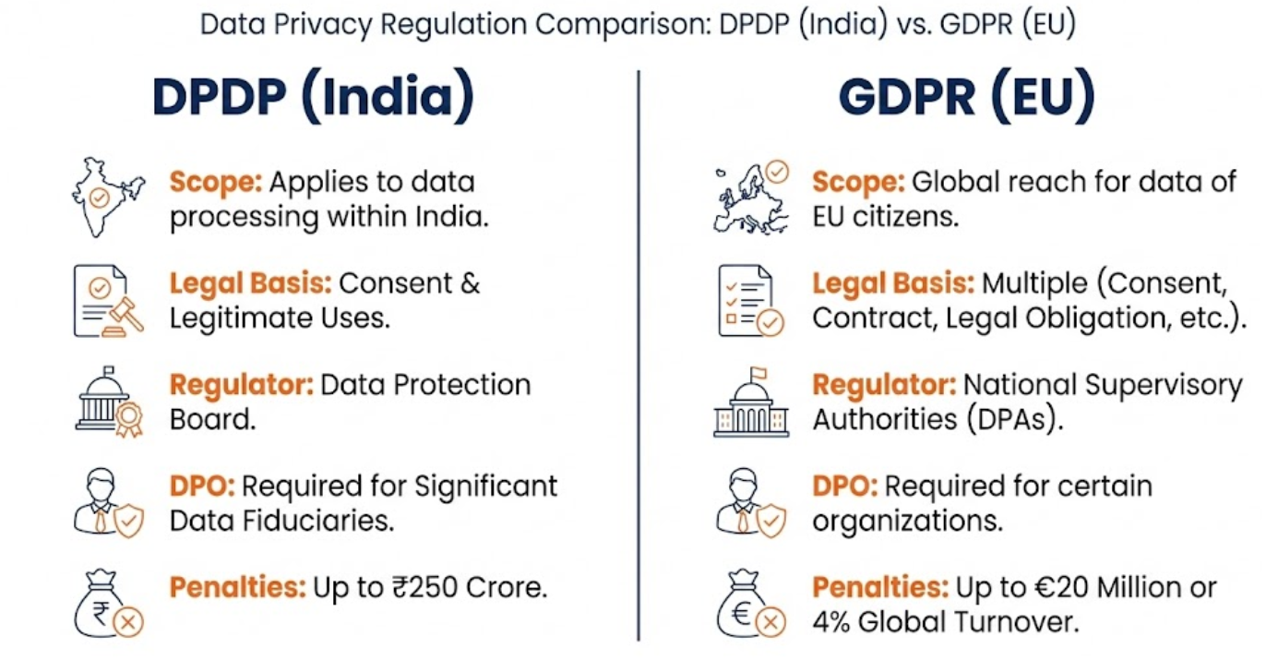
Introduction-II: Machine Unlearning
What is Machine Unlearning?
Not just data deletion. Requires reversing learned representations.
Can be:
Exact
Approximate
Applied at different granularities:
Data point, feature, class, user-level
DNNs, LLMs, GNNs, SVMs, federated learning.
Why Machine Unlearning is Needed
Legal: GDPR (Article 17), CCPA/CPRA, DPDP Act (India)
Ethical: Users should control their data and revoke consent.
Security: Remove poisoned or adversarial data.
Maintenance: Update models without full retraining.
Figure 3: Taxonomy for machine unlearning (Source:
https://doi.org/10.48550/arXiv.2405.07406)
Figure 4: DPDP vs GDPR: where they align and where they differ
(Source:https://singhanialaw.com/digital-personal-data-protection-rules-2025-privacy-competition-corporate-compliance/)

Slide 5
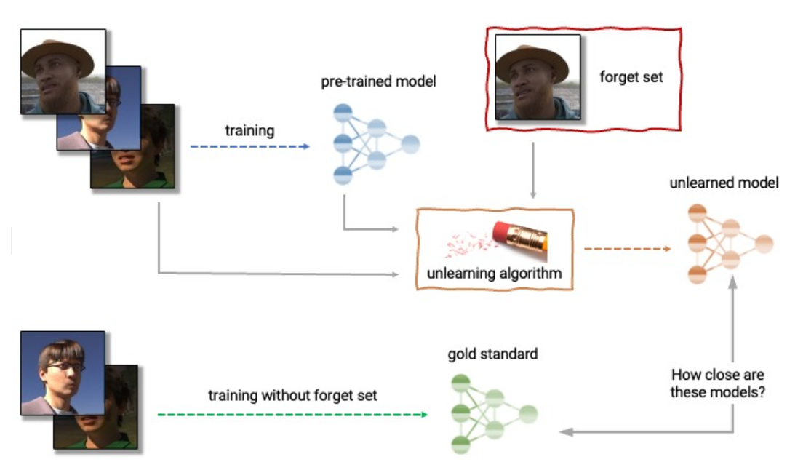
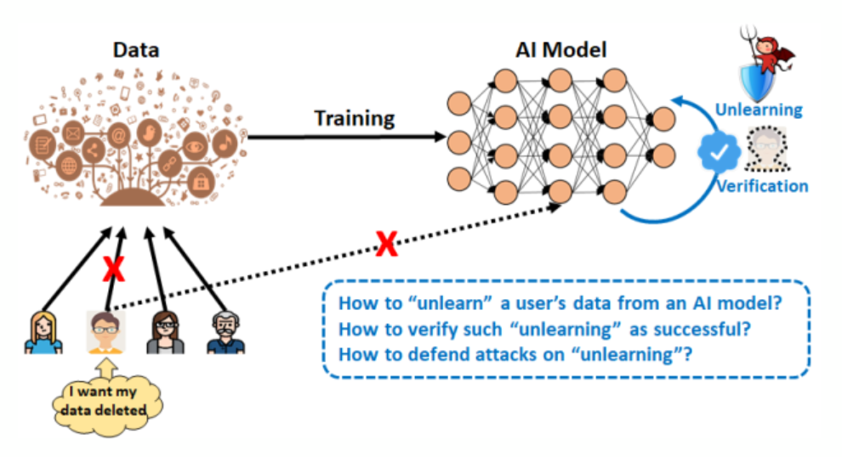
Introduction-II
Figure 5:Anatomy of unlearning.. (source: https://research.csiro.au/isp/research/privacy_mlai/privacy-and-machine-unlearning/
5

Slide 6
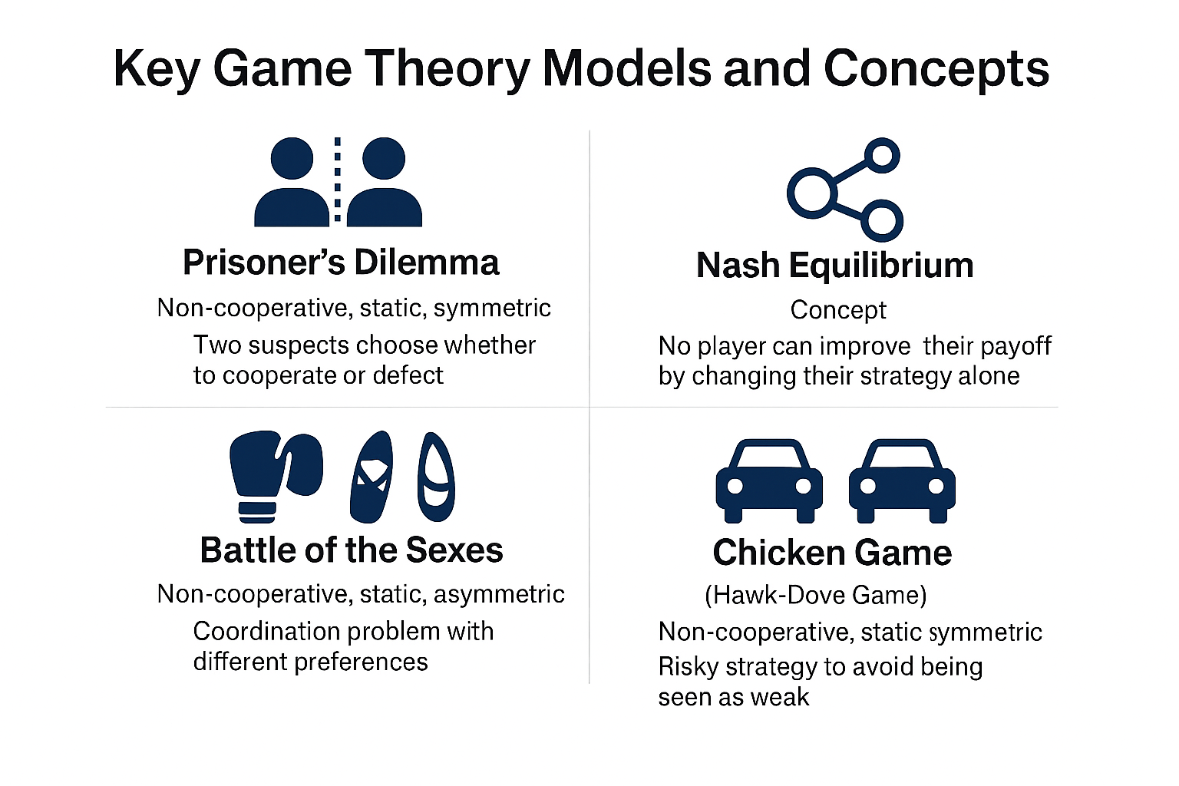
Introduction-III: Game Theory
Game theory is a branch of mathematics and economics that studies strategic interactions between rational decision-makers, often called "players." It provides a framework for analyzing situations where the outcome for each participant depends not only on their own choices, but also on the choices of others.
Here are some key concepts to understand game theory:
Players
Strategies
Payoffs
Information
Equilibrium
Figure 7:Strategic Interactions in Key Game Theory Models
(Source:Created by Abhishek Hupele using AI-generated visualizations via Microsoft Copilot (GPT-4))

Slide 7








Introduction-IV: Example Cases of PII* Misuse
Case / Year | Domain | Issue / Violation | Impact
Cambridge Analytica (2018) | Social Media / Politics | Unauthorized use of Facebook data for election profiling | Manipulation of voter behavior, global privacy concerns
Apple Card Bias (2019) | Finance | Gender bias in credit limit allocation | Discrimination against women, regulatory scrutiny
Amazon Hiring Algorithm (2018) | Employment | Algorithm trained on biased historical data | Gender bias in recruitment, reputational damage
Clearview AI (2020) | Facial Recognition | Scraping billions of images without consent | Privacy invasion, legal challenges
Target Pregnancy Prediction (2012) | Retail | Predictive analytics revealed pregnancy status without consent | Breach of sensitive health information, customer backlash
Cross-Border GenAI Misuse (2025, Gartner prediction) | AI / Global Data | Generative AI misuse across jurisdictions with weak privacy laws | Risk of large-scale exploitation of personal data
Equifax Breach (2017) | Finance | Massive data breach exposing SSNs, birthdates, addresses | 147M+ individuals affected, financial fraud risks
Google Street View (2010) | Tech / Mapping | Collection of Wi-Fi data without consent | Regulatory fines, privacy violations
Aadhaar Data Leak (2018, India) | National ID | Unauthorized access to biometric and demographic data | Millions exposed, national security concerns
* PII : Personally Identifiable Information

Slide 8
Literature Review-I
Publication details | Purpose | Data | Key findings | Limitations and reviews
Machine Unlearning: SISA Training – 42nd IEEE Symposium on Security and Privacy, 2020. Bourtoule et al., 2020 | To design a practical framework (Sharded, Isolated, Sliced, Aggregated – SISA) that enables efficient machine unlearning while reducing computational overhead compared to retraining from scratch. | Purchase,MNIST,CIFAR, SVHN, ImageNet,Mini-Imagenet; | 4.63× speed-up on Purchase dataset, 2.45× on SVHN. 1.36× speed-up on ImageNet with transfer learning. Accuracy degradation ≤2% for simple tasks; larger drop (~19% top-5 accuracy) for complex tasks. Sharding + slicing effective for sequential and batch unlearning requests. | Accuracy trade-off increases with complex tasks and higher shard counts. Requires additional storage for slicing checkpoints. Performance gains diminish if unlearning requests exceed ~3× number of shards. Stronger guarantees than differential privacy, but still challenging for very large foundational models. Not all data is useful, core-set selection, feature
Membership Inference via Backdooring (MIB) – arXiv preprint, June 2022 Hu et al., 2022 | To enable data owners to detect whether their data was used to train a model without consent, using backdoor triggers and hypothesis testing as a membership inference mechanism. | CIFAR-10, Location-30, Purchase-100. | Effective membership inference with only 0.1% marked samples. Achieved high ASR (Attack Success Rate): 39.6% (CIFAR-10), 68.9% (Location-30), 87.2% (Purchase-100). Requires only black-box access and ~30 queries for statistical guarantees. | Performance depends on trigger design (pattern, size, location). Small triggers may fail to activate backdoors. Assumes data owners can proactively mark data before release. Focused on classification tasks; extension to other ML domains remains open

Slide 9
Literature Review-II
Publication details | Purpose | Data | Key findings | Limitations and reviews
Game-Theoretic Machine Unlearning: Mitigating Extra Privacy Leakage - arXiv preprint, Nov 2024. Liu et al. | To design a game-theoretic unlearning algorithm that balances utility (model performance) and privacy (mitigating leakage) by modeling the interaction between unlearning and privacy modules as a Stackelberg game. | Adult (MLP), MNIST (Resnet18), CIFAR10 (Densenet), SVHN (Densenet) | Introduced privacy attack advantage metric to quantify leakage. Achieved unlearned models statistically similar to retrained ones. Reduced membership inference attack success by aligning outputs of original vs. unlearned models. Demonstrated equilibrium strategies between unlearning and privacy modules. | Static framework, Need to explore dynamic game formulations where attacker and defender strategies evolve over time Focused on classification tasks; extension to LLMs and federated settings remains open. Requires careful tuning of loss functions to avoid over-unlearning. Broader Attack Models to be covered
MLPro-GT: Game Theory and Dynamic Games Modeling in Python – SoftwareX, Vol. 28, 2024. Yuwono et al. | To provide a standardized, modular, and open-source Python framework for modeling both native and dynamic game theory, lowering entry barriers for students and enabling reproducible research. | MLPro v1.9.0; Python-based; integrates with libraries like NumPy, Torch, SciPy, Matplotlib. Available via GitHub and PyPI under Apache-2.0 license. | -First framework to support dynamic games (e.g., Stackelberg, potential games). Offers standardized templates for GT components (players, payoffs, solvers). Enables integration with reinforcement learning and industrial control systems. Validated through examples like Prisoner’s Dilemma, Rock-Paper-Scissors, supply-demand, and routing problems. | Still evolving; limited pool of prebuilt dynamic games compared to native GT. Requires familiarity with MLPro ecosystem. Future work aims to expand third-party integration (e.g., NashPy) and add more solvers/game types.

Slide 10
Literature Review-III
Publication details | Purpose | Data | Key findings | Limitations and reviews
Improving Data Utility Through Game Theory in Personalized Differential Privacy Journal of Computer Science and Technology, 2019 Cui et al. | Proposed a personalized differential privacy model based on social distance; modeled user-adversary interaction as a static Bayesian game; derived Bayesian Nash equilibrium using modified Q-learning | Google+ social network dataset (4,000 nodes, 56,352 edges) | Personalized privacy improves data utility game-theoretic modeling enables optimized trade-off between privacy and utility fast convergence achieved via cardinality reduction | Assumes a trusted central authority for privacy budget management. Focused on social network scenarios; extension to IoT/ML requires adaptation. Static Bayesian game may oversimplify dynamic adversarial behaviors. Cardinality reduction improves efficiency but may limit flexibility in complex multi-user settings.
Towards Making Systems Forget with Machine Unlearning – IEEE Symposium on Security and Privacy, 2015. Cao et al. | To design efficient mechanisms for systems to “forget” specific training data and its lineage, enabling privacy, security, and usability restoration without retraining from scratch. | LensKit (recommendation engine) Zozzle (JavaScript malware detector) - OSN spam filter - PJScan (PDF malware detector) | Converted learning algorithms into summation form for efficient unlearning. Achieved huge speed-ups (seconds vs. days) compared to retraining. First efficient unlearning algorithms for normalized cosine similarity and one-class SVM. Empirically prevented privacy and pollution attacks after unlearning. Required minimal code changes ( | Works only for algorithms convertible to summation form (not universally applicable). Completeness depends on representative test sets and randomness in training. More effective when forgetting small subsets of data; retraining may be better for large deletions. naïve Bayes, one‑class SVM, and normalized cosine similarity, classical ML systems and detectors; scaling to large deep networks or LLMs requires new transformations or approximations. Feature‑selection coupling: If feature selection depends heavily on individual samples, updating feature sets may still be nontrivial and can affect completeness.

Slide 11
Literature Review-IV
Publication details | Purpose | Data | Key findings | Limitations and reviews
Investigating the Adoption of Hybrid Encrypted Cloud Data Deduplication With Game Theory IEEE TPDS, 2021 Liang et al. | whether Hybrid Encrypted Cloud Data Deduplication (H-DEDU) can be successfully adopted in practice. It focuses on the economic feasibility and stakeholder incentives (data holders, data owners, and Cloud Storage Providers) using game theory. | Microsoft study (reference data), Simulation experiments | A multi-stage Stackelberg game (CSP Pricing Game, Owner Online Game, Holder Participation Game) effectively models stakeholder interactions. A gradient-based algorithm helps stakeholders converge to near-optimal strategies and reach a sub-game perfect Nash Equilibrium. Incentive mechanisms | Investigate personalized incentive mechanisms, privacy-preserving discounts, and behavioral economics Extend to more complex utility functions including encryption, backup, and trust factors Study real-world adversarial behaviors, collusion risks, and malicious CSP strategies

Slide 12
Literature Review-V
Publication details | Purpose | Data | Key findings | Limitations and reviews
Exploration-Exploitation in Multi-Agent Learning: Catastrophe Theory Meets Game Theory - arXiv preprint, Dec 2020. Leonardos et al. | Developed Smooth Q-Learning (SQL) dynamics and linked them to Quantal Response Equilibria (QRE); used catastrophe theory to analyze bifurcations in learning dynamics | Synthetic simulations of multi-agent games | SQL converges to QRE with bounded regret; exploration can cause phase transitions with unpredictable outcomes; equilibrium selection is path-dependent and sensitive to exploration parameters | Highly sensitive to exploration parameter tuning; outcomes path-dependent. Focused on stateless matrix and coordination games; extension to complex dynamic environments remains open. Exploration can destabilize equilibria, making performance unpredictable. Provides theoretical insight but limited empirical validation in large-scale real-world systems.
Certified Data Removal from Machine Learning Models – Proceedings of the 37th International Conference on Machine Learning (ICML), 2020. Guo et al. | To define and implement certified removal, a strong guarantee that deleted data cannot be distinguished from data never seen by the model, thereby protecting against membership inference attacks. | MNIST, LSUN, SST, and SVHN. | Introduced Newton update mechanism for efficient removal. Achieved certified removal guarantees with added loss perturbation. Removal is orders of magnitude faster than retraining (e.g., 0.04s vs. 15.6s on MNIST). Supported multiple and batch removals with bounded residual errors. Demonstrated practical feasibility for both linear and hybrid models. | Primarily applicable to linear models; extension to deep networks requires DP feature extractors. Accuracy trade-offs due to perturbation and regularization. Removal guarantees depend on tightness of gradient residual bounds. Outlier data harder to remove due to memorization effects

Slide 13
Literature Review-V
From the literature survey, the following findings are noted:
Existing work shows promise in applying game theory to privacy and incentive mechanisms, remain underexplored.
Current unlearning approaches focus on data-level deletion, with limited attention to feature-aware strategies (extraction, generation, selection).
A deeper exploration of Attack Model threats in the context of trained ML models is essential to ensure resilience.
Literature emphasizes technical solutions but lacks economic and behavioral incentives for responsible data sharing.
Applying unlearning to large language models with billions of parameters remains a major challenge.
Most research assumes static datasets, overlooking streaming data ecosystems and sequential deletion requests.

Slide 14
Research Gaps Identified
Game-Theory-Based Balance
Lack of equilibrium strategies between data providers (privacy, minimal sharing) and model providers (performance, utility).
Feature-Based Unlearning
Limited exploration of feature-aware strategies (feature extraction, generation, selection) integrated into unlearning operations.
Adversarial Threats
Limited integration of broader attack models (membership inference, attribute inference, reconstruction, poisoning) into unlearning frameworks.
Incentive Mechanisms
Need for systems that incentivize users to share data responsibly while preventing misuse.
Foundational Models (LLMs)
Difficulty in applying unlearning to large language models with billions of parameters; contributions of individual data points remain uncertain.
Sequential & Dynamic Unlearning
Insufficient research on unlearning in evolving/streaming data ecosystems and sequential deletion requests.

Slide 15
Research Gaps to Objectives Mapping
Game-Theory-Based Balance
Feature-Based Unlearning
Adversarial Threats
Incentive Mechanisms
Sequential & Dynamic Unlearning
Foundational Models (LLMs)
Systematically analyze and incorporate attack models (membership inference, attribute inference, reconstruction, poisoning, jailbreaks) into unlearning frameworks.
Design and evaluate unlearning mechanisms that operate at the feature level (extraction, generation, selection)
Investigate scalable methods for applying unlearning to large language models, addressing challenges of parameter scale and uncertainty in individual data contributions.
Develop adaptive strategies for unlearning in evolving data ecosystems, including streaming contexts and sequential deletion requests, federated settings.

Slide 16
Objectives
Systematically analyze and incorporate attack models (membership inference, attribute inference, reconstruction, poisoning, jailbreaks) into unlearning frameworks.
Design and evaluate unlearning mechanisms that operate at the feature level (extraction, generation, selection)
Investigate scalable methods for applying unlearning to large language models, addressing challenges of parameter scale and uncertainty in individual data contributions.
Develop adaptive strategies for unlearning in evolving data ecosystems, including streaming contexts and sequential deletion requests, federated settings.
4

Slide 17
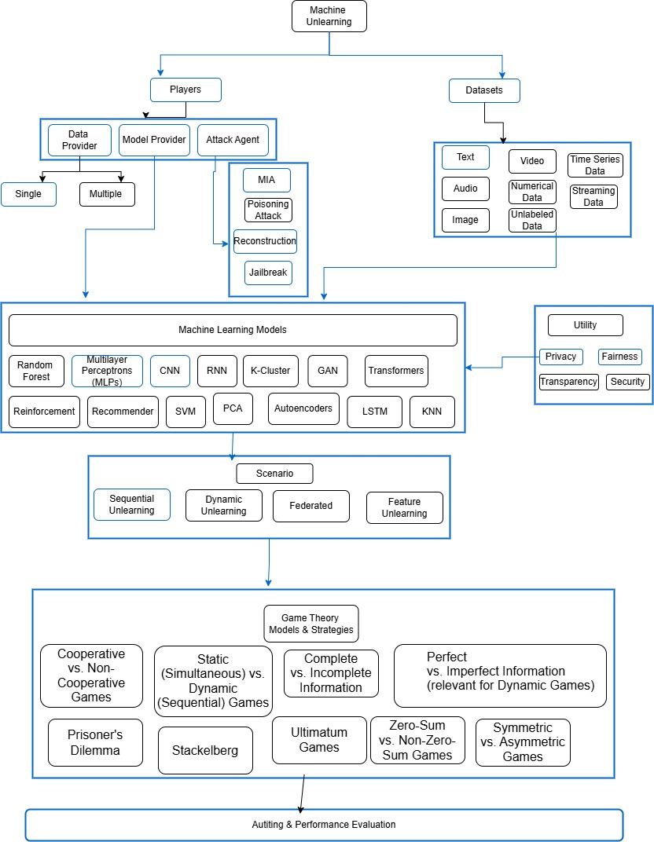
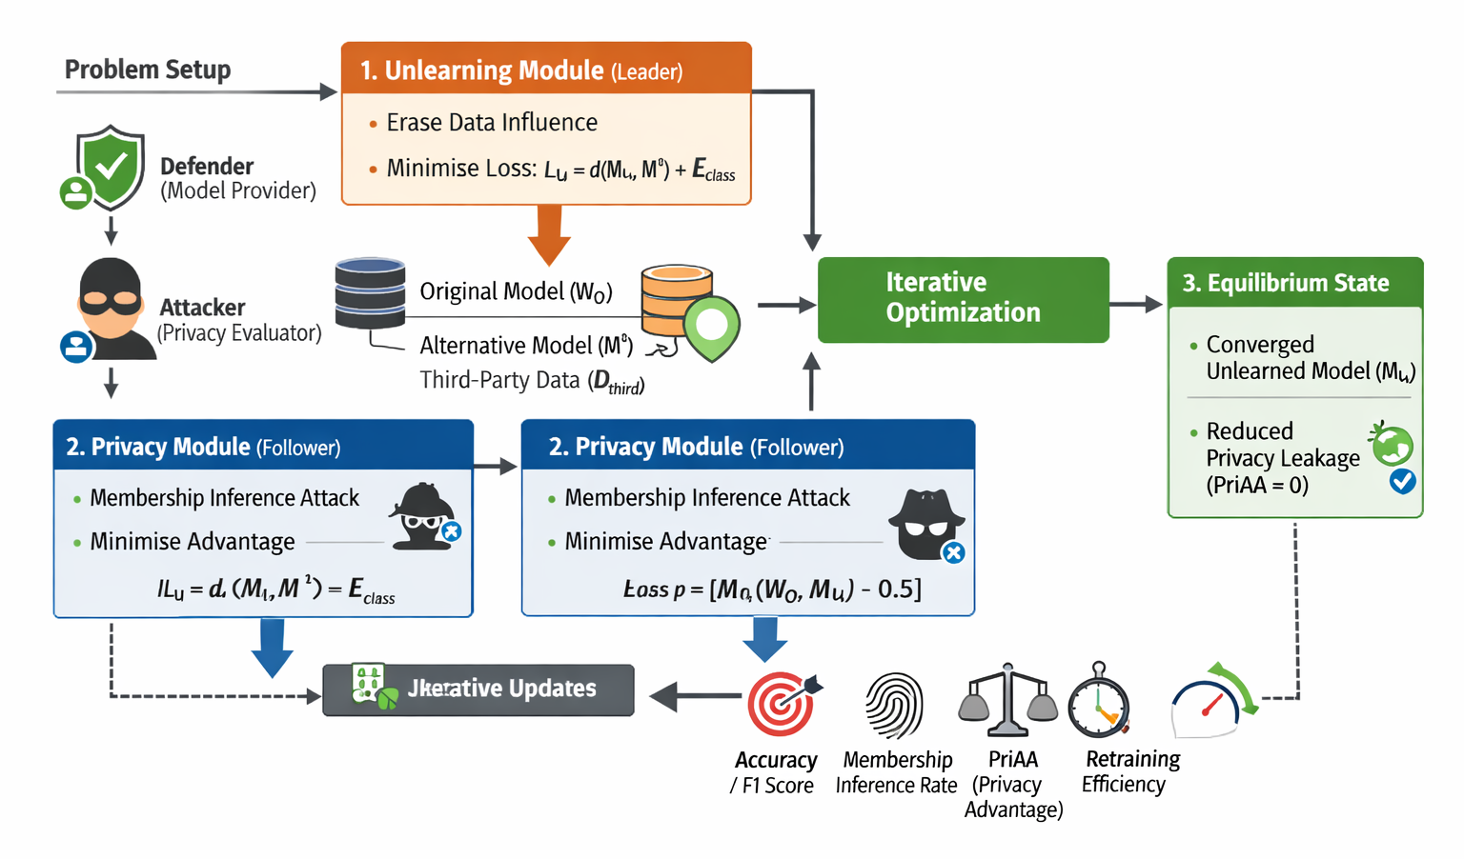
Research Methodology-Objective 1
Objective - 1: Systematically analyze and incorporate attack models (membership inference, attribute inference, reconstruction, poisoning, jailbreaks) into unlearning frameworks.
Figure 8: Proposed Research Methodology objective 1
Figure 9:Game Theory Framework Objective 1

Slide 18
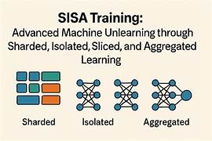
Research Methodology-Objective 2
Objective - 2:Design and evaluate unlearning mechanisms that operate at the feature level (extraction, generation, selection)
Extraction
Generation
Selection
Feature
Lo
S
s
Func
t
I
on
E
V
A
L
Ua
t
i
on
Influence
Influence of Sample
Influence
Influence of Feature
Other Models, Data
Game-Theoretic Framework
Game Type: Stackelberg game, static,dynamic ,etc
Strategy Space : Feature weights and selection masks
Player : Model Provider
Player : Data Provider
Adversary
Figure 10: Objective 2 Research Methodology

Slide 19
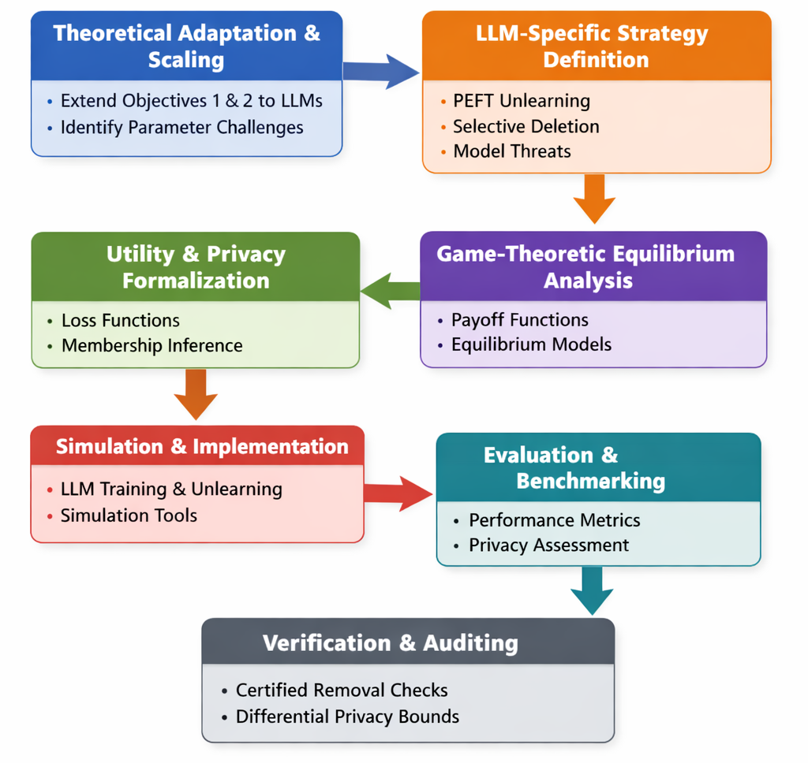
Research Methodology-Objective 3
Objective - 3:Investigate scalable methods for applying unlearning to large language models, addressing challenges of parameter scale and uncertainty in individual data contributions.
Figure 11: Objective 3 Research Methodology

Slide 20
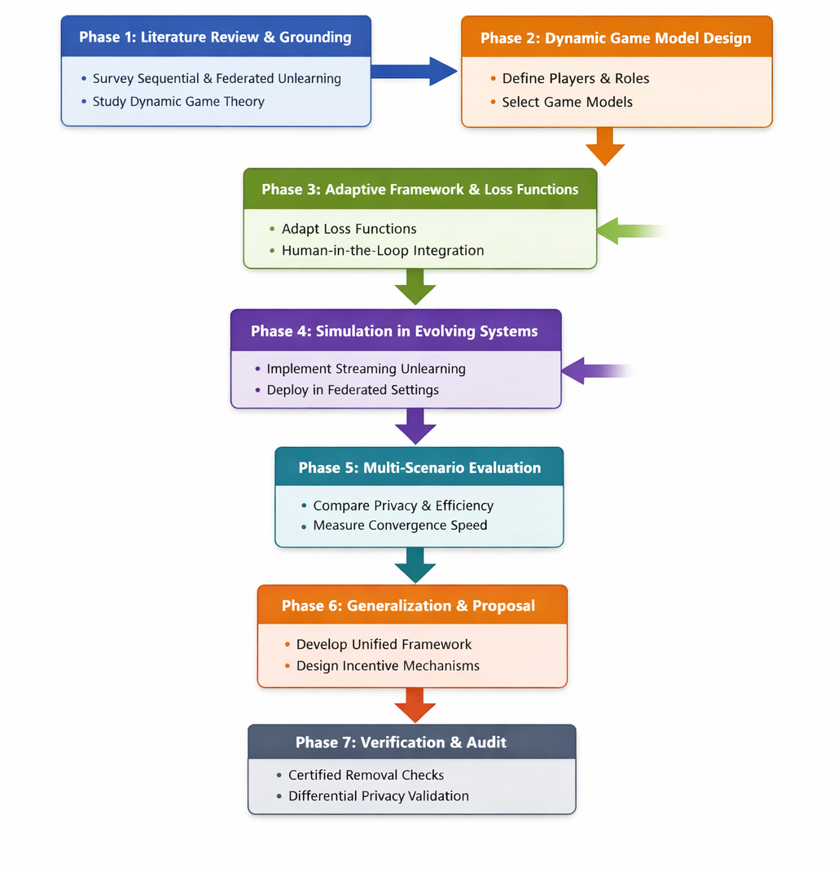
Research Methodology-Objective 4
Objective - 4:Develop adaptive strategies for unlearning in evolving data ecosystems, including streaming contexts and sequential deletion requests, federated settings.
Figure 12: Objective 4 Research Methodology

Slide 21
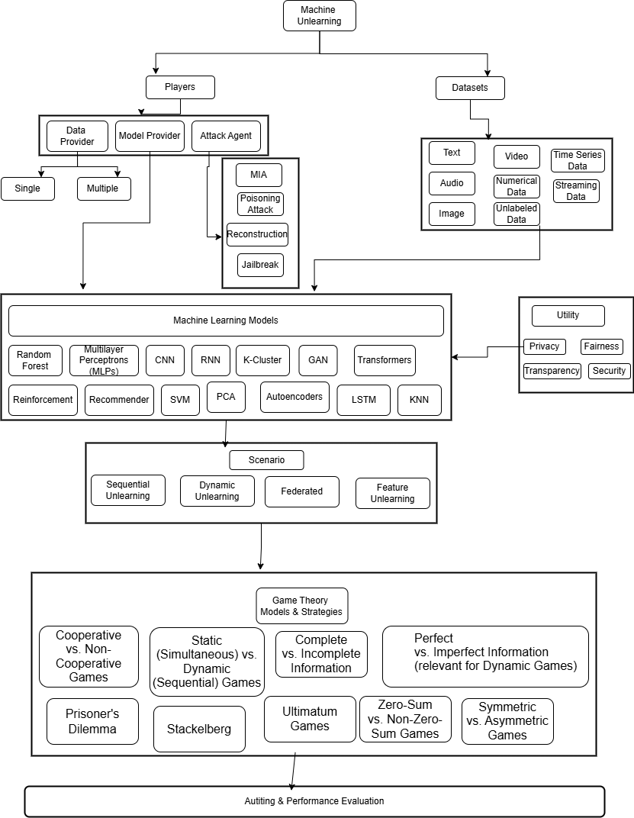
Research Methodology-
Overall Workflow
Objective 1
A Unified Game-Theoretic
Machine Unlearning Framework
Objective 3
Objective 4
Objective 2
Figure 13: Research Methodology-Overall Workflow

Slide 22
Expected Outcomes
Develop strategic frameworks for Machine Unlearning- Define agents, strategies, and payoff functions – Efficient & Effective
Enable model providers to optimize compliance and performance
Empowering Data Providers - Provide users with transparency and control, Help assess effectiveness of unlearning services
Foster trust and responsible data sharing

Slide 23
Importance of Proposed Research
Anchors the “Right to be Forgotten” in machine learning systems.
Ensures compliance with global data protection laws (GDPR, CCPA, DPDP Act).
Reduces conflicts and ensures justice by giving individuals control over their data.
Supports sustainable AI deployment in production environments.

Slide 24
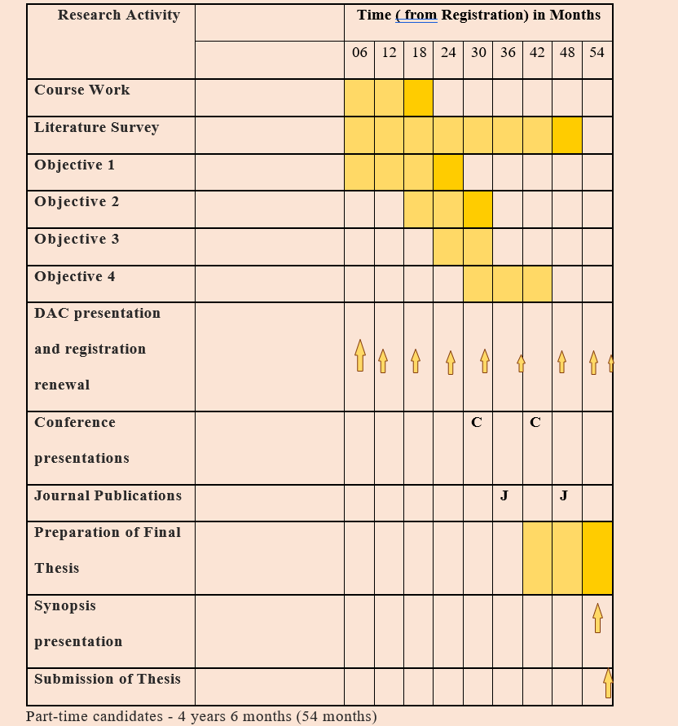
Research Time Plan

Slide 25
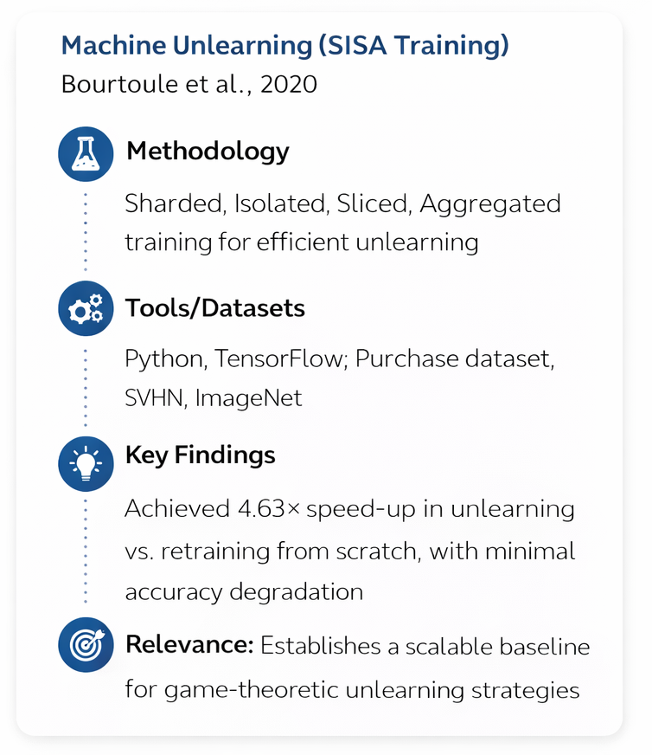
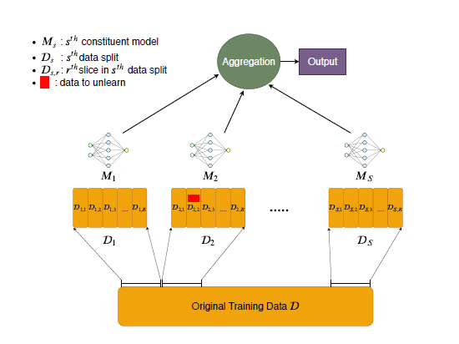
Pilot Study: Model & Dataset
Figure 14: SISA training: data is divided in shards, which are themselves divided into slices. One constituent model is trained on each shard by presenting it with incrementally many slices and saving its parameters before the training set is augmented with a new slice. When data needs to be unlearned, only one of the constituent models whose shards contains the point to be unlearned needs to be retrained — retraining can start from the last parameter values saved before including the slice containing the data point to be unlearned.

Slide 26
Pilot Study: Network Architecture & Experimental Setup
Network Architecture
- Model Type: Deep Neural Networks (DNNs)
- Training Strategy:
- Sharded → dataset split into disjoint subsets
- Isolated → models trained independently per shard
- Sliced → incremental training with checkpoints per slice
- Aggregated → ensemble predictions combined (e.g., majority vote)
- Components:
- Input layer (raw data features)
- Hidden layers (non-linear transformations)
- Output layer (classification labels)
- Optimization: Stochastic Gradient Descent (SGD) with backpropagation
Experimental Setup – SISA Training
Training Data:
Purchase dataset
Training:
Multiple shard config : 2,5,8,10,12,15,18
Num. of unlearning requests : 0 to 60
Models trained independently per shard,
Aggregation via majority vote across shard models
Loss Function:
Cross-Entropy Loss (classification tasks)
Optimizer:
Adam optimizer
Learning rate: 0.001 (tuned per dataset)
Batch size: 128
Regularization:
Dropout (0.5 for deep networks)
Evaluation Metrics:
Accuracy
Unlearning time (speed‑up vs retraining baseline)
Privacy compliance (ability to erase requested data)

Slide 27
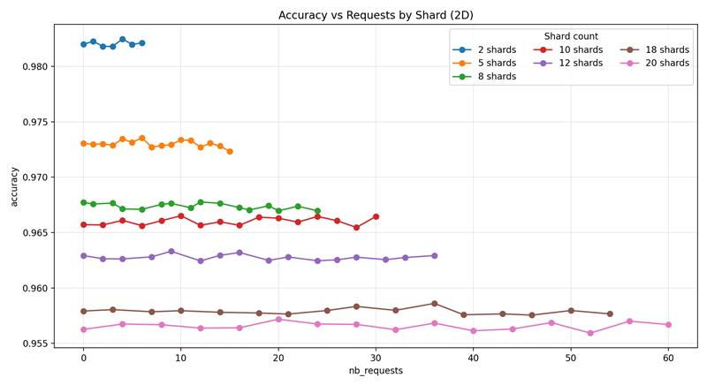
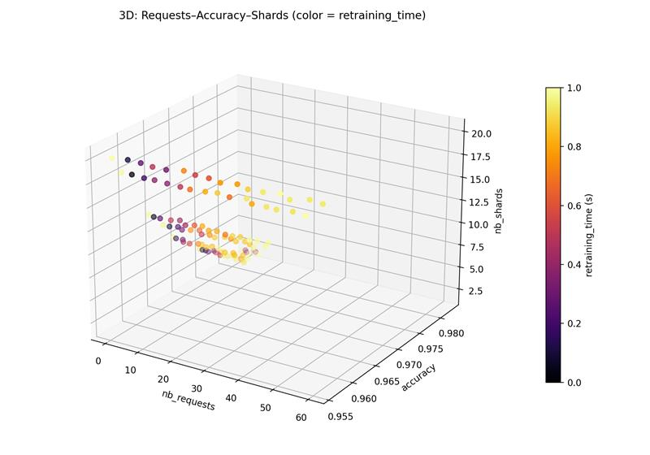
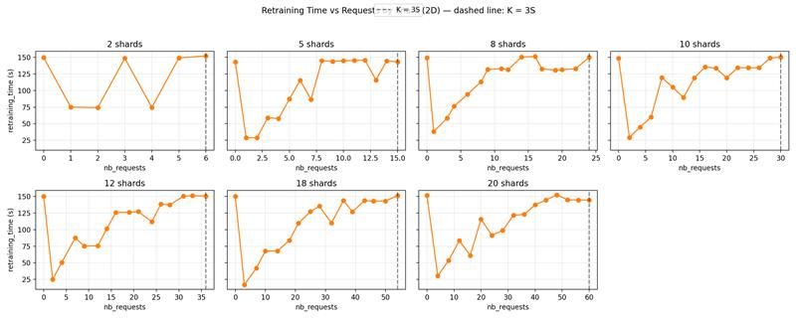
Pilot Study: Results
More shards → faster unlearning, lower accuracy
Slicing → consistent speed-up, extra storage
Figure 7: Pilot Study: Results

Slide 28
Expenses and Funding
The most suitable concepts for research funding will be studied and communicated.

Slide 29
Course Work Details
S. No. | Title of Course Work | Credits | Status
1 | Advanced Research Methodology (ARM) | 4 | In Progress (IP)
2 | Research and Publication Ethics (RPE) | 2 | Completed
3 | Machine Learning | 3 | To Be Taken (TBT)
4 | Responsible and Safe AI Systems | 3 | To Be Taken (TBT)
5 | Game Theory | 2 | To Be Taken (TBT)

Slide 30
References
[1] Machine Unlearning: A Survey HENG XU, TIANQING ZHU, and LEFENG ZHANG, University of Technology Sydney, Australia WANLEI ZHOU, City University of Macau, China PHILIP S. YU, University of Illinois at Chicago, United States
[2] Machine Unlearning: A Comprehensive Survey WEIQI WANG, University of Technology Sydney, Australia ZHIYI TIAN, University of Technology Sydney, Australia CHENHAN ZHANG, University of Technology Sydney, Australia SHUI YU, University of Technology Sydney, Australia
[3] Stefanos Leonardos and Georgios Piliouras. 2022. Exploration-exploitation in multi-agent learning: Catastrophe theory meets game theory. Artif. Intell. 304 (2022), 103653. DOI: http://dx.doi.org/10.1016/j.artint.2021.103653
[4] Lei Cui, Youyang Qu, Mohammad Reza Nosouhi, Shui Yu, Jianwei Niu, and Gang Xie. 2019. Improving data utility through game theory in personalized differential privacy. J. Comput. Sci. Technol. 34, 2 (2019), 272–286. DOI:http: //dx.doi.org/10.1007/s11390-019-1910-3
[5] Xueqin Liang, Zheng Yan, Robert H. Deng, and Qinghua Zheng. 2021. Investigating the adoption of hybrid encrypted cloud data deduplication with game theory. IEEE Trans. Parallel Distrib. Syst. 32, 3 (2021), 587–600. DOI:http://dx.doi. org/10.1109/TPDS.2020.3028685
[6] Jiahui Geng, Qing Li, Herbert Woisetschlaeger, Zongxiong Chen, Fengyu Cai, Yuxia Wang, Preslav Nakov, Hans-Arno Jacobsen, Fakhri Karray A Comprehensive Survey of Machine Unlearning Techniques for Large Language Models DOI: https://doi.org/10.48550/arXiv.2503.01854
[7] Exploring Federated Unlearning: Review, Comparison, and Insights Yang Zhao, Member, IEEE, Jiaxi Yang, Student Member, IEEE, Yiling Tao, Student Member, IEEE, Lixu Wang, Student Member, IEEE, Xiaoxiao Li, Member, IEEE, Dusit Niyato, Fellow, IEEE, and H. Vincent Poor, Life Fellow, IEEE

Slide 31
References
[8] Chuan Guo, Tom Goldstein, Awni Y. Hannun, and Laurens van der Maaten. 2020. Certified data removal from machine learning models. In 37th International Conference on Machine Learning (Proceedings of Machine Learning Research, Vol. 119). PMLR, 3832–3842. Retrieved from http://proceedings.mlr.press/v119/guo20c.html.
[9] Reinforcement Unlearning Dayong Ye∗ , Tianqing Zhu† , Congcong Zhu† , Derui Wang‡ , Kun Gao∗ , Zewei Shi‡ , Sheng Shen, Wanlei Zhou† , and Minhui Xue‡ ∗University of Technology Sydney, †City University of Macau, ‡CSIRO’s Data61, Torrens University Australia, https://arxiv.org/pdf/2312.15910
[10] Xiaofeng Ding, Hongbiao Fang, Zhilin Zhang, Kim-Kwang Raymond Choo, and Hai Jin. 2022. Privacy-preserving feature extraction via adversarial training. IEEE Trans. Knowl. Data Eng. 34, 4 (2022), 1967–1979. DOI:http://dx.doi. org/10.1109/TKDE.2020.2997604
[11] Bo Zhang, Hancheng Ye, Gang Yu, Bin Wang, Yike Wu, Jiayuan Fan, and Tao Chen. 2022. Sample-centric feature generation for semi-supervised few-shot learning. IEEE Trans. Image Process. 31 (2022), 2309–2320. DOI:http://dx. doi.org/10.1109/TIP.2022.3154938
[12] Jiajing Zhu, Yongguo Liu, Chuanbiao Wen, and Xindong Wu. 2022. DGDFS: Dependence Guided Discriminative Feature Selection for predicting adverse drug-drug interaction. IEEE Trans. Knowl. Data Eng. 34, 1 (2022), 271–285. DOI:http://dx.doi.org/10.1109/TKDE.2020.2978055
[13] [Wu et al., 2023] Xinwei Wu, Junzhuo Li, Minghui Xu, Weilong Dong, Shuangzhi Wu, Chao Bian, and Deyi Xiong. DEPN: Detecting and editing privacy neurons in pretrained language models. In Houda Bouamor, Juan Pino, and Kalika Bali, editors, Proceedings of the 2023 Conference on Empirical Methods in Natural Language Processing, pages 2875–2886, Singapore, December 2023. Association for Computational Linguistics.

Slide 32
References
[14] [Jia et al., 2024] Jinghan Jia, Jiancheng Liu, Yihua Zhang, Parikshit Ram, Nathalie Baracaldo, and Sijia Liu. WAGLE: Strategic weight attribution for effective and modular unlearning in large language models. In The Thirty-eighth Annual Conf
[15] A Survey on Recommendation Unlearning: Fundamentals, Taxonomy, Evaluation, and Open Questions Yuyuan Li, Xiaohua Feng, Chaochao Chen*, Senior Member, IEEE, and Qiang Yang, Fellow, IEEE
[16] Alessandro Mantelero. The EU proposal for a general data protection regulation and the roots of the ’right to be forgotten’. Comput. Law Secur. Rev., 29(3):229–235, 2013.
[17] O. of the Privacy Commissioner of Canada. Announcement: Privacy commissioner seeks federal court determination on key issue for canadians’ online reputation.
[18] Lydia de la Torre. A guide to the california consumer privacy act of 2018. Available at SSRN 3275571, 2018.
[19] Digital Personal Data Protection Act, 2023. Available at https://www.meity.gov.in/static/uploads/2024/06/2bf1f0e9f04e6fb4f8fef35e82c42aa5.pdf
[20] L. Bourtoule, V. Chandrasekaran, C. A. Choquette-Choo, H. Jia, A. Travers, B. Zhang, D. Lie, and N. Papernot, “Machine unlearning,” in Proc. IEEE Symposium on Security and Privacy (SP), 2021
[21] Hengzhu Liu, Tianqing Zhu, Lefeng Zhang, Ping Xiong, “Game-Theoretic Machine Unlearning: Mitigating Extra Privacy Leakage”, in JOURNAL OF LATEX CLASS FILES, VOL. 14, NO. 8, AUGUST 2021 1
[22] Stuart Wesselby, “Responsible AI: Principles, Practices, and Applications. How to implement ai responsibly”, https://www.udemy.com/course/responsible-ai-principles-practices-and-applications/?srsltid=AfmBOorcJDN91T-1RxFtCerA13W6GAUedvgXI_K5mlDnzcsPdM9ebOlg

Slide 33
References
[23] Yinzhi Cao and Junfeng Yang. 2015. Towards making systems forget with machine unlearning. In IEEE Symposium
on Security and Privacy. IEEE Computer Society, 463–480. DOI:http://dx.doi.org/10.1109/SP.2015.35
[24] Xiaofeng Ding, Hongbiao Fang, Zhilin Zhang, Kim-Kwang Raymond Choo, and Hai Jin. Privacy-preserving feature extraction via adversarial training. IEEE Trans. Knowl. Data Eng., 34(4):1967–1979, 2022.
[25] Bo Zhang, Hancheng Ye, Gang Yu, Bin Wang, Yike Wu, Jiayuan Fan, and Tao Chen. Sample-centric feature generation for semi-supervised few-shot learning. IEEE Trans. Image Process., 31:2309–2320, 2022.
[26] Jiajing Zhu, Yongguo Liu, Chuanbiao Wen, and Xindong Wu. DGDFS: dependence guided discriminative feature selection for predicting adverse drug-drug interaction. IEEE Trans. Knowl. Data Eng., 34(1):271–285, 2022

Slide 34
Thank You

