Slide 1

Decision Support System for Liver Trauma Assessment
Ph.D Pre-Proposal Presentation
by
Mrs. Cauvery K
Reg. No.: 230900225
Department of Computer Science and Engineering,
Manipal Institute of Technology, Manipal
Under the supervision of
Dr. P.C. Siddalingaswamy
Professor (Guide)
Department of Computer Science and Engineering,
Manipal Institute of Technology, Manipal
Dr. Sanjay Singh
Professor (Co-Guide)
Department of Information and Communication Technology,
Manipal Institute of Technology, Manipal
Dr. Prakashini K
Professor & Head (Co-Guide)
Department of Radiodiagnosis,
Kasturba Medical College, Manipal
Jul 12, 2024

Slide 2
Presentation Overview
Introduction
Literature Review
Research Gaps
Objectives
Research Gaps to Objectives Mapping
Methodology
Course Work Details
Time Plan
References
Decision Support System for Liver Trauma Assessment

Slide 3
Introduction-I
Liver Trauma [1]
Injury to liver due to external forces
~5% of all trauma admissions
Primary cause of death in severe abdominal trauma, 10-15% mortality rate
Mechanism of injury [2,3]
Most injured organ in blunt trauma and in penetrating trauma
Blunt trauma
35-45% of abdominal trauma
MVA, pedestrian accidents, falls, sports, fights
Penetrating trauma
40% SWs and 30% GSWs
Stabbing, gunshot, shear forces
Right lobe of the liver most affected
Decision Support System for Liver Trauma Assessment

Slide 4
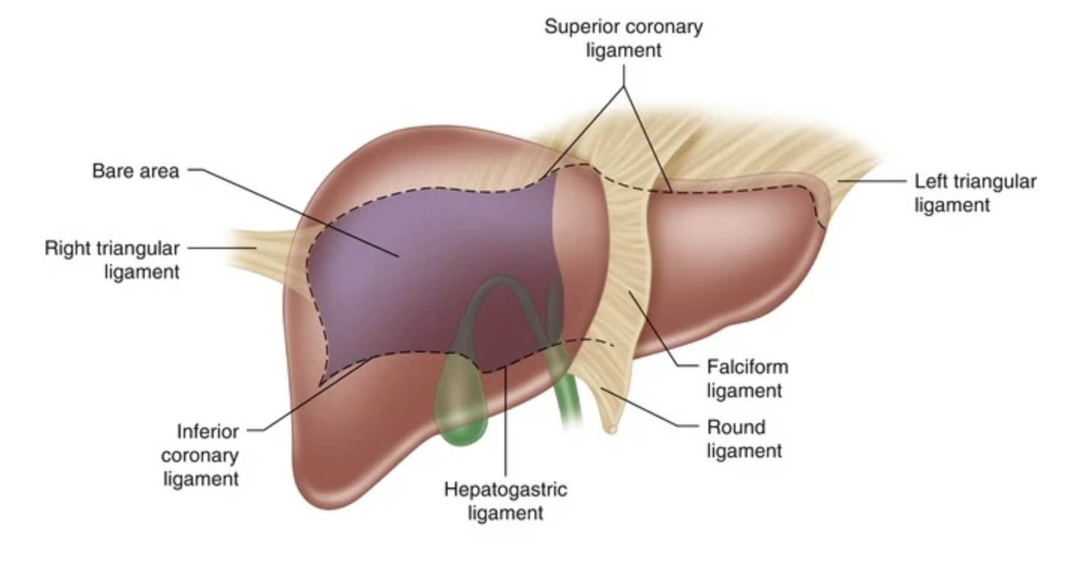
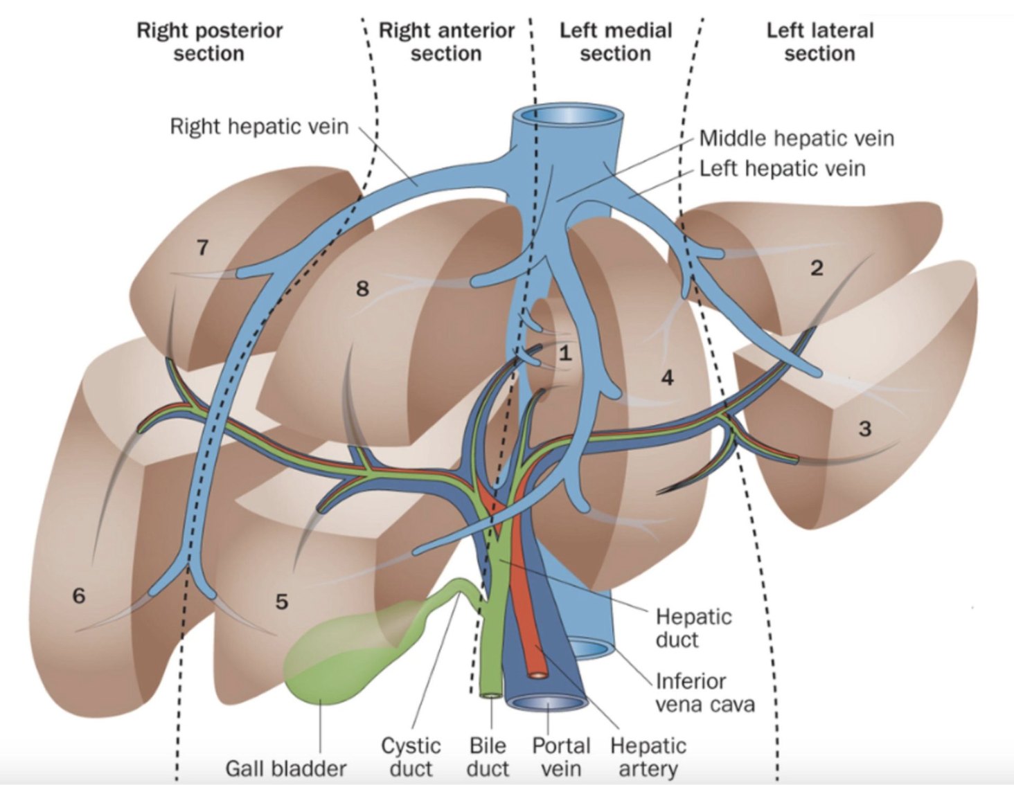
Introduction-II
Why liver is prone to trauma? [4,5,6]
Largest peritoneal abdominal organ in the human body
Location and Size:
Situated in the RUQ
~2% total body mass
Fixed position (falciform, coronary, triangular ligaments)
Fragility:
Covered by thin fibrous capsule (Glisson capsule)
Fragile parenchyma
Vascularity:
Dual blood supply
hepatic artery (25%), portal vein (75%)
High blood flow, haemorrhage
Biliary tree disruption
Figure 1.1: Liver Anatomy.
(Source:https://link.springer.com/chapter/10.1007/978-1-4939-1200-1_1)
Figure 1.2: Liver segmented along Canauid
(Source:https://ilts.org/insights/couinauds-segmental-anatomy-of-the-liver-and-proposed-classification-of-pediatric-liver-tumors/)
Decision Support System for Liver Trauma Assessment

Slide 5
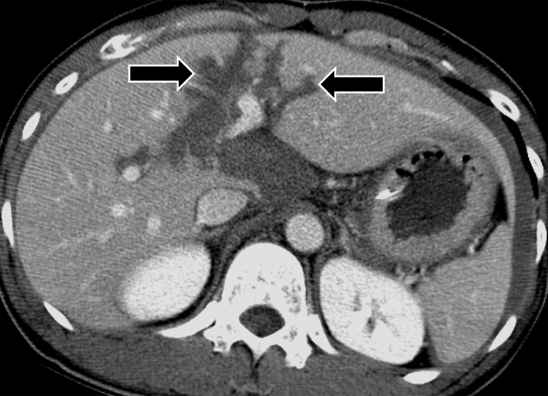
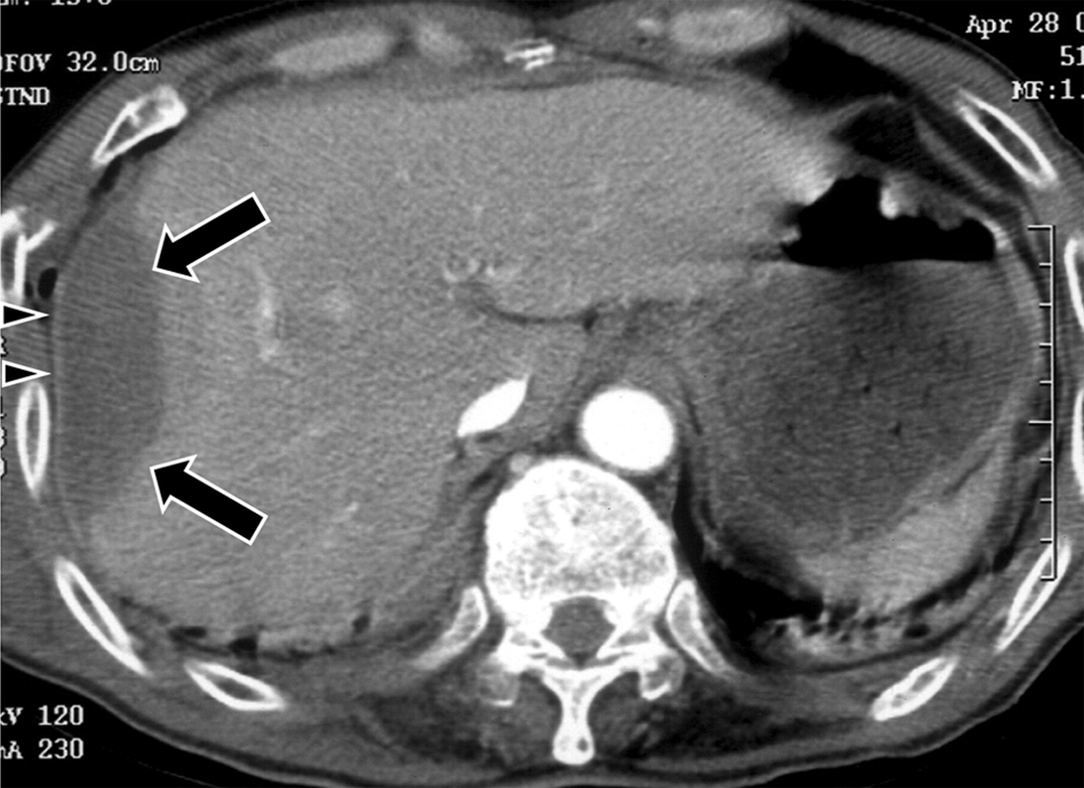
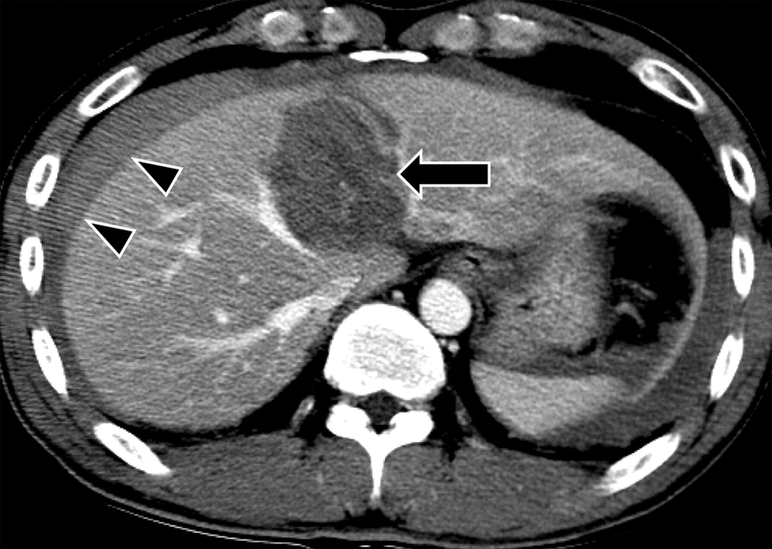
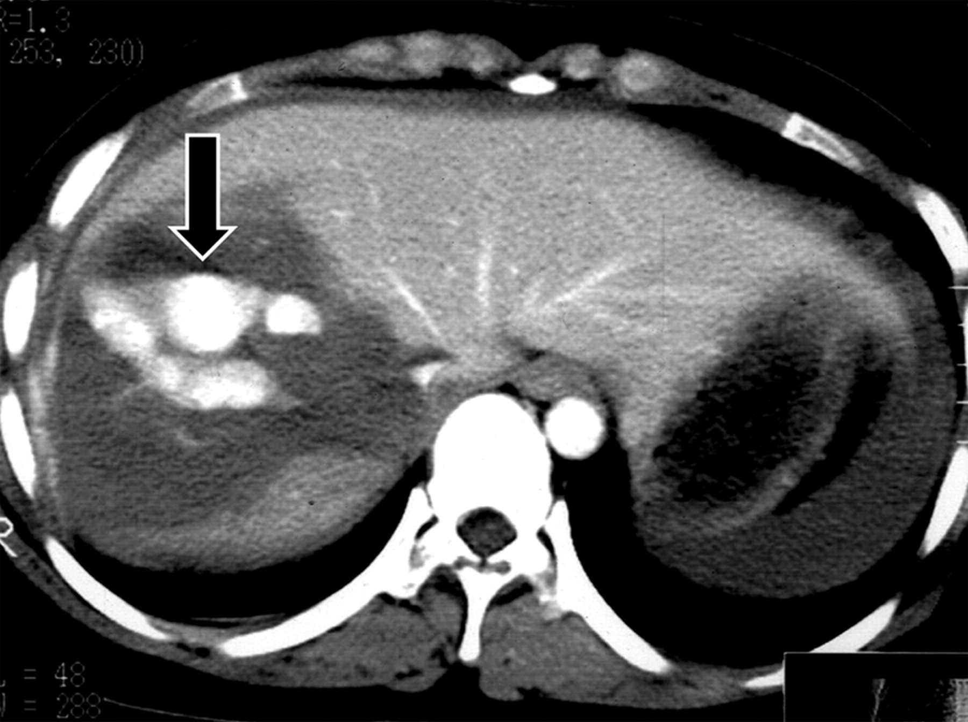
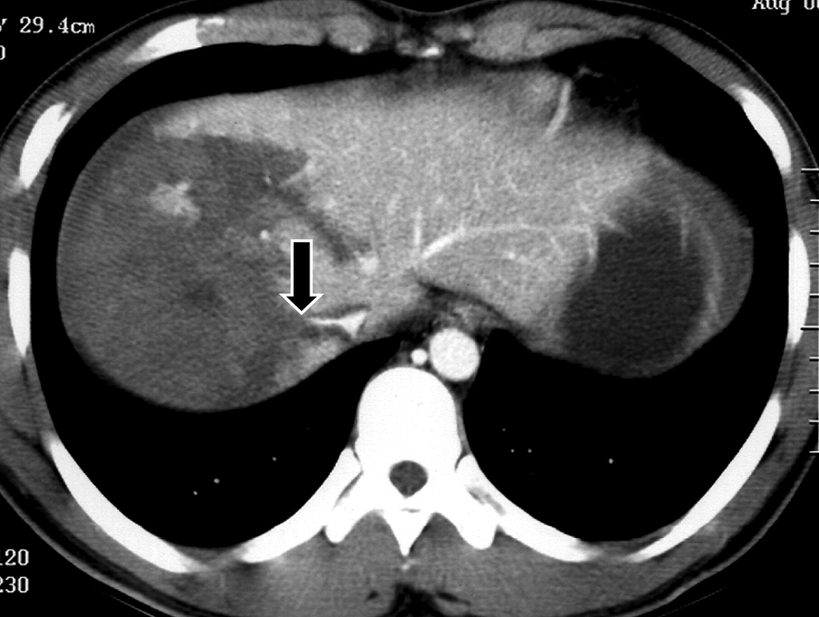
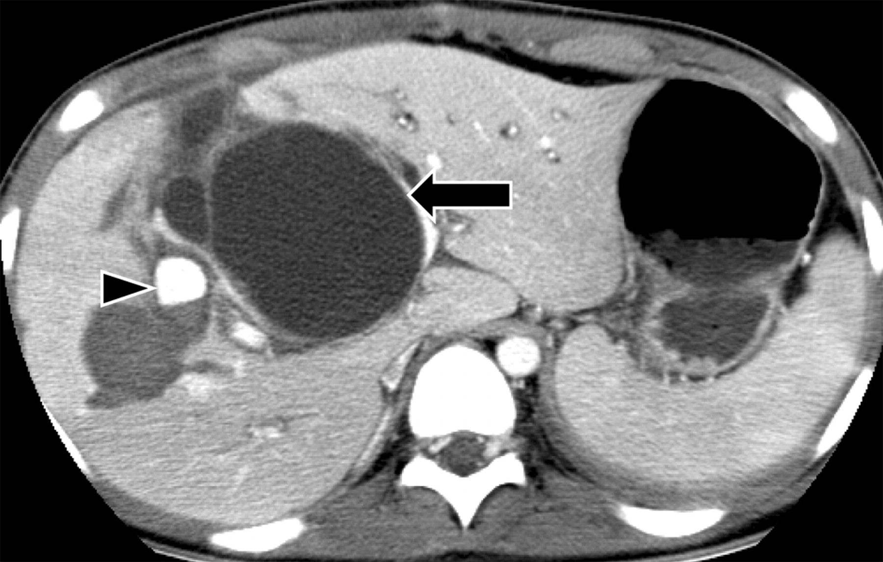
Introduction-III: Liver Trauma Injuries
(a) Lacerations (arrow).
(b) Subcapsular Hematoma (arrow).
(c) Intraparenchymal Hematoma (arrow), Subcapsular Hematoma (arrowhead).
(d) Hepatic vein injury: Active bleeding within intraparenchymal hematoma.
(e) Hepatic venous injury: Lacerations extending to Inferior Vana Cava (IVC) and cutoff of right hepatic venous drainage (arrow).
(f) Biliary duct injury: Biloma (arrow), pseudoaneurysm (arrowhead).
Decision Support System for Liver Trauma Assessment

Slide 6
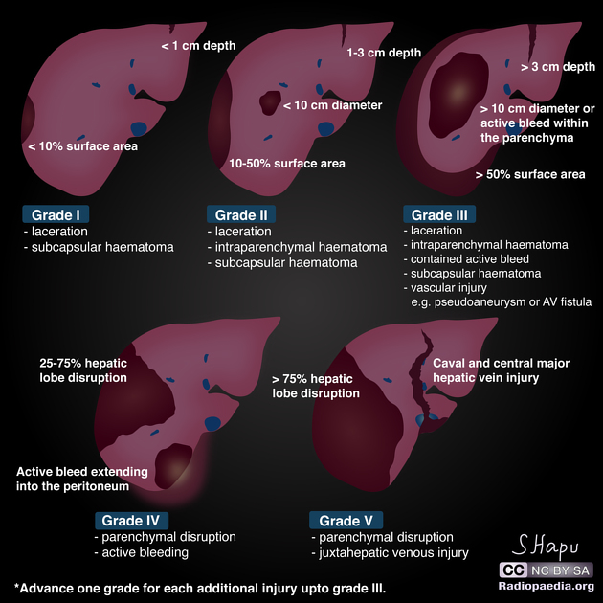
Introduction-IV: AAST-Liver Injury Classification
AAST (American Association for the Surgery of Trauma) Liver Injury Scale (2018 revision) [8]
AAST Grade | Imaging Criteria (CT Findings)
I | Subcapsular hematoma <10% surface area
 | Parenchymal laceration <1 cm depth
II | Subcapsular hematoma 10-50% surface area; intraparenchymal hematoma <10 cm in diameter
 | Laceration 1-3 cm in depth and ≤10 cm length
III | Subcapsular hematoma >50% surface area; ruptured subcapsular or parenchymal hematoma
 | Intrparenchymal laceration >10 cm
 | Laceration >3 cm depth
 | Any injury in the presence of a liver vascular injury or active bleeding contained within liver parenchyma
IV | Parenchymal disruption involving 25-75% of a hepatic lobe
 | Active bleeding extending beyond the liver parenchyma into the peritoneum
V | Parenchymal disruption >75% of hepatic lobe
 | Juxtahepatic venous injury to include retrohepatic vena cava and central major hepatic veins
Table 1.1: CT based AAST Liver Trauma Grading [8].
Decision Support System for Liver Trauma Assessment

Slide 7
Introduction-V: WSES Trauma Classification
WSES (World Society of Emergency Surgery) [10]
Liver trauma classification is based on AAST-OIS anatomic classification + hemodynamic status + associated injuries
 | WSES grade | AAST | Hemodynamic | CT scan | First-line treatment
Minor | WSES grade I | I–II | Stable | Yes | NOM (Clinical/Laboratory/Radiological Evaluation)
Moderate | WSES grade II | III | Stable
Severe | WSES grade III | IV–V | Stable
 | WSES grade IV | I–V | Unstable | No | OM
Table 1.2: WSES classification of Liver Trauma
Decision Support System for Liver Trauma Assessment

Slide 8
Introduction-VI: Initial Assessment (Imaging)
Contrast-enhanced Computed Tomography (CT) [11]
Gold standard: Sens./Spec.: 98%
Grade of injury
Active bleeding
Associated injuries
Why automated assessment? [12]
CT limitations
Time consuming
Radiologist variability
Automated tools can:
Provide rapid, consistent, and accurate evaluations
Decision Support System for Liver Trauma Assessment

Slide 9
Literature Review I
Author, Title, Journal | Dataset | Work-done | Findings
Farzaneh et al (2022) [13] A Deep Learning Framework for Automated Detection and Quantitative Assessment of Liver Trauma. BMC Medical Imaging | University of Michigan Health System (UMHS) Department of Radiology (private: train + test) 3DIRCAD (public: test) | 2 U-Net models used to segment liver parenchyma and trauma regions Post processing done to refine the segmented trauma region by incorporating human domain knowledge and vision algorithms (morphological operations + 3D Chan-Vese active contour model (ACM)) to avoid false positives Calculated the liver parenchyma disruption index (LDI) to assess the presence and extent of liver trauma | The framework was trained on UMHS dataset and additional testing of liver parenchyma segmentation was done on 3DIRCAD dataset. Achieved model performance for Di, Re, Pr = 96.13%, 96.00%, 96.35% for liver and 51.21% (>5%, 72.45%), 53.20% (>5%, 73.84%), 56.76% (>5%, 75.35%) for trauma segmentation. Bland–Altman analysis was also performed to understand the algorithms agreement with the systematic errors and the ground truth. The model showed negligible bias (-0.13) Performance of the liver trauma segmentation improved for considerable injuries with over 5% of LDI The study is limited to liver intra-parenchymal hematoma.
Decision Support System for Liver Trauma Assessment

Slide 10
Literature Review II
Author, Title, Journal | Dataset | Work-done | Findings
Huang et al (2022) [14] Automated Quantitative Assessment of Pediatric Blunt Hepatic Trauma by Deep Learning-Based CT Volumetry European Journal of Medical Research | CT images of 170 children for blunt liver trauma from Children’s Hospital of Soochow University (private dataset) | Leveraged 2 MONAI dynUNet models to segment liver parenchyma and trauma regions Histogram equalization and grayscale inversion was performed as pre-processing step on the output of 1st dynUNet model to highlight the trauma region before passing it to 2nd dynUNet model. Calculated the liver parenchyma disruption index (LDI) to assess the presence and extent of liver trauma | The framework was trained on 118 CT images and validated on 52. Achieved model performance for Di, Re, Pr = 94.75%, 95.46%, 96.35% for liver and 72.91%, 76.8 %, 72.4 % for trauma segmentation. The Spearman rank correlation analysis was performed to show the correlation between automated LPDI and liver trauma volume with the AAST grade (rho=0.823, p<0.001; rho=0.831, p<0.001, respectively) The study is limited to liver intra-parenchymal hematoma. Performance degrades for lower AAST grade trauma regions.
Decision Support System for Liver Trauma Assessment

Slide 11
Literature Review III
Author, Title, Journal | Dataset | Work-done | Findings
Dreizin et al (2021) [15] Added Value of Deep Learning-Based Liver Parenchymal CT Volumetry for Predicting Major Arterial Injury after Blunt Hepatic Trauma. Abdominal Radiology | Dataset of 73 adult patients who underwent contrast-enhanced admission CT of the abdomen followed by hepatic arterial angiography at two level I trauma centers (56 patients from R Adams Cow- ley Shock Trauma Center (STC) , and 17 patients from Ryder Trauma Center (RTC)) (private) | Extensive voxel-wise ground-truth labeling was done. Volumetric measurements such as total liver parenchymal disruption (LPD) volume, total liver volume, subcapsular hematoma volume, and contrast extravasation (CE) volume was extracted from CT images Employed pre-trained DL models for whole organ and injury segmentation. 4-fold validation was used for training LDPI was calculated for liver trauma severity assessment. Two decision tree models created using the classification and regression tree (CART) approach: DR1: Combined automated LPDI and binary CE (CE as either present or absent). DR2: Combined automated LPDI and volumetric CE measurements (from manual segmentation). | The automated results showed excellent correlation and concurrence with the manual measurements, with high ICC and Pearson’s r values, for laceration vol, whole liver vol and LDPI. Bland-Altman plot showed minimal bias for LDPI. Accuracy, sensitivity, specificity, PPV and NPV was calculated for Binary CE, Decision Tree analysis, and AAST grade. DTA with auto LDPI + binary resulted in 32% reduction in false negative DTA with auto LDPI + CE volume resulted in 63% reduction in false negative Study only considered the CT scans of upper abdomen during portal venous phase ignoring the blood pooling in the lower abdomen. Also didn’t consider injury near the bile duct and periphery.
Decision Support System for Liver Trauma Assessment

Slide 12
Literature Review IV
Author, Title, Journal | Dataset | Work-done | Findings
Shen et al (2024) [16] The Application of Deep Learning in Abdominal Trauma Diagnosis by CT Imaging. World Journal of Emergency Surgery | RSNA (Radiological Society of North America) dataset containing 3147 CT scans with various abdominal injuries from 23 sites and 14 countries. Dataset was categorized into six sections: liver, spleen, kidney, intestine, extravasation, and any injury. Each section divided into health or injury categories. | Images cropped to focus on the abdominal organs within each scan. Designed a 2-stage model to detect trauma regions. Stage1-Segmentation (2D): Used U-Net model with EfficientNetB0 as backbone to segment individual organs Stage2: Injury Classification (2.5D): An EfficientNetB1 model was used to process the image from segmented slice. The LSTM (long short-term memory) network was introduced to get the spatial information between the segmented images. A Neck structure and Multi-Label classification was used to compute the average injury probability for each organ Used Grad-CAM to visualize model working. | Classification metrics like accuracy, sensitivity and specificity was calculated Model performance was evaluated using ROC and AUROC The model obtained an accuracy of 0.873 (PPV: 0.789; NPV: 0.895; Sensitivity: 0.789; Specificity: 0.895; AUC:0.817) Overall, the model performance was good in diagnosing liver injuries The model is limited to only classification task – injured, healthy
Decision Support System for Liver Trauma Assessment

Slide 13
Research Gaps
Limited work is reported on detecting and segmenting multiple liver injuries in one study with radiologist level accuracy [13,15].
No major study has been carried out on segmenting the images of liver trauma with pre-existing liver conditions like fatty livers, disease infected liver etc [13].
Although work has been done on volumetric assessment of liver trauma, very limited work has been carried out on grading the severity of the liver injury [14].
There is no major work carried out on designing a decision support system to automate the assessment of liver trauma
Decision Support System for Liver Trauma Assessment

Slide 14
Objectives
Develop an efficient framework to identify and segment the liver and traumatic regions of liver in CT scan for trauma assessment.
Automatic Quantitative Assessment and Severity Grading of Liver Trauma.
Design a decision support system (DSS) integrating objective 1 and 2 into a software tool to provide an accurate and precise understanding of liver trauma.
Decision Support System for Liver Trauma Assessment

Slide 15
Research Gaps to Objectives Mapping
GAP-1
Limited work is reported on detecting and segmenting multiple liver injuries in one study with radiologist level accuracy.
OBJECTIVE-1
Develop an efficient framework to identify and segment the liver and traumatic regions of liver in CT scan for trauma assessment
GAP-2
No major study has been carried out on segmenting the images of liver trauma with pre-existing liver conditions like fatty livers, disease infected liver
OBJECTIVE-2
Automatic Quantitative Assessment and Severity Grading of Liver Trauma.
GAP-3
Although work has been done on volumetric assessment of liver trauma, very limited work has been carried out on grading the severity of the liver injury.
OBJECTIVE-3
Design a decision support system (DSS) integrating objective 1 and 2 into a software tool to provide an accurate and precise understanding of liver trauma.
GAP-4
There is no major work carried out on designing a decision support system to automate the assessment of liver trauma
Decision Support System for Liver Trauma Assessment

Slide 16
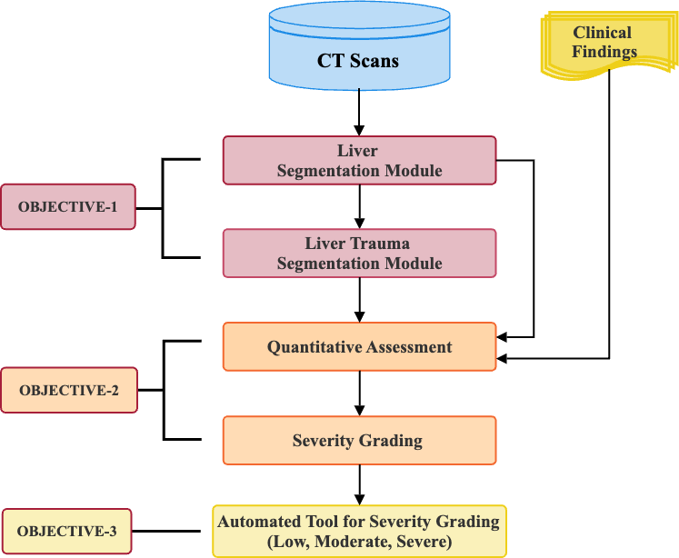
Methodology
Figure 5.1: Decision Support System for Liver Trauma Assessment workflow
Decision Support System for Liver Trauma Assessment

Slide 17
Course Work Details
S. No. | Title of Course Work | Credits | Status
1 | Advanced Research Methodology (ARM) | 4 | To be Taken (TBT)
2 | Research and Publication Ethics (RPE) | 2 | In Progress (IP)
3 | Medical Image Processing (Customized) | 3 | DAC approval pending
4 | Deep Learning and its Applications | 4 | DAC approval pending
Decision Support System for Liver Trauma Assessment

Slide 18
Time Plan
Events | 1st semester | 2nd semester | 3rd semester | 4th semester | 5th semester | 6th semester | 7th semester
Registration for mandatory course work | Immediately after the registration
Constitution of DAC | Within 1 month
PreDAC meeting | Within 2 month
IPAC presentation deadline | 02-11-2024
Registration Renewal deadlines | 02-11-2024 | 02-05-2025 | 02-11-2025 | 02-05-2026 | 02-11-2026 | 02-05-2027
DAC presentation deadlines |  | DAC1 02-05-2025 | DAC2 02-11-2025 | DAC3 02-05-2026 | DAC4 02-11-2026 | DAC5 02-05-2027 | DAC6 02-11-2027
Course Work completion (12 credits)
1st draft of review/ original article submission to guide
Review/ original article submission to journal
2nd article preparation and submission
Conference presentations | As approved by the guide
Synopsis presentation
Submission of NOC request to CDS for thesis submission | Within 3 months of synopsis presentation
Thesis submission to Registrar Evaluation | Immediately after NOC
Decision Support System for Liver Trauma Assessment

Slide 19
References I
[1]S. Taghavi and R. Askari, “Liver Trauma,” PubMed, 2020. https://www.ncbi.nlm.nih.gov/books/NBK513236/
[2]A. S. Pillai, G. Kumar, and A. K. Pillai, “Hepatic Trauma Interventions,” Seminars in Interventional Radiology, vol. 38, no. 01, pp. 096–0104, Mar. 2021, doi: https://doi.org/10.1055/s-0041-1724014.
[3]W. Villegas and J. Vaughan, “Trends in Reduction of Mortality in Liver Trauma,” Critical Care Nursing Clinics of North America, vol. 34, no. 3, pp. 351–359, Sep. 2022, doi: https://doi.org/10.1016/j.cnc.2022.04.008.
[4]A. Kalra, F. Tuma, E. Yetiskul, and C. J. Wehrle, “Physiology, Liver,” National Library of Medicine, May 01, 2023. https://www.ncbi.nlm.nih.gov/books/NBK535438/
[5]R. Laing, M. Edwards, T. Faulkner, and K. Roberts, “Liver Trauma: Review of Management, and Patient Outcomes at Our Major Trauma Centre,” Journal of gastrointestinal and hepatic surgery, vol. 5, no. 1, Dec. 2022, doi: https://doi.org/10.36959/879/385.
[6]I. A. Ziogas, I. Katsaros, and Georgios Tsoulfas, “Damage Control Surgery for Liver Trauma,” IntechOpen eBooks, Jul. 2021, doi: https://doi.org/10.5772/intechopen.94109.
[7]W. Yoon et al., “CT in Blunt Liver Trauma,” RadioGraphics, vol. 25, no. 1, pp. 87–104, Jan. 2005, doi: https://doi.org/10.1148/rg.251045079.
[8]“Injury Scoring Scale,” The American Association for the Surgery of Trauma, Aug. 27, 2009. https://www.aast.org/resources-detail/injury-scoring-scale
[9]S. Hapugoda, “Liver trauma grading (diagrams) | Radiology Case | Radiopaedia.org,” Radiopaedia. https://radiopaedia.org/cases/liver-trauma-grading-diagrams-5 (accessed Jul. 12, 2024).
Decision Support System for Liver Trauma Assessment

Slide 20
References II
[10]F. Coccolini et al., “Liver trauma: WSES 2020 guidelines,” World Journal of Emergency Surgery, vol. 15, no. 1, Mar. 2020, doi: https://doi.org/10.1186/s13017-020-00302-7.
[11]W. Yoon et al., “CT in Blunt Liver Trauma,” RadioGraphics, vol. 25, no. 1, pp. 87–104, Jan. 2005, doi: https://doi.org/10.1148/rg.251045079.
[12]Maria Chiara Brunese et al., “Future Perspectives on Radiomics in Acute Liver Injury and Liver Trauma,” Journal of personalized medicine, vol. 14, no. 6, pp. 572–572, May 2024, doi: https://doi.org/10.3390/jpm14060572.
[13]N. Farzaneh, E. B. Stein, R. Soroushmehr, J. Gryak, and K. Najarian, “A deep learning framework for automated detection and quantitative assessment of liver trauma,” BMC Medical Imaging, vol. 22, no. 1, Mar. 2022, doi: https://doi.org/10.1186/s12880-022-00759-9.
[14]S. Huang, Z. Zhou, X. Qian, D. Li, W. Guo, and Y. Dai, “Automated quantitative assessment of pediatric blunt hepatic trauma by deep learning-based CT volumetry,” European Journal of Medical Research, vol. 27, no. 1, Dec. 2022, doi: https://doi.org/10.1186/s40001-022-00943-1.
[15]D. Dreizin et al., “Added value of deep learning-based liver parenchymal CT volumetry for predicting major arterial injury after blunt hepatic trauma: a decision tree analysis,” Abdominal radiology, vol. 46, no. 6, pp. 2556–2566, Jan. 2021, doi: https://doi.org/10.1007/s00261-020-02892-x.
[16]X. Shen et al., “The application of deep learning in abdominal trauma diagnosis by CT imaging,” World journal of emergency surgery, vol. 19, no. 1, May 2024, doi: https://doi.org/10.1186/s13017-024-00546-7.
Decision Support System for Liver Trauma Assessment

Slide 21
Thank You
Decision Support System for Liver Trauma Assessment

