Slide 1
Park Safe
Recommend safe parking spots using spatio-temporal analysis
16-791 Course Project
Team members: Aashi, Gautham,Vivek

Slide 2
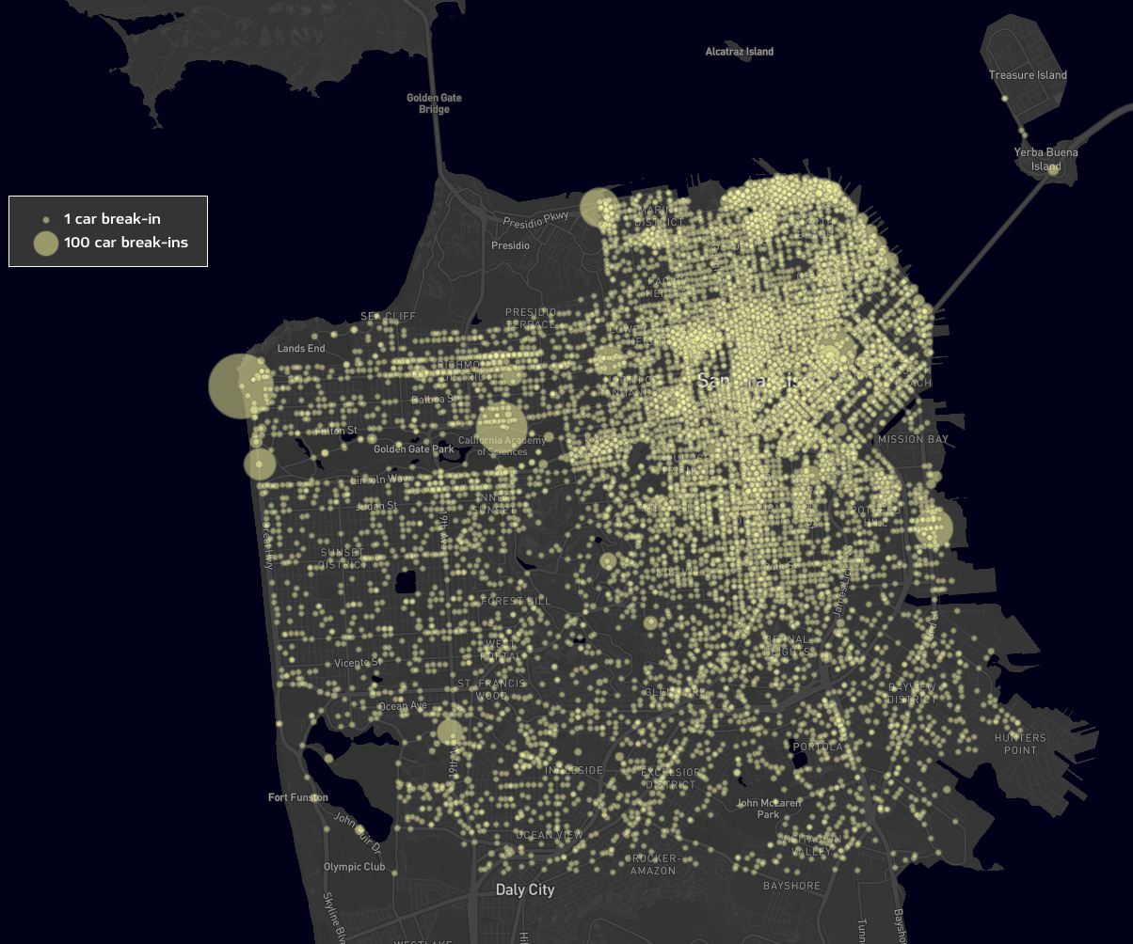
Project Description
Characterize vehicular thefts in San Francisco
Motivation:
25,677 car break-in reports with only 1% of cases arrested
Goal:
Using time and location of the theft incident to recommend safe parking spots
Car break-ins in SF in 2019

Slide 3
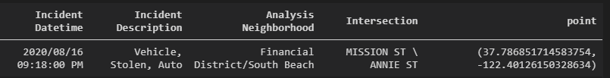
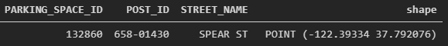
Datasets
SFPD Incident Reports: 2018 to Present
Parking Meters data
Income by Neighborhood
Population by Neighborhood

Slide 4




Technical Approach
Data Augmentation
Feature
Selection
Model
Selection
Prototype
Park Safe application

Slide 5
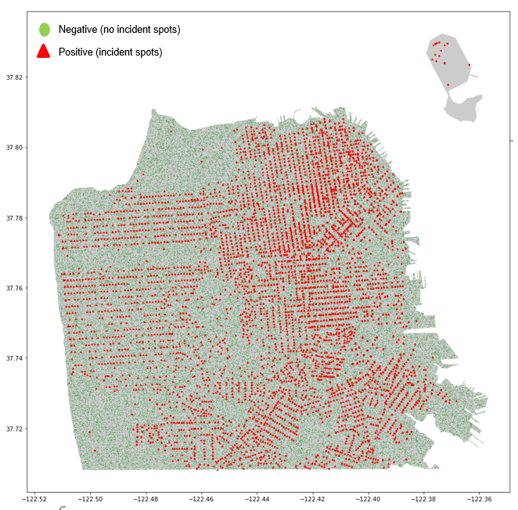

Data Augmentation
Positive ⇒ Incident Spots
Sampled negative data points uniformly at random
Positive : Negative = 1 : 6
Features:
Distribution of class labels (positive and negative)

Slide 6
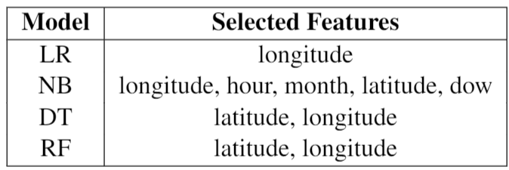
Feature Selection
Models used:
Logistic Regression (LR)
Naive Bayes (NB)
Decision Tree (DT)
Random Forest (RF)
Used Recursive Feature Elimination CV

Slide 7
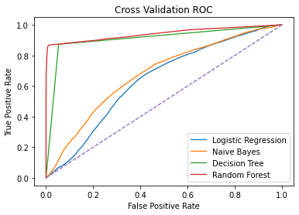
Model Selection
Area Under the Curve
Logistic Regression: 0.638
Naive Bayes: 0.677
Decision Tree: 0.910
Random Forest: 0.942
Performance Evaluation (TPR=80%)
TNR : 99.6%
Precision : 97.0%
Accuracy : 97.1%

Slide 8
Conclusion
Location is the key factor in identifying safe parking spots in San Francisco
Business Application: Trained model can be integrated with a GPS-enabled device to develop an application which recommends safe nearby parking spots [DEMO]

