Slide 1
Ethernet-Based Web Server for Embedded Systems
ECEN 5613 : Embedded System Design (Fall 2024)
Professor Linden McClure
Final Project Preliminary Design Review (PDR)

Slide 2
Project Overview
Title:
Ethernet-Based Web Server for Embedded Systems
Project Description:
Develop a Web Page Server using the AT89C51RC2 microcontroller and ENC2860J Ethernet controller. The server handles TCP/IP requests and serves web pages over the network. The system uses Ethernet for communication.
Team Members:
Abhishek Nadgir, Abhishek Koppa

Slide 3
Objective
Main Goal:
Implement the ENC28J60 driver and process network requests to serve web pages.
Build a TCP/IP stack for efficient Ethernet communication on a resource-constrained microcontroller.
Challenges:
Efficiently manage SPI communication between the AT89C51RC2 and ENC28J60, focusing on speed and memory optimization.
Managing the limited processing power and memory of the microcontroller while running the TCP/IP stack, ensuring smooth performance despite resource constraints.

Slide 4
Software Implementation
SPI Communication:
Interface AT89C51RC2 with ENC28J60 using SPI. Handle data transmission and reception over SPI.
TCP/IP Stack:
Custom stack for Ethernet frame and IP processing. Manage web page requests and responses.
Web Server Development:
HTML webpage Development and Handling the request and response of HTTP.
Temperature Sensor Interface:
Interface the temperature sensor with the AT89C51RC2 to read temperature data. The microcontroller processes the sensor data and transfers it to the web server.

Slide 5
Hardware Development
AT89C51RC2 Microcontroller:
Core system component, managing web server logic and TCP/IP communication, with SPI interface to the ENC28J60 for network data transmission.
ENC28J60 Ethernet Controller:
Ethernet module interfacing with RJ45 for network connectivity, handling TCP/IP packets, and communicating with the microcontroller via SPI.
RJ45 Ethernet Connector:
Provides physical connectivity to the Ethernet network, allowing the microcontroller to communicate over the internet.
Temperature Sensor:
Connected to the microcontroller, providing real-time temperature data to be displayed on the web server.

Slide 6
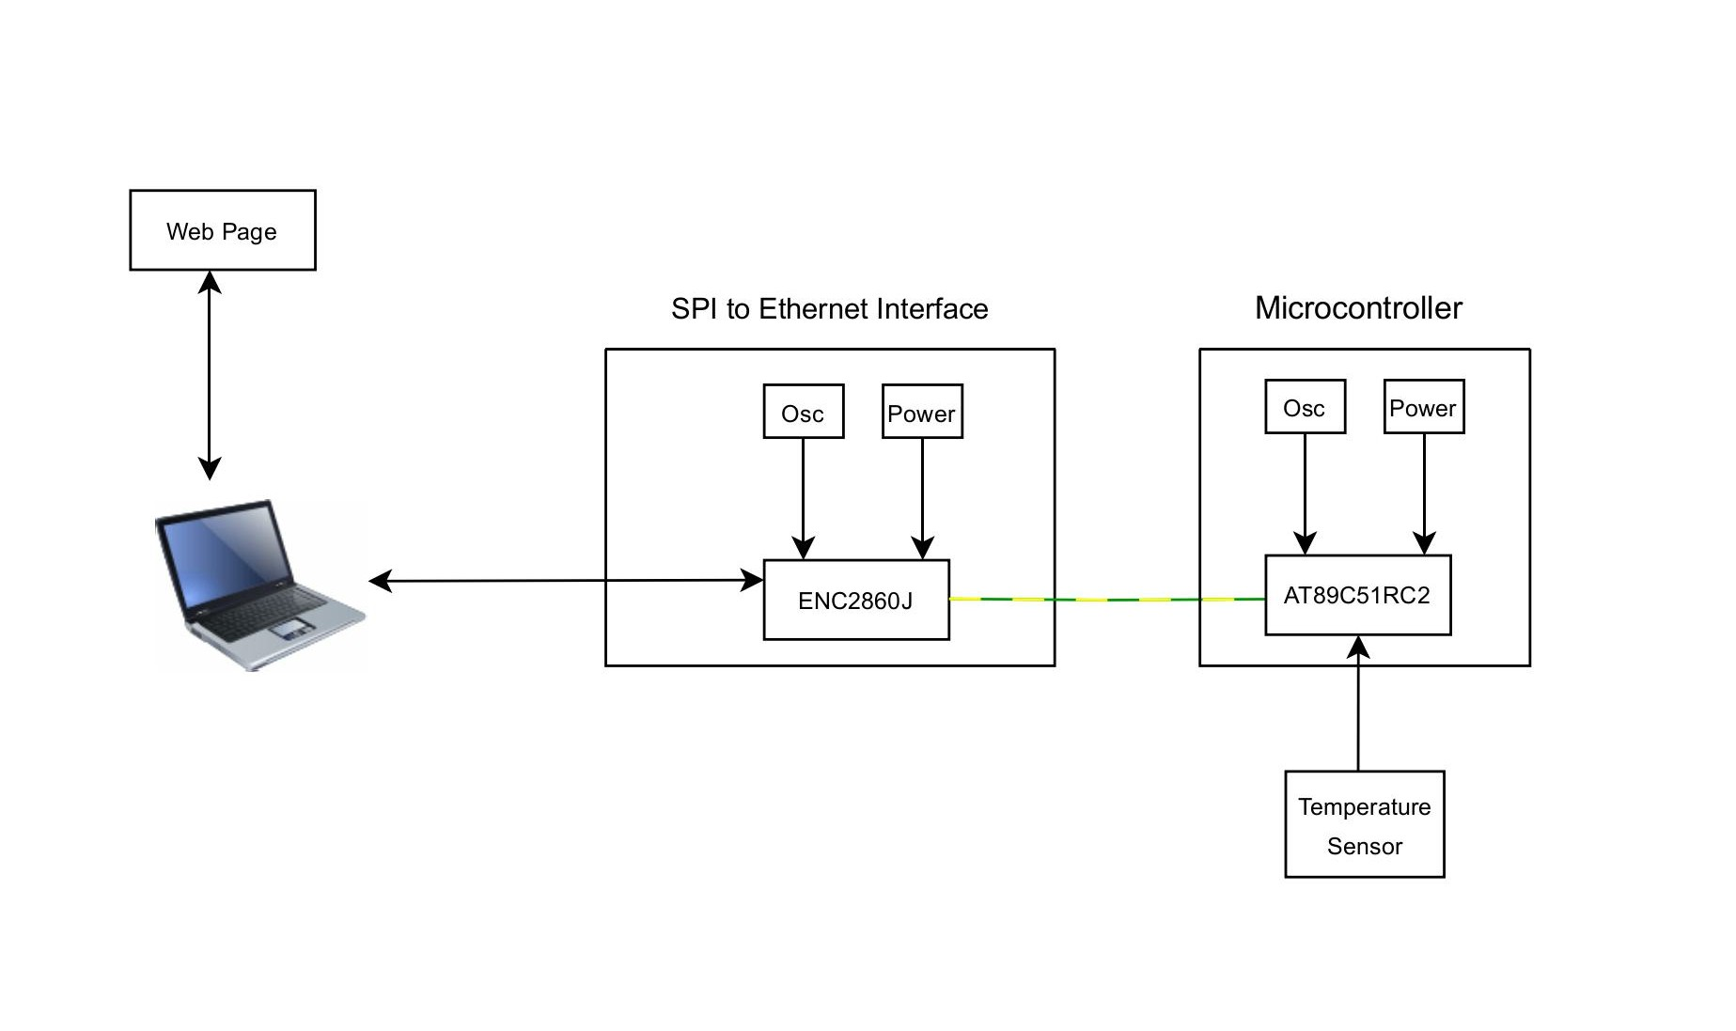
Block Diagram

Slide 7
Project Milestones
Week | Milestones
Week 1 (October 21–27): | Setup hardware environment
Week 2 (October 28–November 3): | Finalize SPI interface
Week 3 & Week 4 (November 4–17): | Ethernet driver implementation
Week 5 (November 18–24): | TCP/IP stack and web server initialization
Week 6 (November 25–December 1): | Handle HTTP requests
Week 7 (December 2–8): | Testing SPI, web server, and Ethernet connectivity
December 9 | Demo day
Week 8 (December 10–14): | Final report preparation
Final Submission (December 15): | Submit the project report

Slide 8
Fall-back Plan
Speed Limitations:
The AT89C51RC2 runs at 11.0592 MHz, which may limit performance for handling TCP/IP tasks. Use X2 mode or a different crystal for improved speed.
Memory Limitations:
Limited RAM and ROM may restrict network stack and web page storage. Use NVSRAM or EEPROM for additional storage.
Hardware Alternatives:
If the AT89C51RC2 is insufficient, switch to STM32 microcontroller for better speed and memory.

Slide 9
Thank You !!!

