Slide 1

MIS/BUAN 6340 Programming for Data Science Project
Airbnb Data Analysis
By,
Hanuman Abhishek Kopparapu
hxk163730

Slide 2
Problem statement & Data description
Challenge of this dataset is to predict the destination country for a new user.
Dataset consists of each new user details who have created an account with Airbnb. Users can create an account but need not have to make a booking. For these types of users a value “NDF” is assigned to the column destination_country.
In this analysis, I have used each feature to know its influence on the target variable: destination_country, what kind of users who created an account also booked and predicting country destination using various classification models.

Slide 3
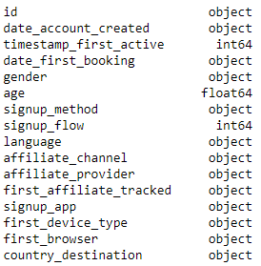
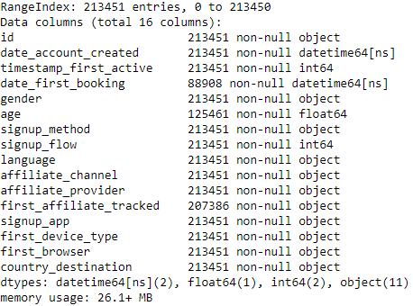
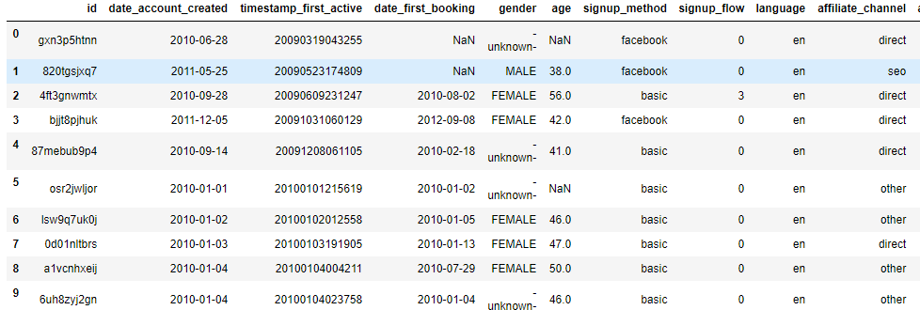
Data Introduction
This dataset has 213451 Rows and 16 Columns.
Main features used in this analysis are: age, gender, date_account_created, date_first_booking,first_device_type and target variable country_destination.
Data Type
Sample data, head(10)

Slide 4
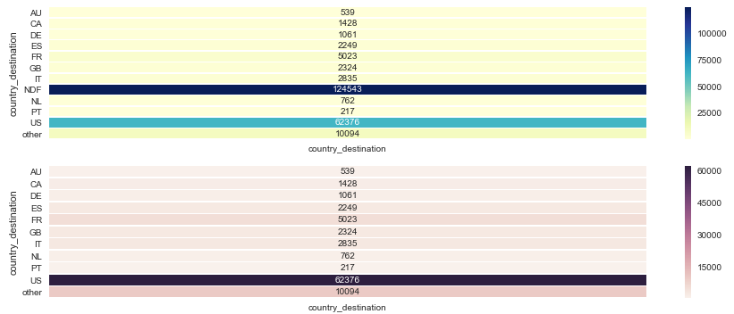
Frequency of visits to each country
First heat map shows the count of each value in the country_ destination variable.
Second heat map shows only booked data excluding NDF. Total number of users traveled to each countries by making a booking through Airbnb.

Slide 5
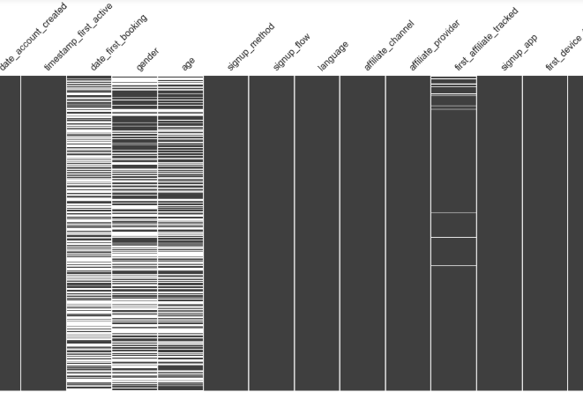
Data Pre-processing – Step 1
Gender variable has values =“-unknown-” which are assigned null.
Age has some unrealistic data: maximum value of age is 2014, 2345 users are elder than 100 and 65 users younger than 16 years who aren’t supposed to make registration according to company policy.
Assigned null to these extreme values.
Other features with nulls are: date_first_booking,first_affiliate_tracked.
Null Matrix

Slide 6
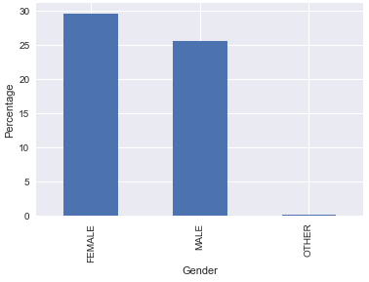
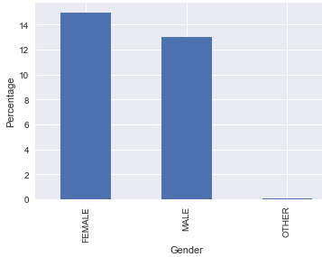
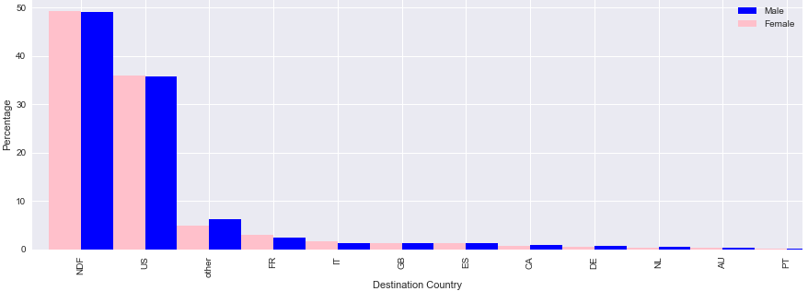
Analysing gender with country destination
30% Female, 26% Male and 1% Other. Therefore, almost 40% of user's gender is “unknown”, which is assigned to null.
There are more female users than male users.
15% of the users population who have made a registration and also booked are Female and 13% are Male, that makes 15% of the users population haven't made a booking are Female and 13% are Male.
There is a 50-50% of gender wise distribution of registrations across all countries.
% of each gender
% of each gender who booked
Country wise and NDF gender distribution

Slide 7
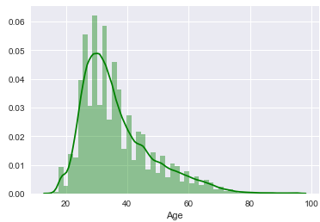
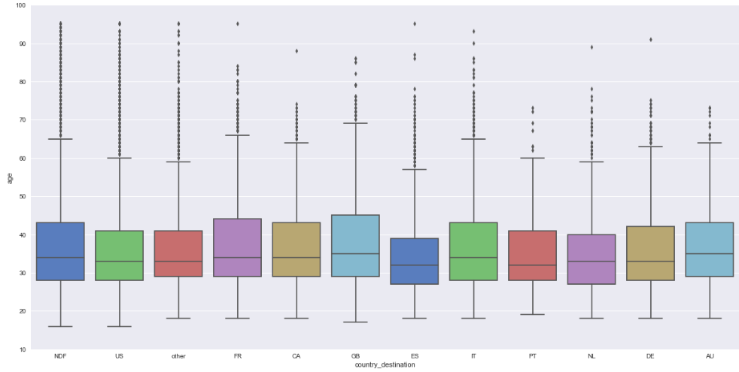
Age distribution
The age group between 16-40 years has highest number of users.
There isn’t a pattern in range of ages and choice of country for traveling.

Slide 8
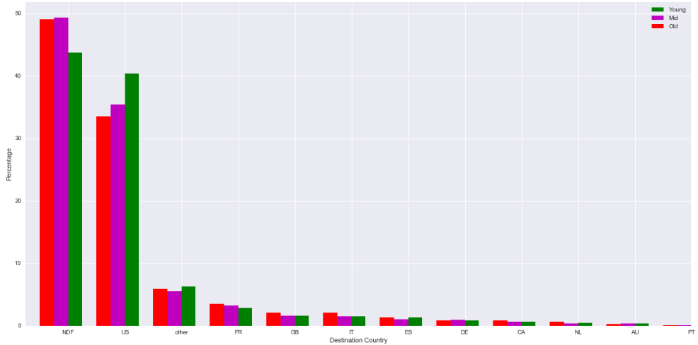
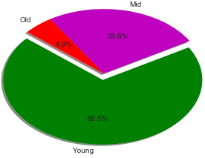
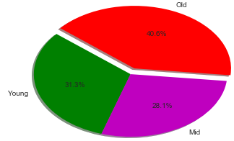
Age groups trends of traveling
Young age grouped users are likely to travel in USA than other 2 groups.
There are 69.5% of users in young age group category(<40 years).
Of all the age groups Old age category people are highly likely to travel/make a registration through Airbnb 40.6%, which means for every 5 old age users created at least 2 will register with Airbnb.
Country wise Age group distribution
% of users in each age group
% of users booked in each group

Slide 9
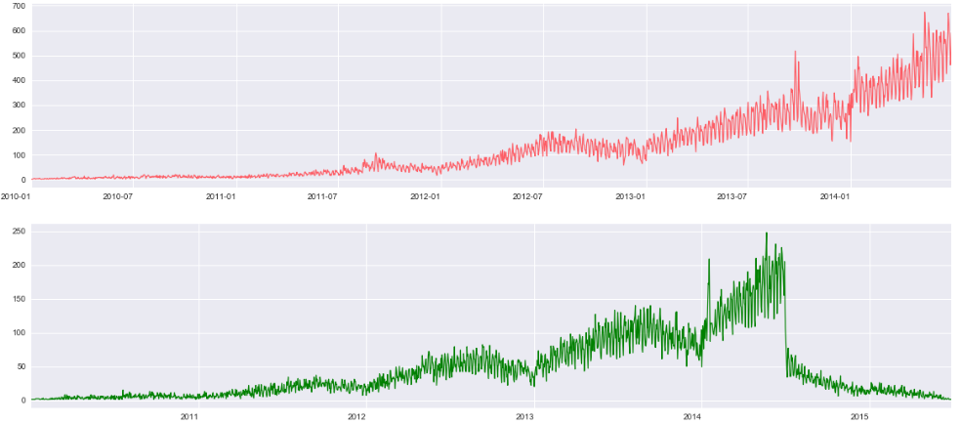
Number of Accounts created and Active users yearly
Airbnb has grown a lot during early 2013 to mid 2014, with 400% increase in the volume of user accounts created.
Same 400% increase from 2013 to mid of 2014 for active users.
Positive correlation between accounts created and active users.
Huge drop in number of active users after July 2014.
Drop in number of active users continued in 2015, cause of concern for Airbnb.

Slide 10
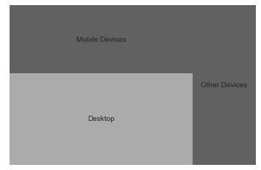
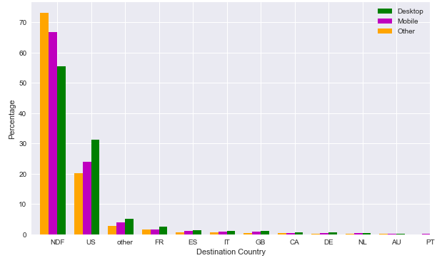
Devices used for registering
9 types of devices are grouped into 2 types Desktop and Mobile devices.
Desktops are highly used for making registrations, next is mobile devices and lastly other devices.
Users who have used desktops for registrations are less likely not to make a registration with 55% NDF (more likely to make registration 45%) where as mobile is 65% and other is 72% of not making a registration.
45% of desktop users have made a booking, 33.3% of mobile users have made a booking and only 27% of other devices users made a booking.
Tree Map of % users who made a booking
% of devices types used for each country and NDF

Slide 11
Other visualizations
During summer time i.e; May and June there are more number of accounts created and bookings made.
More number of users used basic sign_up method, direct affiliated channel and provider, web for signing application with Airbnb, chrome is most used browser of all and en- English is the language mostly used.

Slide 12
Data Pre-Processing – Step 2
UDF get_gender(gender) is used to fill all Nulls in gender variable. Alternatively assigns male and female to null values, as prior analysis on gender suggests there is only slight variation in female and male population,3%. Moreover, country wise gender distribution is same.
UDF assign_rand(var) is used to fill NAs for numerical data. Random values in the range of one std. deviation on either side of mean is used to fill the data.
UDF assign_rand_cat(var) is used to fill NAs for categorical data. Any one value in the category variable is assigned each time a null appears.

Slide 13
Data Pre-Processing - Continued
Additional features like Year, Month and Day of the Week are extracted from existing features like date_created and date_first_booking.
From sklearn.preprocessing, Label Encoder is imported for encoding categorical variables in order to build a classification model to predict destination_country.
Unnecessary columns are dropped: country_destination", "id", 'date_first_booking','date_account_created','timestamp_first_active’.
Cross Validation technique is used to training and testing set with 70-30% split in training and testing set respectively.

Slide 14
Classification Models
Logistic Regression:
Firstly, Logistic Regression is used to predict destination_country.
classification_report is imported from sklearn.metrics to compare different models and suggest the best of all.
Scores for logistic regression are:
1) Precision: 56%
2) Recall: 65%
3) f1-score: 60%

Slide 15
Classification Models - Continued
Random Forest:
Next, random forest classifier is used to predict destination_country
Scores for random forest classifier are:
1) Precision: 69%
2) Recall: 71%
3) f1-score: 69%
Random forest has better results, hence it is recommended for prediction.

Slide 16
Thank You!

