Slide 1
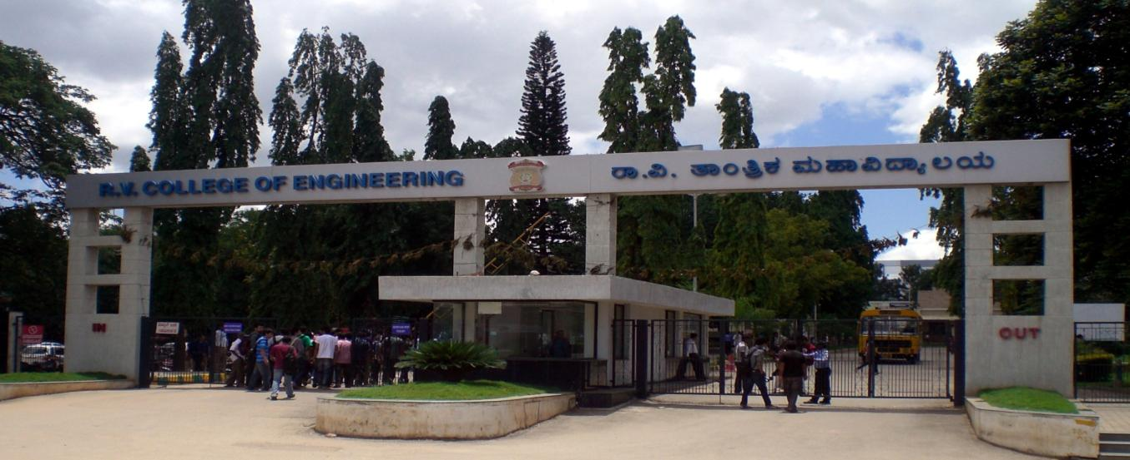
VIII Semester Major Project Work (12CS81)
Department of Computer Science,
R V College of Engineering, Bengaluru.

Slide 2
Video Summarization in Urban Environments
A.S. Karthik 1RV15CS001
Abhishek Krishna 1RV15CS007
Gagan Deep G 1RV15CS053
Internal Guide : Dr Ramakanth Kumar P (Professor and HoD CSE)

Slide 3
Identification of Problem in the program Domain and Detailed Analysis
Large amounts of CCTV footage is generated every hour.
<ADD STAT>
Footage is mostly sparsely distributed with events.
Manual analysis of footage is laborious and time consuming.
There is need for smart tools to generate useful insights and summaries.

Slide 4
Study of the Existing Systems and Feasibility of Project Proposal
Fast-Forwarding
Primitive
Chances of losing information
Motion detection and concatenation
Room for shortening the summary
Overlapping optical flows in time dimension
NP hard problem
Existing systems are proprietory
Smart video querying
Requires expensive hardware
Computationally expensive

Slide 5
Objectives
Develop a video-summarization technique
Experiment with different techniques to efficiently overlap events for creating the summary
Develop a smart method to query a video
Develop a GUI and host it as a service in the cloud

Slide 6
Methodology
Background Masking
Motion Detection
Object Detection
Optical Flow Calculation
Flow Rearrangement
Generating summary

Slide 7
Interdisciplinary Work (Knowledge, Skills, and Research Base)
Deep understanding of an issue from multiple disciplinary perspectives. During the defense, the student provides rich synthesis, analysis, and/or creativity from all three areas of study.

