Slide 1
INVESTMENT ASSIGNMENT SUBMISSION
Name: Abhishek Kumar
Date: 27-09-2020

Slide 2
Introduction
Abstract
The CEO of Spark Funds wants to understand the global trends in investments so that she can take the investment decisions effectively and make investments in a few companies.
Business Understanding
The objective is to identify the best sectors, countries, and a suitable investment/funding type for making investments.
Spark Funds has two minor constraints for investments.
Invest between 5 to 15 million USD per round of investment
Invest only in English-speaking countries for the ease of communication with the companies it would invest in.
The strategy is to invest where most other investors are investing.
Raw Data
Companies - A table with basic data of companies
Rounds2 - A table with Funding round details
Mapping – It contains the mapping of category names in the companies table (such 3D printing, aerospace, agriculture, etc.) to eight broad sector names

Slide 3
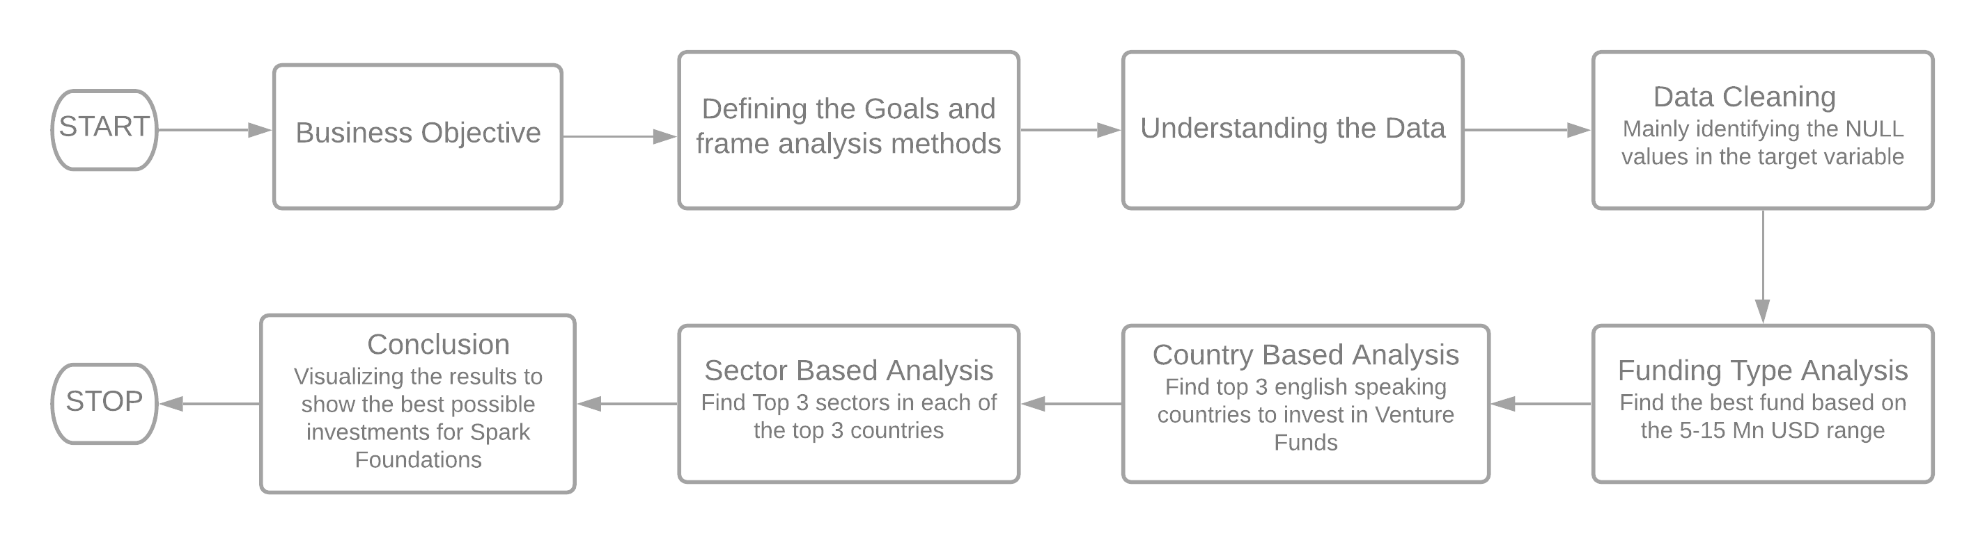
Problem Solving Methodology

Slide 4
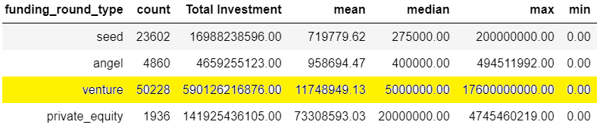
Funding Type Analysis
To find out the best investments for Spark Funds, the analysis is done with three criteria.
1. Funding Type Analysis – Finding the best funding type
2. Country Analysis - – Finding the few top countries to invest
3. Sector Analysis - – Finding the few top sectors to invest
The funding types such as seed, venture, angel, etc. depend on the type of the company (startup, corporate, etc.), its stage (early stage startup, funded startup, etc.), the amount of funding (a few million USD to a billion USD), and so on. For example, seed, angel and venture are three common stages of startup funding.
The different funding type is compared for the Total Amount Invested, the average Investment Amount and the number of investments.
Considering all the statistics, the Venture Funding type is the best type to invest in. Specifically the avg amount of venture funds is between 5-15 millions as required by Spark Funds.

Slide 5
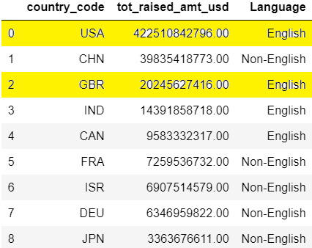
Country Based Analysis
The country based analysis is done only for the Venture funds as the observations related to other funds are removed.
The input data contains the companies of English as well non-English speaking countries. The details of the official language of the countries are scraped from the Wikipedia.
USA, China (CHN), United Kingdom (GBR) and India (IND) are the topmost countries. But China being the non-English speaking country is excluded from the suggestion and further analysis.

Slide 6
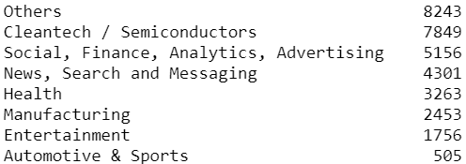
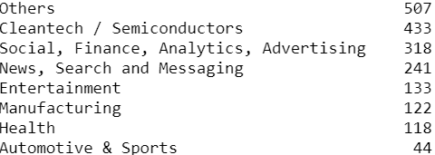
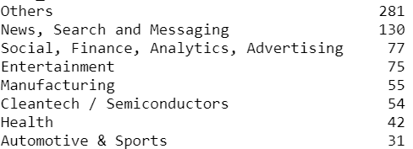
Sector Based Analysis
There are 8 main sectors listed in mapping file. The category list of all the companies map to one of these broad sectors.
After the analysis on countries, the input data is filtered and only the top 3 English speaking countries are retained to conduct analysis on sectors.
The data is now grouped based on the country and the main sectors to get the best performing sectors in the top 3 English speaking countries.
These best sectors are identified by the Number of Investments done in each sector for each country.
USA United Kingdom (GBR) India (IND)

Slide 7
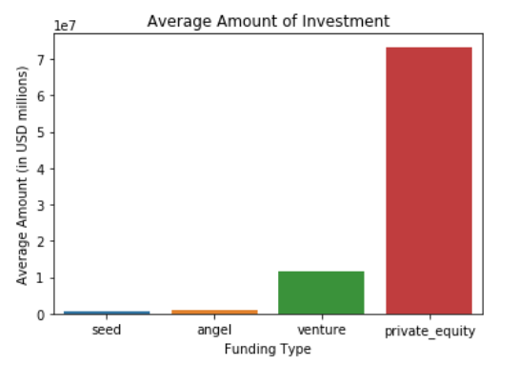
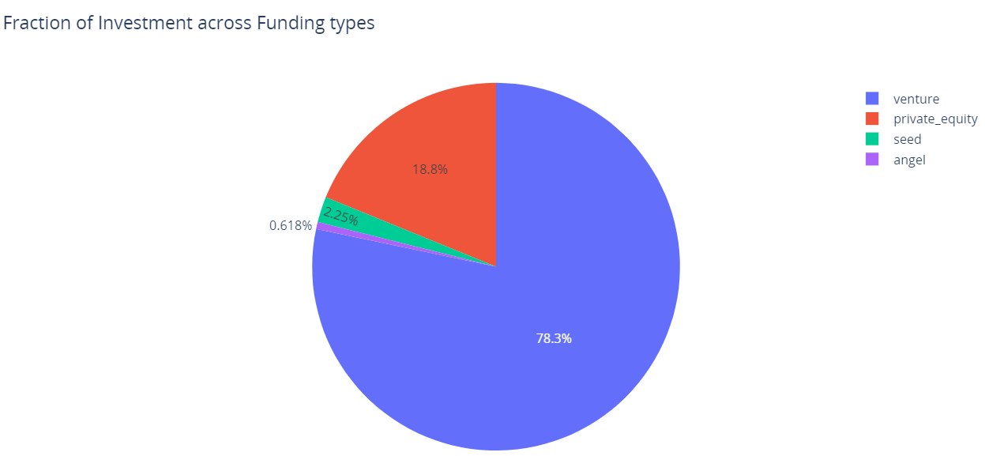
Result – Funding Type Analysis
The below bar graph shows the average amount of investment in seed, angel, venture and private equity.
The venture funds is in the required range of 5-15 Million USD
The below bar graph shows the fraction of each fund against the total investments.
The Venture Funding type has the highest fraction of investment.
Satisfying the 5-15 Mn USD criteria and also the highest fraction of investment, Venture funds is the obvious choice.

Slide 8
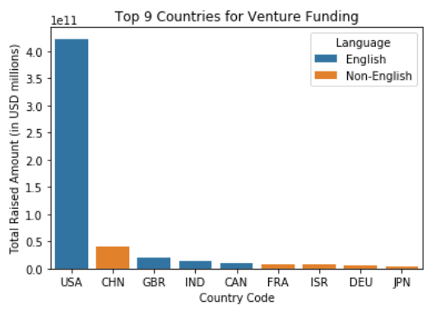
Result – Country Based Analysis
The bar graph shows the top 9 countries for Venture funding.
USA tops the list, followed by China, Great Britain and India.
Considering only the English speaking countries USA, GBR and IND are the top 3 countries to invest in for Venture Funds.

Slide 9
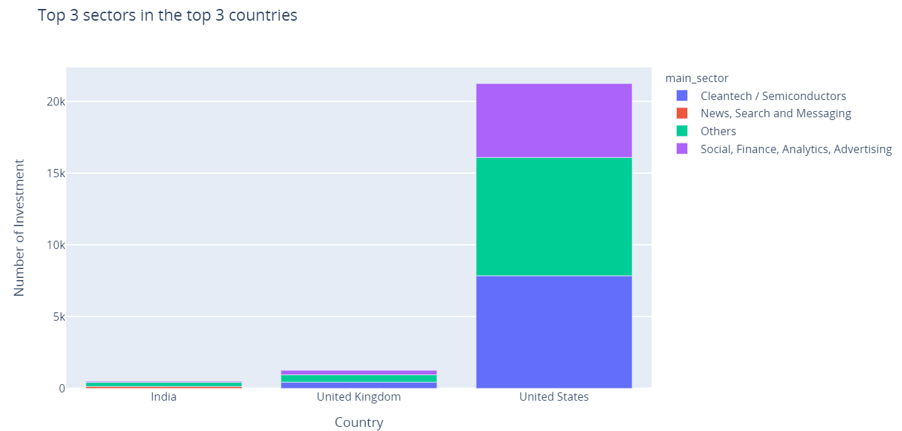
Result – Sector Based Analysis
Based on the sector analysis, the below graph depicts the top 3 sectors on the top 3 countries.

Slide 10
Conclusion
After the analysis on the investments data, we can conclude the following.
Venture Capital is the best investment type with an average size in the 5-15 M USD range.
USA, Great Britain and India are the top 3 English speaking countries with the highest investment amount in the Venture Funding type.
The final decision by the Spark foundation to invest could be in Venture Funds in the sectors 'Others', 'Cleantech/Semiconductors‘ and 'Social/Finance/Analytics/Advertising’ within USA, Great Britain and India.

